Slide 1
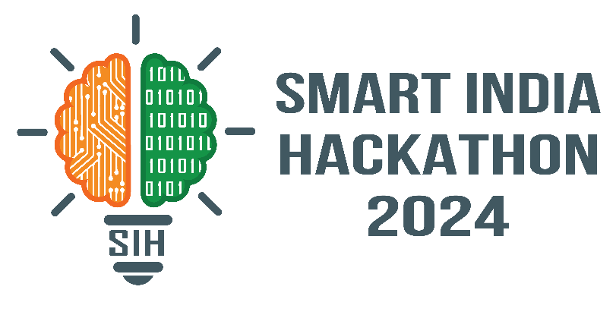
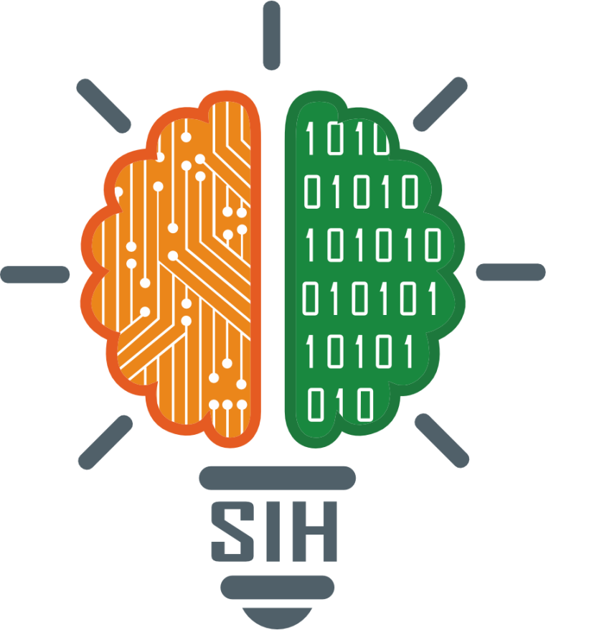
SMART INDIA HACKATHON 2024
TITLE PAGE
Problem Statement ID – SIH1618
Problem Statement Title- ONLINE MONITORING OF
UNAUTHORIZED CONSTRUCTION ACROSS THE CITY
Theme- ROBOTICS AND DRONE
PS Category- SOFTWARE
Team ID-
Team Name (Registered on portal) – DATA_CYBERNETIC GEN

Slide 2
IDEA TITLE
Cybernetics Gen
Idea / Solution:
Implementation of Real-Time Image Processing & Monitoring using Drone Technology for online monitoring of unauthorized construction across the city
Drone & GIS Surveys: Use drones with GPS and GIS for real-time monitoring and mapping of unauthorized construction.
AI Detection: AI analyzes images and alerts authorities about illegal structures.
Satellite Integration: Combine satellite and drone data for wider, frequent updates.
Real-Time Alerts: Stream data live and trigger automated alerts for quick action.
Cloud & City Integration: Store data in the cloud and sync with city systems for permit verification.
Problem Resolution:
• Utilize drone-based surveys to monitor construction activities.
• Benefits include real-time detection, cost-effectiveness, and coverage of large areas.
Unique Value Prepositions (UVP):
Real-time drone imagery
AI-powered object detection
Integration with existing MCD databases
Collaboration with DDA
Web app compatibility
Accessibility features
Scalability
Authenticated Interoperability

Slide 3
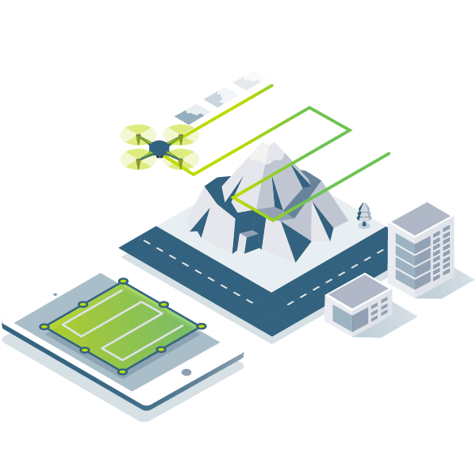
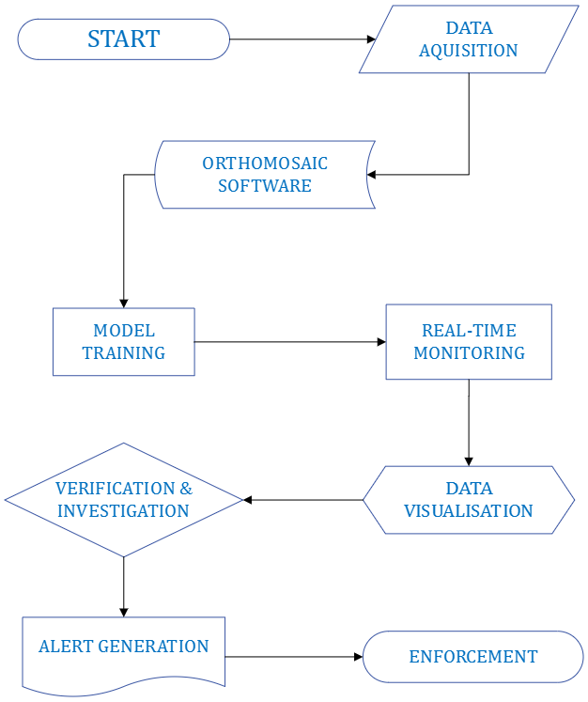





TECHNICAL APPROACH
Cybernetics Gen
1. Algorithm Development:
- Tools: Python, MATLAB
- Libraries: NumPy, SciPy, Scikit-learn
- Frameworks: TensorFlow, PyTorch (for AI models)
2. Web App Development:
- Frontend: React, Angular, or Vue.js
- Backend: Node.js, Django, or Flask
- Frameworks: Bootstrap or Material-UI for UI components
- Deployment: Docker, Kubernetes for containerization and orchestration
3. AI Model Used:
- Model Type: Convolutional Neural Networks (CNNs) for image analysis
- Libraries/Frameworks: TensorFlow, PyTorch, OpenCV for computer vision tasks
- Pre-trained Models: YOLO (You Only Look Once) or Faster R-CNN for object detection
4. Database Services:
- Relational Databases: PostgreSQL or MySQL
- NoSQL Databases: MongoDB or Firebase for flexible data storage
- Cloud Services: AWS, RDS or Azure SQL Database for managed database services

Slide 4
FEASIBILITY AND VIABILITY
Cybernetics Gen
Feasibility Analysis:
Technical: Drones can provide real-time data, but require high-end cameras and stable systems.
Operational: Quick area coverage is feasible but needs trained operators and clear regulations.
Economic: High initial cost, but long-term savings from reduced inspection costs.
Legal: Compliance with airspace and privacy laws is critical.
Social: The public benefits from reduced illegal construction, but privacy concerns may arise.
Potential Risks for Online Monitoring in Delhi
Data Quality and Accuracy: Cloud cover, image resolution, internet connectivity, and power outages can affect data quality.
Social and Political Factors: Resistance from land grabbers and political interference can hinder implementation.
Ethical and Privacy Concerns: Mass surveillance and data security risks.
Resource Constraints: Budget limitations and human resource shortages.
Complex Urban Landscape: Dense urban fabric and rapid urbanization.
Strategies for Overcoming Challenges:
Data Quality: Use high-resolution cameras and ensure backup power and connectivity.
Social & Political: Engage communities, build support, and work with law enforcement.
Ethical & Privacy: Implement strong data security, anonymize information, and ensure transparency.
Resource Constraints: Seek funding partnerships and invest in staff training.
Urban Complexity: Use advanced mapping and focus on high-activity areas.

Slide 5
IMPACT AND BENEFITS
Cybernetics Gen
Potential Benefits of Online Monitoring
Improved Urban Planning: Data-driven decisions and prevention of illegal encroachments.
Enhanced Law Enforcement: Efficient enforcement and reduced corruption.
Improved Public Safety: Identification of unsafe structures and prevention of natural disasters.
Environmental Protection: Prevention of environmental damage and compliance with regulations.
Economic Benefits: Increased property values and reduced litigation.
Improved Citizen Engagement: Public participation and transparency.
Potential Impacts of Online Monitoring using Drone Technology
Positive Aspects:
- Improvement: Real-time data boosts monitoring efficiency.
- Economical: Cuts manual inspection costs.
- New Opportunities: Opens jobs in drone operation and analysis.
- Social Benefits: Prevents illegal construction, enhancing city planning.
Negative Aspects:
- Cost: One-time high initial investment.
- Technology Adaptation Issues: Requires training and may face resistance.

Slide 6
RESEARCH AND REFERENCES
Cybernetics Gen
Your Team Name
Unmanned aerial vehicle - Wikipedia
6Wresearch- Market Intelligence Solutions
Municipal Corporation of Delhi (mcdonline.nic.in)
Drone Survey India | Drone Solutions in India | AIRPIX (bing.com)
India's Best Drone Survey Company for UAV Aerial and … (bing.com)
Home | Open Government Data (OGD) Platform India
Drone Survey: Drone survey and 3-way pact to curb illegal construction in New Delhi | Delhi News - Times of India (indiatimes.com)
LAND SURVEYING AND MAPPING BY DRONE - Atom Aviation Services
The Enduring Problem of Illegal Constructions in India’s Cities (orfonline.org)
Delhi: DDA signs MoU for drone surveys to combat land encroachments, ET RealEstate (indiatimes.com)

