Slide 1
Insights into the housing market
Sam Hoste
AI Engineering Bootcamp BeCode Ghent
July2023

Slide 2
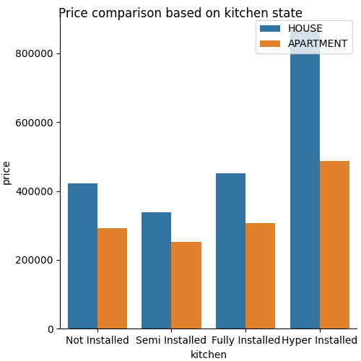
Kitchens don’t matter…
Until they do!

Slide 3

The importance of data validation!
When analysing the data and drawing conclusions, it’s easy to make a wrong assumption, as you’ll see in the next slides.

Slide 4
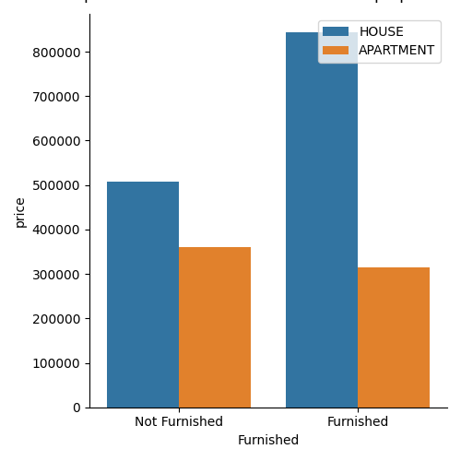
To sell furnished or not furnished…
… and get out of your comfort zone!
Looking at the data, I thought it was
interesting to see furnished houses
selling for less than non furnished
houses.
The reverse is true for apartments

Slide 5
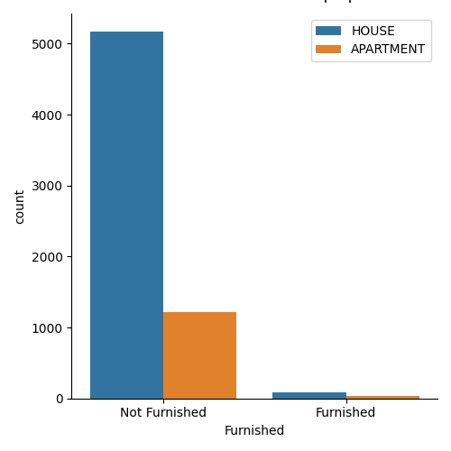
To sell furnished or not furnished…
… and get out of your comfort zone!
However, when we check our data,
we can see that there is only a
negligible amount of properties
being sold furnished.
The previous conclusion might not
be valid.

Slide 6
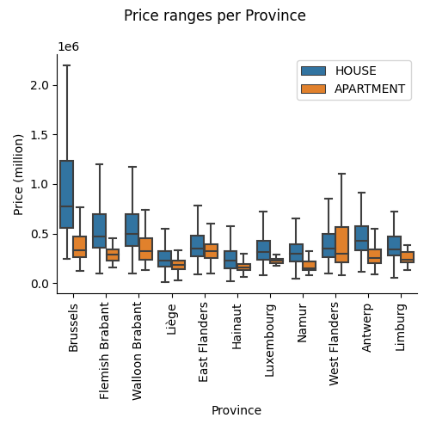
Interesting price ranges
… and get out of your comfort zone!
Looking at the price ranges,
Brussels is clearly the most
expensive Province.
We can see that every province
has a pretty wide range on property
types.

Slide 7

Interesting price ranges
… and get out of your comfort zone!
One price range in particular looked interesting to me:
The price range of apartments in Luxembourg.
Unlike other categories, the range is very limited.
From this we could assume that apartment prices are within a very specific range for Luxembourg.

Slide 8

Interesting price ranges
… and get out of your comfort zone!
But we would be wrong!
Looking at the dataset, we can see there’s only 13 entries for apartments in Luxembourg, so this is most likely a skewed result.

Slide 9
Thank you!
Q&A
Sam Hoste
Linkedin: https://www.linkedin.com/in/sam-hoste-15610945
Github: https://github.com/Riddis
Project repo: https://github.com/Riddis/-ImmoEllizaDataAnalysis

