Slide 1





INSURANCE · MACHINE LEARNING · REVENUE OPTIMIZATION
Insurance Incentive
Prediction
An end-to-end ML system that predicts policy renewal and optimizes
agent incentives to maximize expected net revenue.
End-to-end ML application
FastAPI backend
Deployed web frontend
Incentive optimization
Parth Sharma
ML Engineering Project

Slide 2



THE BUSINESS PROBLEM
Renewals drive revenue — incentives are costly if mistimed
Insurance companies rely on agents to encourage policyholders to renew. Offering an
incentive can raise the renewal probability — but the size of that incentive is a balancing act.
Too little incentive
Too much incentive
Agent effort stays low, renewal probability barely improves, and the policy is more likely to lapse.
Renewal probability improves, but the incentive cost erodes — or exceeds — the revenue it was meant to protect.
Objective
What incentive should be offered to maximize expected net revenue?
Insurance Incentive Prediction
2

Slide 3


THE APPROACH
Four connected components form the solution
Machine learning, incentive modeling, optimization, and a web application work together end to end.
01
02
03
04
Machine Learning
Agent Incentive Modeling
Revenue Optimization
Web Application
Predicts each policy’s renewal probability from historical and policy data.
Estimates how agent effort responds as the incentive amount changes.
Tests a range of incentive values to find the one with highest expected revenue.
Lets a user enter policy details and instantly view the recommendation.
Insurance Incentive Prediction
3

Slide 4









SYSTEM ARCHITECTURE
From user input to a revenue-optimized recommendation
User
Web Frontend
FastAPI /predict
Preprocessing
Renewal Model
Incentive Optimization
Revenue Calc
JSON Response
Enters policy details
HTML · CSS · JS
Request received
Missing-value imputation
Predicts probability
₹500 → ₹4,500 tested
Expected net revenue
Back to website
One continuous request/response cycle — the user never leaves the website.
Python
scikit-learn
FastAPI
Render
Vercel
Insurance Incentive Prediction
4

Slide 5







DATA PIPELINE
Preprocessing & feature engineering
Important Features
Missing Values
Handled using a dedicated trained imputer, serialized as:
Premium paid by cash / credit (%)
Age (in days)
Income
Parth_Imputer.pkl
Feature Engineering
Late payment history
Underwriting score
No. of premiums paid
A new feature, Total_late, is created by combining late-payment counts:
Total_late = Count_3-6m + Count_6-12m + Count_12m+
Sourcing channel
Residence area type
Premium
These engineered features feed directly into the renewal-probability model on the next slide.
Insurance Incentive Prediction
5

Slide 6

MODELING
Machine learning pipeline
The trained pipeline’s job is singular: estimate the probability that a policy renews.
Input Policy Data
Preprocessing
Trained ML Pipeline
Renewal Probability
Raw record from the API request
Imputation via Parth_Imputer.pkl
renewal_pipeline.pkl
P(Renewal) returned downstream
Renewal Probability = P(Renewal)
Note: exact algorithm and performance metrics are implementation details not included here.
Insurance Incentive Prediction
6

Slide 7
THE CORE LOGIC
Incentive optimization
The system doesn’t stop at predicting renewal — it searches for the incentive that maximizes expected revenue, in the range ₹500–₹4,500.
Agent Effort
Renewal Contribution
Expected Revenue
effort(I) = 10 × (1 − e^(−I / 400))
agent_proba(effort) = 0.20 × (1 − e^(−effort / 5))
revenue = premium × (base_p + agent_p) − incentive
Effort rises with incentive I, with diminishing returns.
Effort converts to an added renewal-probability boost.
Net revenue after subtracting the incentive cost.
Conceptual expected-revenue curve vs. incentive amount
Selection Rule
The incentive that produces the highest expected revenue — compared against the no-incentive baseline — is recommended.
Illustrative curve — shape only, not measured project data.
Insurance Incentive Prediction
7

Slide 8

BACKEND
FastAPI backend & prediction endpoint
POST
/predict
Example Request
{
"data": [[0.5, 12000, 500000, 1, 0, 0,
0.85, 10, "A", "Urban", 15000]]
}
Backend Responsibilities
Receive policy records
Validate request data
Example Response
Apply preprocessing
{
"Result": [{
"premium": 15000,
"revenue": 6200.5,
"incentive": 1500
}]
}
Generate renewal probability
Evaluate incentive options
Calculate expected revenue
Return recommendation as JSON
Illustrative example request / response — not live output.
Live API Endpoint
https://insurance-incentive-prediction.onrender.com/predict
Insurance Incentive Prediction
8

Slide 9



LIVE DEMO
Frontend & live application
A user-friendly web form collects policy details and instantly returns the recommended incentive and expected revenue.
User-friendly policy input form
Sends prediction request to FastAPI
Displays expected revenue
Displays recommended incentive
Fully deployed application
Accessible from any browser
The live website preview is on the next page.
insurance-incentive-prediction.vercel.app
insurance-incentive-prediction.onrender.com/predict
Insurance Incentive Prediction
9

Slide 10
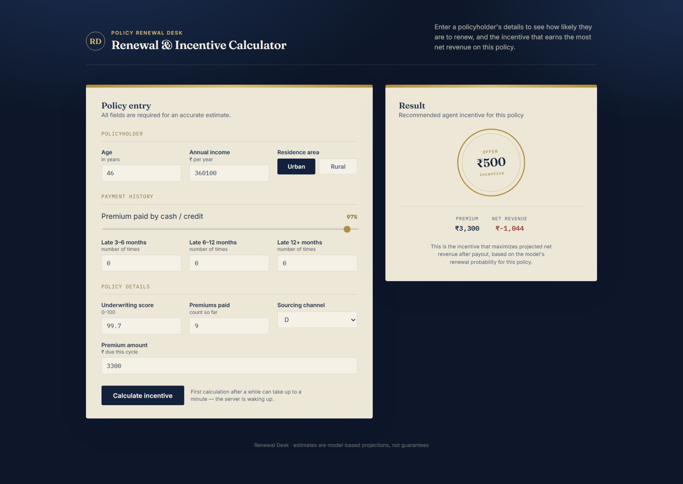

Slide 11


DEPLOYMENT
Deployment & production flow
A deployed, end-to-end ML application — frontend and backend communicate over REST with CORS enabled.
Frontend
Communication
Backend API
Vercel
REST + CORS
Render
HTML, CSS & JavaScript served as the live site.
Frontend and backend communicate over a CORS-enabled REST API.
FastAPI service hosting the /predict endpoint.
ML Artifacts Loaded by the Backend
Parth_Imputer.pkl
renewal_pipeline.pkl
Deployed as a working end-to-end ML application — not positioned as enterprise production infrastructure.
Insurance Incentive Prediction
11

Slide 12

REFLECTION
Key insights & learnings
Business Insights
Technical Learnings
Not every policy benefits from an agent incentive.
Building an end-to-end ML inference pipeline
Model serialization with joblib
Optimal incentives vary based on premium and renewal risk.
FastAPI API development
CORS configuration
Incentive cost must be balanced against expected renewal revenue.
Frontend-backend integration
Diminishing-return behavior offers a simple way to model agent effort.
Cloud deployment using Render and Vercel
Combining ML predictions with business optimization
Insurance Incentive Prediction
12

Slide 13







WHAT’S NEXT
Future improvements
CSV batch upload
Cache ML models instead of per-request loading
Authentication & API rate limiting
Frontend charts for incentive recommendations
More advanced optimization strategies
Model monitoring & performance tracking
TRY THE LIVE APPLICATION
Website
insurance-incentive-prediction.vercel.app
API
insurance-incentive-prediction.onrender.com/predict
GitHub
github.com/Rider-04/Insurance_incentive_prediction
Parth Sharma — Insurance Incentive Prediction
13

