Slide 1


Flight Data Engineering
Pipeline & Dashboard Analysis
End-to-end Data Engineering · ETL (Pentaho) · Power BI Dashboards
MySQL
Pentaho Spoon
Power BI
445K Rows
375K
4
6K
Flights
Dashboards
Optimized Rows
✈ Prepared for Interviews · LinkedIn Portfolio · Academic Presentations

Slide 2




01 / CONTEXT
📌 Problem Statement
Why this project needed to be built
Massive Raw Dataset
445,000+ rows of raw US flight data — completely unstructured and impossible to analyze directly in any BI tool without optimization first.
No Analytical Structure
Data had no grouping, schema, or model. Queries were slow, and there was no clean way to slice by airline, city, or delay type.
Performance Bottleneck
Loading raw data into SQL and Power BI caused extreme lag. Dashboards couldn't filter in real-time, making the tool unusable for business stakeholders.

Slide 3



02 / OBJECTIVE
🎯 Project Objective
What we set out to achieve — end to end
01
02
End-to-End Pipeline
Clean & Transform Data
Build a fully automated pipeline from raw MySQL → ETL → cleaned MySQL → SQL Views → Power BI dashboards
Remove 50–60 irrelevant columns, aggregate 445K rows → 6K rows using GROUP BY and aggregation functions
03
04
Star Schema Modeling
Business Dashboards
Design a dimensional model with fact and dimension tables for fast, flexible analytical queries
Deliver 4 Power BI dashboards: Overview, Airline Performance, Route Analysis, and Delay Root Cause

Slide 4
03 / ARCHITECTURE
🏗️ Architecture Diagram
MySQL → ETL → MySQL → SQL Views → Power BI
MySQL
Raw Data
Pentaho
Spoon ETL
MySQL
Cleaned
SQL Views
vw_flight
Power BI
Dashboards
›
›
›
›
Source
Transform
Storage
Analytical Layer
Visualization
Extraction
Transformation
Modeling
Visualization
Pull 445K rows from MySQL source using Spoon transformation jobs
Apply GROUP BY, SUM, AVG · Reduce to ~6K analytical rows
Create vw_flight_analysis SQL view with star schema structure
Connect Power BI → DirectQuery/Import · Build 4 dashboards

Slide 5

04 / WORKFLOW
🔄 End-to-End Workflow
The 5-stage data engineering pipeline
01
02
03
04
05
Extraction
Cleaning
Transformation
Modeling
Visualization
Pull raw flights from MySQL using Spoon input step
Drop 50–60 columns · Standardize types · Handle nulls
GROUP BY aggregation · 445K → 6K rows · AVG delays
Star schema · Dimension tables · vw_flight_analysis
4 Power BI dashboards · Interactive · Filterable

Slide 6
05 / DATA PREP
🧹 Data Cleaning
Stripping noise, keeping signal
By the Numbers
Cleaning Actions
50–60
Removed tail numbers, cancellation codes & carrier-specific internal columns
Retained: AirlineName, OriginCity, DestCity, Month, Year, all Delay fields
Standardized all date/time formats and string capitalizations
Replaced NULL delay values with 0 (no delay occurred)
Validated data types: INT for counts, FLOAT for delay minutes
Columns Removed
~20
Key Columns Kept
445K
Total Source Rows

Slide 7
06 / TRANSFORM
⚙️ Data Transformation
Aggregating 445K rows into 6K insight-ready rows
BEFORE
AFTER
445,827
~6,324
⟶
rows · Slow · Redundant · Unoptimized
98.7%
reduction
rows · Fast · Clean · Dashboard-ready
Direct Power BI load took minutes to refresh
Sub-second Power BI filter response time
Techniques used in Pentaho Spoon transformation:
GROUP BY Airline + City + Month
SUM(DelayMinutes)
AVG(WeatherDelay)
COUNT(Flights)
SQL View: vw_flight_analysis

Slide 8
07 / MODELING
🧱 Data Modeling
Star schema — optimized for analytical queries
Airline Dim
Date Dim
AirlineName · Code
⭐ FACT TABLE
Year · Month · Quarter
vw_flight_analysis
TotalFlights · AvgDelays · Routes
Airport Dim
Route Dim
OriginCity · DestCity
Origin → Destination

Slide 9
08 / DATASET
🗂️ Dataset Overview
Final view: vw_flight_analysis — the backbone of all dashboards
Column Name
Type
Description
AirlineName
VARCHAR
Name of the airline carrier
OriginCity
VARCHAR
Departure city
DestCity
VARCHAR
Destination city
Month / Year
INT
Time dimensions for trend analysis
TotalFlights
INT
Aggregated flight count per group
AvgWeatherDelay
FLOAT
Average weather delay in minutes
AvgNASDelay
FLOAT
Average NAS system delay (mins)
AvgLateAircraftDelay
FLOAT
Average late-aircraft delay (mins)

Slide 10
09 / DASHBOARDS
📊 Dashboard Overview
4 interactive Power BI dashboards for business intelligence
Dashboard 01
Dashboard 02
Overview
Airline Performance
KPIs · Top Airlines · Origin Cities · Delay Breakdown by airline
Scatter Plot (Flights vs Weather Delay) · Delay Scores · Rankings
Dashboard 03
Dashboard 04
Route Analysis
Delay Analysis
Interactive Map · Top Origin/Destination Cities · Route-level delays
Root Cause Donut · By Airline Bars · City-level · Type Comparison

Slide 11
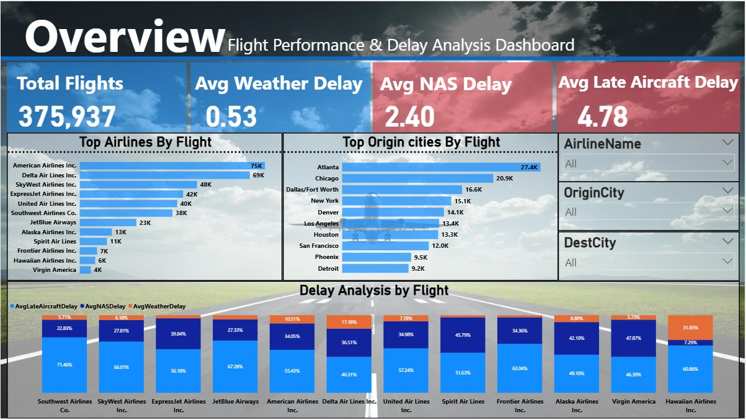
Dashboard 01
Overview Dashboard
Flight Performance & Delay Analysis
375,937
Total Flights
0.53 min
Avg Weather
2.40 min
Avg NAS
4.78 min
Late Aircraft

Slide 12
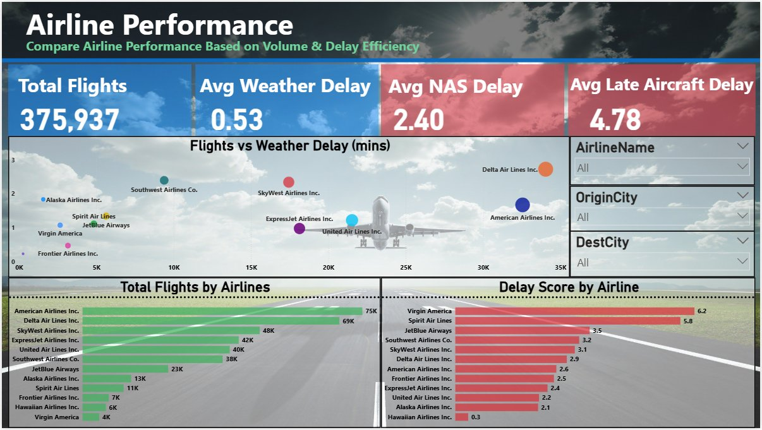
Dashboard 02
Airline Performance
Volume vs Efficiency Scatter Plot · Delay Scores
Virgin Am.
Highest Score
6.2
Am. Airlines
Most Flights
75K
Hawaiian
Lowest Score
0.3
$Delta
2nd Busiest
69K

Slide 13
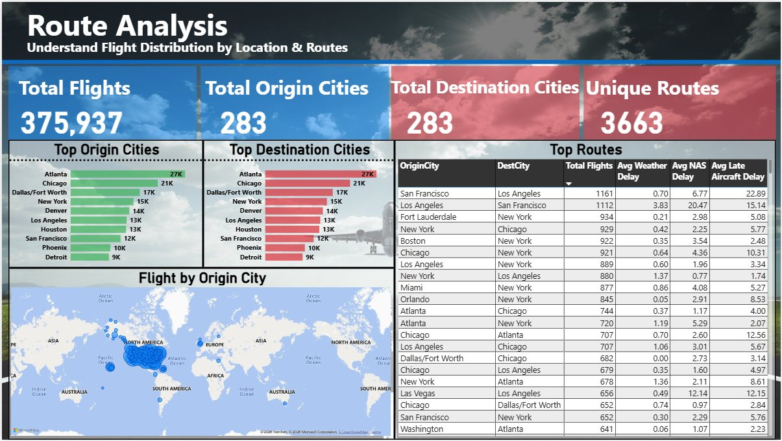
Dashboard 03
Route Analysis
Interactive Map · Origin & Destination Cities · Unique Routes
283
Origin Cities
283
Dest Cities
3,663
Unique Routes
Atlanta
Top City
27K flights

Slide 14
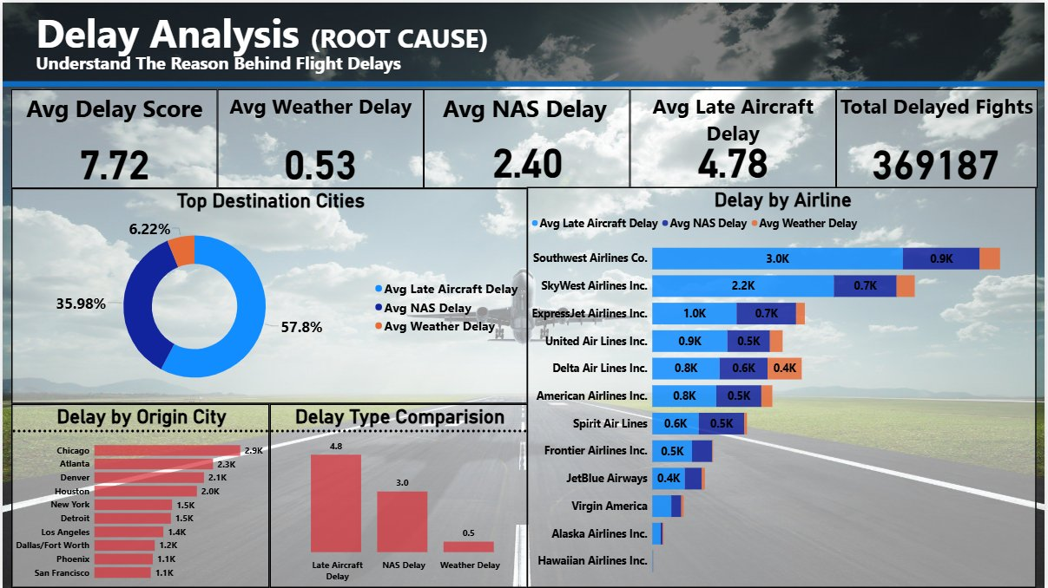
Dashboard 04
Delay Analysis — Root Cause
Donut Breakdown · By Airline · By City · Type Comparison
57.8%
Late Aircraft
35.98%
NAS Delay
6.22%
Weather
369,187
Total Delayed

Slide 15

14 / INSIGHTS
🔍 Key Insights
What the data tells us about US domestic flights
Late Aircraft = #1 Delay Cause
57.8% of all delays stem from late-arriving aircraft — not weather or ATC. This means airline turnaround efficiency is the biggest lever to pull.
Volume Leaders Aren't Delay Leaders
American (75K) and Delta (69K) fly the most — but Hawaiian Airlines has a delay score of just 0.3, proving scale doesn't require poor performance.
Atlanta is the Network's Pulse
27K+ flights make Atlanta the busiest hub. Delays there cascade nationally — it's the single most impactful city for network-wide on-time performance.
NAS Delays Are Systemic
36% of delays come from the National Airspace System — air traffic control, airport congestion. This points to infrastructure issues beyond individual airlines.

Slide 16
15 / ANALYSIS
📈 What the Data Reveals
Patterns, trends & analytical discoveries from 375K flights
Delay Peaks at Hubs
Airline Efficiency Gap
Atlanta, Chicago, Denver are the top delay-generating cities. Flights leaving these hubs late create a chain of delays across connected routes.
Virgin America delay score (6.2) vs Hawaiian (0.3) — a 20x difference. Airlines with fewer routes often achieve better on-time records.
SF ↔ LA = Highest NAS Delay
High Traffic ≠ High Delay
San Francisco → Los Angeles is the single route with the highest NAS delay (6.77 min avg), driven by Bay Area ATC congestion.
Southwest Airlines runs 38K flights but maintains a competitive delay score — strong operational scheduling buffers make the difference.

Slide 17
16 / STRATEGY
💡 Recommendations
Actionable strategies derived directly from dashboard findings
Target High-Delay Carriers
R1
Virgin America (6.2) and Spirit Air (5.8) should audit turnaround schedules. Reducing late aircraft departure time by 20 min could shift the 57.8% delay share significantly.
Optimize Critical Hub Operations
R2
Atlanta, Chicago, and Dallas account for 65K+ combined departures. Better gate management and buffer scheduling at these hubs has outsized national impact.
Coordinate NAS-Level Delays
R3
36% of delays are NAS-related. Airlines should work with ATC on slot scheduling and explore CDM (Collaborative Decision Making) at peak-congestion airports.
Learn from Hawaiian Airlines
R4
Score of 0.3 — the lowest in the dataset. Point-to-point route structure, fewer connections, and disciplined turnaround times are best practices to replicate.

Slide 18

17 / LEARNINGS
🧠 Insights Gained
Key engineering & analytical lessons from this project
ETL is the Foundation
Schema Design Multiplies Value
Pentaho Spoon made the transformation repeatable and parameterized. A well-built ETL job saved hours of manual SQL work.
Star schema made every Power BI measure faster to write. Good modeling at the start pays dividends in every downstream step.
Visualization Drives Decisions
Aggregation is the Secret
The raw numbers meant nothing until charted. Power BI turned abstract delay averages into immediately actionable airline comparisons.
Reducing 445K → 6K without losing insight was the highest-impact optimization. Smart summarization is a core Data Engineering skill.

Slide 19
18 / TECH
🛠️ Technology Stack
Tools that powered this end-to-end pipeline
MySQL
Pentaho Spoon
Power BI
Source & Storage
ETL Engine
Visualization
Stored both the raw 445K-row dataset and the final cleaned, aggregated 6K-row analytical table. Used for all SQL view definitions.
Orchestrated all extraction, transformation (GROUP BY logic, aggregation), and load operations via visual job/transformation pipelines.
Connected to MySQL to build 4 interactive dashboards with slicers, KPI cards, scatter plots, maps, and stacked bar charts.

Slide 20
19 / CHALLENGES
⚠️ Challenges Faced
Real obstacles encountered — and how they were overcome
Large Dataset Memory Issues
445K rows caused Spoon to crash during initial runs. Solved by increasing JVM heap size and processing data in staged chunks using filtered input steps.
Power BI Refresh Lag
Loading raw data into Power BI took 8–12 minutes per refresh. Resolved by pre-aggregating in MySQL and using the optimized view as the data source instead.
Limited Row-Level Granularity
GROUP BY aggregation removed individual flight details. This required careful decisions about which dimensions to preserve vs. summarize for dashboard use.

Slide 21

20 / FUTURE
🚀 Future Improvements
Making this pipeline smarter, faster, and more scalable
Pipeline Automation
Incremental Loading
Cloud Migration
Schedule Pentaho jobs via cron or Airflow to run nightly — fully automated data refresh without manual execution every time.
Instead of full table reload each run, load only new/changed records using CDC (Change Data Capture) or timestamp-based delta queries.
Move MySQL to AWS RDS or Azure SQL. Connect Power BI Service for cloud-hosted dashboards with scheduled refresh and public sharing.

Slide 22
21 / FUTURE SCOPE
🔮 Future Scope — Prediction & AI
Taking this project from analytics to intelligence
ML Delay Prediction
01
Train classification models (Random Forest, XGBoost) to predict whether a flight will be delayed based on airline, origin, time of day, and season.
Traffic Forecasting
02
Use time-series models (Facebook Prophet, LSTM) to forecast monthly flight volumes per city and airline for capacity planning.
Real-Time Streaming
03
Integrate FlightAware or OpenSky API for live flight data. Build a Power BI streaming dataset that updates every minute with live delays.
Automated Anomaly Alerts
04
Set Power BI alert thresholds — notify ops teams automatically when delay scores exceed defined SLA limits for any airline or hub.

Slide 23


✈ Flight Data Engineering
Pipeline & Dashboard Analysis
Pipeline Complete
MySQL → Spoon ETL → SQL Views → Power BI — fully functional and validated end-to-end.
Insights Delivered
4 dashboards surfacing actionable intelligence on delays, airlines, routes, and root causes.
Scalable Architecture
Star schema + aggregated views designed to scale with more years, airlines, or dimensions.
MySQL
Pentaho
Power BI
Data Engineering

