Slide 1

Loan Approval
Prediction
Using Machine Learning
End-to-End Data Analytics & Machine Learning Project
Prepared by: Parth Sharma
Notes:
Welcome. This presentation covers an end-to-end Machine Learning project to predict loan approvals using real-world banking data. We will walk through the full data science pipeline — from exploration to deployment.

Slide 2



Problem Statement
Manual Process
Financial Risk
Business Need
Loan decisions rely on human judgment — slow, inconsistent, and prone to bias.
Incorrect approvals lead to defaults; rejections mean lost customers and revenue.
Automate decisions using ML to improve speed, accuracy, and fairness.
🎯 Objective: Predict whether a loan application will be Approved or Rejected using Machine Learning
Notes:
Banks process thousands of loan applications daily. The manual process is slow and prone to bias. By building an ML model, we can automate and standardize these decisions — reducing risk while improving customer experience.

Slide 3
Dataset Overview
📋 Dataset Features
4,269
12
💰 Annual Income
⭐ CIBIL Score (Credit Score)
🏦 Loan Amount
📅 Loan Term
🎓 Education Level
💼 Employment Status
🏠 Residential Assets
🏢 Commercial Assets
💎 Luxury Assets
🏦 Bank Assets
Total Records
Total Features
~62%
~38%
Approved
Rejected
🎯 Target Variable: loan_status (Approved / Rejected)
Notes:
The dataset contains 4,269 loan applications with 12 features covering applicant financials, demographics, and asset information. The target variable is loan_status — binary classification: Approved or Rejected.

Slide 4
Project Workflow
End-to-End Machine Learning Pipeline
1
2
3
4
5
6
7
8
Raw Data
Data
Understanding
EDA
Preprocessing
Model
Training
Evaluation
Feature
Importance
Streamlit
Deploy
CSV dataset
with 12 features
Shape, types,
missing values
Visualize
distributions
Encode, scale,
train-test split
5 ML models
trained
Accuracy,
F1, Precision
Top predictive
features
Interactive
web app
Tech Stack:
Pandas & NumPy
Matplotlib & Seaborn
Scikit-learn
XGBoost
Streamlit
Notes:
This slide shows the complete project pipeline: Starting from raw data, we perform data understanding and EDA, then preprocess the data before training multiple ML models. We evaluate, analyze feature importance, and finally deploy via a Streamlit web application.

Slide 5
Exploratory Data Analysis (EDA)
Loan Status Distribution
CIBIL Score Distribution
[ Chart Placeholder — Insert Screenshot Here ]
[ Chart Placeholder — Insert Screenshot Here ]
📝 ~62% Approved, ~38% Rejected
📝 Clear bimodal separation
Income Distribution
Loan Amount Distribution
[ Chart Placeholder — Insert Screenshot Here ]
[ Chart Placeholder — Insert Screenshot Here ]
📝 Right-skewed distribution
📝 Concentrated in mid-range
Key Observations: Higher CIBIL scores → Higher approval rate | Higher income → Better approval chances | Assets improve eligibility
Notes:
EDA revealed key patterns: CIBIL score shows the clearest separation between approved and rejected applicants. Income is right-skewed. Loan amounts cluster in a mid-range. The target variable shows a moderate class imbalance with ~62% approvals.

Slide 6
Data Preprocessing
01
Remove ID Columns
Encoding Reference
Dropped non-informative loan_id column
Feature | 0 | 1
Education | Not Grad | Graduate
Self Employed | No | Yes
Loan Status | Rejected | Approved
02
Duplicate Check
Verified and removed any duplicate rows
03
Label Encoding
Education & Self-Employed → Binary (0/1)
04
Train-Test Split
80% Training / 20% Testing — Stratified
05
Feature Scaling
StandardScaler applied for LR, KNN, SVM
Notes:
Preprocessing is critical to model performance. We removed the ID column, encoded categorical variables into binary values, ensured no duplicates, and split the data strategically using stratified sampling to maintain class balance.

Slide 7





Machine Learning Models
5 Classification Algorithms Trained & Compared
Logistic Regression
Decision Tree
Random Forest
Linear Model
Tree-Based
Ensemble
Baseline model. Fast and interpretable. Works well with scaled features.
Rule-based splits. Highly interpretable. Prone to overfitting.
Aggregates many trees. Robust and accurate. Handles non-linearity well.
XGBoost
KNN
Gradient Boosting
Distance-Based
Powerful boosting algorithm. Strong performer on tabular data.
Classifies based on nearest neighbors. Sensitive to scaling.
Notes:
We trained five different classifiers to ensure a thorough comparison. Logistic Regression serves as the baseline. Tree-based models (Decision Tree, Random Forest) and XGBoost are suited for tabular banking data. KNN rounds out the comparison.

Slide 8
Model Evaluation & Comparison
Model | Accuracy | Precision | Recall | F1-Score
Logistic Regression | XX% | XX% | XX% | XX%
Decision Tree | XX% | XX% | XX% | XX%
Random Forest ⭐ | XX% | XX% | XX% | XX%
XGBoost ⭐ | XX% | XX% | XX% | XX%
KNN | XX% | XX% | XX% | XX%
Accuracy
[ Insert Score ]
Precision
[ Insert Score ]
Recall
[ Insert Score ]
F1-Score
[ Insert Score ]
🏆 Best Model: Random Forest / XGBoost — Highest Accuracy & F1-Score | Fill in results after running the notebook
Notes:
We compare all 5 models across 4 key metrics. Accuracy alone can be misleading on imbalanced data — F1-Score gives a balanced view. Update the XX% values with your actual results after running the notebook. Random Forest and XGBoost typically lead.

Slide 9
Feature Importance Analysis
1. CIBIL Score
92%
Top
Insights
2. Annual Income
75%
CIBIL
is #1
3. Bank Asset Value
58%
4. Residential Assets
50%
5. Loan Amount
42%
Income
matters
6. Commercial Assets
35%
7. Luxury Assets
28%
Assets
count
8. Loan Term
18%
9. No. of Dependents
12%
Ensemble
models
reveal
best
features
10. Education
8%
📝 Note: Importance values shown are indicative. Replace with actual values from your notebook output.
Notes:
Feature importance reveals which variables drive our model's decisions most. CIBIL Score dominates — it encodes complete credit history. Income and assets follow. This analysis also helps explain the model to stakeholders — critical for trust in financial AI.

Slide 10
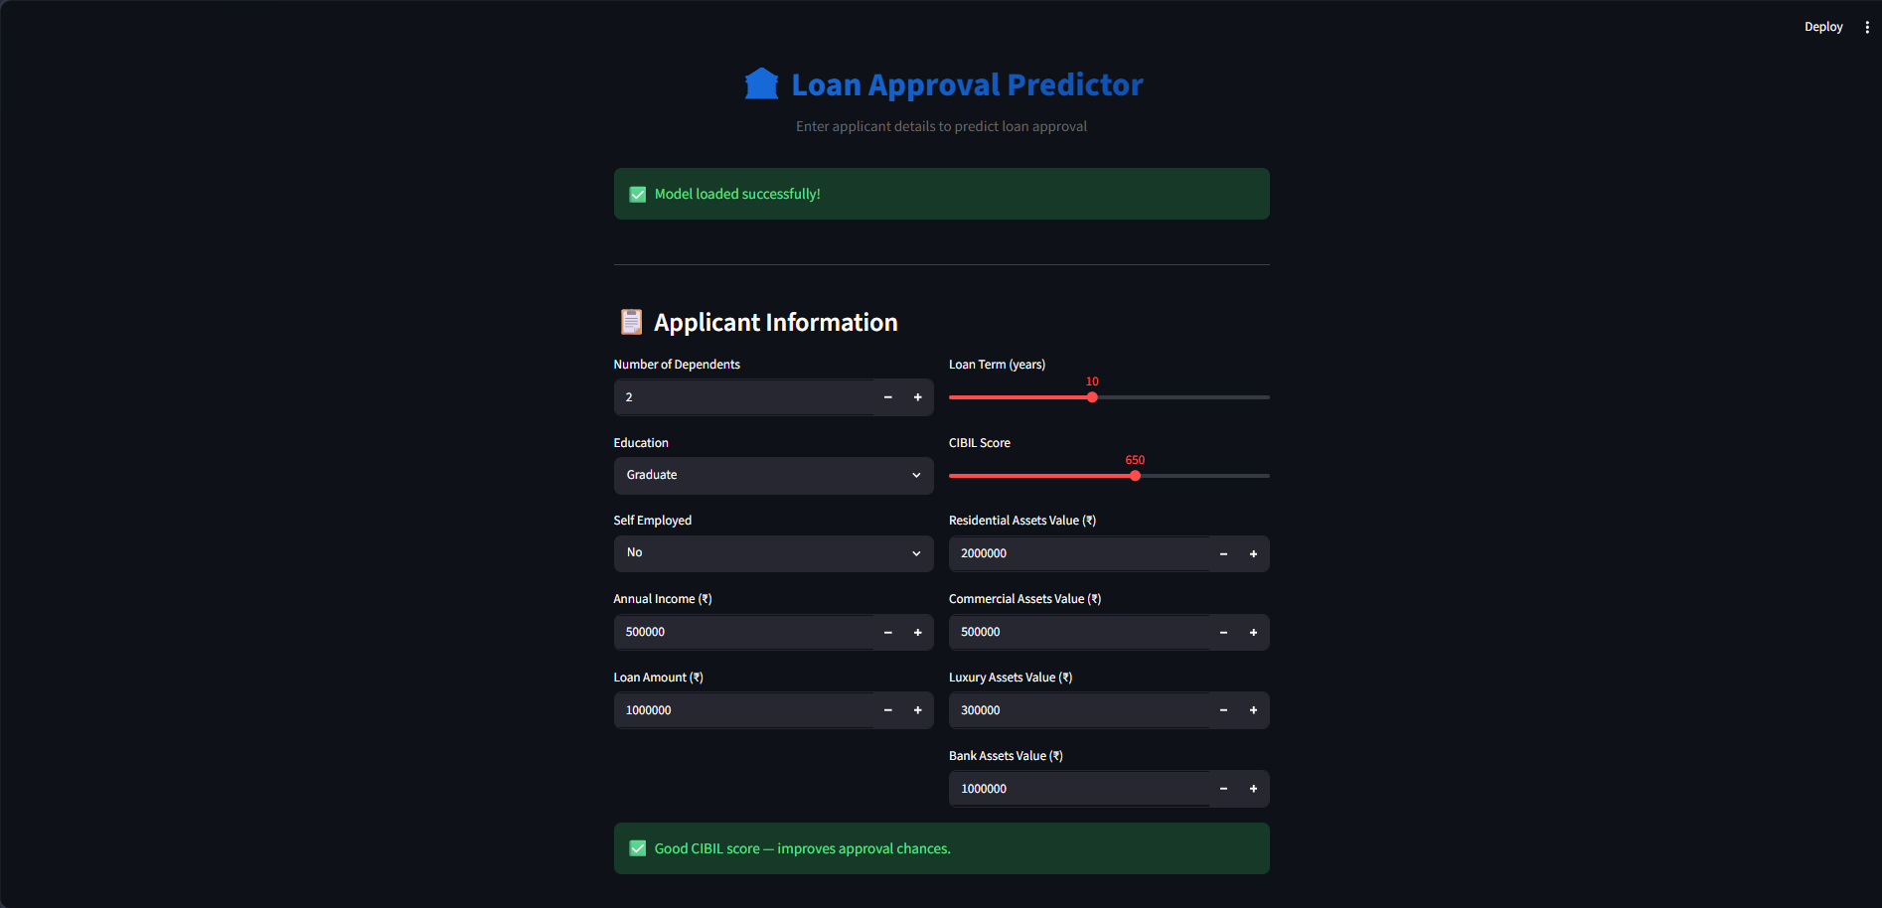
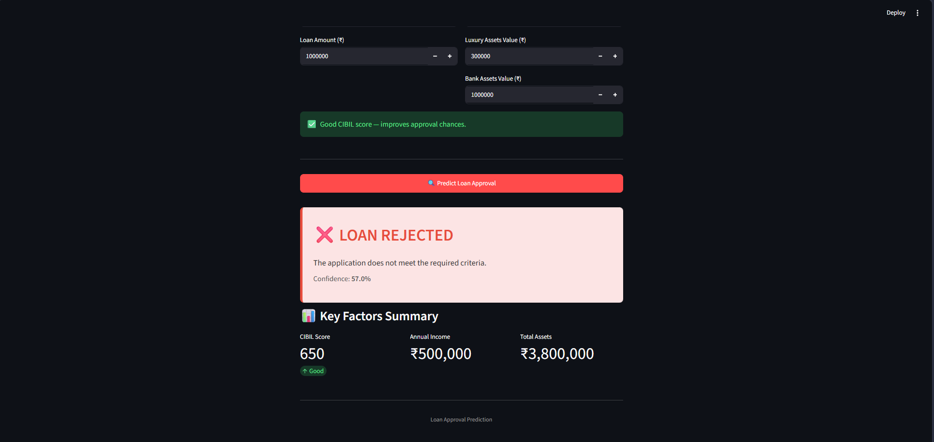
Streamlit Web Application
🖥️ App Interface
✅ Prediction Result
[ Screenshot: images/app_interface.png ]
[ Screenshot: images/prediction_result.png ]
Replace this box with your actual screenshot
Replace this box with your actual screenshot
🔢 Enter all applicant details via interactive form
🤖 Model predicts loan approval instantly
📊 Confidence score displayed with result
✅ / ❌ Clear Approved or Rejected output
Notes:
The Streamlit app provides a user-friendly interface for the model. Anyone can enter applicant details and receive an instant prediction. Run it with: python -m streamlit run app/streamlit_app.py

Slide 11
Key Insights & Business Impact
What we found and why it matters
📊 Key Findings
💼 Business Impact
CIBIL Score is the strongest single predictor of loan approval
Higher annual income significantly improves approval chances
Asset holdings (residential, bank) act as strong collateral signals
Ensemble models (RF, XGBoost) outperform single classifiers
Education and employment have secondary but measurable influence
⚡ Faster Decisions
Automate approvals in milliseconds vs days
🛡️ Reduced Risk
Data-driven decisions reduce default rates
😊 Better CX
Instant responses improve customer experience
📈 Scalability
Process thousands of applications simultaneously
Notes:
The business value of this project is clear: faster, fairer, more consistent loan decisions at scale. CIBIL score dominance aligns with real-world banking practice — confirming our model's validity. Ensemble methods give the best balance of accuracy and robustness.

Slide 12
Conclusion & Future Improvements
✅ Conclusion
🚀 Future Improvements
Built a complete end-to-end ML pipeline for loan approval prediction
Successfully trained and compared 5 classification models
Identified CIBIL Score & Income as critical approval factors
Deployed an interactive Streamlit prediction application
Achieved strong accuracy with ensemble-based models
Hyperparameter Tuning (GridSearchCV, Optuna)
SMOTE for Class Imbalance handling
SHAP Values for model explainability
Cloud Deployment (Streamlit Cloud / AWS)
Neural Network models for comparison
Real-time data pipeline integration
Thank You | Questions & Discussion | Parth Sharma
Notes:
To summarize: we successfully built a complete ML solution for loan approval prediction. The model is deployed as an interactive app. Future work focuses on improving performance, explainability, and scaling to production. Thank you — I'm happy to take any questions.

