Slide 1

Cryptocurrency
Market Analysis Dashboard
A Comprehensive Power BI Analysis of Top 100 Cryptocurrencies
Power BI
DAX
CoinGecko API
Data Visualization
Market Analytics
100
$2.41T
6
5+
Coins Tracked
Market Cap
Dashboards
Key Insights

Slide 2




PROJECT OBJECTIVE
What We Set Out to Achieve
Market Intelligence
Performance Tracking
Analyze real-time data from the top 100 cryptocurrencies using the CoinGecko API to extract meaningful market trends and patterns.
Monitor price movements, 24h/7d changes, and volatility scores to identify top gainers, losers, and most volatile assets.
Supply & Tokenomics
Actionable Insights
Evaluate circulating supply, max supply, FDV, and scarcity levels to assess long-term investment viability of each coin.
Deliver a multi-page interactive Power BI dashboard enabling data-driven decisions for traders, analysts, and researchers.

Slide 3
PROBLEM STATEMENT
The Challenge with Crypto Data
01
Market Fragmentation
Thousands of cryptocurrencies exist across multiple exchanges — making it extremely difficult to get a unified, structured view of the market.
02
High Volatility & Noise
Prices fluctuate by double digits within hours. Without structured volatility scoring, distinguishing risk from opportunity is nearly impossible.
03
Tokenomics Opacity
Supply metrics (circulating, max, FDV) are scattered and inconsistent, leaving investors without clarity on inflation risk or scarcity value.
04
No Unified Analytics Tool
Raw API data alone offers no visual insight. A structured dashboard is essential to identify trends, outliers, and market concentration.

Slide 4
PROJECT OVERVIEW
End-to-End Data Pipeline
1
2
3
4
5
CoinGecko API
Data Ingestion
Data Modeling
Visualization
Insights
Live market data
for top 100 coins
Power Query
ETL process
DAX measures
& calculated cols
6 interactive
Power BI pages
Key findings &
recommendations
This project leverages the CoinGecko public API to fetch structured data on the top 100 cryptocurrencies by market capitalization. Power Query was used for data transformation and cleaning, while DAX (Data Analysis Expressions) powered the creation of calculated metrics such as volatility score, market dominance, performance category, and scarcity level. The final output is a 6-page interactive Power BI report providing 360° market visibility.

Slide 5

DATASET OVERVIEW
Data Source: CoinGecko API
Key Columns
id / name / symbol
Identification
Source Details
current_price
Pricing
API:
CoinGecko /coins/markets
market_cap / market_cap_rank
Market Data
Records:
Top 100 Coins by Mkt Cap
total_volume
Trading Activity
Update:
Real-time (on refresh)
Format:
JSON → Power Query
price_change_percentage_24h / 7d
Performance
Rows:
~100 per refresh
circulating_supply / max_supply
Tokenomics
Cols:
20+ raw data fields
fully_diluted_valuation (FDV)
Valuation
ath / atl (all-time high/low)
Historical

Slide 6
DATA PREPARATION & MODELING
Cleaning, Transforming & Calculating
⚙ Power Query — Data Cleaning
📊 DAX — Measures & Columns
1
Removed null/blank values in max_supply & FDV columns
Volatility Score
ABS(24h%) + ABS(7d%)
2
Converted scientific notation prices to decimal format
Volatility Index
Price STD / AVG Price
3
Standardized column data types (text, decimal, whole)
Market Dominance
Market Cap / Total Mkt Cap
4
Replaced null max_supply with 0 for infinite-supply coins
Scarcity Level
IF Circulating > 90% → High
5
Filtered out coins with zero market cap or missing rank
Performance Category
Based on 24h & 7d % change
6
Renamed columns for readability and consistency
Rank Category
Top 10 / 11–50 / 51–100
7
Added calculated column: Circulating Ratio %
MC vs FDV Ratio
Market Cap / FDV

Slide 7
DASHBOARD OVERVIEW
6 Interactive Power BI Pages
01
Market Overview
02
Market Performance
03
Top Coins Analysis
Total market cap, coin count, volume, average price, top-10 rankings, and top gainers at a glance.
Highest/lowest prices, max 24h gain/loss, volatility rankings, price & performance distribution.
Drill-down into individual coins — price meter, market cap tree, and detailed table with filters.
04
Tokenomics & Supply
05
Volatility & Performance
06
Conclusion & Insights
Circulating supply, max supply, FDV, MC vs FDV ratio, scarcity distribution, and supply breakdown.
24h & 7d change averages, volatility scores, stability levels, and most volatile coin rankings.
Top 3 market share, high volatility flag, key textual insights, summary & market structure views.

Slide 8
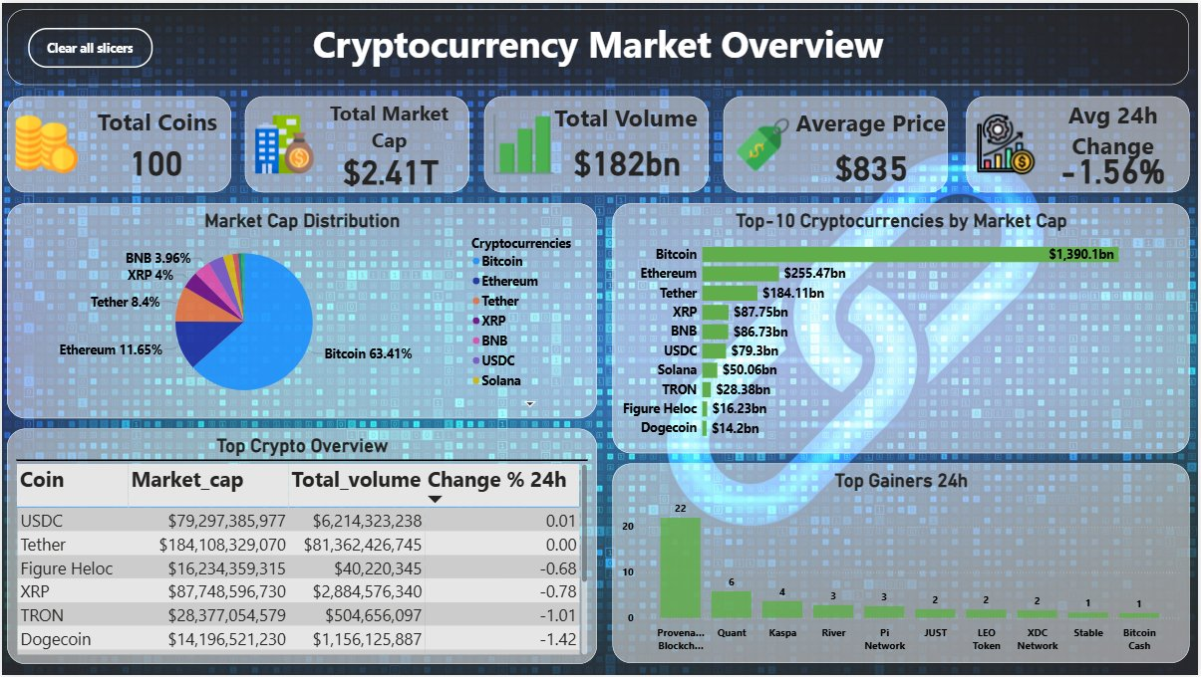
DASHBOARD
Market Overview Dashboard
A bird's-eye view of the entire cryptocurrency market
Key Insights
Bitcoin dominates with 63.41% of total market cap — $1.39T out of $2.41T total.
Top 3 coins (BTC, ETH, Tether) hold over 75% combined market share.
Total 24h volume hits $182bn with avg price change of -1.56%, signaling bearish pressure.
Provenance Blockchain leads top gainers with 22% growth in 24 hours.

Slide 9
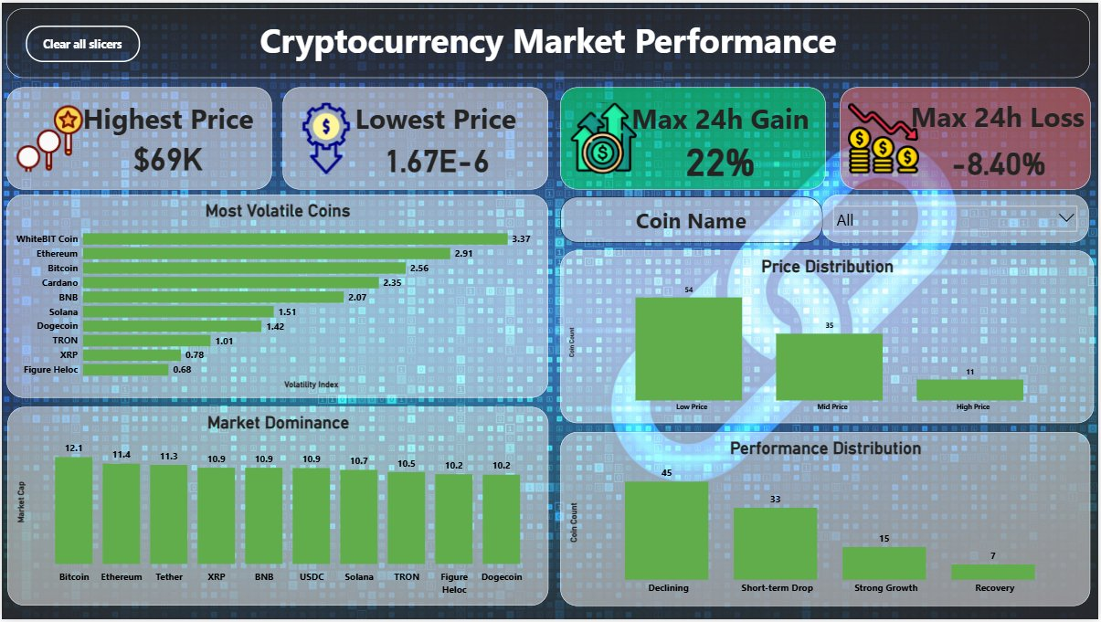
DASHBOARD
Market Performance Dashboard
Volatility, price range, and performance distribution analysis
Key Insights
Highest price at $69K (Bitcoin); lowest at 1.67E-6 — extreme price range across 100 coins.
Max 24h gain: +22%. Max 24h loss: -8.40%. High intraday risk environment.
WhiteBIT Coin ranks most volatile with index of 3.37, followed by Ethereum at 2.91.
45 out of 100 coins are in 'Declining' category — market-wide bearish dominance.

Slide 10
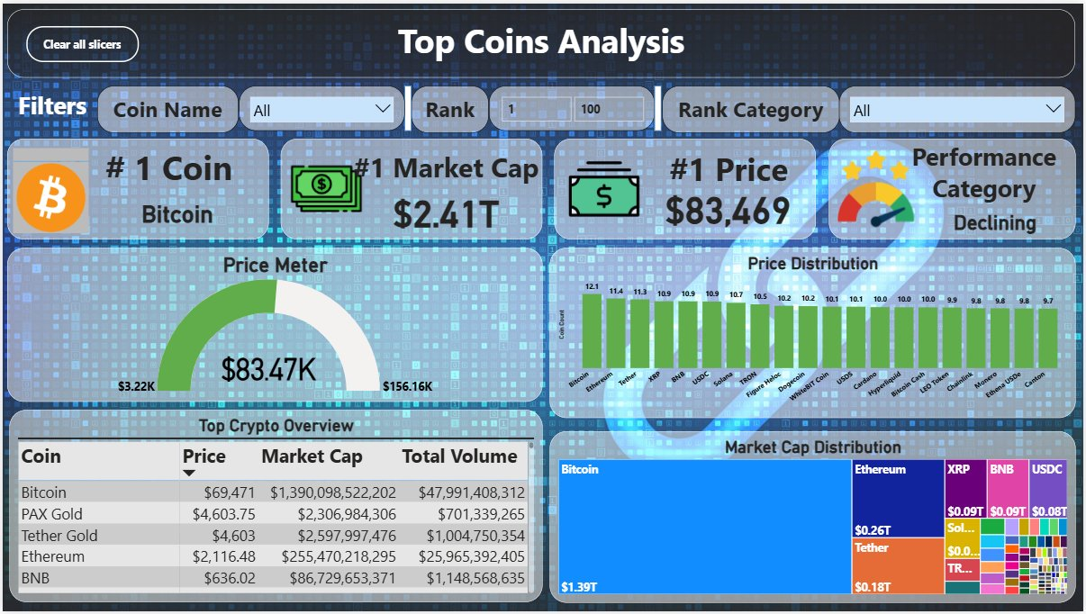
DASHBOARD
Top Coins Analysis
Deep-dive into individual coin metrics with interactive filters
Key Insights
#1 Coin: Bitcoin — Market Cap $2.41T, Price $83,469, Performance: Declining.
Price Meter shows BTC at $83.47K — midway between $3.22K–$156.16K range.
PAX Gold ($4,603) and Tether Gold ($4,603) rank highest in price after Bitcoin.
Market Cap Treemap reveals Bitcoin's massive visual dominance ($1.39T block).

Slide 11
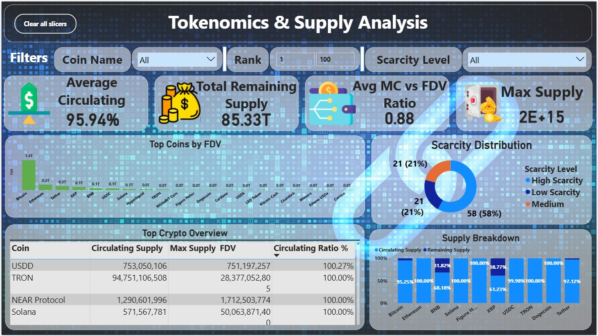
DASHBOARD
Tokenomics & Supply Dashboard
Supply metrics, scarcity levels, and valuation analysis
Key Insights
Average circulating supply ratio: 95.94% — most coins are nearly fully in circulation.
Max supply across dataset reaches 2E+15 (SHIB-class coins) — enormous inflationary risk.
58% of coins fall in 'Medium' scarcity; only 21% are classified as 'High Scarcity'.
Avg MC vs FDV ratio of 0.88 shows most coins are close to fully diluted market value.

Slide 12
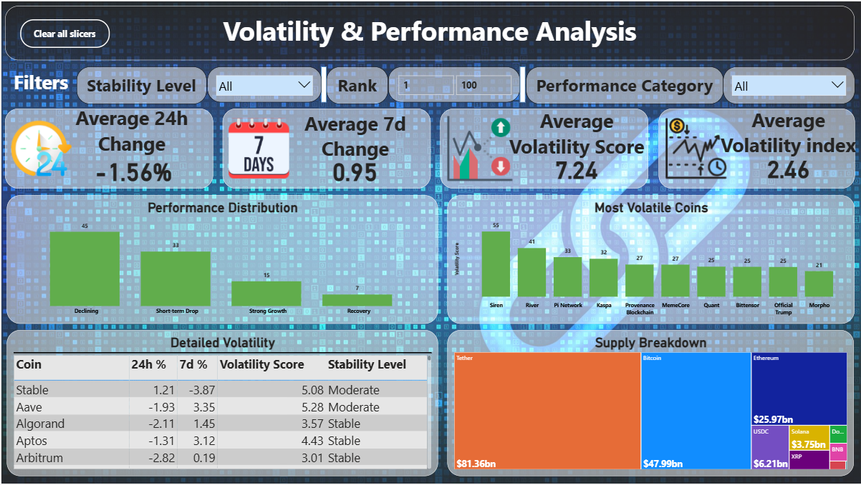
DASHBOARD
Volatility & Performance Dashboard
Stability scoring, volatility index, and performance categorization
Key Insights
Average 24h change: -1.56%; Average 7d change: +0.95% — slight mid-term recovery.
Average Volatility Score: 7.24; Volatility Index: 2.46 — elevated market turbulence.
Siren leads volatility scores at 55, followed by River (41) and Pi Network (33).
Only 15 coins show 'Strong Growth' vs 33 in 'Short-term Drop' — risk-heavy landscape.

Slide 13
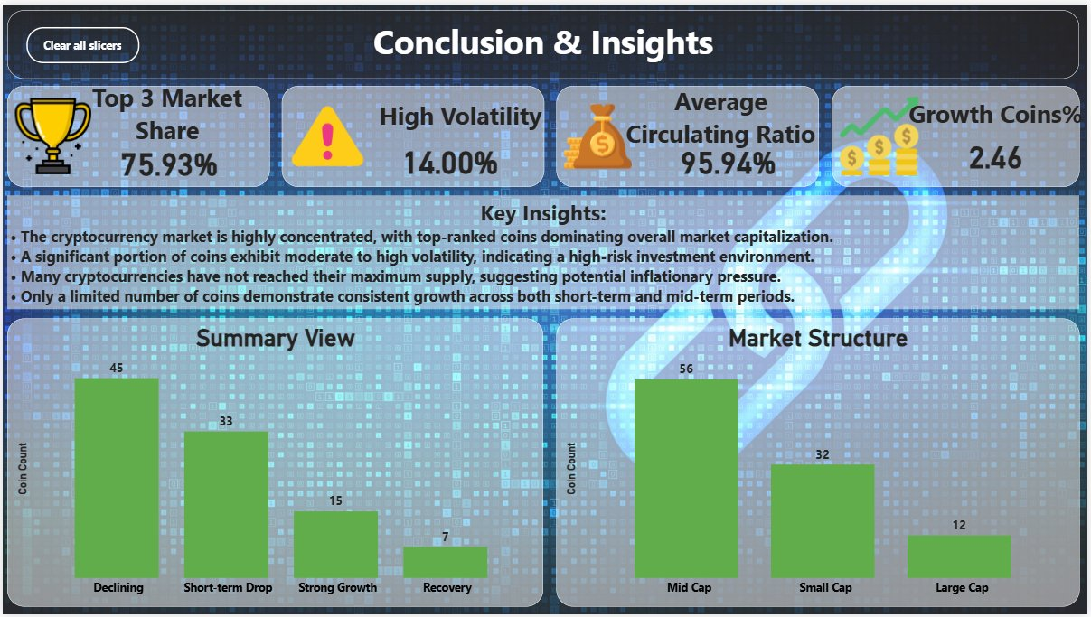
DASHBOARD
Conclusion & Insights Dashboard
Summary findings and strategic market structure overview
Key Insights
Top 3 coins hold 75.93% market share — extreme concentration in crypto markets.
14% of coins show high volatility — significant risk for short-term traders.
Growth Coins % (2.46) and 95.94% circulation ratio signal mature market dynamics.
Market structure: 56 Mid-Cap, 32 Small-Cap, 12 Large-Cap — mid-caps dominate.

Slide 14
KEY INSIGHTS
What the Data Reveals
75.93%
-1.56%
95.94%
Market Concentration
Avg 24h Change
Circulating Ratio
Top 3 coins dominate — market is highly centralized. Bitcoin alone holds 63.41%.
Broad market decline — 45 of 100 coins are in 'Declining' performance category.
Most coins are near full circulation — limited room for new supply to suppress prices.
14%
0.88
High Volatility Coins
Avg MC/FDV Ratio
14% of coins exhibit extreme price swings — high risk, but also high opportunity.
Close to fully diluted — means less future dilution risk for top-ranked coins.

Slide 15
STRATEGIC RECOMMENDATIONS
Data-Driven Actionable Guidance
🛡
Prioritize Large-Cap Stability
With 75.93% market share in top 3 coins, conservative portfolios should focus on BTC/ETH as anchors, using small/mid-caps for satellite positions only.
⚡
Monitor Volatility Leaders
Siren, River, Pi Network show extreme volatility scores (55, 41, 33). Traders can leverage these for short-term opportunities with strict stop-loss strategies.
🔍
Evaluate Scarcity for Long-Term
Only 21% of coins are 'High Scarcity'. Focus on coins with capped max supply and high circulating ratios for deflationary long-term investment thesis.
📊
Track Performance Categories
With 45 coins 'Declining' and only 15 in 'Strong Growth', wait for market recovery signals before broad allocation. Focus on the 7 'Recovery' category coins.

Slide 16
TOOLS & SKILLS DEMONSTRATED
Technology Stack & Competencies
TOOL
Power BI Desktop
LANGUAGE
DAX
Built 6 interactive dashboard pages with slicers, filters, cards, charts, and treemaps.
Created 8+ calculated measures and columns for volatility, scarcity, and performance logic.
ETL
Power Query (M)
DATA SOURCE
CoinGecko API
Cleaned, shaped, and transformed raw JSON API data into analysis-ready structured tables.
Fetched live market data for 100 cryptocurrencies including price, supply, and volume metrics.
Data Analysis
Data Visualization
Data Modeling
ETL / Data Wrangling
Dashboard Design
API Integration

Slide 17
CHALLENGES FACED
Real Obstacles, Real Solutions
⚠ Null & Missing Values
→ Used Power Query conditional replacements and filters to handle nulls in max_supply and FDV columns without data loss.
⚠ Extreme Outliers in Price
→ Coins ranged from $69K (BTC) to ~$0.0000017. Applied log-scale logic in DAX and separate 'Price Distribution' segmentation.
⚠ Scientific Notation in API Data
→ Raw API returns values like '1.67E-6'. Power Query custom column transformations normalized these to decimal numbers.
⚠ Defining Volatility Metrics
→ No standard volatility formula in the dataset — designed custom DAX measures combining 24h%, 7d%, and price deviation scoring.
⚠ Scarcity & Supply Classification
→ Built DAX IF/SWITCH logic to classify coins into High/Medium/Low scarcity buckets based on circulating ratio thresholds.

Slide 18
FUTURE SCOPE
What Comes Next
01
02
03
Real-Time Auto Refresh
Predictive Analytics
Historical Trend Analysis
Implement Power BI scheduled refresh with live CoinGecko API calls every 15 minutes for up-to-date dashboards.
Integrate Python/R ML models to forecast 24h price direction using historical volatility, volume, and momentum signals.
Extend dataset to include 30/90/365-day historical data for trend analysis, drawdown metrics, and cycle identification.
04
05
Portfolio Simulator
Sentiment Integration
Add an interactive portfolio builder within Power BI to simulate returns based on user-defined crypto allocations.
Incorporate social sentiment scores (Twitter, Reddit) via APIs to correlate market behavior with community emotion.

Slide 19
CONCLUSION
Project Impact & Learning
This project successfully demonstrates the full power of Power BI in transforming raw API data into structured, visually compelling, and analytically rich dashboards. By applying DAX modeling, Power Query transformations, and thoughtful design, the report delivers a 360° view of the cryptocurrency market — from macro trends to micro-level coin analysis.
Technical Skill
Analytical Depth
Power BI + DAX + API
6-Page Insights Report
Business Value
Scalability
Actionable Market Intelligence
Ready for Real-Time Expansion

