Slide 1
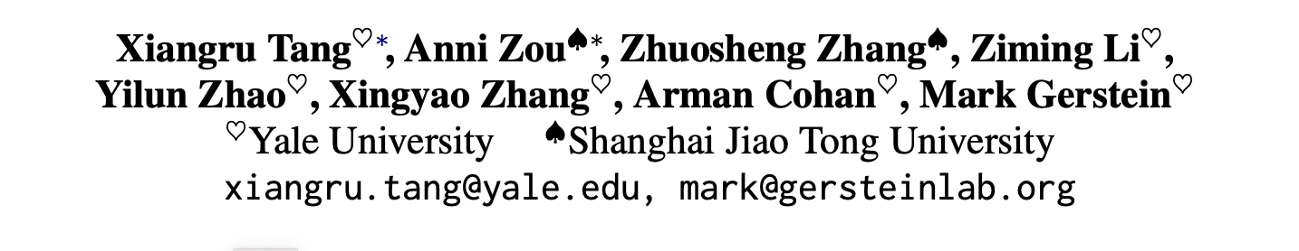
MEDAGENTS: Large Language Models as Collaborators for Zero-shot Medical Reasoning
By Zihan Jia the Chinese University of Hong Kong
4 June 2024

Slide 2
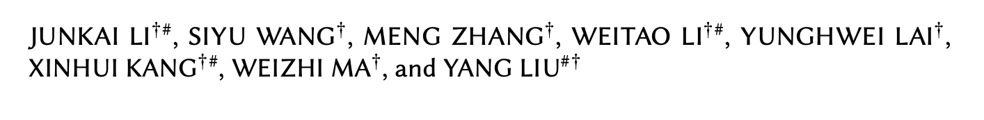
Outline
详：MEDAGENTS: Large Language Models as Collaborators for Zero-shot Medical Reasoning（局部）
略：Agent Hospital: A Simulacrum of Hospital with Evolvable Medical Agents （整体）
May 2024

Slide 3
01 Introduction

Slide 4
Background
Large language models (LLMs), despite their remarkable progress across various general domains, encounter significant barriers in medicine and healthcare.
Challenges: domain-specific terminologies and reasoning over specialized knowledge.
More specific?

Slide 5
Background
Challenges
Limited volume and specificity of medical training data compared to the vast general text data, due to cost and privacy concerns.
The demand for extensive domain knowledge and advanced reasoning skills makes eliciting medical expertise via simple prompting challenging.
Although numerous attempts, strategies used in the medical field have been shown to induce hallucination, indicating the need for more robust approaches.

Slide 6
Progress
Meanwhile, recent research has surprisingly witnessed the success of multi-agent collaboration which highlights the simulation of human activities.
Through such design, the expertise implicitly embedded within LLMs, or that the model has encountered during its training, which may not be readily accessible via traditional prompting, is effectively brought to the fore.

Slide 7
02 Method

Slide 8
Method
Assume such a case:A 66-year-old male with a history of heart attack and recurrent stomach ulcers is experiencing persistent cough and chest pain, and recent CT scans indicate a possible lung tumor. Designing a treatment plan that minimizes risk and maximizes outcomes is the current concern due to his deteriorating health and medical history.
What shell we do under such condition as human-beings?

Slide 9
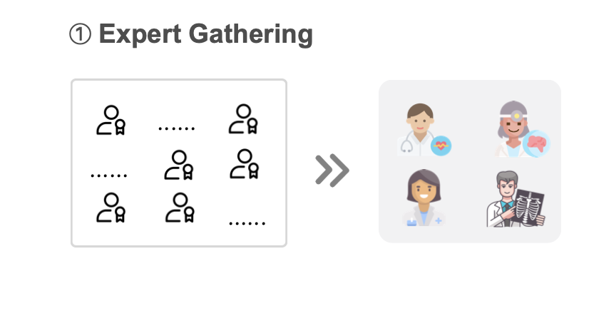
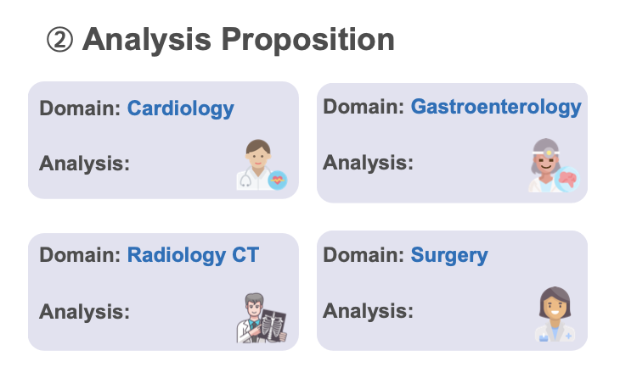
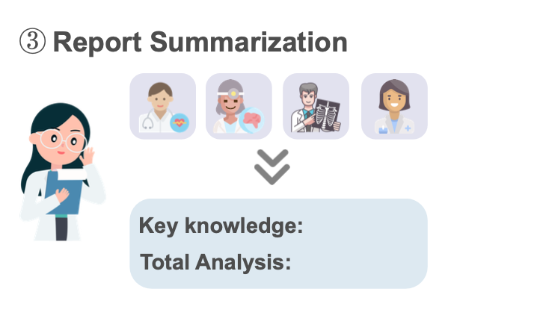
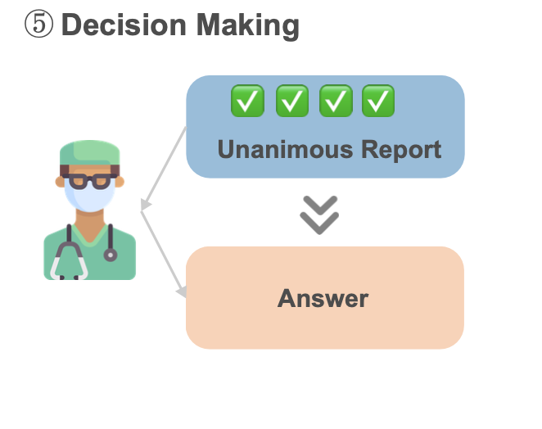
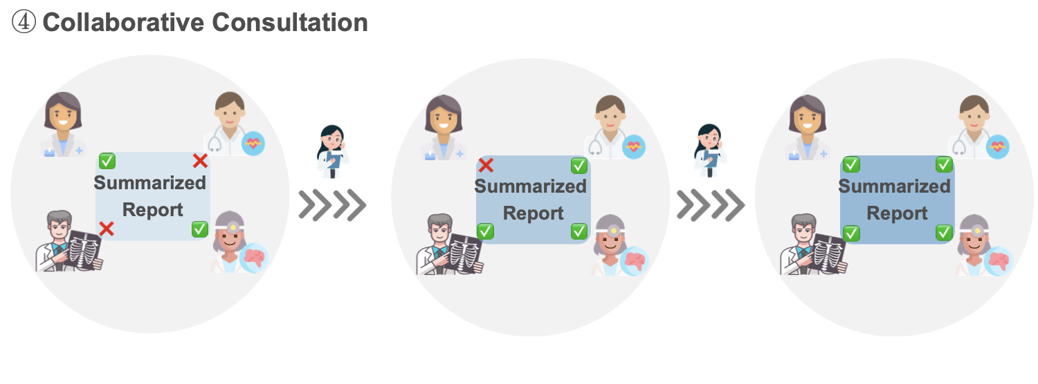
Method
Assume such a case:A 66-year-old male with a history of heart attack and recurrent stomach ulcers is experiencing persistent cough and chest pain, and recent CT scans indicate a possible lung tumor. Designing a treatment plan that minimizes risk and maximizes outcomes is the current concern due to his deteriorating health and medical history.

Slide 10
Method
Med-agents framework: a.k.a. multi-disciplinary collaboration framework
(i) expert gathering: assemble experts from various disciplines based on the clinical question;
(ii) analysis proposition: domain experts present their own analyses with their expertise;
(iii) report summarization: develop a report summary on the basis of previous analyses;
(iv) collaborative consultation: hold a consultation over the summarized report with the experts. The report will be revised repeatedly until every expert has given their approval.
(v) decision making: derive a final decision from the unanimous report.

Slide 11
Method
contributions
(i) The first to propose a multi-agent framework within the medical domain and explore how multi-agent communication within the medical setting can lead to a consensus decision, adding a novel dimension to the current literature on medical question answering.
(ii) Our proposed MEDAGENTS framework enjoys enhanced faithfulness and interpretability by harnessing role-playing and collaborative agent discussion. And we demonstrate that role-playing allows LLM to explicitly reason with accurate knowledge, without the need for retrieval augmented generation (RAG).

Slide 12
Method
advantages
Med-agents framework: a.k.a. multi-disciplinary collaboration framework
To better align with real-world application scenarios, our study focuses on the zero-shot setting, which can serve as a plug-and-play method to supplement existing medical LLMs such as Med- PaLM 2.
conduct experiments on 9 datasets.
Encouragingly, our proposed approach outperforms settings for both chain-of-thought (CoT) and self-consistency (SC) prompting methods.

Slide 13
Method
Common errors
(i) lack of domain knowledge,
(ii) mis-retrieval of domain knowledge,
(iii) consistency errors, and
(iv) CoT errors.

Slide 14
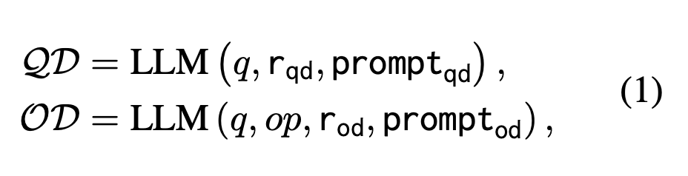
Methods
5 steps: expert gathering
Given a clinical question q and a set of options op = {o1,o2,...,ok} where k is the number of options ,
question domain experts and option domain experts
QD = {qd1, qd2, . . . , qdm} ; OD = {od1, od2, . . . , odn} (m and n represent the number of question domain experts and option domain experts respectively )

Slide 15
Methods
5 steps Analysis Proposition
Question Analyses
Given a question q and a question domain qdi ∈ QD, we ask LLM to serve as an expert specialized in domain qdi and derive the analyses for the question q following the guideline prompt promptqa:
Option Analyses
Now that we have an option domain odi and question analyses QA, we can further analyze the options by taking into account both the relationship between the options and the relationship between the options and question. Concretely, we deliver the question q, the options op, a specific option domain odi ∈ OD, and the question analyses QA to the LLM:

Slide 16

Methods
5 steps: Report Summarization
In the Report Summarization stage, we attempt to summarize and synthesize previous analyses from various domain experts QA ∪ OA. Given question analyses QA and option analyses OA, we ask LLMs to play the role of a medical report assistant, allowing it to generate a synthesized report by extracting key knowledge and total analysis based on previous analyses:

Slide 17
Methods
5 steps: collaborative consultation
During each round of discussions, the experts give their votes (yes/no): vote = LLM (Repo, rvote, promptvote), as well as modification opinions if they vote no for the current report. Afterward, the report will be revised based on the modification opinions.
In this way, the discussions are held iteratively until all experts vote yes for the final report for the discussion number attains the maximum attempts threshold.

Slide 18

Methods
5 steps: Decision Making

Slide 19
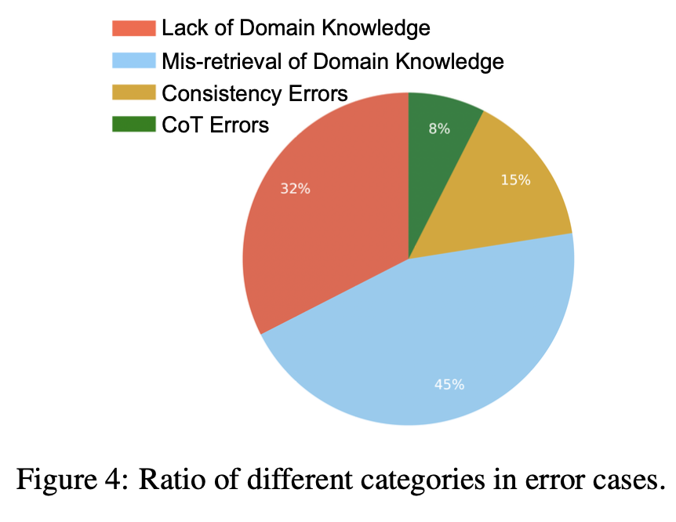
Results_most common errors

Slide 20
03 Agent hospital

Slide 21
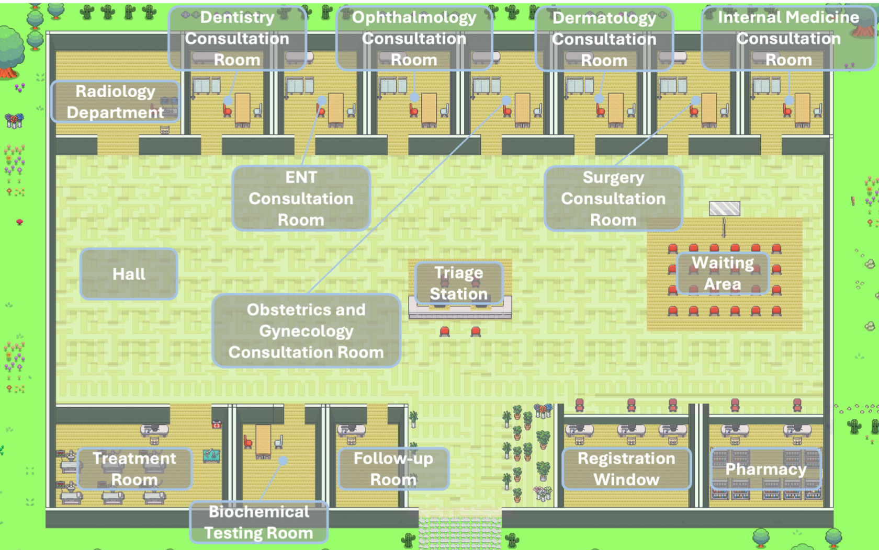
What is agent hospital?

Slide 22
What is agent hospital?
Imagine a virtual hospital with virtual doctors and patients, just like a computer game. This virtual hospital is called "Agent Hospital", and the entire process of a patient's visit, from getting sick, going to the hospital, seeing a doctor, getting an examination, diagnosis to finally getting medicine and recovering, all takes place in this virtual world.

Slide 23
Why agent hospital?
Researchers want to see if they can use large language models (LLM, which can be understood as a very powerful AI) to train virtual doctors so that they can learn how to diagnose and treat diseases like real doctors.

Slide 24
How does it work?
Virtual patients: These virtual patients will randomly "get sick" and then go to the virtual hospital for treatment.
Virtual doctors: The virtual doctors will diagnose and give treatment plans based on the patient's description and examination results.
Learning and evolution: The virtual doctor will learn from each diagnosis and treatment process. If the treatment is successful, the case will be recorded; if it fails, the reasons will be analyzed to avoid making the same mistakes next time. Just like real doctors accumulate experience, virtual doctors will continue to improve their medical skills.

Slide 25
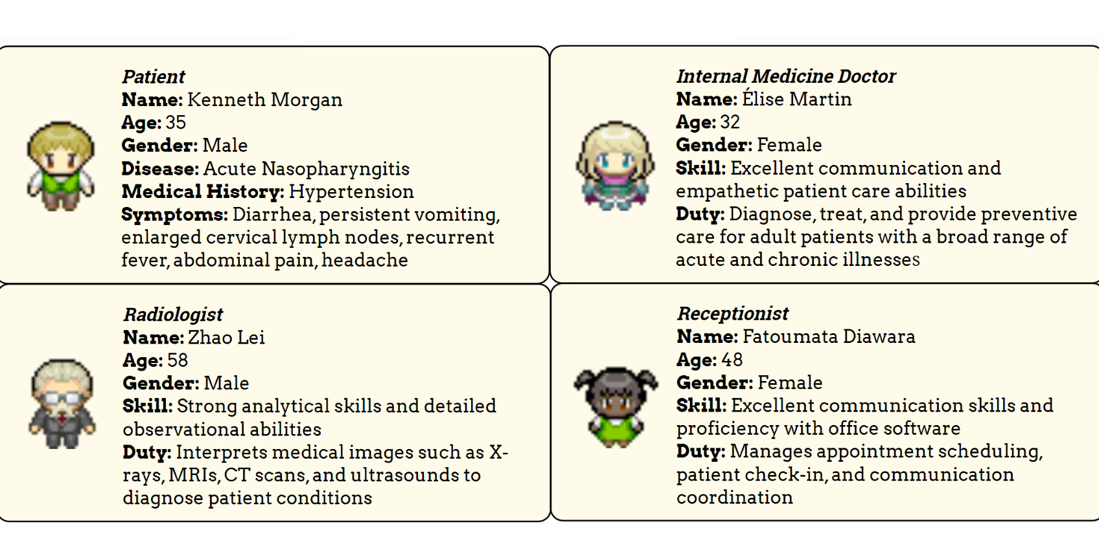

Slide 26
Med-agent zero
*无需任何数据标注
*24h学习进化
*更加严谨安全可靠
*不能全方位取代 医院和医生

Slide 27
Thank you!

