Slide 1
RIDGEHOLD
AI Account Growth Operator for B2B AI & SaaS
Yash Kothari · Srinivasan R
AIBoomi Startup Weekend Bangalore · June 2026

Slide 2
THE PROBLEM
01 Problem
Account Managers Are Flying Reactive, Not Strategic
EXTERNAL SIGNALS MISSED
INTERNAL SIGNALS IGNORED
EXPANSION = CHURN DEFENCE
Market moves, competitor wins, funding rounds, product launches — AMs learn about them too late or not at all.
Product usage drops, support spikes, feature adoption gaps go unnoticed until renewal is at risk.
Without proactive identification, every missed expansion opportunity either becomes a churn risk or a lost revenue moment.
📊 "44% of sales reps miss quota because they can't identify upsell signals in time." — Gartner, 2024
RIDGEHOLD
AI Account Growth Operator
01 / 07

Slide 3
INSIGHT & WHY NOW
02 Why Now
Three Forces Making This the Right Moment
01
AI Can Now Act, Not Just Inform
LLMs move beyond summarisation — they can now read signals, reason across accounts, and generate specific next actions. The intelligence layer is ready.
02
NRR Is the New Growth Metric
Post-2023 SaaS reset: boards and VCs measure Net Revenue Retention above all. AMs under NRR pressure need tools that surface expansion, not just track it.
03
B2B AI Companies Are the Fastest-Growing Accounts
The customers selling AI are scaling fastest — and they're the hardest to manage manually. Their usage patterns, integrations, and signals change weekly.
RIDGEHOLD
AI Account Growth Operator
02 / 07

Slide 4
SOLUTION
03 Demo
Ridgehold in Action
Signal Detected
→
Account Briefed
→
Action Recommended
→
Draft Generated
→
Outcome Tracked
RIDGEHOLD
AI Account Growth Operator
03 / 07

Slide 5
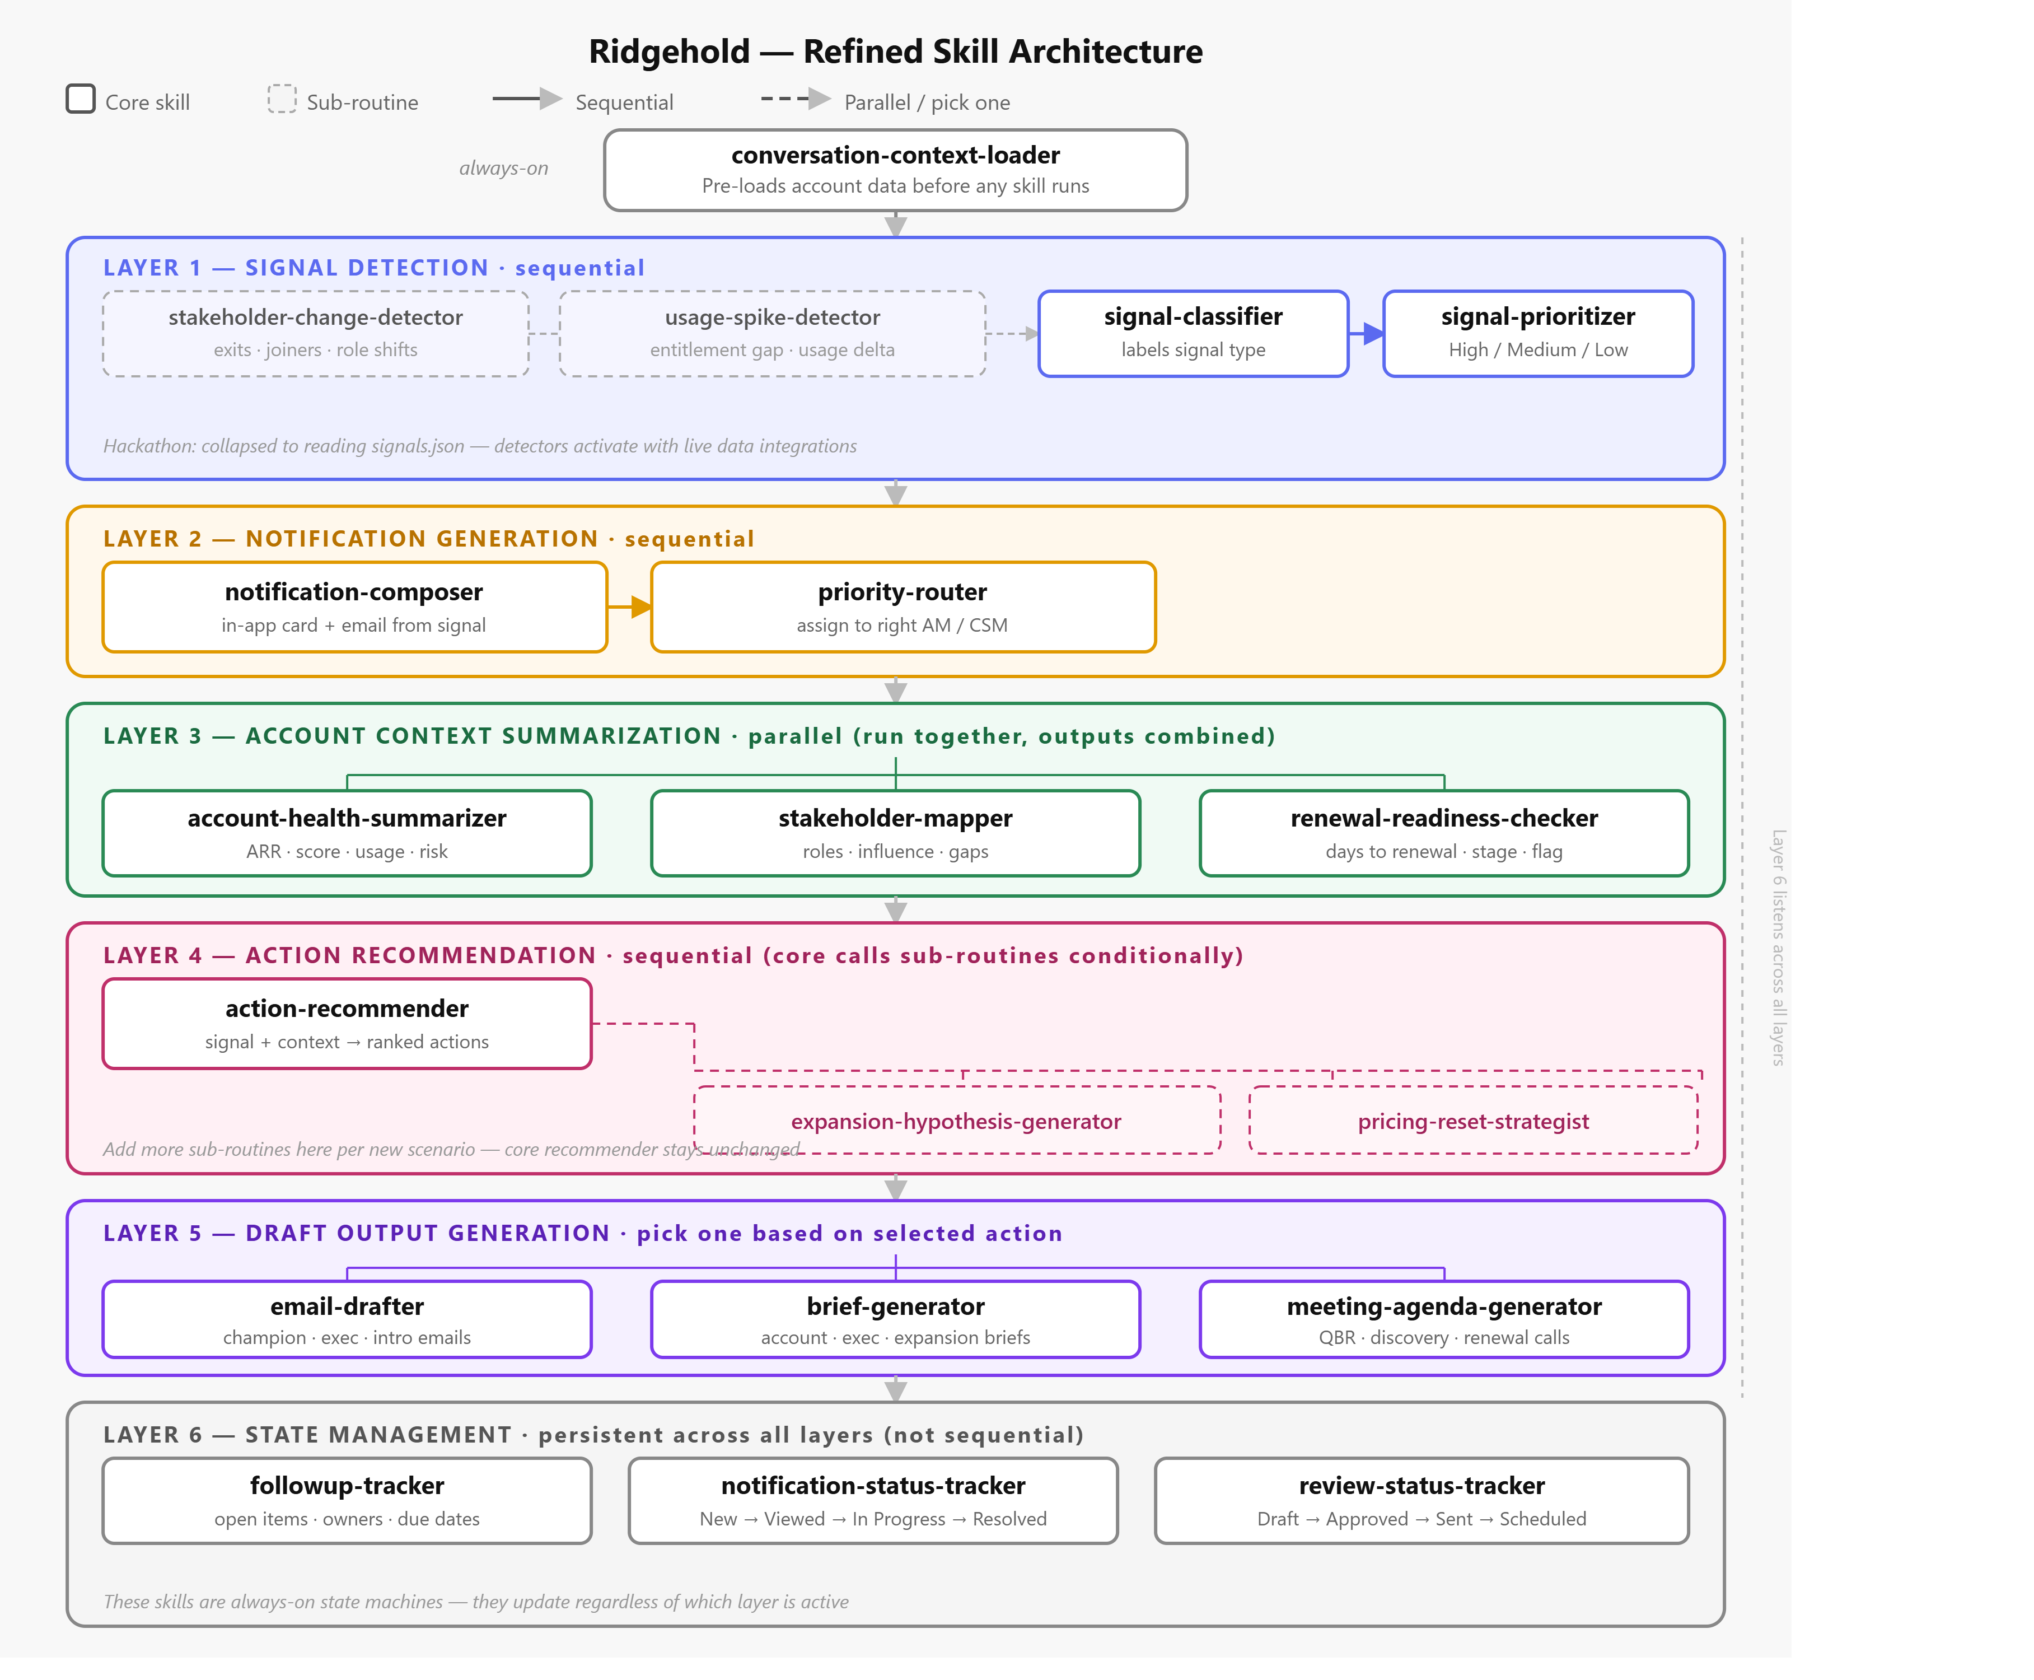
TECHNOLOGY
04 Tech
6-Layer Agentic Architecture
Signal Detection
External & internal triggers
Notification Generation
Prioritised alert surface
Context Summarisation
Full account brief on demand
Action Recommendation
Next best action engine
Draft Output Generation
Email/deck/proposal ready
State Management
Progress tracking & closure
🛡 Guardrails
⚡ Model
📄 Licenses
Hallucination checks · Tone enforcement · Human-in-loop gates
GPT-5.5 — reasoning, widget gen, skill runs, artifact generation
Django BSD-3 · FastAPI MIT · React MIT · ChakraUI MIT
RIDGEHOLD
AI Account Growth Operator
04 / 07

Slide 6
VALUE & GTM
05 Value & GTM
Who We Serve and How We Win
VALUE DELIVERED
GO-TO-MARKET
NRR Improvement
🎯 Wedge
Surface upsell/cross-sell opportunities before renewal windows close
B2B AI & SaaS companies with 10–200 person sales/CS teams
📦 Entry Product
Hours Saved per AM
Ridgehold for Account Management — signal-to-action workflow
Auto-brief, signal digest and draft generation cuts prep from hours to minutes
💰 Revenue Model
SaaS per seat · $49–$149/AM/month · Land via CS leaders
Faster Response
🔗 Distribution
From signal to personalised outreach in under 5 minutes
Direct outbound + partnerships with RevOps tools (HubSpot, Gainsight)
📈 Expansion
Churn Defence
Add Finance, Legal, Procurement signal layers post-PMF
Early warning on usage drops and support spikes before they escalate
RIDGEHOLD
AI Account Growth Operator
05 / 07

Slide 7
ROADMAP & RISKS
06 Roadmap
Where We Go Next
NOW Hackathon MVP
NEXT 0–3 Months
LATER 3–12 Months
→ Conversational AI interface
→ Live signal connectors (LinkedIn, G2, CRM)
→ Enterprise SSO + RBAC
→ Synthetic signal agents
→ CRM write-back (Salesforce/HubSpot)
→ Custom signal library
→ Account brief + action reco
→ Team collaboration layer
→ Finance & Legal signal layers
→ Draft generation (email/deck)
→ First 5 paying customers
→ Series A fundraise
KEY RISKS
⚠ Data access
⚠ CRM adoption
⚠ LLM reliability
Signals require API/scraping — mitigated by synthetic layer + partnerships
AM habits are sticky — onboarding with CS leaders, not bottom-up
Guardrails + human-in-loop on all customer-facing drafts
RIDGEHOLD
AI Account Growth Operator
06 / 07

Slide 8
AI IMPACT
07 AI Impact
What Ridgehold Makes Possible
⚡ Speed
🎯 Precision
Signal → personalised outreach in < 5 minutes. What took an AM 2 hours now happens automatically.
Every recommendation is grounded in real account context — not generic playbooks.
📈 Scale
🔮 Foresight
One AM can effectively manage 3× more accounts with the same quality of attention.
Move from reactive churn defence to proactive expansion identification.
Ridgehold doesn't replace the Account Manager — it makes every AM the best in the team.
RIDGEHOLD
AI Account Growth Operator
07 / 07

