Slide 1
Parking Pool
Team number: 2
Team members: Bhavna Jindal (B00871368)
Vanshika Gohel (B00888111)
Ridham Kathiriya (B00893712)
Siddharth Kharwar (B00897211)
Samarth Jariwala (B00899380)
Client Team number: 8

Slide 2
Summary
This project is all about utilizing parking slots available in a city in an efficient way. Where users/vendors can add the parking slot and other users can utilize those parking slots.
The application starts with the feature option to turn on text to speech which converts the console text into audio. Different features are provided according to the user role, that is , customer, vendor and admin.
Our application is trying to achieve that the empty spaces in every area are utilized as parking spot. Moreover, there should not be any difficulties faced by vendors and customers.
The vendors can easily add, view and remove their parking slot. The customers should not face any difficulties in finding parking spots nearby them.
We have also targeted the customers who has low vision, so for them, text-to-speech feature comes in to play the role.

Slide 3
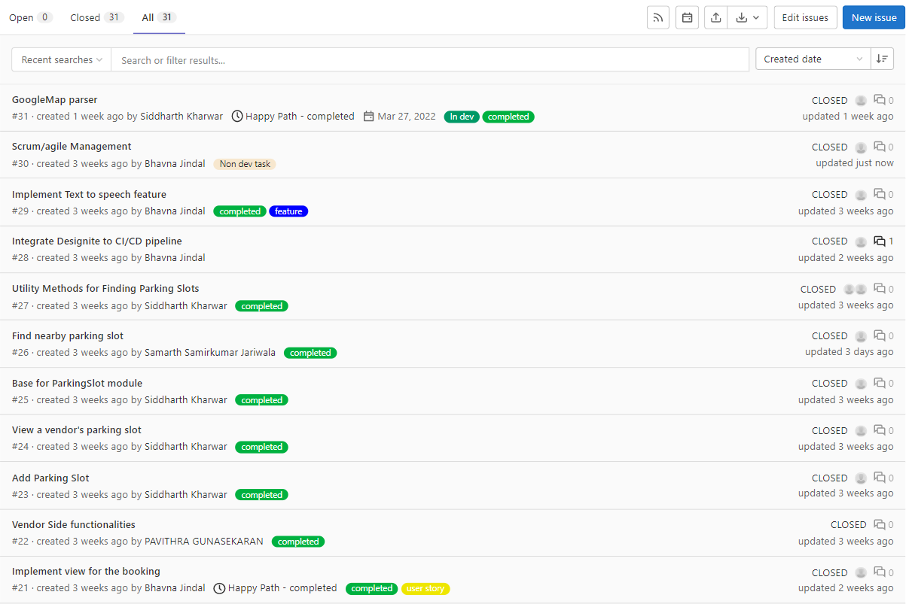
Dashboard
Total Task = 31

Slide 4
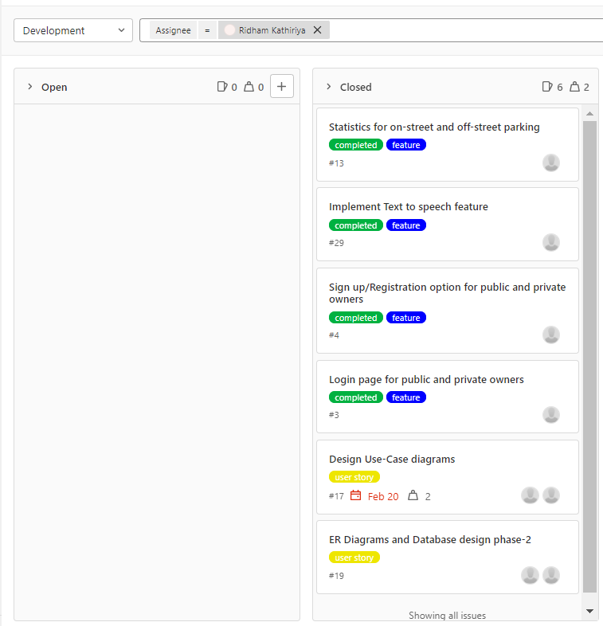
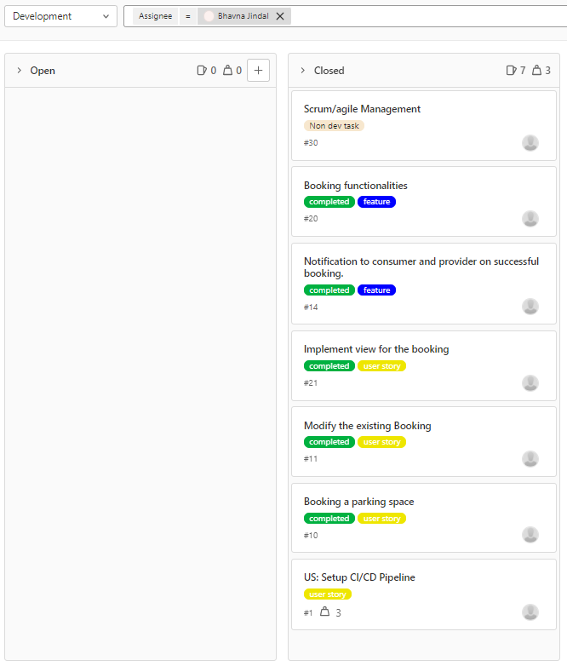
Dashboard
Ridham Kathiriya
Bhavna Jindal

Slide 5
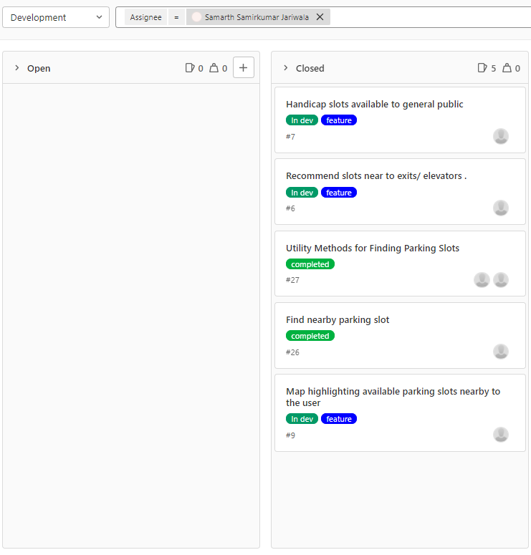
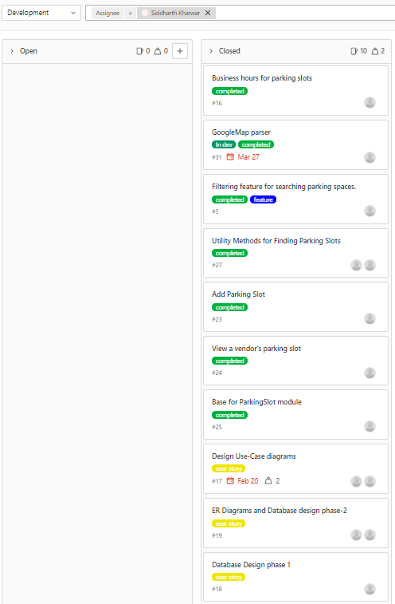
Dashboard
Samarth Jariwala
Siddharth Kharwar

Slide 6
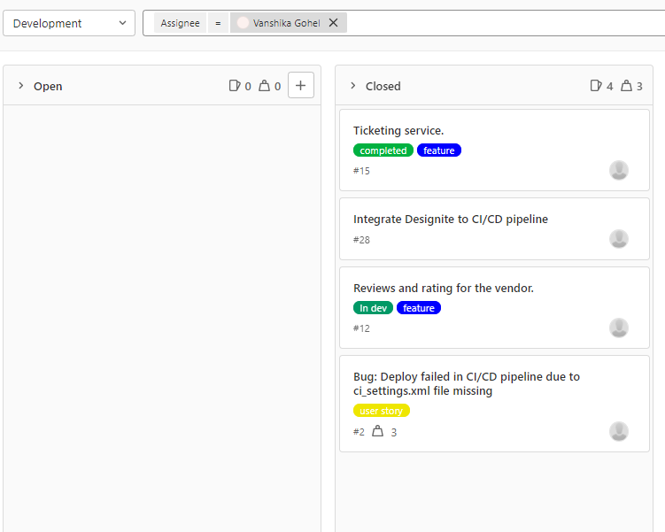
Dashboard
Vanshika Ghoel

Slide 7
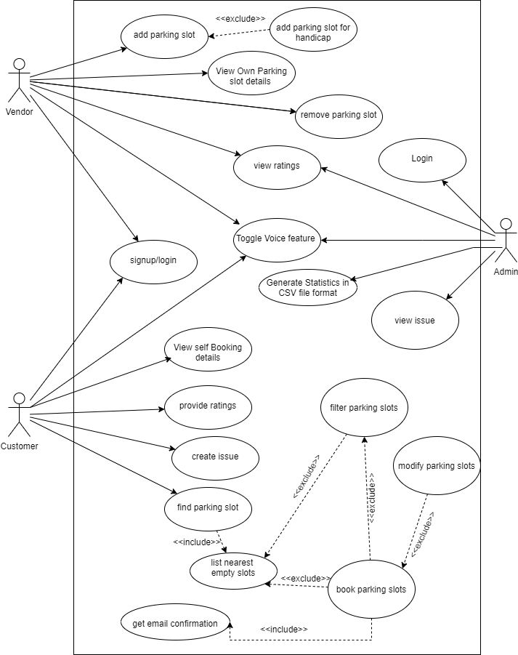
Demo
Usecase Diagram

Slide 8
Project Status
Milestones | Status
Log in/Sign up | Achieved
List Nearby Parking Spaces | Achieved
Filtering searches | Achieved
Recommend slots closer to elevator | Achieved
Slots for handicapped | Achieved
Handle Non-Registered Users | Achieved
Map Highlighting | Achieved
Analytics | Achieved
Milestones (Long Term) | Status
Modify Existing Booking | Achieved
Send Confirmation Email | Achieved
Ticketing Service | Achieved
Review and Rating | Achieved
Voice Feature (Extra goal) | Achieved

Slide 9
Learning
Doing this project in core java helped to strengthen the basic understanding of the concepts.
The branches should be merged frequently as there might occur a high chance of causing huge merge conflicts down the lane.
The checking of smells should be done frequently, that is, after every feature Is implemented. This will help to refactor the code easily while reducing the technical debt as much as possible.
As the technical challenges are now clear, the project can be improvised by introducing a proper User Interface.

Slide 10
Thank you
Slide template- https://slidesgo.com/

