Slide 1
BLUESTOCK FINTECH
Mutual Fund Analytics Platform
End-to-End Data Engineering, ETL Pipeline & Interactive Dashboard
Ridham Gupta
Data Analyst Intern | Bluestock Fintech Pvt. Ltd.
June 2026
87,533
40
46,000
4-Page
Database Rows
Fund Schemes
NAV Records
Power BI Dashboard

Slide 2
India's ₹81 Lakh Crore MF Industry Lacks Unified Analytics
5 Core Problems
8 Project Objectives
Data fragmentation across AMFI website formats
O1 — Automated ETL pipeline (Python)
O2 — 10-table SQLite star schema
1
No risk-adjusted fund comparison tool
2
O3 — 15+ chart EDA notebook
O4 — 7 performance metrics from raw NAV
No benchmark tracking for retail investors
3
O5 — 4-page Power BI dashboard
O6 — Investor cohort + SIP continuity analysis
Investor behaviour data is siloed
4
Manual reporting takes days, not seconds
O7 — Benchmark comparison + tracking error
O8 — Final report & presentation
5

Slide 3
10 Datasets, 87,533 Rows, 4.4 Years of Market Data
Dataset | Rows | Source
fund_master.csv | 40 | AMFI India
nav_history.csv | 46,000 | mfapi.in API
investor_transactions.csv | 32,778 | Simulated (real distributions)
benchmark_indices.csv | 8,050 | NSE / BSE
scheme_performance.csv | 40 | Computed from NAV
+ 5 more supporting datasets | ~700 | AMFI Monthly Notes
40
5,000
Fund Schemes
Investors
12
14
States Covered
Sectors Tracked
Source URLs: amfiindia.com | api.mfapi.in/mf/{code} | nseindia.com | bseindia.com

Slide 4
5-Layer Data Engineering Architecture
01
→
→
→
→
02
03
04
05
EXTRACT
TRANSFORM
LOAD
ANALYSE
VISUALISE
10 CSVs + mfapi.in REST API
Pandas cleaning, validation,
forward-fill
SQLite star schema
10 tables, 87,533 rows
5 notebooks, 7 metrics,
VaR, HHI, recommender
4-page Power BI dashboard
slicers, drill-through
This 5-layer architecture mirrors real-world fintech pipelines used at Zerodha, Groww, and Paytm Money.
10
87,533
10
1
Tables
Total Rows
SQL Queries
Command ETL

Slide 5
SIP Inflows Grew 171% — From ₹11,438 Cr to ₹31,002 Cr
₹31,002 Cr
All-time high SIP inflow — December 2025
9.35 Crore
Active SIP accounts (Dec 2025)
171% growth
Industry SIP inflow, 2022 → 2025
India crossed the ₹30,000 Cr monthly SIP milestone for the first time in December 2025 — reflecting deepening equity culture.

Slide 6
SBI Dominates — ₹12.5L Cr of ₹62.74L Cr Tracked AUM
Top 3 AMCs (SBI, ICICI, HDFC) control ~50% of tracked AUM
Folio count nearly doubled: 13.26 → 26.12 crore (2022–2025)
Consumer Goods & IT sectors dominate equity portfolios (>14% & >11%)
Industry AUM in our dataset: ₹62.74L Cr across 10 AMCs

Slide 7
All 7 Metrics Computed from Raw NAV — Not Pre-Loaded Values
Metric | Formula | Top Result
Daily Return | NAV(t) / NAV(t-1) − 1 | 40 funds × 1,150 trading days
CAGR (3yr) | (NAV_end / NAV_start)^(1/3) − 1 | Axis Midcap: 35.11%
Sharpe Ratio | (Return − 6.5%) / (σ × √252) | Mirae Large Cap: 1.637
Sortino Ratio | (Return − 6.5%) / Downside σ | Debt funds rank highest
Alpha & Beta | OLS regression vs NIFTY100 | All 40 funds: positive alpha
Max Drawdown | min(NAV / running_max − 1) | SBI Small Cap: −52.57%
Fund Scorecard Formula
30% × 3yr CAGR rank
25% × Sharpe rank
20% × Alpha rank
15% × Expense rank (inverse)
10% × Max DD rank (inverse)
Inputs sourced entirely from our own ETL + analytics pipeline — not from scheme_performance.csv

Slide 8
Mirae Asset Large Cap Leads Risk-Adjusted Returns
Small Cap funds deliver the highest returns but the worst drawdowns — SBI Small Cap fell −52.57% at its trough.

Slide 9
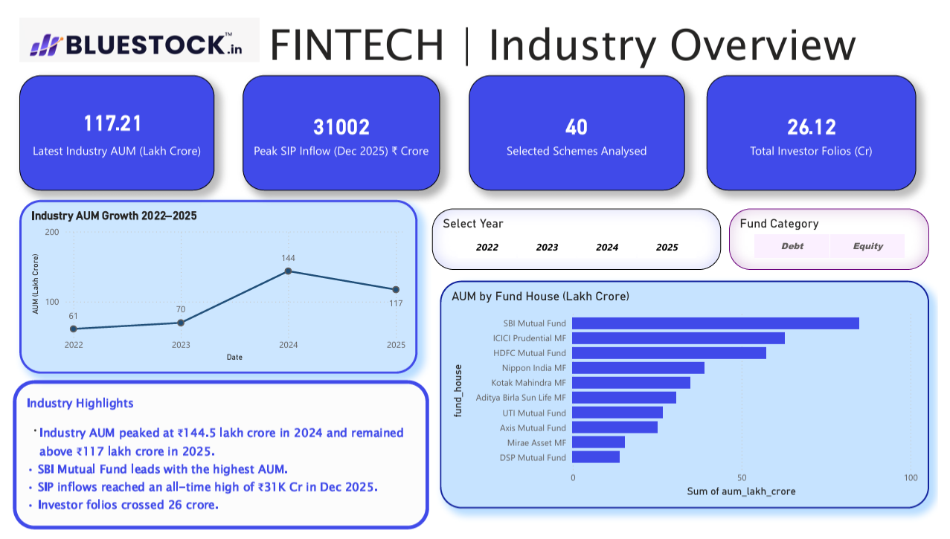
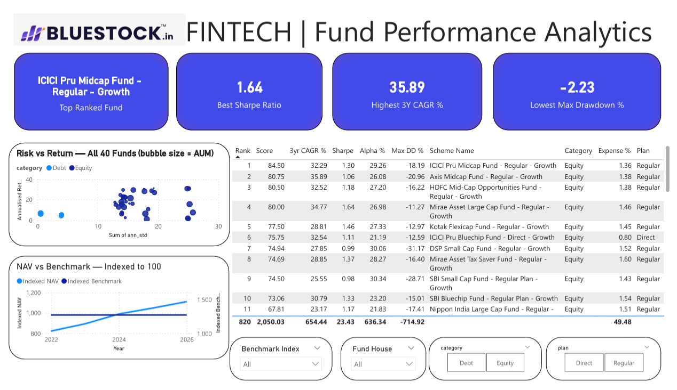
4-Page Interactive Power BI Dashboard
[ Insert Dashboard Screenshot ]
[ Insert Dashboard Screenshot ]
Page 1 — Industry Overview
Page 2 — Fund Performance
KPI cards (AUM, SIP, Folios) + AUM trend + Fund house comparison
Risk-return scatter (40 funds) + Sortable scorecard + NAV vs benchmark

Slide 10
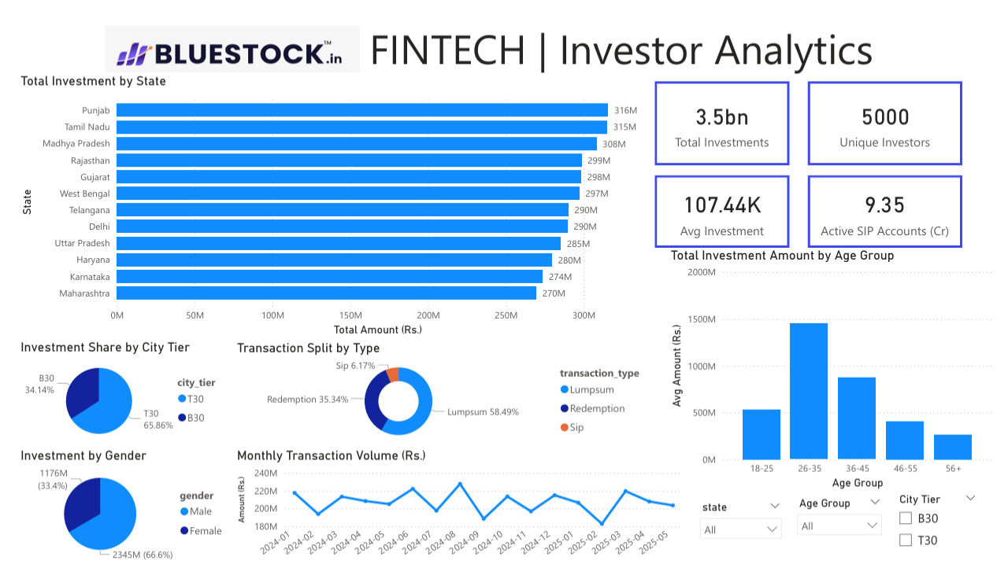
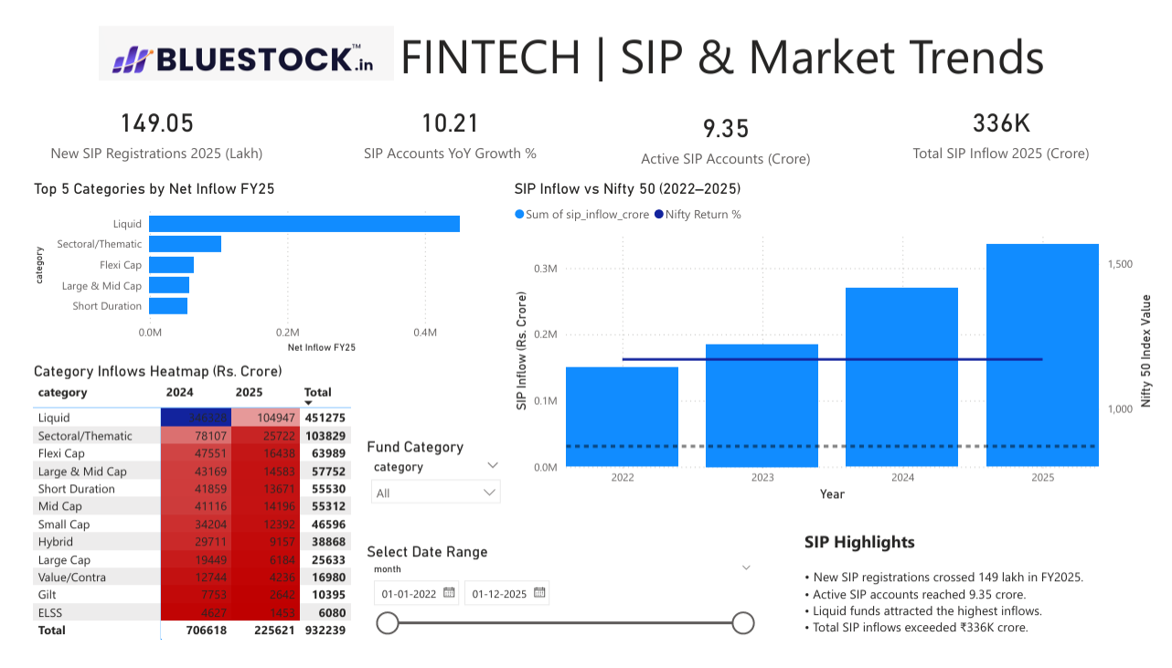
Investor Analytics & SIP Market Trends
[ Insert Dashboard Screenshot ]
[ Insert Dashboard Screenshot ]
Page 3 — Investor Analytics
Page 4 — SIP & Market Trends
State-wise investment + Transaction split + Age group analysis
SIP inflow vs Nifty 50 (dual axis) + Category inflow heatmap

Slide 11
5 Actionable Recommendations for Bluestock Fintech
R1
R2
R3
R4
R5
Direct Plan Migration
SIP Continuity Intervention
Small Cap Risk Warning
B30 City Expansion
Concentration Risk Awareness
Saves 0.7–1.0% expense annually — ₹28,000 extra on ₹1L over 10yrs
Auto-remind investors with gap > 35 days (1,362 tracked)
Map only to Very High risk appetite — max drawdown −52.57%
33.7% transactions from B30 — untapped Tier-2/3 growth
Axis Bluechip HHI 2,968 — recommend diversification
All five recommendations are derived directly from computed metrics in this project's analytics pipeline.

Slide 12
Bluestock MF Analytics Platform — Complete
87,533
15+
7
4-Page
Database Rows
Charts Created
Metrics Computed
Dashboard
Thank You
Ridham Gupta | Data Analyst Intern
Bluestock Fintech Pvt. Ltd. | June 2026
github.com/RidhamGupta1201/bluestock-mf-capstone

