Slide 1

Ridhi Guntur
SRM AP UNIVERSITY - Ap22110011467
ridhi_guntur@srmap.edu.in
Edunet Foundation - Artificial Intelligence and Machine Learning
SUMMER INTERNSHIP COURSE - 2024 ( 4th June – 25th July )

Slide 2
PROJECT TITLE: EMPLOYEE BURNOUT PREDICTION using linear regression
Problem Statement :
Employee burnout is a critical issue in the workplace, characterized by physical, emotional, and mental exhaustion caused by prolonged stress. Burnout can significantly impact employee well-being, productivity, and overall job performance. In order to mitigate these negative effects, it is crucial for organizations to proactively identify employees who are at risk of burnout.
The goal of this project is to develop a predictive model using regression techniques to estimate the burnout rate of employees based on various factors such as workload, mental fatigue, job designation, work-life balance, and other relevant features. By accurately predicting burnout, organizations can take timely interventions to promote employee well-being and maintain a healthy work environment.
1

Slide 3
AGENDA
Project Title and Problem Statement ---------------------------------------------------------------------------------------------- 1
Project Overview --------------------------------------------------------------------------------------------------------------------------------- 3
Who Are the End Users of This Project? ---------------------------------------------------------------------------------------------- 4
Solution and Value Proposition ----------------------------------------------------------------------------------------------------- 5
Customization of the Project ----------------------------------------------------------------------------------------------------- 6
Modelling ----------------------------------------------------------------------------------------------------------------------------------------------- 7
Results ----------------------------------------------------------------------------------------------------------------------------------------------- 13
Links ----------------------------------------------------------------------------------------------------------------------------------------------------- 16
2

Slide 4
PROJECT OVERVIEW
The goal of this project was to develop a predictive model to identify factors contributing to employee burnout and to accurately predict burnout levels. The dataset included various attributes such as Employee ID, Personal Information, Employment Details, and a 'Burnout' column.
Key steps in the project included:
Data Preprocessing : We handled missing values, dropping columns with high missing rates and those irrelevant to our analysis. We engineered a 'Days Worked' feature to capture the duration of employment and checked for outliers.
Encoding and Normalization : Categorical variables were transformed into numerical values using ‘LabelEncoder’, and the 'Burnout' column was normalized using Min-Max scaling to standardize the data.
Correlation Analysis : We analyzed the correlation between 'Burnout' and other key features like 'Days Worked,' 'Employee Status,' and 'Pay Zone' to identify significant predictors.
Model Development : The dataset was split into training and testing sets, and features were standardized. A linear regression model was trained and evaluated using performance metrics such as Mean Squared Error (MSE), Root Mean Squared Error (RMSE), Mean Absolute Error (MAE), and R-squared Score.
Interpretation of Results : The model exhibited high accuracy and explanatory power, providing insights into the factors influencing employee burnout. This information is valuable for organizations to take proactive measures to address burnout risks and improve employee well-being.
3

Slide 5
WHO ARE THE END USERS of this project?
The primary end users of the Employee Burnout Prediction model are:
HR Departments : Utilize predictive insights to identify employees at risk of burnout and implement targeted interventions.
Management : Gain data-driven insights into team well-being and optimize workload distribution for improved performance.
Employee Wellness Programs : Develop and tailor wellness initiatives to proactively prevent employee burnout.
Employees : Benefit from enhanced organizational practices, support mechanisms, and a healthier work environment.
Consultants : Advise organizations on improving employee well-being and productivity using data-driven strategies.
4

Slide 6
MY SOLUTION AND ITS VALUE PROPOSITION
My solution involved creating a predictive model to identify factors contributing to employee burnout. By preprocessing the data, engineering relevant features, and employing a linear regression model, I achieved highly accurate predictions of burnout levels.
The model's performance was validated using key metrics: Mean Squared Error (MSE), Root Mean Squared Error (RMSE), Mean Absolute Error (MAE), and R-squared Score. The results demonstrated the model's exceptional accuracy and explanatory power.
The value proposition of this solution lies in its ability to provide actionable insights into employee burnout, enabling organizations to proactively address burnout risks and implement targeted interventions.
By identifying critical factors influencing burnout, such as 'Days Worked,' 'Employee Status,' and 'Pay Zone,' the model empowers decision-makers to improve employee well-being and enhance overall productivity.
5

Slide 7
How did you customize the project and make it your own
I customized the project by implementing several key steps to prepare the data, engineer features, and build a predictive model. Initially, I identified and handled missing values, specifically noting that the "Termination Description" column had 1467 missing entries.
I then dropped unnecessary columns to streamline the dataset. To enhance the dataset, I created a 'Days Worked' column by calculating the difference between the current date and each employee's start date, subsequently verifying the absence of outliers through a boxplot analysis.
I further customized the project by encoding categorical variables using ‘LabelEncoder’ to convert them into numerical values, making them suitable for machine learning algorithms. I applied Min-Max scaling to normalize the 'Burnout' column, ensuring all values were within the same range.
Following this, I conducted a correlation analysis to identify key features influencing burnout, retaining significant predictors and dropping those with negligible correlations.
Finally, I split the dataset into training and testing sets, applied standard scaling, and evaluated the linear regression model using various performance metrics. This thorough customization process ensured a robust and accurate predictive model for employee burnout.
6

Slide 8
MODELLING
The dataset includes the following columns: Employee ID, FirstName, Last Name, StartDate, Title, Supervisor, AD Email, Employee Status, Employee Type, Pay Zone, Employee Classification Type, Termination Type, Termination Description, Department Type, Division, DOB, State, Job Function Description, Gender Code, Location Code, Race Desc, Marital Desc, Performance Score, Current Employee Rating and Burnout.It has a shape of (3000,25).
STEP 1 : Finding out missing values
The first step in our data preparation process involved identifying missing values in the dataset.
We used the ‘isna().sum()’ method and found that the "Termination Description" column had 1467 missing values.
STEP 2 : Dropping Unnecessary Columns
We removed columns that were not needed for our analysis using the following syntax: Emp ID, FirstName, Last
Name, Supervisor, AD Email, DOB, Location Code, Termination Type, Termination Description, State.
We used the ‘drop()’ method to remove several columns and the dataset's shape was updated to (3000, 15).
7

Slide 9
STEP 3 : Creating 'Days Worked’ column and Removing Outliers
We created a new feature, 'Days Worked', by calculating the number of days between the current date and the
'StartDate' for each employee.
After generating this feature, we removed the 'StartDate' column as it was no longer necessary.
To ensure the accuracy of the 'Days Worked' data, we used a boxplot to check for outliers. The analysis revealed no
outliers.
STEP 4 : Encoding Categorical Variables
We converted categorical variables into numerical values to prepare the dataset for machine learning algorithms. We
used ‘LabelEncoder’ from ‘sklearn.preprocessing’ to achieve this transformation.
Each categorical column was transformed into numerical values, allowing us to effectively incorporate these features
into our machine learning models.
8

Slide 10
STEP 5 : Normalizing the 'Burnout' Column
To normalize the 'Burnout' column and ensure all values are within the same range, we applied Min-Max scaling. This
process was implemented using the ’MinMaxScaler’ from ‘sklearn.preprocessing’ .First, we reshaped the 'Burnout’
data into a 2D array with ‘reshape(-1,1)’ , a necessary step for the scaler. Then, we used the ‘fit_transform’ method to
scale the data, normalizing all values in the 'Burnout' column to a range between 0 and 1. This normalization step is
crucial for improving the performance and convergence speed of many machine learning algorithms.
STEP 6 : Finding Correlation with the 'Burnout' Column
We analyzed the correlation between 'Burnout' and three important features: 'Days Worked', 'Employee Status', and
'Pay Zone'. Using the ‘corr()’ method from pandas, we found the following correlations with 'Burnout’:
Title | -0.002105
Current Employee Rating | -0.006051
Performance Score | -0.008370
RaceDesc | 0.022460
Days Worked | 0.999975
Employee Status | 0.042389
Pay Zone | 0.005124
GenderCode | -0.017346
9

Slide 11
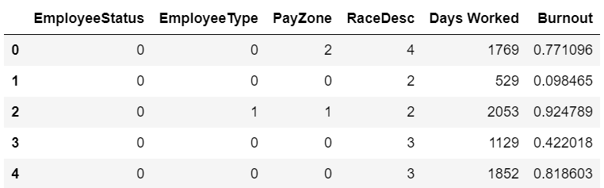
EmployeeType | 0.010323
EmployeeClassificationType | -0.038544
JobFunctionDescription | -0.002066
Division | -0.018893
DepartmentType | -0.033351
MaritalDesc | -0.001358
STEP 7 : Evaluating Feature Importance
Based on the correlation analysis, the features 'Title', 'MaritalDesc', 'JobFunctionDescription', 'Current Employee
Rating', 'Performance Score', 'GenderCode', 'Division’, 'DepartmentType’, and 'EmployeeClassificationType’ show
negligible correlation with 'Burnout’. Features with minimal correlation are not significant predictors of burnout and
can be considered for dropping to simplify the model.
After all the preprocessing of the data , the dataset looks like this:
10

Slide 12
STEP 8 : Data Splitting and Scaling
We separated the dataset into features (‘X’) and the target variable (‘y’) then split it into training and testing sets (70%
train, 30% test). We standardized the feature variables using ‘StandardScaler’ to ensure consistent scaling across both
sets.
STEP 9 : Model Evaluation - Metrics
We evaluated the linear regression model using performance metrics. To assess how well the model predicts burnout,
we computed the - Mean Squared Error (MSE) using ‘mean_squared_error(y_test, y_pred)’
- Root Mean Squared Error (RMSE) with ‘mean_squared_error(y_test, y_pred, squared=False)’
- Mean Absolute Error (MAE) was determined using ‘mean_absolute_error(y_test, y_pred)’
- R-squared Score was calculated using ‘r2_score(y_test, y_pred)’
11

Slide 13
STEP 10 : Interpretation of Results
The evaluation metrics indicate that the linear regression model performs exceptionally well. The very low MSE,
RMSE, and MAE suggest that the model's predictions are very close to the actual values. The high R-squared score
confirms that the model explains nearly all the variability in the burnout data. These results demonstrate the
effectiveness of the linear regression model for predicting employee burnout based on the provided features.
METRIC | VALUE
Mean Squared Error | 4.40 × 10⁻⁶
Root Mean Squared Error | 0.0021
Mean Absolute Error | 0.0017
R-squared Score | 0.9999
12

Slide 14
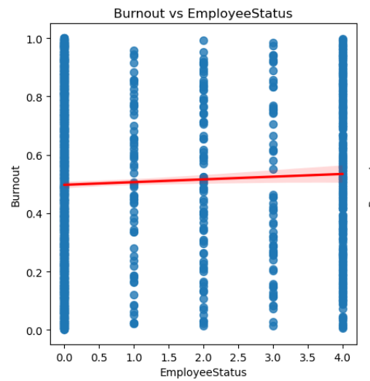
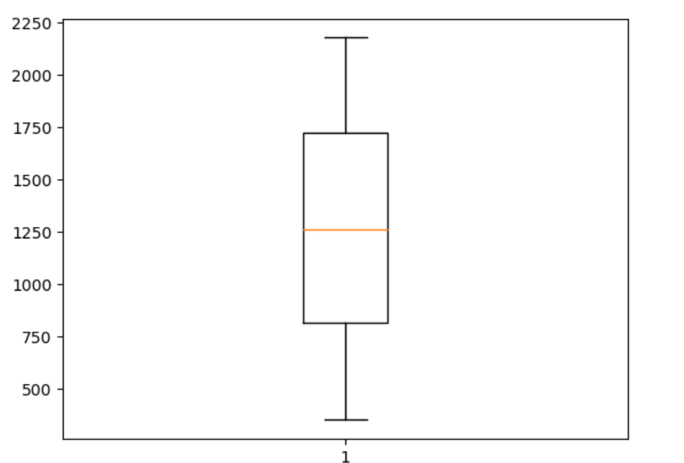
Results
Visualization of outlier detection for 'Days Worked’ using a boxplot to ensure data accuracy and integrity.
Scatter plot with regression line showing the relationship between Employee Status and Burnout.
------------------------------------------------------------------------------------
13

Slide 15
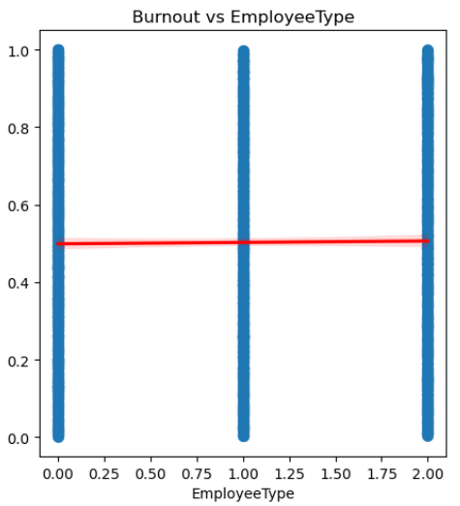
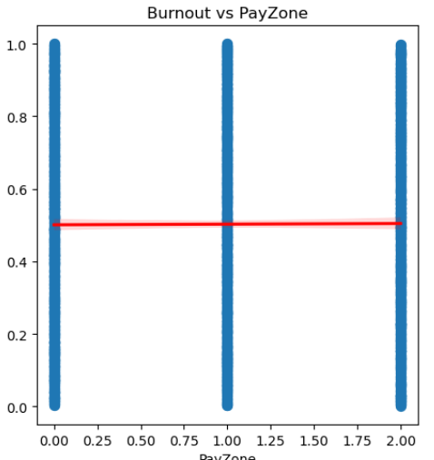
Scatter plot with regression line illustrating the correlation between Employee Type and Burnout
Scatter plot with regression line depicting the link between Pay Zone and Burnout.
------------------------------------------------------------------------------------
14

Slide 16
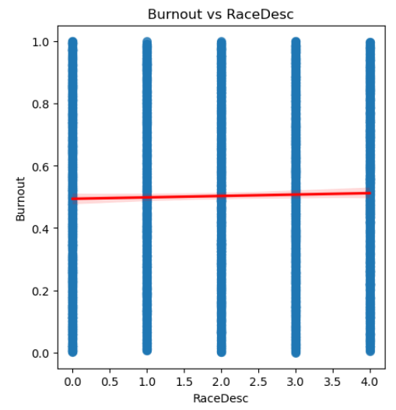
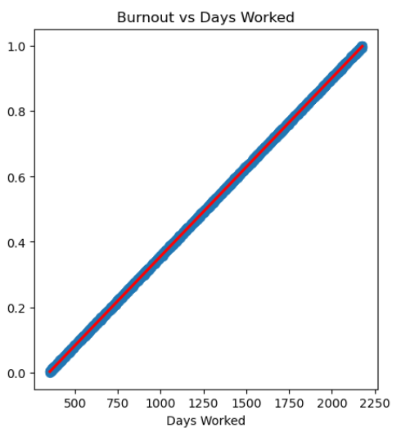
Scatter plot with regression line demonstrating the relationship between Race Description and Burnout.
Scatter plot with regression line highlighting the correlation between Days Worked and Burnout.
------------------------------------------------------------------------------------
15

Slide 17
links
Dataset : https://drive.google.com/file/d/19KavHhQLGAErD9J2WaiF7gDvRmf6ApRL/view?usp=sharing
16

