Slide 1

Solving Competitive Problems using
Data Structures
Topic: Array
By
Ravi Kant Sahu
Assistant Professor
Lovely Professional University, Punjab

Slide 2
What is an Array?
An Array is a list of a finite number (n) of homogeneous data elements such that the elements of the array are:
referenced by an index set consisting of n consecutive numbers.
stored respectively in successive memory locations.

Slide 3
Reference Variable or Pointer
arr[2]
2040
int* arr;
or
int arr [];
0 1 2 3 4
2040
new int[size];

Slide 4
Pros and Cons
++ Fast Access through indexes
-- Fixed Size

Slide 5
Linear Search
int linear_Search(int arr[], int n)
{
for(int i=0; i<n; i++)
{
if(arr[i] == key) return i;
}
return -1;
}
Worst Case Complexity: O(n)
Best Case Complexity: Ω(1)

Slide 6
Binary Search
int binary_search(int beg, int end, int key) { if(beg > end) return -1;
int mid = (beg+end)/2;
if(arr[mid] == key) return mid;
if(key < arr[mid]) return binary_search(beg, mid-1, key);
return binary_search(mid+1, end, key);
}
Worst Case Complexity: O(log n)
Best Case Complexity: Ω(1)

Slide 7
Binary Search
int binary_search(int beg, int end, int key){
while(beg <= end){
int mid = (beg + end)/2;
If(key == arr[mid]) return mid;
else if (key < arr[mid]) end = mid-1;
else beg = mid+1;
}
return -1; }

Slide 9
Search an element in a Rotated-Sorted Array
Input : arr[] = {4, 5, 6, 7, 8, 1, 2, 3}
key = 2
Output : 6

Slide 10
int search(int arr[], int beg, int end, int key) {
while (beg <= end)
{
int mid = (beg + end) /2;
if (arr[mid] == key) return mid;
if (arr[beg] <= arr[mid]) //Left portion is sorted
{
if (arr[beg] <= key && arr[mid] >= key) end = mid - 1;
else beg = mid + 1;
}
else { //Right portion is sorted
if (arr[mid] <= key && key <= arr[end]) beg = mid + 1;
else end = mid - 1;
}
}
return -1;
}

Slide 11
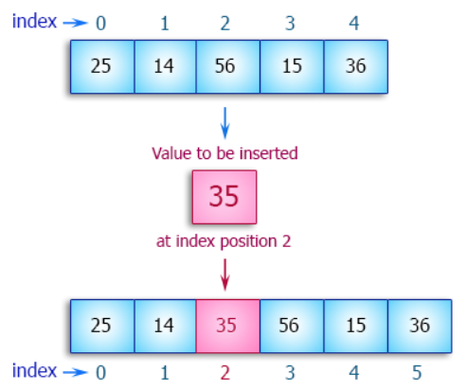
Insertion at a given index k
Requires shifting of elements to right
from last index till index k.
for(int i=n; i>k; i--) //shifting logic
for(int i=n-1; i>=k; i--) //shifting logic
Worst Case Complexity: O(n)
Best Case Complexity: Ω(1)

Slide 12
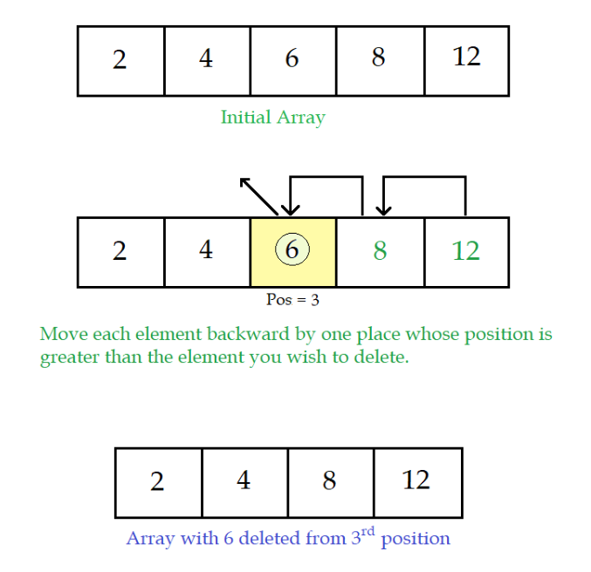
Deletion at a given index k
Requires shifting of elements to the left
from Index k till the end.
for(int i=k; i<n-1 ; i++) //shifting logic
for(int i=k+1; i<n; i++) //shifting logic
Worst Case Complexity: O(n)
Best Case Complexity: Ω(1)

Slide 13
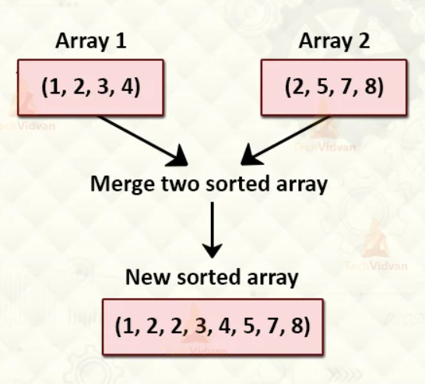
Merging of Arrays
Both the arrays must be sorted in the
same order.
Number of elements may be different in
both the arrays.
Complexity: O(m + n)
Where m and n are the number of elements in 2
arrays

Slide 15
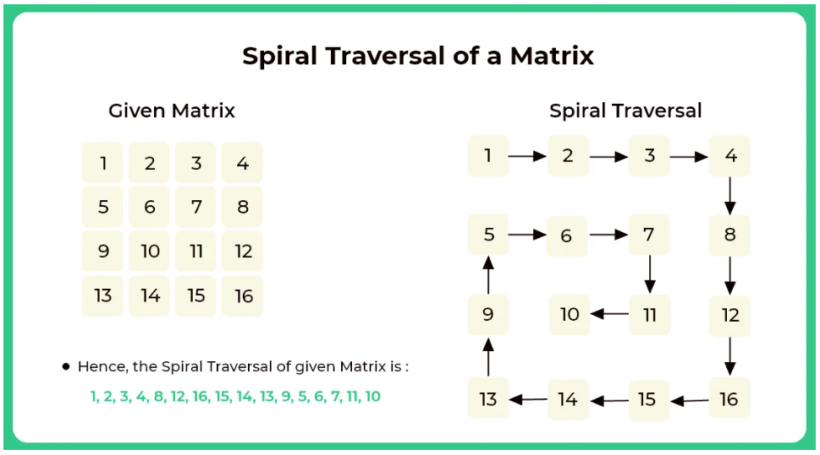

Slide 16
Sorting Algorithms
Bubble Sort
Selection Sort
Insertion Sort

Slide 18
Which of the following operation in an unsorted array with n elements requires minimum time in Worst Case?
A. Finding the Largest element
B. Inserting in the beginning of Array
C. Deleting the Last element of Array
D. Both B and C

Slide 19
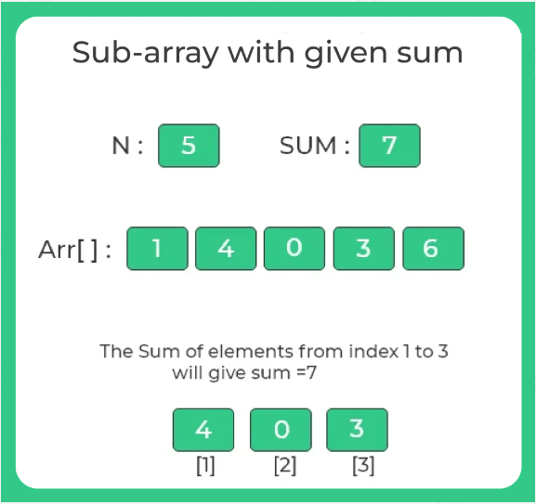
Sub-array with Given Sum

Slide 20
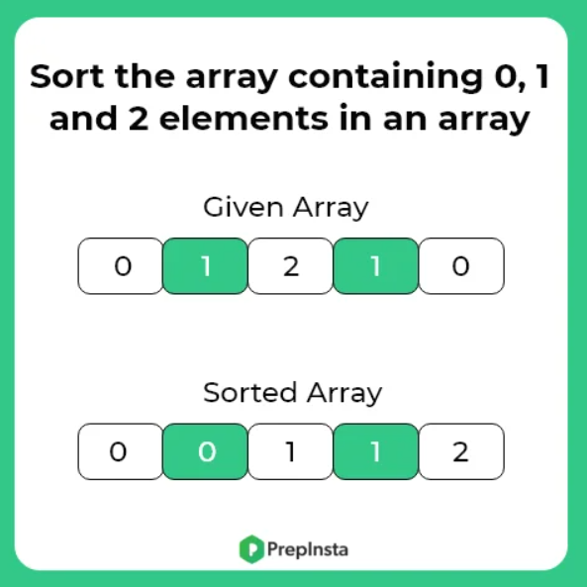

Slide 21
Sorting Algorithms (Divide & Conquer)
Quick Sort
Merge Sort

Slide 22
Quick Sort

Slide 23
Merge Sort

