Slide 1
K-NN
Supervised algorithm

Slide 2
K-Nearest Neighbor is one of the simplest Machine Learning algorithms based on Supervised Learning technique.
K-NN algorithm assumes the similarity between the new case/data and available cases and put the new case into the category that is most similar to the available categories.
K-NN algorithm stores all the available data and classifies a new data point based on the similarity. This means when new data appears then it can be easily classified into a well suite category by using K- NN algorithm.

Slide 3
K-NN is a non-parametric algorithm, which means it does not make any assumption on underlying data.
It is also called a lazy learner algorithm because it does not learn from the training set immediately instead it stores the dataset and at the time of classification, it performs an action on the dataset.

Slide 4
How does K-NN work?
The K-NN working can be explained on the basis of the below algorithm:
Step-1: Select the number K of the neighbors
Step-2: Calculate the Euclidean distance of K number of neighbors
Step-3: Take the K nearest neighbors as per the calculated Euclidean distance.
Step-4: Among these k neighbors, count the number of the data points in each category.
Step-5: Assign the new data points to that category for which the number of the neighbor is maximum.
Step-6: model is ready.

Slide 5
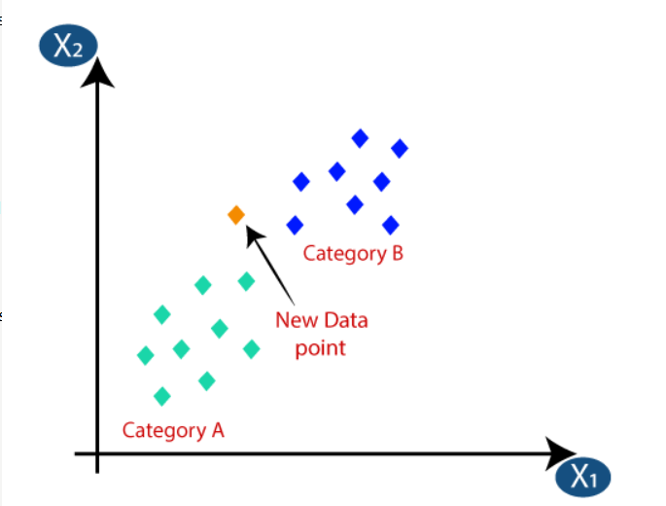
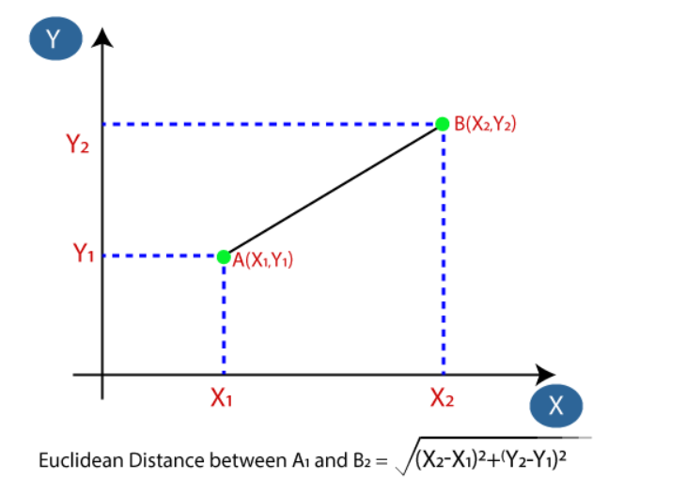
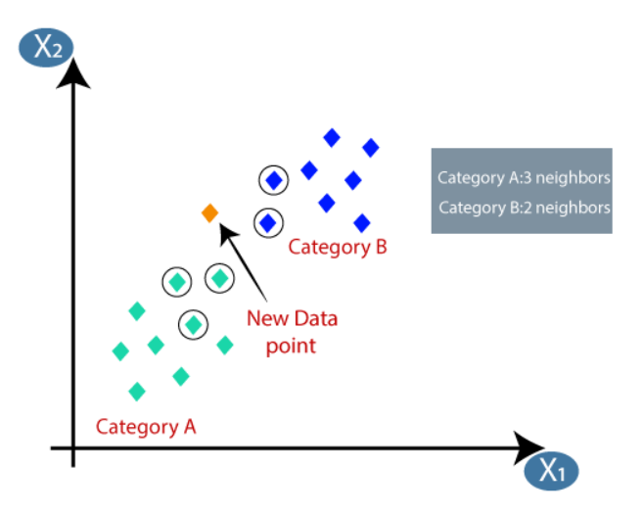

Slide 6
Advantages of KNN Algorithm:
It is simple to implement.
It is robust to the noisy training data
It can be more effective if the training data is large.

Slide 7
Disadvantages of KNN Algorithm:
Always needs to determine the value of K which may be complex some time.
The computation cost is high because of calculating the distance between the data points for all the training samples.

Slide 8
Step 1 – collecting data
The breast cancer data includes 569 examples of cancer biopsies, each with 32 features. One feature is an identification number, another is the cancer diagnosis, and 30 are numeric-valued laboratory measurements. The diagnosis is coded as "M" to indicate malignant or "B" to indicate benign. The other 30 numeric measurements comprise the mean, standard error, and worst (that is, largest) value for 10 different characteristics of the digitized cell nuclei.
These include:
• Radius
• Texture
• Perimeter
• Area
• Smoothness
• Compactness
• Concavity
• Concave points
• Symmetry
• Fractal dimension

Slide 9
Step 2 – exploring and preparing the data
wbcd <- read.csv("wisc_bc_data.csv", stringsAsFactors = FALSE)
wbcd <- wbcd[-1]
table(wbcd$diagnosis)
wbcd$diagnosis<- factor(wbcd$diagnosis, levels = c("B", "M"), labels = c("Benign", "Malignant")
round(prop.table(table(wbcd$diagnosis)) * 100, digits = 1)
summary(wbcd[c("radius_mean", "area_mean", "smoothness_mean")])

Slide 10
Transformation – normalizing numeric data
normalize <- function(x) { return ((x - min(x)) / (max(x) - min(x))) }
normalize(c(1, 2, 3, 4, 5))
normalize(c(10, 20, 30, 40, 50))
wbcd_n <- as.data.frame(lapply(wbcd[2:31], normalize))
summary(wbcd_n$area_mean)

Slide 11
Data preparation – creating training and test datasets
Split dataset into 2parts:
> wbcd_train <- wbcd_n[1:469, ]
> wbcd_test <- wbcd_n[470:569, ]
For training the k-NN model, we will need to store these class labels in factor vectors, split between the training and test datasets:
> wbcd_train_labels <- wbcd[1:469, 1]
> wbcd_test_labels <- wbcd[470:569, 1]

Slide 12
Step 3 – training a model on the data
classify our unknown records.
For the k-NN algorithm, the training phase actually involves no model building; the process of training a lazy learner like k-NN simply involves storing the input data in a structured format. To classify our test instances, we will use a k-NN implementation from the class package, which provides a set of basic R functions for classification.
install.packages("class")

Slide 13
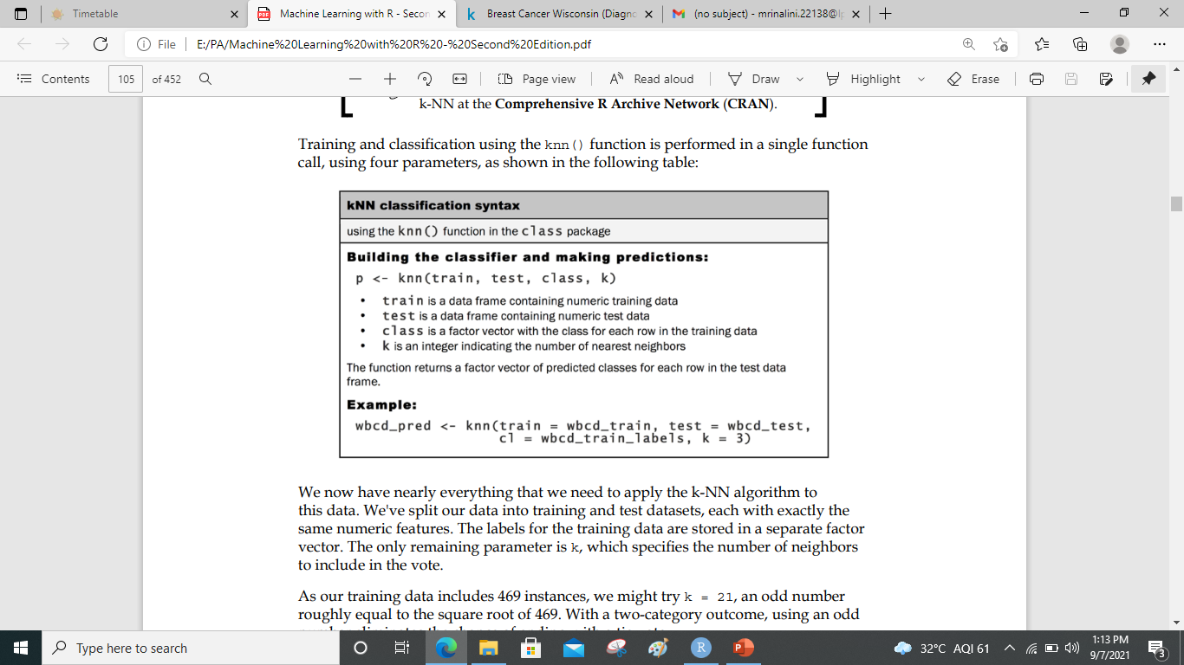
wbcd_test_pred <- knn(train = wbcd_train, test = wbcd_test, cl = wbcd_train_labels, k = 21)
wbcd_test_pred <- knn(train = wbcd_train, test = wbcd_test, cl = wbcd_train_labels, k = 21)

Slide 14
Step 4 – evaluating model performance
CrossTable(x = wbcd_test_labels, y = wbcd_test_pred, prop.chisq=FALSE)

Slide 15
Step 5 – improving model performance
Transformation – z-score standardization
wbcd_z <- as.data.frame(scale(wbcd[-1]))
summary(wbcd_z$area_mean)
wbcd_train <- wbcd_z[1:469, ]
wbcd_test <- wbcd_z[470:569, ]
wbcd_train_labels <- wbcd[1:469, 1]
wbcd_test_labels <- wbcd[470:569, 1
wbcd_test_pred <- knn(train = wbcd_train, test = wbcd_test, cl = wbcd_train_labels, k = 21)
CrossTable(x = wbcd_test_labels, y = wbcd_test_pred, prop.chisq = FALSE)

Slide 16
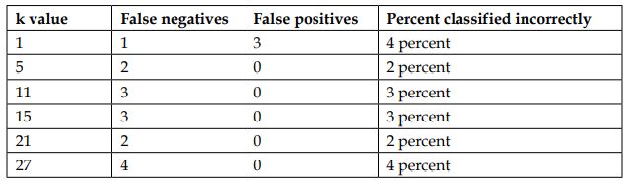
Testing alternative values of k
Using the normalized training and test datasets, the same 100 records were classified using several different k values. The number of false negatives and false positives are shown for each iteration:

Slide 17
kNN Algorithm – Pros and Cons
Pros:
The algorithm is highly unbiased in nature and makes no prior assumption of the underlying data.
Being simple and effective in nature, it is easy to implement and has gained good popularity.
Cons:
If we take a deeper look, this doesn’t create a model since there’s no abstraction process involved.
Yes, the training process is really fast as the data is stored verbatim (hence lazy learner) but the prediction time is pretty high with useful insights missing at times.
Therefore, building this algorithm requires time to be invested in data preparation (especially treating the missing data and categorical features) to obtain a robust model.

Slide 18
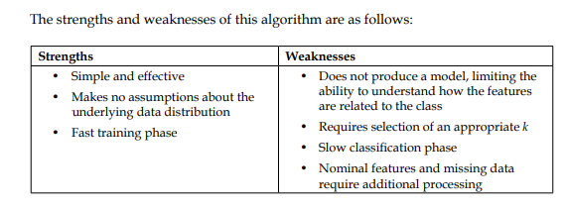
Cont…

Slide 19
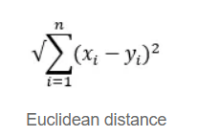
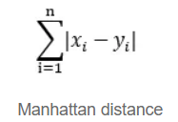
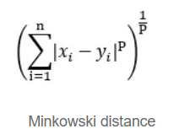
Distance Metrics — Measuring Data Point Proximity
Euclidean distance is the most widely used metric, calculating the straight-line distance between two points in a multidimensional space.
Manhattan distance measures the sum of the absolute differences between the coordinates of two points, often used in grid-based systems.
Minkowski distance is a generalized metric that includes both Euclidean and Manhattan distances as special cases.

Slide 20
Defining k — Determining the Number of Neighbors
Cross-Validation: Utilize techniques like cross-validation to test different k values and select the one that maximizes the model’s performance. This helps ensure that the chosen k generalizes well to unseen data.
Elbow Method: Plot the error rate or accuracy against various k values and identify the point of diminishing returns, often referred to as the “elbow.” This can help pinpoint a suitable k value.
Domain Knowledge: Consider the context of your problem and domain expertise. Depending on the specific task and dataset, certain k values may align better with the inherent patterns in the data.
Square Root of N rule: This rule offers a quick and practical way to determine an initial k value for your KNN model, especially when no other domain-specific knowledge or optimization techniques are readily available. The rule suggests setting k to the square root of N. Here, N represents the total number of data points in the dataset.

Slide 21
Summary
Unlike many classification algorithms, k-NN does not do any learning.
It simply stores the training data.
Unlabeled test examples are then matched to the most similar records in the training set using a distance function, and the unlabeled example is assigned the label of its neighbors.
In spite of the fact that k-NN is a very simple algorithm, it is capable of tackling extremely complex tasks, such as the identification of cancerous masses.

