Slide 1
Coursera Introduction to Front End Development
Name: Ridhimaa Sinha
Batch: D2
Roll no. : 48
F.Y. B.TECH.
Course Module: 1
Guided By-
Manisha Ma’am

Slide 2
INDEX
The Internet
Web Server
How to Prevent Web Server Failures?
Websites and Webpages
Web Browser and Web Hosting
Introduction to Protocols
Introduction to HTML, CSS and JS

Slide 3

HOW THE INTERNET WORKS?
1. The Internet is a vast network connecting millions of devices worldwide.
2. A network switch helps devices communicate efficiently, like a group chat for friends.
3. When you visit a website or watch a video, your device sends a request to a server.
4. The server acts like a library, storing and providing information when requested.
5. This communication between devices and servers makes the Internet fast and powerful.

Slide 4
WHAT IS A WEB SERVER?
A “web server” stores and delivers web pages to users.
It handles requests from web browsers and sends the correct content.
Web servers can serve “static” (fixed) or “dynamic” (interactive) web pages.
Examples include Apache, Nginx, and Microsoft IIS.
HOW DOES A WEB SERVER RESPOND TO A REQUEST?
The user enters a website URL, and the browser sends a request to the web server.
The DNS system translates the website name into an IP address.
The web server processes the request and retrieves the required files or data.
The server sends the response back, and the browser displays the webpage.

Slide 5

HOW TO PREVENT SERVER FAILURES?
1. Use load balancing to distribute traffic across multiple servers.
2. Enable server monitoring to detect and fix issues early.
3. Have backup servers to take over if the main server fails.
4. Regular maintenance and security updates help prevent crashes.

Slide 6
WEBSITES AND WEBPAGES
WEBSITE
1. A website is a collection of related web pages under a single domain name.
2. Websites can be static (fixed content) or dynamic (interactive, like social media).
3. They are accessed using a web browser (e.g., Chrome, Firefox).
4. Websites can be personal, business-related, educational, or entertainment-based.
5. Example: www.amazon.com(an e-commerce website for shopping).
WEBPAGE
1. A webpage is a single document within a website, displayed in a browser.
2. Each webpage has a unique URL (web address) that allows users to access it.
3. It can contain text, images, videos, links, and interactive elements.
4. Webpages are built using HTML, CSS, and JavaScript.
5. Example: www.amazon.com/deals (a specific webpage showing Amazon’s deals).

Slide 7
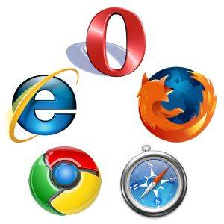
WEB BROWSER AND WEB HOSTING
WEB BROWSER
1. A web browser is a software application used to access websites and webpages.
2. It fetches and displays content from the Internet using HTTP/HTTPS protocols.
3. Browsers can display text, images, videos, and interactive elements from websites.
4. Example: When you type www.google.com in Chrome, the browser fetches and displays
Google’s homepage.
WEB HOSTING
1. Web hosting is a service that stores website files and makes them accessible on the Internet.
2. Websites are hosted on servers, which are powerful computers connected to the Internet.
3. Hosting services can be shared, VPS, dedicated, or cloud-based depending on needs.
4. Popular web hosting providers include Bluehost, Hostinger, and AWS.
5. Example: A business website like www.example.com is hosted on a server to be available
online 24/7.

Slide 8
INTRODUCTION TO PROTOCOLS
What Are Internet Protocols?
They are rules that allow computers and devices to communicate over the internet.
Types of Internet Protocols:
- HTTP/HTTPS – Used for accessing websites.
- TCP/IP – Ensures reliable data transmission.
- DNS – Translates website names (like google.com) into IP addresses.
IP Addresses and Domain Names:
- Each device on the internet has a unique IP address.
Domain names (like facebook.com) are easier to remember than IP addresses.
Security Considerations:
- HTTPS (Hypertext Transfer Protocol Secure) encrypts data for secure communication.
- Firewalls and encryption help protect data from cyber threats.

Slide 9
INTRODUCTION TO PROTOCOLS
HTTP (HyperText Transfer Protocol)
HTTP is a protocol used for transferring data between a web browser and a web server.
It allows users to access websites and webpages over the Internet.
HTTP is not secure, meaning data is sent in plain text and can be intercepted.
Websites using HTTP start with "http://" (e.g., http://example.com).
It is mostly replaced by HTTPS for better security.
HTTPS (HyperText Transfer Protocol Secure)
HTTPS is a secure version of HTTP that encrypts data for safe communication.
It uses SSL/TLS encryption to protect sensitive information like passwords and payments.
Websites using HTTPS have a padlock symbol in the address bar.
URLs using HTTPS start with "https://" (e.g., https://example.com).
HTTPS is essential for e-commerce, banking, and secure data transfer.

Slide 10
Introduction to HTML, CSS and JS
HTML (Hypertext Markup Language)
1. HTML is the standard language used to create the structure of webpages.
2. It uses tags (like ‘<h1>’, ‘<p>’, ‘<img>’) to define headings, paragraphs, images, and other elements.
3. HTML provides the skeleton of a webpage, setting up the content and structure.
4. Example: ‘<h1>Hello World!</h1>’ creates a main heading on a page.
CSS (Cascading Style Sheets)
1. CSS is used to style and design the layout of webpages.
2. It controls colors, fonts, spacing, and the overall appearance of HTML elements.
3. CSS helps make a webpage look visually appealing by separating content (HTML) from design.
4. Example: ‘ color: blue ’ changes the text color to blue.

Slide 11
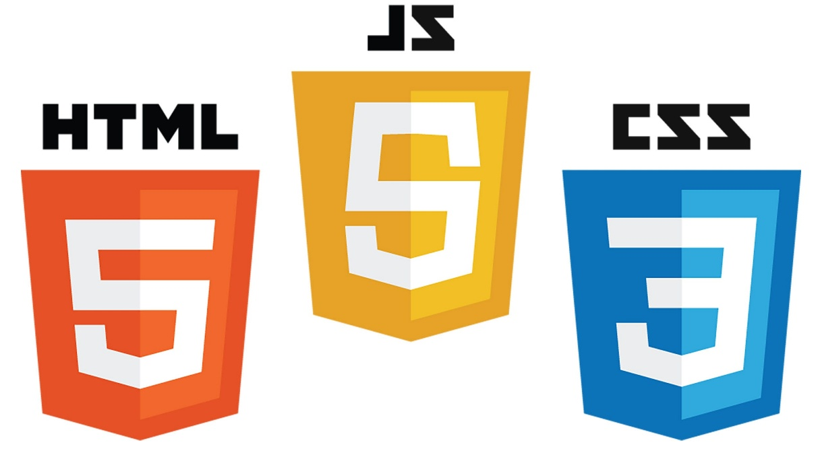
Introduction to HTML, CSS and JS
JavaScript
1. JavaScript is a programming language that adds interactivity to webpages.
2. It allows you to create dynamic features like animations, forms, and games.
3. JavaScript can interact with HTML and CSS to make webpages responsive to user actions.
4. Example: ‘ alert('Hello!'); ’ displays a pop-up message on the webpage.

