Slide 1
Estimating Atrial Ectopy Burden from Smartwatch Beat Intervals: A Two-Scale Spatio-Temporal Graph Neural Network and Its Feasibility in Post-Stroke Survivors
Proposal Defence
Ridhwan Amin
Matric No.: 25118475
Supervisors
Doctor of Philosophy (by Research) · Faculty of Computer Science and Information Technology
Dr. Bryan Raj A/L Peter Jabaraj
Universiti Malaya
Associate Prof. Ts. Dr. Ismail Bin Ahmedy
Notes:
About 30 seconds. Name, programme, supervisors. One line on the thesis: a smartwatch already worn after discharge could give the ectopy measure that currently needs a Holter, if we can estimate it honestly from beat intervals and know when not to report it.

Slide 2
Background: Atrial Ectopy and the Monitoring Decision
Excessive supraventricular ectopic activity (ESVEA) is an atrium producing too many premature beats. It is usually symptomless, but it marks a remodelled atrium.
25.3%
3.3%
18.5% vs 5.9%
ESVEA after acute ischaemic stroke (≥48 h Holter)
AF detected on the same Holter
New AF by 24 months, with vs without ESVEA (Haeusler et al., 2025)
Defined as ≥30 supraventricular ectopic complexes per hour or any run of ≥20 (Binici et al., 2010); stroke cohorts also use ≥480 supraventricular beats per day or runs of 10 to 29 s (Haeusler et al., 2025).
Predicts AF after ischaemic stroke, pooled HR 2.91 across 20 studies (Yang et al., 2022), and stroke beyond AF, HR 1.96 when censored at AF (Larsen et al., 2015).
Finding AF changes treatment: anticoagulation lowers ischaemic stroke in device-detected AF (RR 0.68) at the cost of more major bleeding (RR 1.62) (McIntyre et al., 2024); the absolute benefit is larger after prior stroke or TIA (Shoamanesh et al., 2025).
Ectopy is therefore measurable in far more patients than AF, and before AF is documented.
2
Notes:
About 1.5 minutes. The clinical decision: after stroke, finding AF moves the patient from antiplatelet to anticoagulant. ESVEA is far more common than AF on the same Holter and predicts later AF, so it is used to decide who gets prolonged monitoring. Definition note: Binici used supraventricular ectopic complexes per hour; MonDAFIS used beats per day. We match the definition before any comparison. MonDAFIS figures are from the intervention arm with at least 48 hours of analysable Holter in the first 72 hours.

Slide 3
Background: Monitoring Capacity and the Smartwatch
Prolonged monitoring finds more AF but is a limited resource, so it must be allocated.
Duration drives yield: AF in 5.1% with ≤72 h, 15% with ≥7 days and 29.15% with 3 months (Dussault et al., 2015); implantable monitors reach 34% beyond 24 months (Tsivgoulis et al., 2019).
Ectopy as selector: 90-day AF probability rises from <9% with <100 atrial premature beats per 24 h to 40% beyond 1,500 (Gladstone et al., 2015); pooled OR 4.16 across 12 stroke studies (Tao et al., 2021).
Clinical scores as the alternative: no monitoring needed, but AUROC 0.54 to 0.94 across cohorts (Kishore et al., 2022), and no model excellent on external validation (Helbitz et al., 2025).
One ECG day is not enough: first-day sensitivity for ESVEA was 44.6% against 14-day telemetry (Måneheim et al., 2023).
The smartwatch: AF detection pooled sensitivity 95%, specificity 97% across 26 studies (Barrera et al., 2025), but coverage is partial: worn on 21.2 of 30 days after stroke (Ding et al., 2023); 22.3% of PPG minutes unusable vs 1.3% of ECG (Gruwez et al., 2021).
A smartwatch worn after discharge could observe ectopy repeatedly, without consuming Holter capacity.
3
Notes:
About 1.5 minutes. Longer monitoring finds more AF, so capacity is the constraint. Two ways to allocate it: ectopy from Holter, which consumes the same capacity, or clinical scores, which are unstable across cohorts. And one day of ECG misses more than half of patients who show ESVEA on some day. The smartwatch is already good at AF windows; the open question is ectopy and coverage. Gladstone probabilities are for 90-day detection. Helbitz: three models were excellent in pooled analysis, but none when limited to external validation.

Slide 4
Problem Statement
Atrial ectopy burden is among the strongest selectors for prolonged monitoring after stroke, but every threshold was derived on Holter ECG, the resource the selection rations; newer scores still take PACs from a single Holter, while scores that need no monitoring rank patients inconsistently (Gladstone et al., 2015; Haeusler et al., 2025; Maille et al., 2026; Helbitz et al., 2025).
Smartwatch beat intervals carry ectopy, yet performance is reported only as window classification; the error of a daily ectopic-beat count, and the loss when morphology is removed and flagged beats are discarded, have not been quantified (Mittal et al., 2021; Han et al., 2026).
Observation is informative, not random: analysable PPG is concentrated at night, while PACs peak in the afternoon and rise with activity; models usually delete missing data rather than model it, so a naive estimate under-counts ectopy, most in high-burden patients (Merschel & Reinhardt, 2022; Larsen et al., 2016; Johnson et al., 2021; Nijman et al., 2022).
Consequently, a smartwatch-derived ectopy value cannot currently be compared with ECG-derived thresholds or used to select post-stroke survivors for prolonged monitoring.
As such, this study attempts to quantify the information lost from PPG waveform to filtered beat intervals, develop a two-scale ST-GNN that estimates the ectopy rate using quality flags and unobserved time as input, and evaluate its deployability and selection value in post-stroke survivors.
4
Notes:
About 1.5 minutes. Three linked problems: the measure is Holter-bound; wearable evidence stops at window classification; and the missing time is not random. The third point is new and comes from combining two literatures: Merschel and Reinhardt found analysable smartwatch PPG above 94% between midnight and 6 AM, and Larsen found PACs in frequent-PAC subjects lowest around 6 AM and peaking around 3 PM. So the clean hours are the low-PAC hours. Scaling a rate from analysable time to 24 hours will under-count. That is the core reason RO2 treats the quality flag and unobserved time as inputs. Pause on the consequence box: this is the thesis in one sentence.

Slide 5
Aim, Research Questions and Objectives
Aim: to establish whether smartwatch beat intervals, analysed with an estimator that models signal quality and unobserved time, can yield a daily atrial ectopy estimate accurate and complete enough to compare with ECG-derived ESVEA thresholds after stroke.
RQ1: How much ectopy information is lost when a PPG waveform is reduced to a quality-filtered beat-interval series?
RQ2: Can a two-scale beat-interval ST-GNN that uses per-beat quality flags as input estimate atrial ectopy rate more accurately than sequence-based baselines?
RO1: To quantify the cost of reducing a PPG waveform to a filtered beat-interval series, separating the loss from absent pulse morphology from the loss due to interval-level beat rejection.
RO2: To develop and evaluate a two-scale beat-interval ST-GNN (beat-graph and epoch-graph) that estimates atrial ectopy rate from interval sequences and their quality flags.
RQ3: Can a 7-day smartwatch protocol in post-stroke survivors yield enough analysable and stable data to compute a per-day ESVEA classification?
RQ4: Does substituting a smartwatch-derived ectopy estimate for the ECG-derived count change ESVEA classification, and how do wearable-based selections compare with clinical risk scores?
RO3: To determine the analysable data yield, threshold computability and within-subject stability of a 7-day smartwatch protocol in post-stroke survivors against pre-specified progression criteria.
RO4: To determine (a) the reclassification of ESVEA status when ECG-derived counts are replaced by estimates from simulated smartwatch intervals, and (b) the agreement and composition of wearable-based versus score-based selections.
H1 filtering removes PAC intervals at a higher rate than normal ones · H2 the ST-GNN beats the best non-graph baseline on daily-count error · H3 at least 75% of participants yield 3 valid days (null 50% or below) · RQ4 is descriptive
5
Notes:
About 1.5 minutes. Walk the chain: RO1 measures what is lost, RO2 builds the estimator that uses the quality flag instead of deleting it, RO3 tests whether the protocol works in the real population, RO4 asks whether it changes clinical classification. Note that RO4 is now split: 4a is a retrospective substitution test on Icentia11k where ECG truth exists; 4b is descriptive agreement in the cohort. This removes the earlier net reclassification improvement, which needs an outcome we do not collect.

Slide 6
Scope and Significance
Dimension | Within scope | Outside scope
Clinical question | Selecting post-stroke survivors for prolonged rhythm monitoring | Predicting recurrence; deciding anticoagulation
Measured quantity | Atrial ectopy rate per day (the ESVEA-defining quantity) | Continuous AF burden
Signal | Beat intervals and per-beat quality flags from a consumer smartwatch | Raw PPG waveform; on-device ECG
Population | Adults after ischaemic stroke or TIA, no known AF, after discharge | Acute in-hospital monitoring; screening
Reference standard | ECG beat labels in Icentia11k (RO1, RO2, RO4a); published cohort thresholds | Concurrent Holter alongside the watch
Clinical
Methodological
Measurement
Deployment
Selection without consuming Holter capacity
Quality flag as evidence, not a deletion rule
First error profile for a smartwatch daily ectopy count
A coverage gate that states when not to report
No concurrent ECG is recorded in the cohort: a design boundary, not a limitation deferred. Substitution is tested where ECG truth exists (RO4a, by simulation).
6
Notes:
About 1 minute. Scope and significance merged for time. Stress the reference-standard row: ECG truth is used where it exists, in Icentia11k, for RO1, RO2 and RO4a. The cohort has no concurrent ECG by design; that is stated up front, and RO4a is how the substitution question is still answered. National relevance, if asked: prolonged monitoring capacity in Malaysia sits mainly in tertiary centres, so a wearable triage step fits local practice.

Slide 7
Literature Review: Selecting Patients for Monitoring
Table 1: Holter-derived ectopy versus clinical risk scores (full tables in Appendix A)
Author (Year) | Cohort / Design | Key findings | Limitation for this study
Gladstone et al. (2015) | EMBRACE; 237 cryptogenic stroke/TIA; 30-day monitor | Atrial premature beats the only significant AF predictor at 30 days; median 629 vs 45 per 24 h | Single 24-h Holter
Shimada et al. (2024) | 381 cryptogenic stroke; implantable monitor; 8 centres | AF 15.5%, 44.0%, 71.4% per year by PAC group; adjusted HR 3.23 for >500/24 h | Ectopy from one Holter
Haeusler et al. (2025) | MonDAFIS; 1,435 acute ischaemic stroke | ESVEA 25.3% vs AF 3.3%; AF at 24 months 18.5% vs 5.9% | In-hospital Holter only
Maille et al. (2026) | PAVA score; 1,002 cryptogenic stroke; loop recorder | PAC >200/24 h scores 2 points; c-index 0.79 in validation | Holter-derived; internal validation only
Mele et al. (2025) | 194 cryptogenic stroke/TIA; loop recorder; 9 scores | Accuracy 45.4 to 66.3%; best AUROC 0.697; no score adequate | Single centre
Helbitz et al. (2025) | Meta-analysis; 75 studies; 58 models | 66% high risk of bias; none excellent on external validation | No clinical impact studies
7
Notes:
About 1.5 minutes. The pattern: ectopy predicts AF consistently, but every ectopy measure comes from a single Holter. The newest score, PAVA (Maille et al., 2026), includes a PAC term and validates well internally, which strengthens the case for ectopy, but it still needs a Holter. Clinical-only scores vary between cohorts: Palaiodimou found C2HEST best at 0.770, Mele found Brown ESUS-AF best at 0.697 and concluded none is adequate. Full Tables 1 and 2 are in the appendix.

Slide 8
Literature Review: Wearable Ectopy and Coverage
Table 2: Ectopy from beat intervals, and when a smartwatch can see it (full tables in Appendix A)
Author (Year) | Data / Design | Key findings | Limitation for this study
Mittal et al. (2021) | 425 loop-recorder patients; 1,483 AF episodes adjudicated | PACs the most common cause of false AF; device PPV 53.9% | Subcutaneous ECG, not PPG
Han et al. (2026) | Pulsewatch; 106 subjects (72 post-stroke, 14 days); Bi-GRU | PAC/PVC sensitivity 83%; AF accuracy 97.31% | PAC and PVC merged; 30-s windows
Vargova et al. (2026) | Two inter-beat-interval features; trained on PPG simulated from ECG RR | Beat-level PAC vs PVC, F1 0.76 on real PPG | Beat class, not a daily count; abstract
Ding et al. (2023) | Pulsewatch RCT; 120 stroke survivors aged ≥50 | Watch worn on 21.2 of 30 days; usability 65/100 | Days worn, not analysable hours
Merschel & Reinhardt (2022) | 41 adults; 24-h smartwatch PPG | 71.5% analysable; above 94% midnight to 6 AM; r = −0.64 with activity | Healthy adults
Larsen et al. (2016) | 638 adults; Copenhagen Holter Study | Frequent PACs lowest about 6 AM, peak about 3 PM | Holter, not wearable
PPG burden has been validated against ECG for AF only (Zuo et al., 2026); no study reports a smartwatch-derived daily PAC count.
8
Notes:
About 1.5 minutes. Three points. First, beat intervals carry ectopy: PACs are the main source of false AF alarms. Second, the best wearable work classifies 30-second windows with PAC and PVC merged; Vargova and colleagues (CinC 2026, accepted abstract) show beat-level PAC versus PVC from intervals alone is possible, trained on simulated PPG, which is the closest comparator to our design. Third, the bottom two rows together: analysable smartwatch time is concentrated at night, PACs in the afternoon. That pairing is the informative-missingness argument. If asked about Han: the 106 subjects are 72 post-stroke participants over 14 days plus 34 from an AF trial.

Slide 9
Summary of Research Gaps
Gap | What the literature establishes | What remains unaddressed | Addressed by
1. Measurement | Beat intervals carry ectopy; window-level PAC/PVC sensitivity 83 to 94% (Han et al., 2026; Bhurane et al., 2026) | The error of a derived daily ectopic-beat count, and the loss caused by quality filtering | RO1, RO2
2. Delivery | Wear and PPG quality are partial and night-weighted (Ding et al., 2023; Merschel & Reinhardt, 2022) | Whether a 7-day protocol supplies a per-day estimate with enough coverage and stability after stroke | RO3
3. Method | Beat models assume complete, trusted sequences (Hu et al., 2022; Kraft et al., 2026); missing data are usually deleted (Nijman et al., 2022) | An architecture that treats the per-beat quality flag and unobserved time as inputs to a count | RO2
4. Utility | Scores discriminate inconsistently (Kishore et al., 2022; Helbitz et al., 2025); ectopy terms remain Holter-based (Maille et al., 2026) | How often a wearable estimate reclassifies ESVEA under realistic device losses, and how its selections compare with scores | RO4
Searches of PubMed, Consensus and Wiley Scholar Gateway (October 2026) found no smartwatch or PPG daily PAC count validated against ECG, and no graph neural network applied to PPG or inter-beat-interval series for arrhythmia.
9
Notes:
About 1 minute. One gap per objective. Gap 4 is reworded: the question is no longer whether the wearable term can replace the Holter term in a score, but how often it reclassifies ESVEA under realistic losses, which RO4a can answer with ECG truth. The footnote is the defence against a novelty challenge: state the date and databases searched. Bhurane et al. is a conference paper and did not report whether testing was subject-independent, so do not compare its 93.96% directly with Han.

Slide 10
Closest Prior Work and What This Study Adds
Study | What it does | What remains | What this study adds
Han et al. (2026) | Bi-GRU on Pulsewatch PPG, accelerometer, heart rate; PAC/PVC sensitivity 83% per 30-s window | PACs and PVCs merged; windows, not counts; unobserved time ignored | Daily PAC count with an error profile; unobserved time as input
Chen et al. (2024) | DenseNet on Pulsewatch spectrograms, subject-independent testing | PAC/PVC sensitivity 0.664, falling to 0.143 and 0.373 externally | Counting evaluated across burden, with quality-aware retention
Bhurane et al. (2026) | On-device network on Pulsewatch PPG; accuracy 98.0% | Abstract only; window classification | Count-level validation against ECG truth
Schoels et al. (2025) | HRV from 1 h of stroke-unit ECG predicts AF (external AUROC 0.79) | In-hospital ECG; ectopic beats interpolated away | Ectopy estimated explicitly from wearable intervals after discharge
Siejko et al. (2025) | Implanted monitor: daily PVC burden r = 0.95 vs Holter despite 80.1% beat sensitivity | ECG device; PVCs; near-complete data | Same count-level logic for PACs on PPG intervals with missingness
Contributions: methodological (quality flag as evidence: frozen retention weighting and a coverage gate), empirical (ectopy loss from waveform to intervals; error of a daily count against ECG), and feasibility evidence (7-day protocol after stroke). The graph is a means, tested against baselines, not the claim.
10
Notes:
About 1 minute. This answers the panel's novelty question directly. Name the closest study first: Han et al. on the same Pulsewatch data, which classifies 30-second windows and merges PACs with PVCs. Chen et al. shows why counting is hard: PAC/PVC sensitivity 0.664, and far lower on external data. Siejko shows the logic we borrow: an imperfect beat detector can still give a valid daily burden if the count is validated at day level. Close with the three contribution types, and say plainly that the graph architecture is not itself the contribution.

Slide 11
Conceptual Framework
Selecting post-stroke survivors for prolonged rhythm monitoring
Clinical risk scores
Atrial ectopy burden (ESVEA)
Holter or in-hospital ECG
Smartwatch beat intervals
Window classification (existing work)
Two-scale ST-GNN: daily ectopy rate with observation model
Bold box = contribution of this study
Independent construct: observed beat intervals with quality flags · Dependent construct: daily ectopy rate and the ESVEA classification derived from it · Moderating construct: coverage (analysable time per day, by time of day)
11
Notes:
About 45 seconds. This now follows the gaps, so it reads as derived. Two routes select patients: clinical scores, or ectopy burden. Ectopy currently comes from Holter, which is the resource being rationed. The smartwatch is the alternative source; existing work classifies windows, this study estimates the daily rate with an explicit observation model. Coverage moderates everything, and it is time-of-day dependent.

Slide 12
Research Methodology: Overview
Phase 1 · RO1
Phase 2 · RO2
Phase 3 · RO3
Phase 4 · RO4
Quantify information loss
Develop two-scale ST-GNN
Evaluate deployability
Substitution and selection
Data: Pulsewatch (PPG, window labels); Icentia11k (ECG beat labels)
Cohort: ischaemic stroke or TIA; 7-day continuous wear; recruit about 40, analyse ≥34
4a: Icentia11k degraded to smartwatch-like intervals; reclassification against ECG truth
Model: beat-graph per window; epoch-graph over the day; flag as input; frozen retention correction; coverage gate
Analyses: waveform vs interval model; filter threshold sweep; premature vs PAC-only count
Measures: yield; computability; day-to-day stability; activity; ESVEA proportion
4b: cohort; wearable vs score-based selections
Compared with: classical, sequence and graph baselines; ablations
Outputs: reclassification rate; agreement and composition
Outputs: morphology loss; share of ectopic beats filtered; count bias by burden
Outputs: feasibility against progression criteria; abstention rate
Outputs: daily-rate error; bias and limits of agreement
Sequential mixed design: three retrospective secondary-data analyses (RO1, RO2, RO4a) and one prospective observational cohort (RO3, RO4b).
12
Notes:
About 1 minute. Four phases in order, each feeding the next: RO1 measures the loss, RO2 builds the estimator, RO3 tests delivery in patients, RO4 asks whether it changes classification. RO4 now has a retrospective arm (4a) with ECG truth, and a prospective descriptive arm (4b).

Slide 13
Validation Matrix: Where the Truth Comes From
Objective | Data | Ground truth | Primary metric | Cannot claim
RO1 | Pulsewatch (PPG + reference ECG); Icentia11k (ECG) | Expert window labels; ECG beat labels | Change in F1/AUROC; share of ectopic beats removed | PPG beat loss from Icentia11k (ECG RR)
RO2 | Icentia11k, subject-wise splits; Pulsewatch transfer | ECG beat labels, summed to a true daily count | Daily-count MAE; Bland–Altman bias and limits | Daily-count accuracy on PPG or Garmin intervals
RO3 | Prospective cohort; analyse ≥34 | None (no concurrent ECG) | Proportion with ≥3 valid days; ICC(2,1) across days | Accuracy of any individual estimate
RO4a | Icentia11k degraded to smartwatch-like intervals | ECG beat labels → true ESVEA status | Reclassification rate; κ; sensitivity and specificity at the cut-off | Real-device performance (simulation)
RO4b | Cohort plus routine records | None (agreement only) | Cohen κ; Jaccard overlap; discordant profile | Which selection is better (no outcome)
Icentia11k beat labels come from automatic detection reviewed by technologists and approved by a senior technologist (Tan et al., 2019); about 24% of beats are unclassifiable and are excluded from the truth count.
13
Notes:
About 1.5 minutes. This slide answers the panel’s most likely question before it is asked: for every objective, what is the truth and what can we not claim. ECG truth exists for RO1, RO2 and RO4a. RO3 and RO4b have no truth by design, so they are framed as feasibility and agreement. Be open about Icentia11k: labels are technologist-reviewed, not cardiologist-adjudicated, and a quarter of beats are unclassifiable. Pulsewatch includes a reference patch ECG, with three-expert 30-second labels.

Slide 14
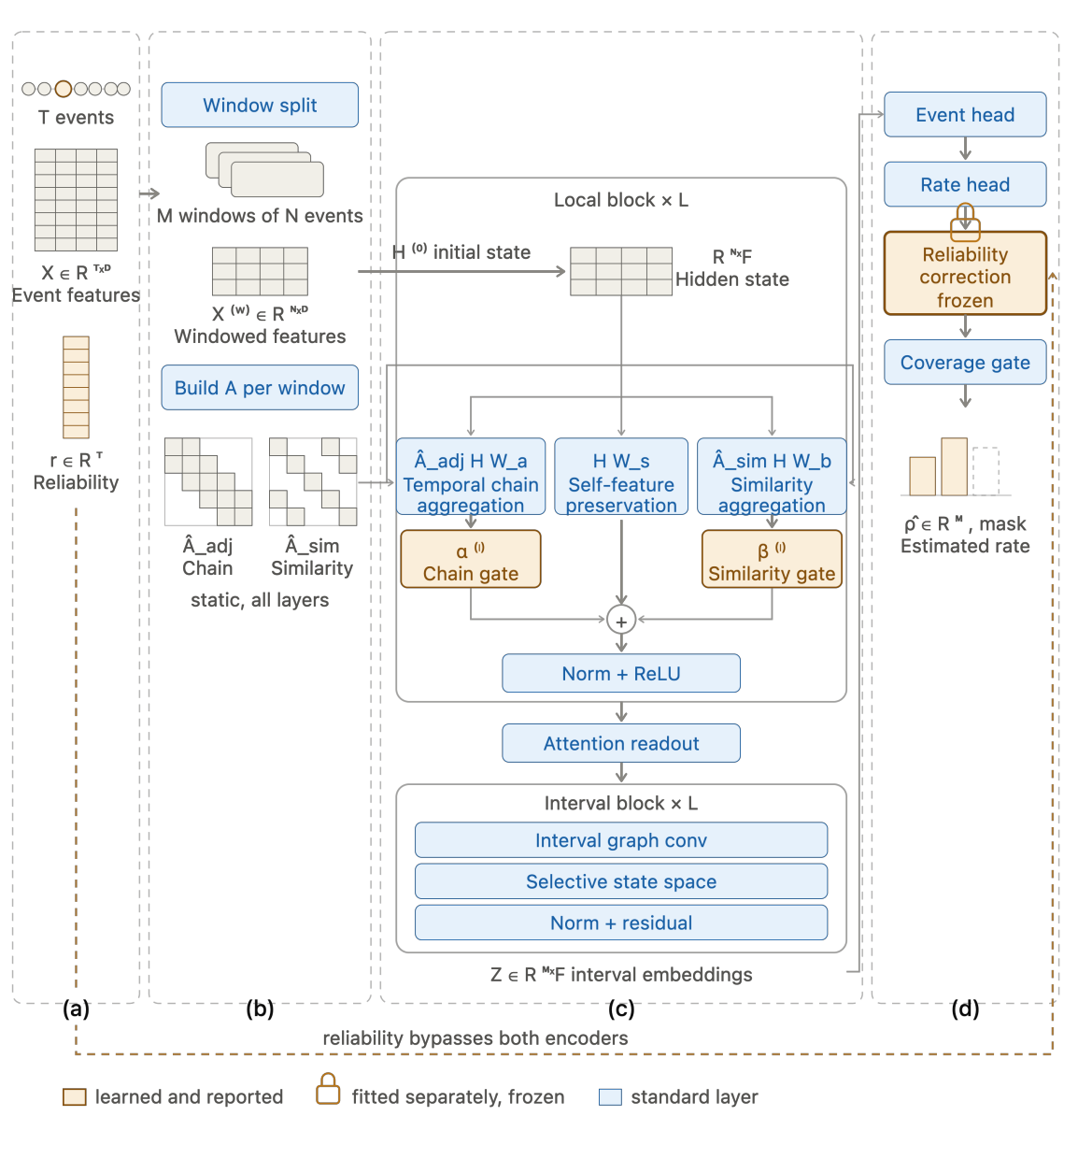
RO1 and RO2: Information Loss and the Two-Scale ST-GNN
RO1: what is lost (Pulsewatch, Icentia11k)
Morphology: waveform model vs interval model on the same recordings
Filtering: share of ectopic beats removed by percent-deviation (Karlsson et al., 2012) and adaptive (Lipponen & Tarvainen, 2019) filters
Origin: all premature beats vs PAC-only count, by burden
RO2: the estimator (shown left)
Beat-graph per window: temporal chain plus similarity edges
Epoch-graph over the day: interval graph convolution and state space
Quality flag enters as input; frozen retention weighting and coverage gate (Equations 3.1 to 3.3, appendix)
Benchmarks: logistic regression, SVM, random forest, Poincaré rule, BiLSTM, GRU-D, transformer; component ablations (Appendix B)
Graph structure is tested, not assumed: an MLP slightly outperformed a GCN on visibility-graph beat features (EPMoghaddam et al., 2024).
14
Notes:
About 1.5 minutes. RO1 separates two losses: morphology (the P wave is gone in intervals) and filtering (devices delete beats that look abnormal, which are often the ectopic ones). RO2: the beat-graph sees local structure in a window; the epoch-graph aggregates across the day. The reliability pathway bypasses both encoders and is fitted separately, so its contribution is identifiable by ablation. The coverage gate makes the model abstain rather than report a number on thin data. A precedent that an imperfect beat detector can still give a usable daily burden: Siejko et al. (2025), PVC burden from an implanted monitor, beat sensitivity 80.1% yet burden r = 0.95 against Holter.

Slide 15
RO3: Deployability Protocol
Element | Specification
Population | Adults after ischaemic stroke or TIA, no known AF; consecutive sampling; site [to be confirmed]
Sample | Recruit about 40 to analyse ≥34 (traffic-light criteria, 90% power; Lewis et al., 2021)
Device | Garmin Enhanced BBI with binary per-beat confidence, gap markers and accelerometer (published specification); device not yet received, verified before ethics
Duration | 7 days continuous wear; one short daily charging window
Valid day | Minimum analysable coverage in both a daytime and a night-time block [thresholds pre-specified]
Daily rate | Time-of-day weighted estimate; ESVEA in rate form (≥30 per hour; Binici et al., 2010)
Primary feasibility outcome
Proportion of participants with ≥3 valid days
Red ≤50% · Amber 51 to 74% · Green ≥75%
RQ3.1 Analysable yield per patient-day
RQ3.2 Share meeting the daily denominator
RQ3.3 Stability: ICC(2,1) across days
RQ3.4 Activity co-variation: mixed model
RQ3.5 ESVEA proportion vs 25.3%: plausibility check only
Seven days because sensitivity for high PAC frequency rises from 76.6% on one day to 88.8% by day 7 (Måneheim et al., 2024), matching the up-to-7-day Holter benchmark (Haeusler et al., 2021).
15
Notes:
About 1.5 minutes. Three changes from the earlier draft. One: n is now justified, not conventional. The traffic-light method gives about 34 analysable participants for 90% power to reject the red zone if green is true; recruit about 40 to allow for dropout and wrist discomfort. Two: duration is 7 days, not 4. Three: a valid day needs coverage in both a day and a night block, because analysable time is night-weighted while PACs are day-weighted, and the daily rate is weighted by time of day rather than scaled by 24. RQ3.5 is a plausibility check: at n = 34 the confidence interval on ESVEA prevalence is too wide to validate anything. Eligibility is broad, not cryptogenic-only, because a cryptogenic-only smartwatch study screened 92.5% of candidates as ineligible (Huntelaar et al., 2024).

Slide 16
RO4: Substitution and Comparative Selection
RO4a · Substitution (Icentia11k)
RO4b · Selection (cohort)
True ESVEA status from ECG beat labels, then the same records degraded to smartwatch-like intervals and re-estimated.
Wearable-based selection vs CHA₂DS₂-VASc, HAVOC, C₂HEST, AS5F and Brown ESUS-AF (ESUS subgroup only), at equal monitoring capacity.
Degradation | Calibrated from
Beat rejection | RO1 filtering results
Coverage gaps | Night-weighted pattern (Merschel & Reinhardt, 2022); RO3 cohort
Pulse deficit | Pulse lost below a coupling interval of about 55% of RR (Zheng et al., 2008); swept around this value
Metrics: Cohen κ; Jaccard overlap; profile of discordant patients
Substrate: each selection vs left atrial volume, P-wave duration, NT-proBNP
Descriptive: no outcome is collected, so no net reclassification improvement.
Metrics: reclassification rate; κ, sensitivity and specificity at the ESVEA cut-off, across a severity sweep
Precedent: smartwatch algorithms simulated on continuous implantable-monitor records, burden r > 0.97 (Aguilar et al., 2025). Garmin PPG short-term variability agrees only moderately with ECG after stroke, rMSSD ρc = 0.66 (Theurl et al., 2023).
16
Notes:
About 1.5 minutes. The substitution claim is now tested where truth exists. The degradation model has three operators, each calibrated from data, and results are reported across severities, not one setting. Pulse deficit matters because a premature beat can fill the ventricle too little to produce a wrist pulse, so the watch sees one long interval instead of short-then-long. Zheng et al. (2008) found the shortest coupling interval with a visible pulse was 373 to 531 ms, about 55% of the sinus RR. No PAC-specific missed-pulse rate exists, so this is an assumption stated openly. RO4b is descriptive because NRI needs events and non-events (Pencina et al., 2014), and expected AF at n = 34 would be about 3 events.

Slide 17
Preliminary Findings (1): Cross-Device Pilot
A beat-graph ST-GNN on the same representation was built for rhythm classification from wearable PPG and tested on four held-out cohorts with subject-level splits: no subject appears in both training and test.
Held-out cohort | Device | n (segments) | AF-vs-rest AUROC | Zero-shot recall
Clinical (Pulsewatch) | Wrist smartwatch PPG | 48,396 | ≈1.00 (AF-vs-PAC 0.986) | 100%
MIMIC-III | ICU fingertip PPG | 705 | 0.996 to 1.00 | 99%
Simband | Wrist PPG, motion-affected | 66 | 0.90 to 0.95 | 88% (equals per-device oracle)
Pulsewatch AF trial holdouts | Wrist smartwatch PPG | 5,483 | Not computed | 97% / 100%
The operating threshold was set once on the development validation set and transferred to every external device without retuning.
AF was separated from PACs (AUROC 0.986): beat-interval structure carries ectopy information. The graph's own contribution was not isolated; RQ2.1 and RQ2.3 test it.
What this pilot does not show: labels are per-window rhythm classes, not beat counts, and the task is AF rather than ectopy burden. It establishes feasibility of the representation, which RO1 and RO2 extend to counting.
17
Notes:
About 1 minute. Lead with the split unit, because an AUROC near 1.00 invites a leakage question: splits are by subject, never by window. The threshold was fixed once and transferred without retuning. Then say plainly what the pilot does not show: it is AF, not ectopy burden, and windows, not counts. The AF-versus-PAC figure of 0.986 is the most relevant number for this thesis.

Slide 18
Preliminary Findings (2): Filtering Removes Ectopy
First RQ1.2 analysis on Icentia11k beat labels: 298 patients, median 57.5 h each. Share of RR intervals removed by a percent-deviation filter (%).
Interval | 10% | 20% | 30% | 20%: ESVEA − | 20%: ESVEA +
Coupling interval ending at a PAC | 81.5 | 60.9 | 37.4 | 78.5 | 60.0
Pause after a PAC | 74.9 | 54.5 | 37.3 | 50.1 | 54.8
Coupling interval ending at a PVC | 85.4 | 70.0 | 46.5 | 65.4 | 77.9
Normal to normal | 20.1 | 8.8 | 6.2 | 8.1 | 11.5
About 7 times more PAC intervals removed than normal ones at 20%; no threshold keeps most PACs.
Loss depends on burden (78.5% vs 60.0%), so one correction factor cannot restore the count: retention must be learned (RO2).
RO4a is viable: 66 of 298 (22.1%) met ESVEA; median 1.35 PACs/h. Limits: ECG RR, not PPG; normal intervals include AF.
18
Notes:
About 1 minute. This is the first result specific to this thesis. Say the headline number: at the usual 20% threshold, 61% of PAC intervals are thrown away against 9% of normal intervals. Then the second point, which is the methodological hook: the share lost is smaller in high-burden patients, probably because frequent PACs contaminate the filter's reference, so the loss depends on the quantity being measured. That is why RO2 learns retention instead of applying a fixed correction. Close with RO4a: 66 ESVEA-positive patients is enough for the substitution test. If asked, Icentia11k is not a stroke cohort, so the 22% is not compared with MonDAFIS as validation.

Slide 19
Risks, Likelihood and Fallback
Risk | Likelihood | Impact | Mitigation
7-day wear not tolerated (Tse et al., 2024) | Medium | High | Wear log; scheduled contacts; recruit about 40
Under-recruitment or site not secured (Huntelaar et al., 2024) | Medium | High | Broad eligibility; screening log; fallback design
Device not yet received; export, flags, battery unconfirmed | Medium | High | Published specification; device verification before ethics; fallback design
ST-GNN no better than baselines (H2 rejected) | Medium | Medium | Retention correction and gate tested on best baseline; negative result reported
RO4a simulation optimistic (ECG RR, not PPG) | High | Medium | Calibrated operators; severity sweep; stated limitation
ECG-to-PPG domain shift for RO2 | High | Medium | Window-level transfer test on Pulsewatch
About 24% of Icentia11k beats unclassifiable | High | Low | Excluded; sensitivity analysis
Fallback: if site or device is not secured by semester 5, RO3 becomes device verification with coverage modelled from Pulsewatch wear data; RO4a proceeds and RO4b is deferred. RO1, RO2 and RO4a do not depend on the cohort.
19
Notes:
About 45 seconds. Name the principal risk first: continuous 7-day wear in this population is untested; the evidence is from about 12 hours a day. Each risk has a concrete mitigation that is already built into the design. The two data risks (simulation optimism and label quality) are stated here so the panel does not have to find them.

Slide 20
Ethics, Data Access and Reproducibility
Dataset | Access and licence | Status
Icentia11k | PhysioNet open access; CC BY-NC-SA 4.0 (non-commercial) | Annotations analysed (preliminary findings)
Pulsewatch | Controlled access through Synapse (syn23565056) | Used in pilot work
Simband; MIMIC-III | Research releases; MIMIC-III via credentialed PhysioNet access | Used in pilot; fallback external sets
RO3 cohort | Medical research ethics approval; written consent; PDPA 2010 | Pending device and site
Incidental findings: watch data are not reviewed in real time; participants are told the study is not clinical monitoring; concerns go through usual care
Data route: pseudonymised at collection; exported under study-managed accounts, not personal accounts, where possible
Reproducibility: five seeds per model; versions, configs and subject-level splits recorded; code released on publication; RO3 protocol registered before recruitment
AI use: declared as required by the UM AI policy (Senate, November 2025)
20
Notes:
About 45 seconds. Lead with the two data facts a panel checks: Icentia11k is open but non-commercial, and Pulsewatch is already in hand from the pilot. Then the participant safeguard: because no one reviews the watch data in real time, participants are told clearly that this is not clinical monitoring. Close on reproducibility, which answers the leakage and repeatability questions before they are asked.

Slide 21
Expected Contributions, Schedule and Publications
RO1
RO2
RO3
RO4
First decomposition of ectopy lost from waveform to filtered intervals
ST-GNN using quality flags and unobserved time as inputs
Feasibility of a 7-day per-day ectopy estimate after stroke
Reclassification under device losses; agreement with scores
Task | RO | S1–S2 | S3 | S4 | S5 | S6 | S7 | S8
Literature review and proposal |  | ■ | ■
Information-loss analyses | RO1 |  | ■ | ■
ST-GNN development and ablations | RO2 |  |  | ■ | ■ | ■
Ethics, recruitment, device set-up | RO3 |  |  | ■ | ■
7-day monitoring and analysis | RO3 |  |  |  | ■ | ■ | ■
Substitution and selection analyses | RO4 |  |  |  |  | ■ | ■
Candidature defence |  |  |  |  | ■
Thesis writing and submission |  |  |  |  |  |  | ■ | ■
Planned papers: RO1 information loss (S4) · RO2 ST-GNN under informative missingness (S6) · RO3 coverage and stability after stroke (S7) · pilot conference paper (S4). Indicative; subject to supervisor approval.
21
Notes:
About 1.5 minutes, then close. Conclusion in one breath: the clinical decision exists and atrial ectopy addresses it, but the measure is unvalidated on wearable intervals, delivery is untested after stroke, and no method treats the observation process as part of estimation. The four objectives follow in that order, and the pilot shows the representation is feasible. Universiti Malaya requires proof of acceptance of at least one indexed publication before graduation; the RO1 paper is the first target.

Slide 22
Thank you
Contribution: the first error-characterised, coverage-aware estimate of daily atrial ectopy from smartwatch beat intervals, built to be compared with ECG-derived ESVEA thresholds after stroke.
Questions and comments are welcome
Notes:
Q&A. Likely questions and where the answer sits: where does the truth come from (validation matrix); why 7 days and 34 participants (RO3 slide, Appendix C); why not net reclassification improvement (RO4 notes); is the simulation realistic (RO4 and risks slides); what is new (closest prior work slide); has anyone done this already (gaps slide footnote: PubMed, Consensus and Scholar Gateway, October 2026); how the flag is used (appendix equations); why a graph rather than a sequence model (RO1 and RO2 slide, Appendix B2).

Slide 23
References
Aguilar, M., et al. (2021). Influence of monitoring strategy on assessment of ablation success and postablation atrial fibrillation burden assessment. Circulation, 144. https://doi.org/10.1161/CIRCULATIONAHA.121.056109
Aguilar, M., et al. (2025). Wearable smartwatches for atrial fibrillation detection and burden estimation after ablation: Comparison with continuous monitoring. Europace. https://doi.org/10.1093/europace/euaf280
Bacevičius, J., et al. (2022). High specificity wearable device with photoplethysmography and six-lead electrocardiography for atrial fibrillation detection challenged by frequent premature contractions: DoubleCheck-AF. Frontiers in Cardiovascular Medicine, 9. https://doi.org/10.3389/fcvm.2022.869730
Barrera, N., et al. (2025). Accuracy of smartwatches in the detection of atrial fibrillation. JACC: Advances. https://doi.org/10.1016/j.jacadv.2025.102133
Bhurane, A., et al. (2026). Ultra lightweight residual network for multiclass arrhythmia classification using raw smartwatch PPG signals. 2026 IEEE CSPA. https://doi.org/10.1109/CSPA68262.2026.11517622
Binici, Z., et al. (2010). Excessive supraventricular ectopic activity and increased risk of atrial fibrillation and stroke. Circulation, 121(17), 1904–1911. https://doi.org/10.1161/CIRCULATIONAHA.109.874982
Che, Z., et al. (2018). Recurrent neural networks for multivariate time series with missing values. Scientific Reports, 8, 6085. https://doi.org/10.1038/s41598-018-24271-9
Dias, F. M., et al. (2021). Arrhythmia classification from single-lead ECG signals using the inter-patient paradigm. Computer Methods and Programs in Biomedicine, 202, 105948. https://doi.org/10.1016/j.cmpb.2021.105948
Ding, E. Y., et al. (2023). Accuracy, usability, and adherence of smartwatches for atrial fibrillation detection in older adults after stroke: Randomized controlled trial. JMIR Cardio, 7, e45137. https://doi.org/10.2196/45137
Dussault, C., et al. (2015). Electrocardiographic monitoring for detecting atrial fibrillation after ischemic stroke or transient ischemic attack: Systematic review and meta-analysis. Circulation: Arrhythmia and Electrophysiology, 8(2), 263–269. https://doi.org/10.1161/CIRCEP.114.002521

Slide 24
References (cont.)
EPMoghaddam, D., et al. (2024). A graph-based cardiac arrhythmia classification methodology using one-lead ECG recordings. Intelligent Systems with Applications, 22, 200385. https://doi.org/10.1016/j.iswa.2024.200385
Gladstone, D. J., et al. (2015). Atrial premature beats predict atrial fibrillation in cryptogenic stroke: Results from the EMBRACE trial. Stroke, 46(4), 936–941. https://doi.org/10.1161/STROKEAHA.115.008714
Gruwez, H., et al. (2021). Performance of an artificial intelligence algorithm to detect atrial fibrillation on a 24-hour continuous photoplethysmography recording using a smartwatch: ACURATE study [Abstract]. European Heart Journal, 42(Suppl 1). https://doi.org/10.1093/eurheartj/ehab724.0489
Gruwez, H., et al. (2024). Real-world validation of smartphone-based photoplethysmography for rate and rhythm monitoring in atrial fibrillation. Europace, 26(4), euae065. https://doi.org/10.1093/europace/euae065
Haeusler, K. G., et al. (2021). Systematic monitoring for detection of atrial fibrillation in patients with acute ischaemic stroke (MonDAFIS): A randomised, open-label, multicentre study. The Lancet Neurology, 20(6). https://doi.org/10.1016/S1474-4422(21)00067-3
Haeusler, K. G., et al. (2025). Excessive supraventricular ectopic activity in patients with acute ischemic stroke is associated with atrial fibrillation detection within 24 months after stroke: A predefined analysis of the MonDAFIS study. Journal of the American Heart Association, 14(2), e034512. https://doi.org/10.1161/JAHA.123.034512
Han, D., et al. (2020). Premature atrial and ventricular contraction detection using photoplethysmographic data from a smartwatch. Sensors, 20(19), 5683. https://doi.org/10.3390/s20195683
Han, D., et al. (2026). Multiclass arrhythmia classification using multimodal smartwatch photoplethysmography signals collected in real-life settings. IEEE Transactions on Biomedical Engineering, 73(4), 1679–1693. https://doi.org/10.1109/TBME.2025.3613471
Helbitz, A., et al. (2025). Prediction of atrial fibrillation after a stroke event: A systematic review with meta-analysis. Heart Rhythm, 22(7), 1637–1645. https://doi.org/10.1016/j.hrthm.2025.01.026
Hu, R., et al. (2022). A transformer-based deep neural network for arrhythmia detection using continuous ECG signals. Computers in Biology and Medicine, 144, 105325. https://doi.org/10.1016/j.compbiomed.2022.105325

Slide 25
References (cont.)
Huntelaar, M., et al. (2024). Photoplethysmography-based atrial fibrillation detection in patients after cryptogenic stroke. Frontiers in Stroke. https://doi.org/10.3389/fstro.2024.1496003
Johnson, L., et al. (2021). Activity levels influence frequency of premature atrial contractions [Abstract]. European Heart Journal, 42(Suppl 1). https://doi.org/10.1093/eurheartj/ehab724.0304
Karlsson, M., et al. (2012). Automatic filtering of outliers in RR intervals before analysis of heart rate variability in Holter recordings: A comparison with carefully edited data. BioMedical Engineering OnLine, 11, 2. https://doi.org/10.1186/1475-925X-11-2
Kishore, A. K., et al. (2022). Use of risk scores for predicting new atrial fibrillation after ischemic stroke or transient ischemic attack: A systematic review. International Journal of Stroke, 17(6), 608–617. https://doi.org/10.1177/17474930211045880
Kraft, D., et al. (2026). Automated detection of normal, atrial, and ventricular premature beats from single-lead ECG using convolutional neural networks. Sensors, 26(2), 513. https://doi.org/10.3390/s26020513
Larsen, B. S., et al. (2015). Excessive atrial ectopy and short atrial runs increase the risk of stroke beyond incident atrial fibrillation. Journal of the American College of Cardiology, 66(3), 232–241. https://doi.org/10.1016/j.jacc.2015.05.018
Larsen, B. S., et al. (2016). The circadian variation of premature atrial contractions. Europace. https://doi.org/10.1093/europace/euv389
Lewis, M., et al. (2021). Determining sample size for progression criteria for pragmatic pilot RCTs: The hypothesis test strikes back! Pilot and Feasibility Studies, 7, 40. https://doi.org/10.1186/s40814-021-00770-x
Lipponen, J. A., & Tarvainen, M. P. (2019). A robust algorithm for heart rate variability time series artefact correction using novel beat classification. Journal of Medical Engineering & Technology, 43(3), 173–181. https://doi.org/10.1080/03091902.2019.1640306
Liu, Z., et al. (2022). Multiclass arrhythmia detection and classification from photoplethysmography signals using a deep convolutional neural network. Journal of the American Heart Association, 11(7), e023555. https://doi.org/10.1161/JAHA.121.023555

Slide 26
References (cont.)
Maille, B., et al. (2026). Identifying patients at low risk for atrial fibrillation after cryptogenic stroke: The PAVA score. Europace, 28(9). https://doi.org/10.1093/europace/euag183
Måneheim, A., et al. (2023). How reliable are single day electrocardiogram measurements to detect excessive supraventricular ectopic activity? [Abstract]. European Heart Journal, 44(Suppl 2). https://doi.org/10.1093/eurheartj/ehad655.303
Måneheim, A., et al. (2024). Diagnostic reliability of monitoring for premature atrial and ventricular complexes. Europace, 26. https://doi.org/10.1093/europace/euae198
McIntyre, W. F., et al. (2024). Direct oral anticoagulants for stroke prevention in patients with device-detected atrial fibrillation: A study-level meta-analysis of the NOAH-AFNET 6 and ARTESiA trials. Circulation, 149(13), 981–988. https://doi.org/10.1161/CIRCULATIONAHA.123.067512
Mele, F., et al. (2025). Prediction scores of subclinical atrial fibrillation in patients with cryptogenic stroke and transient ischemic attack. International Journal of Stroke, 20(9), 1150–1158. https://doi.org/10.1177/17474930251341101
Merschel, S., & Reinhardt, L. (2022). Analyzability of photoplethysmographic smartwatch data by the Preventicus Heartbeats algorithm during everyday life: Feasibility study. JMIR Formative Research, 6. https://doi.org/10.2196/29479
Mittal, S., et al. (2021). AI filter improves positive predictive value of atrial fibrillation detection by an implantable loop recorder. JACC: Clinical Electrophysiology, 7(8), 965–975. https://doi.org/10.1016/j.jacep.2020.12.006
Nijman, S., et al. (2022). Missing data is poorly handled and reported in prediction model studies using machine learning: A literature review. Journal of Clinical Epidemiology, 142, 218–229. https://doi.org/10.1016/j.jclinepi.2021.11.023
Palaiodimou, L., et al. (2024). Performance of different risk scores for the detection of atrial fibrillation among patients with cryptogenic stroke. Stroke, 55(2), 454–462. https://doi.org/10.1161/STROKEAHA.123.044961
Pencina, K. M., Pencina, M. J., & D’Agostino, R. B. (2014). What to expect from net reclassification improvement with three categories. Statistics in Medicine, 33(28), 4975–4987. https://doi.org/10.1002/sim.6286

Slide 27
References (cont.)
Pinnacchio, G., et al. (2026). External validation of published scoring systems to predict incident atrial fibrillation after cryptogenic stroke/embolic stroke of undetermined source. Journal of the American Heart Association, 15(13), e047601. https://doi.org/10.1161/JAHA.125.047601
Shimada, Y., et al. (2024). Higher frequency of premature atrial contractions correlates with atrial fibrillation detection after cryptogenic stroke. Stroke, 55(4), 946–953. https://doi.org/10.1161/STROKEAHA.123.044813
Shoamanesh, A., et al. (2025). Apixaban versus aspirin for stroke prevention in people with subclinical atrial fibrillation and a history of stroke or transient ischaemic attack: Subgroup analysis of the ARTESiA randomised controlled trial. The Lancet Neurology, 24(2), 140–151. https://doi.org/10.1016/S1474-4422(24)00475-7
Siejko, K. Z., et al. (2025). Premature ventricular contraction detection and estimation of daily burden by an insertable cardiac monitor. Heart Rhythm O2, 6(4), 528–536. https://doi.org/10.1016/j.hroo.2025.01.004
Sisk, R., et al. (2023). Imputation and missing indicators for handling missing data in the development and deployment of clinical prediction models: A simulation study. Statistical Methods in Medical Research, 32(8), 1461–1477. https://doi.org/10.1177/09622802231165001
Skrebelyte-Strøm, L., et al. (2022). Prediction of occult atrial fibrillation in patients after cryptogenic stroke and transient ischaemic attack: PROACTIA. Europace, 24(12), 1881–1888. https://doi.org/10.1093/europace/euac092
Sun, M., et al. (2024). Incorporating informatively collected laboratory data from EHR in clinical prediction models. BMC Medical Informatics and Decision Making, 24. https://doi.org/10.1186/s12911-024-02612-1
Tan, S., et al. (2019). Icentia11K: An unsupervised representation learning dataset for arrhythmia subtype discovery. arXiv. https://doi.org/10.48550/arXiv.1910.09570
Tao, Y., et al. (2021). Premature atrial complexes can predict atrial fibrillation in ischemic stroke patients: A systematic review and meta-analysis. Pacing and Clinical Electrophysiology, 44(9), 1599–1606. https://doi.org/10.1111/pace.14302
Teare, M. D., et al. (2014). Sample size requirements to estimate key design parameters from external pilot randomised controlled trials: A simulation study. Trials, 15, 264. https://doi.org/10.1186/1745-6215-15-264

Slide 28
References (cont.)
Theurl, F., et al. (2023). Smartwatch-derived heart rate variability: A head-to-head comparison with the gold standard in cardiovascular disease. European Heart Journal: Digital Health. https://doi.org/10.1093/ehjdh/ztad022
Tse, T., et al. (2024). Feasibility of accelerometry in a self-directed upper limb activity program of a subacute setting with stroke survivors. Brain Impairment, 25. https://doi.org/10.1071/IB24008
Tsivgoulis, G., et al. (2019). Duration of implantable cardiac monitoring and detection of atrial fibrillation in ischemic stroke patients: A systematic review and meta-analysis. Journal of Stroke, 21(3), 302–311. https://doi.org/10.5853/jos.2019.01067
Väliaho, E.-S., et al. (2019). Wrist band photoplethysmography in detection of individual pulses in atrial fibrillation and algorithm-based detection of atrial fibrillation. Europace, 21(7), 1031–1038. https://doi.org/10.1093/europace/euz060
Vargova, E., et al. (2026). Effortless beat-level classification of PACs and PVCs in PPG signals [Accepted abstract]. Computing in Cardiology 2026. https://cinc.org/2026/Program/accepted/166.html
Yang, M., et al. (2022). Excessive supraventricular ectopic activity and the risk of atrial fibrillation and stroke: A systematic review and meta-analysis. Journal of Cardiovascular Development and Disease, 9(12), 461. https://doi.org/10.3390/jcdd9120461
Zahid, M. U., et al. (2023). Global ECG classification by self-operational neural networks with feature injection. IEEE Transactions on Biomedical Engineering, 70(1), 205–215. https://doi.org/10.1109/TBME.2022.3187874
Zheng, D., Allen, J., & Murray, A. (2008). Determination of aortic valve opening time and left ventricular peak filling rate from the peripheral pulse amplitude in patients with ectopic beats. Physiological Measurement, 29(12), 1411–1419. https://doi.org/10.1088/0967-3334/29/12/005
Zuo, S., et al. (2026). Validation of smartwatches integrated with photoplethysmography for continuous evaluation of atrial fibrillation burden. JACC: Clinical Electrophysiology. https://doi.org/10.1016/j.jacep.2026.03.036

Slide 29
References (cont.)
Chen, D., Han, D., Mercado-Díaz, L. R., Moon, J., & Chon, K. H. (2024). Smartwatch photoplethysmogram-based atrial fibrillation detection with premature atrial and ventricular contraction differentiation using densely connected convolutional neural networks. In 2024 IEEE 20th International Conference on Body Sensor Networks (BSN). https://doi.org/10.1109/BSN63547.2024.10780734
Schoels, M., et al. (2025). Artificial intelligence for prediction of atrial fibrillation in the stroke unit: A retrospective derivation validation cohort study. eBioMedicine, 118, Article 105869. https://doi.org/10.1016/j.ebiom.2025.105869
Universiti Malaya. (2025). Policy and guidelines on the use of artificial intelligence (AI) in teaching and learning. Institute for Advanced Studies, Universiti Malaya.

Slide 30
Appendix
A · Full literature tables B · RO1 and RO2 detail C · Analysis plan and RO3 data
Held for the question-and-answer session

Slide 31
Appendix: Retention-Weighted Daily Rate (Equations 3.1 to 3.3)
(3.1) π̂(m, h) = P̂(true beat reported with high confidence | motion m, block h)
(3.2) R̂(d) = Σh wh · [ Σi∈A(d,h) p̂i / π̂(mi, h) ] / τ(d,h), Σh wh = 1
(3.3) report R̂(d) only if c(d, day) ≥ θday and c(d, night) ≥ θnight
A(d,h): retained beats in day d, time-of-day block h; p̂i: predicted PAC probability; mi: accelerometer motion; τ(d,h): observed hours
wh: time-of-day weights from the diurnal PAC profile in Icentia11k; θ: coverage thresholds fixed in the registered protocol
Retention is fitted where censoring is observable and frozen, so its effect can be isolated by ablation; daily count = 24 · R̂(d)
30
Notes:
Held for questions. If asked how the quality flag is used rather than deleted: each retained beat is weighted by the inverse of its retention probability, as in inverse-probability weighting, and the rate is normalised by observed time per block, so night-weighted coverage does not bias the daily rate. The gate refuses to report when either block is too thin.

Slide 32
Appendix A1: Atrial Ectopy as a Selector (Holter-Derived)
Author (Year) | Cohort / Design | Measure | Key findings | Limitation
Larsen et al. (2015) | Copenhagen Holter Study; 678 adults without CVD; 15-year follow-up | ESVEA on 48-h ECG | Ischaemic stroke HR 1.96 censored at AF; 14.3% with stroke had AF first | General population; one recording
Gladstone et al. (2015) | EMBRACE; 237 cryptogenic stroke/TIA ≥55 y | Atrial premature beats per 24 h | Median 629 vs 45; only significant predictor at 30 days; significant at 90 days and 2 years | Single 24-h Holter
Skrebelyte-Strøm et al. (2022) | PROACTIA; 236 cryptogenic stroke/TIA; implantable monitor | PAC/24 h, P-wave, LA volume | 4 of 9 candidates retained; subclinical AF 75% vs 10% top vs bottom quartile | Needs Holter, ECG P-wave and echocardiography
Shimada et al. (2024) | 381 cryptogenic stroke; implantable monitor; 8 centres | PACs/24 h: ≤200, 201 to 500, >500 | AF 15.5%, 44.0%, 71.4% per year; adjusted HR 3.23 for >500 | Retrospective; single Holter
Haeusler et al. (2025) | MonDAFIS; 1,435 acute ischaemic stroke, ≥48 h Holter | ≥480 SVEB/day or runs of 10 to 29 s | ESVEA 25.3% vs AF 3.3%; AF at 24 months 18.5% vs 5.9% | In-hospital Holter; composite outcome not different
Maille et al. (2026) | PAVA; 1,002 cryptogenic stroke; loop recorder | PAC >200/24 h in a 4-item score | c-index 0.73 development, 0.79 validation; score ≤2 NPV 89.2% and 100% | Internal validation only

Slide 33
Appendix A2: Clinical Risk Scores, the Alternative Selector
Author (Year) | Cohort / Design | Scores evaluated | Key findings | Limitation
Kishore et al. (2022) | Systematic review; 21 studies, 23 cohorts | 17 integer-based scores | AUROC 0.54 to 0.94; stroke-derived 0.70 to 0.94 vs others 0.53 to 0.79 | Heterogeneous outcomes
Palaiodimou et al. (2024) | 250 cryptogenic stroke; implantable monitor | CHA₂DS₂-VASc, HAVOC, Brown ESUS-AF, C₂HEST | C₂HEST best (0.770); Brown ESUS-AF 0.666 | Single centre
Helbitz et al. (2025) | Meta-analysis; 75 studies | 58 models | 66% high risk of bias; none excellent on external validation; no impact studies | Wide heterogeneity
Mele et al. (2025) | 194 cryptogenic stroke/TIA; loop recorder | 9 scores incl. STAF, HAVOC, AS5F | Accuracy 45.4 to 66.3%; best AUROC 0.697 (Brown ESUS-AF) | Single centre
Pinnacchio et al. (2026) | 132 cryptogenic stroke/TIA; implantable monitor | 7 scores | Brown ESUS-AF 0.755; 3 of 7 above 0.70 | Small; mean follow-up 13 months

Slide 34
Appendix A3: Ectopy Detection from Photoplethysmography
Author (Year) | Data / Model | Output | Key findings | Limitation
Han et al. (2020) | Smartwatch PPG; Poincaré plot with vector resemblance | PAC/PVC detection | Sensitivity 67%, specificity 97%, PPV 81% | PAC and PVC merged
Liu et al. (2022) | 228 ablation patients; 10-s PPG; deep CNN | 6 rhythms incl. PAC, PVC | Accuracy 85.0%; mean sensitivity 75.8%, PPV 75.2% | In-hospital; segment labels
Bacevičius et al. (2022) | DoubleCheck-AF; 344 incl. 128 with frequent PACs/PVCs | PPG AF algorithm vs Holter | All 7 PPG false-positive AF calls in the frequent-ectopy group | Ectopy a confounder, not a target
Han et al. (2026) | Pulsewatch; 106 subjects; Bi-GRU on PPG, accelerometer, HR | NSR, AF, PAC/PVC | PAC/PVC sensitivity 83%; AF accuracy 97.31% | Merged class; 30-s windows
Bhurane et al. (2026) | Pulsewatch; raw PPG; Tiny-ResNet | NSR, AF, PAC/PVC | PAC/PVC sensitivity 93.96%; accuracy 98.00% | Conference; split not reported

Slide 35
Appendix A4: Coverage, Stability and Observation Timing
Author (Year) | Cohort / Design | Measure | Key findings | Limitation
Ding et al. (2023) | Pulsewatch RCT; 120 stroke survivors ≥50 y | AF accuracy, usability, wear | Accuracy 92.9%; usability 65/100; worn 21.2 of 30 days | Days worn, not analysable hours
Gruwez et al. (2021) | 96 patients; 24-h smartwatch PPG with Holter | Usable 1-min fragments | 22.3% of PPG vs 1.3% of ECG fragments insufficient | Abstract; not post-stroke
Merschel & Reinhardt (2022) | 41 adults; 24-h smartwatch PPG | Analysable data vs acceleration | 71.5% analysable; above 94% midnight to 6 AM; r = −0.64 with activity | Healthy adults
Måneheim et al. (2024) | 8,245 patients; 14-day telemetry | Daily PAC frequency vs 14-day mean | After 3 days, ≥50% error in 25%; 10 days for ±20% in 80% | ECG, not wearable
Zuo et al. (2026) | 728 AF patients; smartwatch PPG with patch ECG | AF burden agreement | Valid PPG 62.5% vs ECG 96.2%; burden bias −1.34% | AF only, not ectopy

Slide 36
Appendix A5: Monitoring Duration and Stability of Ectopy
Author (Year) | Cohort / Design | Measure | Key findings | Limitation
Dussault et al. (2015) | Meta-analysis; 31 studies after stroke/TIA | AF by monitoring duration | 5.1% (≤72 h), 15% (≥7 days), 29.15% (3 months) | AF only; heterogeneity
Tsivgoulis et al. (2019) | Meta-analysis; 28 implantable-monitor studies, 4,531 patients | AF by implant duration | 5% (<6 mo), 21%, 26%, 34% (>24 mo) | AF only
Aguilar et al. (2021) | CIRCA-DOSE; 346 with implantable monitor; simulation | Intermittent strategies sampled from a continuous record | Short monitors missed recurrences and overestimated burden | Post-ablation; precedent for simulation
Måneheim et al. (2023) | 9,899 patients; ≥14-day telemetry | Daily ESVEA | ESVEA on ≥1 day in 45%; among them, one day only in 28%; first-day sensitivity 44.6% | Abstract; referral population

Slide 37
Appendix A6: Beat Detection, Pulse Deficit and Ectopy as a Confounder
Author (Year) | Cohort / Design | Measure | Key findings | Limitation
Väliaho et al. (2019) | 213 patients; 5-min wristband PPG with ECG | Individual pulse detection | Sensitivity 91.7% in AF vs 99.4% in sinus rhythm; 86.7% in recent-onset AF | Supervised rest
Mittal et al. (2021) | 425 with loop recorder; 1,483 AF episodes adjudicated | Device AF episode PPV | PPV 53.9%, 74.5% with AI filter; PACs most common false positive | Subcutaneous ECG
Zheng et al. (2008) | 25 subjects with ectopic beats; finger PPG with ECG | Pulse amplitude vs coupling interval | Ectopic pulses 68% smaller; shortest interval with a pulse 373 to 531 ms (about 55% of RR) | PAC and PVC not separated
Gruwez et al. (2024) | 50 AF patients; 3,407 fingertip smartphone PPG sets | PPG heart rate vs single-lead ECG before and after | Heart rate underestimated by 6.6 bpm in AF | Not simultaneous; AF population
Theurl et al. (2023) | 129 ischaemic stroke, 104 STEMI, 30 controls; Garmin vívoactive 4 | PPG vs 1,000-Hz ECG HRV | Mean HR ρc 0.9998; rMSSD only ρc 0.66 | 30 min, standardised conditions

Slide 38
Appendix A7: Beat-Level Models and Graph Representations
Author (Year) | Data / Model | Output | Key findings | Limitation
Dias et al. (2021) | MIT-BIH inter-patient; RR, morphology, higher-order statistics | N, S, V beats | Supraventricular sensitivity 89.7%, PPV 36.8% (with simulated R-peak jitter) | Low PPV would inflate a count
Zahid et al. (2023) | MIT-BIH; self-operational NN with injected RR features | Beat classes | Supraventricular F1 82.34% vs ventricular 95.2% | Needs ECG morphology
Hu et al. (2022) | ECG DETR transformer; continuous single-lead ECG | Position and class of every beat | Accuracy 99.12% (8 labels) | Within-database CV; ECG
EPMoghaddam et al. (2024) | Visibility graphs; GCN, MLP, random forest | 6 classes incl. PAC | MLP 99.02% slightly above the GCN | Graph alone gave no advantage
Kraft et al. (2026) | 1D U-Net trained on Icentia11k; 7 external sets | Normal, PAC, PVC segmentation | PAC sensitivity 0.539 to 0.797 vs PVC up to 0.986 | Even with P waves, PAC varies

Slide 39
Appendix A8: Missing Observations and Rate Estimation
Author (Year) | Data / Design | Approach | Key findings | Limitation
Che et al. (2018) | GRU-D; MIMIC-III, PhysioNet, synthetic | Masking and time interval as inputs | Exploiting missing patterns reached state-of-the-art performance | ICU series, not beats
Nijman et al. (2022) | Review of 152 ML prediction-model studies | Reporting and handling | 56 did not report missing data; 65 of 96 that did used deletion | Clinical tabular data
Sisk et al. (2023) | Simulation plus critical-care data | Imputation and missing indicators | Indicators helped in many cases but harm under outcome-dependent missingness | Ectopic beats may be flagged more often
Sun et al. (2024) | 105,198 inpatient encounters; LASSO, MLP, LSTM | Informatively missing laboratory data | Strategies allowing not-at-random missingness performed best | EHR, not signals
Siejko et al. (2025) | Implantable monitor; 89 with 24-h Holter | Daily PVC burden from beat detection | Beat sensitivity 80.1%, yet burden r = 0.95 vs Holter | Ventricular; ECG device

Slide 40
Appendix B1: RO1 Design
Research question | Data | Comparison | Output
RQ1.1 How much does ectopy detection change when the same recordings are represented as beat intervals rather than the raw waveform? | Pulsewatch (PPG with reference ECG; window labels) | Waveform model vs beat-interval model on identical recordings | Performance loss from absent morphology
RQ1.2 What share of annotated ectopic beats is removed by quality-based interval rejection across deployed thresholds? | Icentia11k (beat labels) | Percent-deviation filter (Karlsson et al., 2012); adaptive threshold (Lipponen & Tarvainen, 2019) | Ectopic vs normal beats removed; retention curve
RQ1.3 How closely does an origin-agnostic premature-beat count approximate the supraventricular count, and does the gap vary with burden? | Icentia11k (PAC and PVC labels) | All premature beats vs PAC-only count | Count discrepancy by ectopy burden
Rationale: beat intervals discard the P wave that separates PACs from other premature beats, and PAC detection is the least reliable class even on ECG (sensitivity 0.539 to 0.797; Kraft et al., 2026). No new data collection is required.

Slide 41
Appendix B2: RO2 Comparison Models and Ablations
Research question | Comparison | Models benchmarked | Isolates
RQ2.1 Does a graph over beat intervals estimate ectopy more accurately than non-graph models on the same intervals? | Beat-graph vs classical, rule-based and sequence models | LR, SVM, RF on RR features; RR + morphology (Dias et al., 2021); Poincaré rule (Han et al., 2020); BiLSTM; GRU-D (Che et al., 2018); transformer (Hu et al., 2022) | Value of relational structure
RQ2.2 Does aggregating over a graph of epochs estimate the daily rate better than direct aggregation? | Epoch-graph vs summation and pooling | Sum over analysable hours; mean pooling; LSTM over epochs | Value of the second scale
RQ2.3 Which components account for any difference? | Component ablation | Remove chain edges, similarity edges, interval block, retention correction, coverage gate | Each component
RQ2.4 Does treating the quality flag as an input change accuracy? | Flag as filter vs input vs input with correction | Same encoder under three regimes | Reliability as input
Graph structure is tested against non-graph baselines rather than assumed (EPMoghaddam et al., 2024).

Slide 42
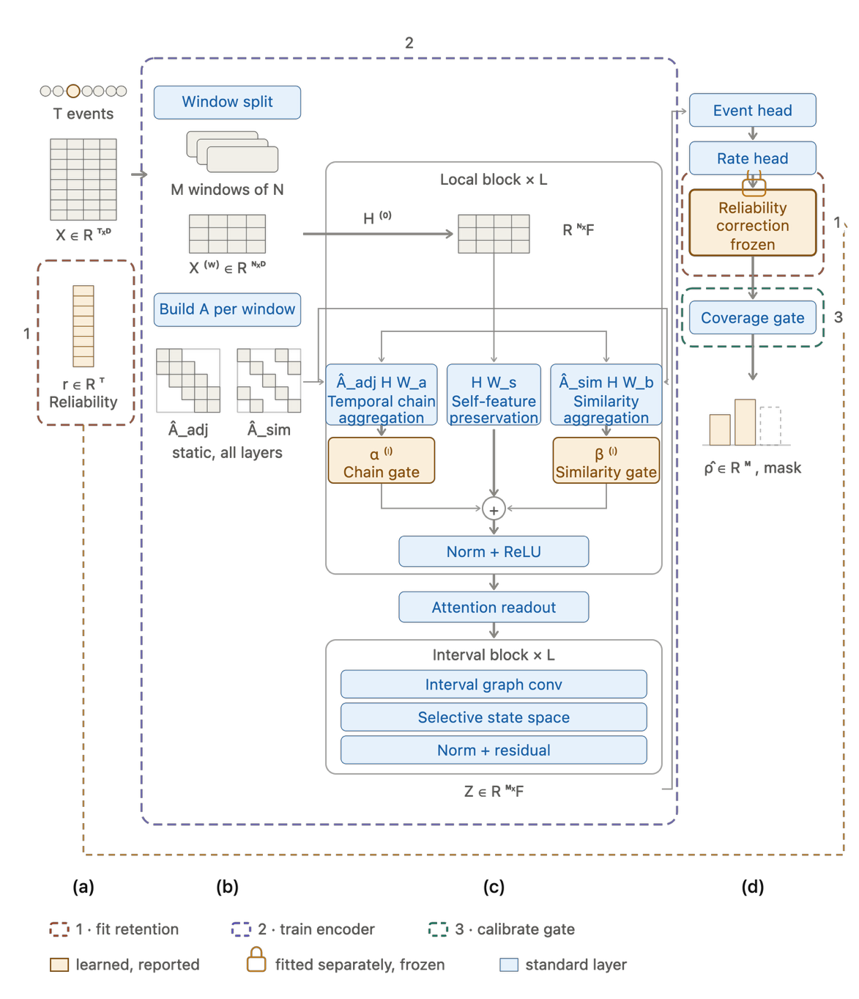
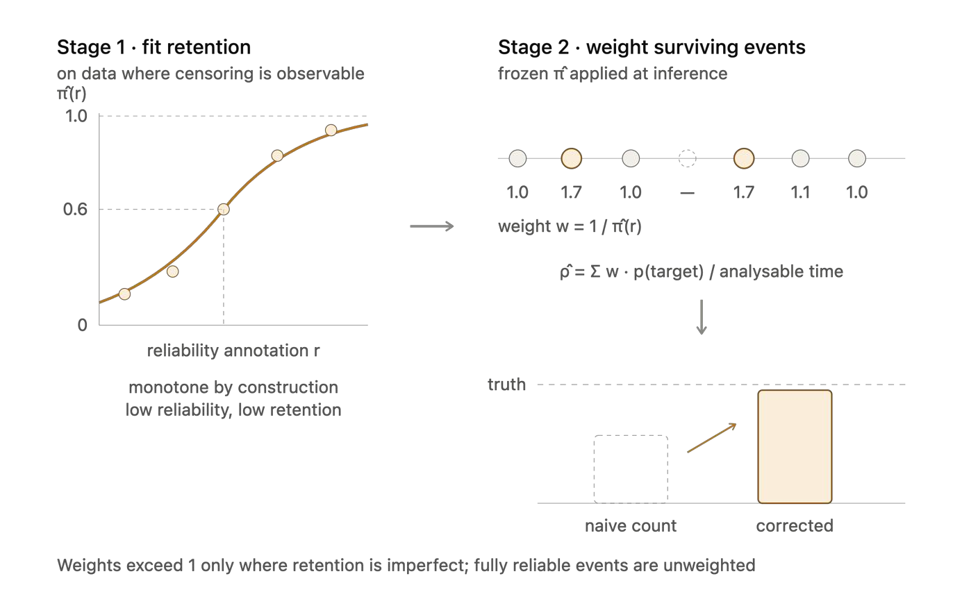
Appendix B3: Three-Stage Estimation and the Retention Correction
Stage 1 fits the retention curve where censoring is observable; Stage 2 weights each surviving beat by 1/π(r); Stage 3 calibrates the coverage gate that decides whether a value is reported.

Slide 43
Appendix C1: Data Analysis Plan
Objective | Primary metrics | Statistical treatment
RO1 | Change in F1 and AUROC between representations; share of ectopic vs normal beats removed; count discrepancy | DeLong test for AUROC; paired bootstrap for F1; Bland–Altman bias and limits; κ at ESVEA cut-offs
RO2 | Beat level: PAC sensitivity, PPV, F1. Day level: MAE of the daily count; agreement with the true count | Subject-wise splits; Bland–Altman; Friedman test with Nemenyi post hoc across models; bootstrap 95% CI; ablation contrasts
RO3 | Proportion with ≥3 valid days (primary); analysable yield; computability; day-to-day agreement; ESVEA proportion | One-sided test against the red-zone boundary (50%); Wilson 95% CI; ICC(2,1); linear mixed-effects model for activity; plausibility against published cohorts
RO4a | Reclassification of ESVEA status; sensitivity and specificity of wearable ESVEA | Rates with Wilson 95% CI across a severity sweep per degradation operator; κ against ECG-derived status
RO4b | Agreement and overlap between selections; association with atrial substrate | Cohen κ and Jaccard index; logistic regression and rank correlation with 95% CI; descriptive only
Missing data are modelled rather than deleted: the per-beat quality flag and time since the last accepted beat enter the model, the retention correction reweights the count, and the daily rate is weighted by time of day.

Slide 44
Appendix C2: RO3 Instrument and Precision
Field (Garmin) | What it provides
Enhanced BBI series | Beat-level intervals; a PAC appears as a short interval then a longer pause
Per-beat confidence | Binary flag; abnormally short beats are marked low, so they are retained and reweighted, not deleted
Beat timestamp | Places each beat in time and relative to the index stroke; enables time-of-day weighting
Gap indicator | Separates “not recording” from “recording, no beat”; defines the coverage denominator
Accelerometer | Separates true ectopy from movement artefact; RQ3.4
Raw PPG | Not available from the device: the loss quantified in RO1
Wilson 95% CI by sample size
n | At 50% | At 80% | ESVEA 25.3%
20 | 30 to 70% | 58 to 92% | 11 to 47%
30 | 33 to 67% | 63 to 90% | 13 to 43%
40 | 35 to 65% | 65 to 90% | 14 to 41%
50 | 37 to 63% | 67 to 89% | 15 to 39%
ESVEA prevalence stays imprecise at any feasible n, so RQ3.5 is a plausibility check; event-rate estimation can need 60 to 100 participants (Teare et al., 2014).
To confirm before ethics: confidence and gap encoding in the export; battery life under 7-day continuous BBI with accelerometer; SDK access and licensing.

Slide 45
Appendix C3: Operational Definitions
Term | Definition used throughout this study
Beat-interval series | The sequence of pulse-to-pulse intervals a watch reports, without the waveform
Per-beat quality flag | The device confidence that a reported interval is a genuine beat
Coverage | The proportion of a monitoring period with analysable intervals, reported separately for daytime and night-time blocks
Valid day | A day meeting the pre-specified minimum coverage in both blocks
Ectopy rate | Ectopic beats per hour, weighted by time of day; extrapolated to 24 h for comparison with per-day thresholds
ESVEA | ≥30 supraventricular ectopic complexes per hour or a run of ≥20 (Binici et al., 2010); ≥480 per day or runs of 10 to 29 s for MonDAFIS comparison (Haeusler et al., 2025)
Pulse deficit | A premature beat that produces no detectable wrist pulse, so the watch reports one long interval instead of two

