Slide 1
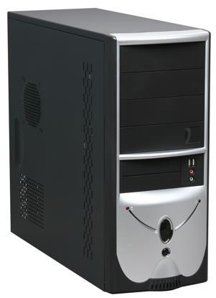


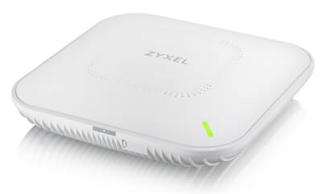
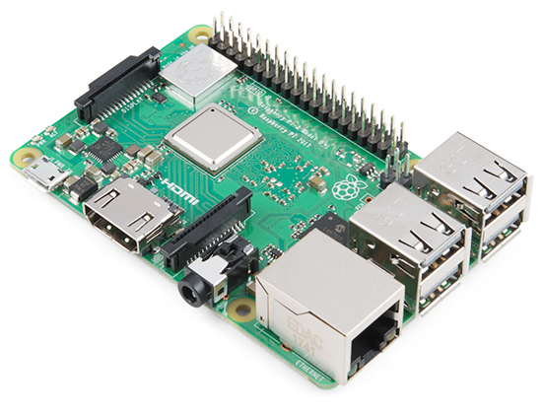
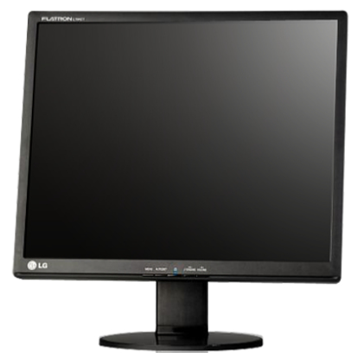
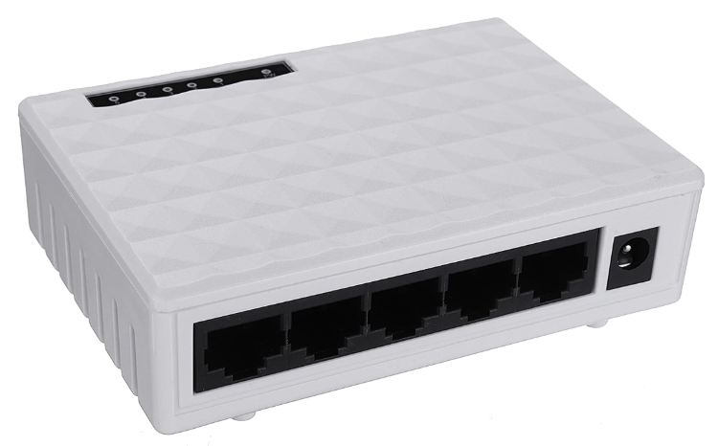


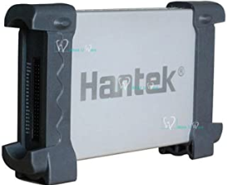
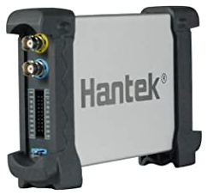
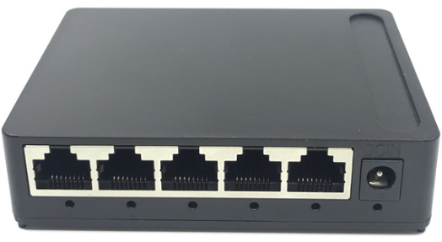
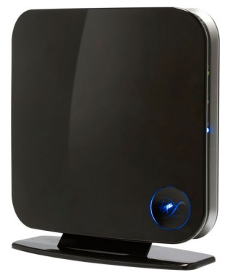
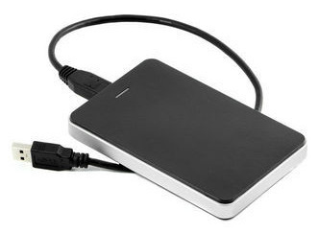
One slide presentation – all others will seem bloated from now on
Shelf mains power
6x 4TB HDD in Raid-Z2
480GB SATA SSD
10Gbps
Desk mains power
4TB HDD
480GB NVME
1Gbps
1Gbps
1Gbps
Power brick
Bench mains power
Bench power rail
Auto
swap-over
100Mbps
1Gbps
100Mbps
100Mbps
1Gbps
100Mbps
Power brick
100Mbps
100Mbps
100Mbps
Passive splitter
+
Auto swap-over
Passive injector
Pi server + 2TB USB HDD
100Mbps
60Mbps
100Mbps
Web server
Mains power
Power brick

