Slide 1

OSDA BIG HW
“FCA”
Faculty of Computer Science
Data Science
By Rudenkov Dmitriy
Moscow, 2021

Slide 2

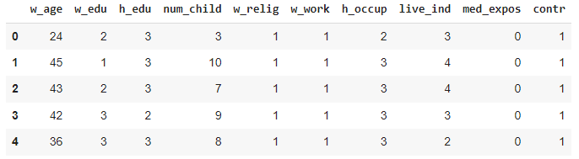
Faculty of Computer Science
«Contraceptive Method Choice Data Set»
Description
Problem
Attribute Information
This dataset is a subset of the 1987 National Indonesia Contraceptive Prevalence Survey. The samples are married women who were either not pregnant or do not know if they were at the time of interview.
To predict the current contraceptive method choice (no use, long-term methods, or short-term methods) of a woman based on her demographic and socio-economic characteristics. Number of Attributes: 9. Number of Instances: 1473.
1. Wife's age (numerical) 2. Wife's education (categorical) 1=low, 2, 3, 4=high 3. Husband's education (categorical) 1=low, 2, 3, 4=high 4. Number of children ever born (numerical) 5. Wife's religion (binary) 0=Non-Islam, 1=Islam 6. Wife's now working? (binary) 0=Yes, 1=No 7. Husband's occupation (categorical) 1, 2, 3, 4 8. Standard-of-living index (categorical) 1=low, 2, 3, 4=high 9. Media exposure (binary) 0=Good, 1=Not good 10. Contraceptive method used (class attribute) 1=No-use, 2=Long-term, 3=Short-term

Slide 3
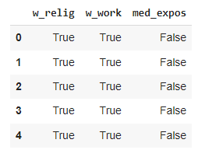

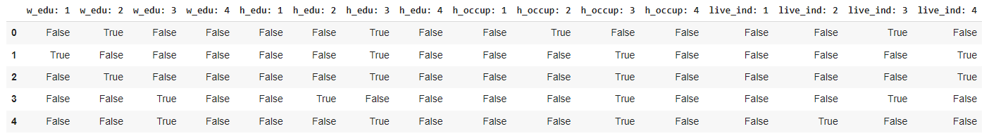
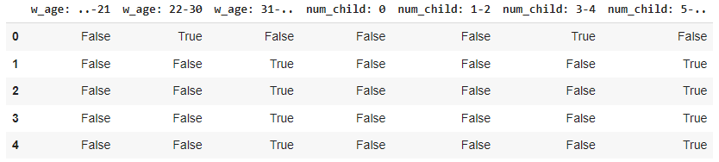
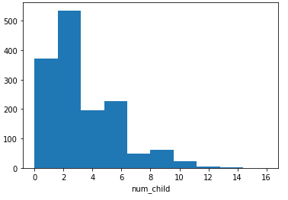
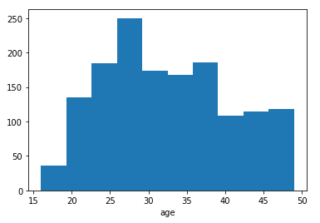
Faculty of Computer Science
Attributes binarization
Numerical
Categorical
Prediction class
Binary
For «Wife's age»: 1) <=21 (age of majority) 2) 22<=…<=30 (mid life) 3) >=31
For « Number of children ever born »: 1) 0 (child free temporary) 2) 1 and 2 (average European family) 3) 3 and 4 4) more and equal 5
Categorical attributes were converted into a set binary features (for example, the attributes "Standard-of-living index" was transform to for binary attributes "living index 1", " living index 2", "living index 3","living index 4")
We don’t change binary attribute.
We will be classify if women use or not contraceptive

Slide 4
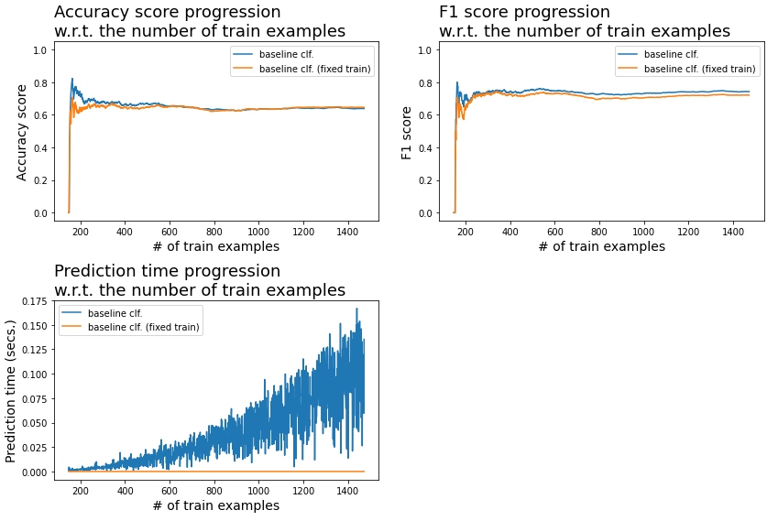

Faculty of Computer Science
Prediction algorithm
Analyze results
We use baseline algorithm for lazy FCA-based classification. And it is called "Generators framework“
We split all train data to positive and negative examples. To classify the descriptions, we follow the procedure:
1) Count the number of counterexamples for positive examples. For each positive example we compute the intersection. Then, we count the counterexamples for this intersection, that is the number of negative examples containing intersection;
2) Dually, count the number of counterexamples for negative examples. For each negative example we compute the intersection. Then, we count the counterexamples for obtained intersection, that is the number of positive examples containing intersection.
Finally, we compare the average number of counterexamples for positive and negative examples. We classify as being positive if the number of counterexamples for positive examples is smaller the one for negative examples.

Slide 5
Thanks for the attention

