Slide 1





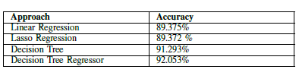
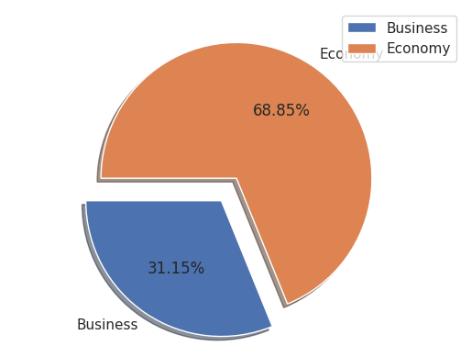
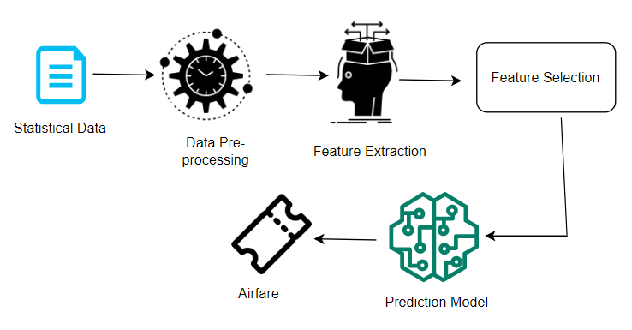
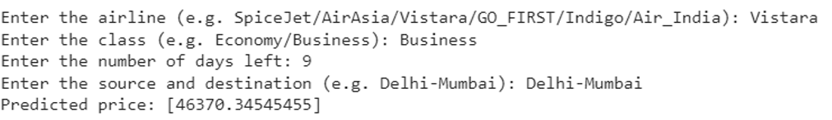
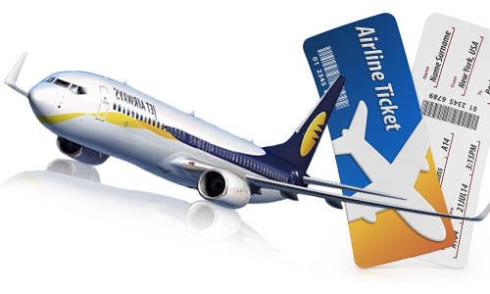
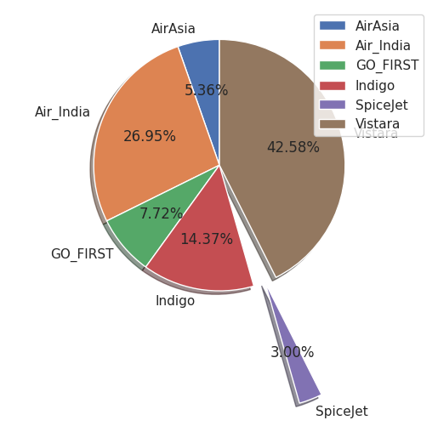
Flight Price Prediction using Machine Learning
Ridima Verma, (PhD Research Scholar)
[AU2149013]
Ahmedabad University
Abstract
Model
Results
Conclusion
In the airline industry, predicting flight fares is a crucial matter that affects both consumers and providers. To tackle this challenge, different machine learning techniques, such as linear regression, decision trees, random forests, and neural networks, have been implemented. A thorough assessment was carried out to examine the benefits and drawbacks of various machine learning methods, and their efficiency was tested on a real-world dataset. The findings indicate that machine learning approaches have greatly enhanced the accuracy of flight fare prediction, providing valuable insights for airlines and customers to make informed decisions.
The prediction model for flight fare prediction uses machine learning techniques to forecast flight fares and inform pricing decisions.
The model employs various machine learning techniques, including linear regression, lqsso regression, decision tree and decision tree regressor trained on historical flight data.
Pre-processing techniques are applied to the training data to handle missing values and outliers, and feature selection techniques are used to identify the most relevant variables.
Model performance is evaluated using metrics such as mean absolute error, mean squared error, and root mean squared error.
The study compares the performance of different machine learning algorithms on a real-world data set.
The developed prediction model provides valuable insights for airlines and customers to make informed decisions about ticket pricing and purchasing.
To improve machine learning models, hyper-tuning should be performed using GridSearchCV or RandomSearchCV.
After hyper-tuning, machine learning model is trained and evaluated using performance measures such as accuracy.
Accuracy is the proportion of correctly expected data points among all data points.
The input for the flight fare prediction model includes airline name, class, number of days, and source and destination cities.
The given example takes input for Vistara airline, business class, 9 days, and Delhi-Mumbai as source and destination cities to predict ticket fare.
The report explored various regression techniques to predict flight fares.
The techniques investigated were linear regression, lasso regression, decision tree, and decision tree regressor.
The data used in this study consisted of factors such as departure time, arrival time, airline, route, and number of stops.
All four methods produced reasonable predictions of flight fares.
The lasso regression model performed better than the other models by identifying the most important features in predicting flight fares and producing more accurate predictions.
Regression techniques have potential for predicting flight fares and a combination of these techniques could be used to produce the most accurate predictions depending on the specific needs of the user.
Problem Formulation
Model Accuracy
Flight fares impact airlines and passengers.
Accurate prediction can help optimize pricing strategies and inform purchasing decisions.
Traditional approaches to prediction are ineffective.
Need to evaluate and compare effectiveness in real-world scenarios.
Study aims to provide comprehensive review of techniques and their advantages.
Goal is to develop a precise prediction model and provide insights.
Output: Price Prediction
Share of economy vs business class for domestic travel
Bibliography
Air Fare machine learning model
[1] W. Groves and M. Gini, ”A regression model for predicting
optimal purchase timing for airline tickets,” Technical
Report 11-025, University of Minnesota, Minneapolis, 2011.
[2] H.-C. Huang, ”A hybrid neural network prediction model
of air ticket sales,” Telkomnika Indonesian Journal of Electrical Engineering, vol. 11, no. 11, pp. 6413–6419, 2013.
[3] M. Papadakis, ”Predicting Airfare Prices,” 2014. Clerk Maxwell.
[4] T. Janssen, ”A linear quantile mixed regression model
for prediction of airline ticket prices,” in A Treatise on
Electricity and Magnetism 3rd ed., vol. 2, 2014, pp. 68- 73
[5] R. Ren, Y. Yang and S. Yuan, ”Prediction of the airline
ticket price,” Technical Report, Stanford University, 2014.
https://www.aionlinecourse.com/blog/airline-tickets-price-prediction
Analysis of share of airlines in domestic travel

