Slide 1



ICBT · INNOVA 2026 · IEEE COMPUTER SOCIETY
TrustFarm
Trusted AI irrigation and farm energy
Sense → Verify → Predict → Advise → Power
3D DIGITAL TWIN
TRUST-GATED AI
WASTE-TO-ENERGY
International College of Business Technology · Sri Lanka
Live demo: github.com/Ridma-kithara/TrustFarm_INNOVA
Notes:
Open with the product, not the slides. This is TrustFarm: an interactive 3D farm twin, a trust gate for sensor data, a 3-hour irrigation forecast, and energy-aware advice. Everything shown is a working prototype; field results are not claimed yet.

Slide 2

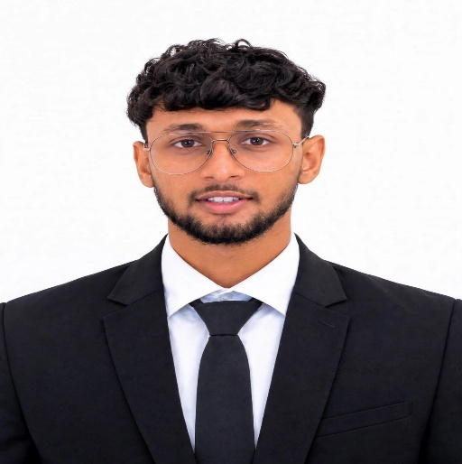
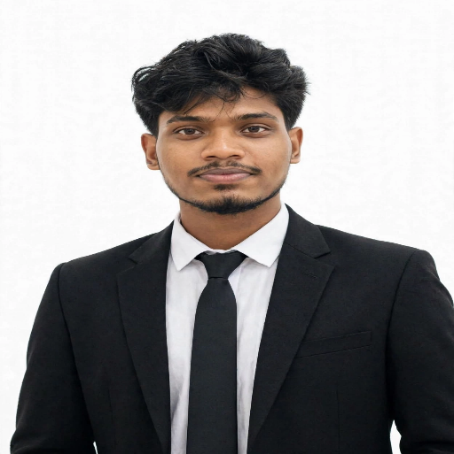
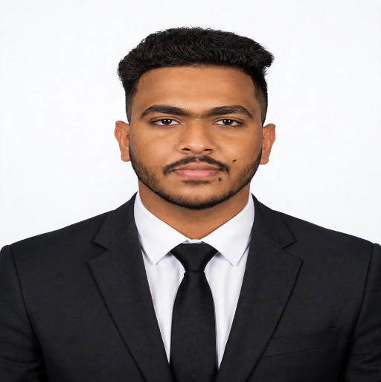

TEAM · ICBT
Four disciplines. One integrated system.
TEAM OF 4
International College of Business Technology · INNOVA 2026
“Trust before advice.”
AI & backend · web & mobile · IoT & communication · deployment & integration
TEAM LEADER
G.W.W.M.R. Kithara Kirinda
AI & Backend
B.V.D.T. Senmitha Binaragama
IoT & Communication
W.P.A. Rasith Maleesha
Web & Mobile Applications
B.W.A.M. Kaushalya
Deployment & Integration
One codebase, one demo story: sensing → trust → forecast → advice → energy.
Notes:
Four members, four clear ownership areas. Kithara leads and owns AI/backend; Kaushalya owns deployment and integration; Rasith owns web and mobile; Senmitha owns IoT and communication. Avoid the old '3-member team' line.

Slide 3
PROBLEM
Bad data becomes confident bad advice.
PROBLEM
Low-cost field sensors fail quietly — and the model still produces an answer.
01
Sensor degrades
THE GAP BETWEEN IoT AND AI
Dirty, corroded, disconnected or stuck probes produce plausible-looking values.
A forecast is only as trustworthy as the reading behind it.
02
The model trusts it
A forecast cannot tell a real soil reading from a stuck one.
Good data in → advice the farmer can act on.
Bad data in → a confident answer that is still wrong.
03
The farmer acts
Wrong irrigation advice wastes water and erodes trust in AI.
TrustFarm inserts a verification layer before the model is allowed to advise.
TrustFarm · INNOVA 2026 · ICBT
03 / 25
Notes:
This is the core problem: sensor faults are silent. The system does not just need a better model; it needs a gate that decides whether the model should be allowed to speak.

Slide 4
SDG ALIGNMENT
Trust is the enabling layer for water, food and climate action.
SDG 2 · 6 · 13
The project contributes to three SDGs through one operating loop.
2
Zero Hunger
6
Clean Water
13
Climate Action
PRIMARY FOCUS
SECONDARY
SECONDARY
Better irrigation decisions protect yields and reduce avoidable crop stress.
Fewer wrong irrigations mean less pumped water and less waste.
Farm waste is treated as an energy resource, not a disposal problem.
The measurable claim is narrower than the vision: trusted advice, less wasted water, and visible energy — validated in a pilot before savings are claimed.
TrustFarm · INNOVA 2026 · ICBT
04 / 25
Notes:
Keep SDG claims proportional. The project supports SDG 2, 6 and 13 through better irrigation decisions and farm-energy visibility; it does not yet claim measured water savings.

Slide 5
SOLUTION
One loop: sense, verify, forecast, advise, power.
SOLUTION
Trust-gated AI plus energy-aware irrigation advice — demonstrated in a live 3D twin.
SENSE
VERIFY
PREDICT
ADVISE
POWER
ESP32 + INA219
Trust Engine
3-hour forecast
Explained action
Energy gate
DATA-QUALITY GATE
3-HOUR FORECAST
ENERGY-AWARE ADVICE
The model is not always allowed to answer.
Soil moisture, 36 steps ahead.
Water only when power allows.
Green → advise. Amber → predict, but ask for a sensor check. Red → pause and alert.
A GradientBoosting model forecasts soil moisture; a balanced classifier turns it into Low / Medium / High need.
Battery state and generation can turn “irrigate now” into “delay or use manual supply”.
This is one integrated system — not three disconnected prototypes.
Status: trust engine, forecast, advice, monitoring and 3D twin are implemented. Physical energy hardware and field validation are next.
TrustFarm · INNOVA 2026 · ICBT
05 / 25
Notes:
Explain the loop in one breath. The differentiator is not a single model; it is the order: verify first, then predict, then advise, then check energy. The 3D twin is the interface for the same loop.

Slide 6
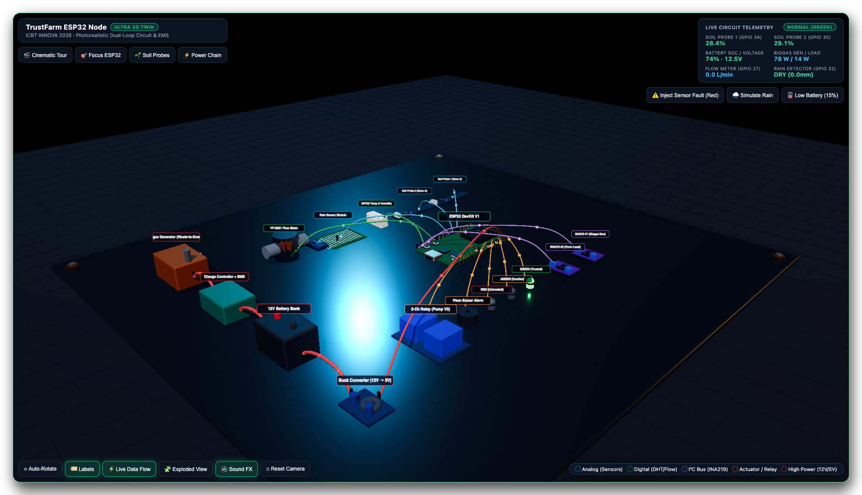
3D SYSTEM VIEW
Interactive 3D digital twin.
IMPLEMENTED · THREE.JS
A real browser-based hardware model — not a rendered mock-up.
WHAT JUDGES CAN DO
• Orbit and inspect labelled ESP32, probes, INA219, relay, battery and generator.
• Inject a fault and watch Trust turn Red; the buzzer and LED respond.
• Simulate rain or 15% battery to show wet/dry logic and PROTECT mode.
• Follow the data through animated flow particles and pin labels.
NORMAL · GREEN
FAULT · RED
RAIN
The same model is the visual language for the mobile twin on the next slide.
circuit.html · actual project model · demo telemetry shown
TrustFarm · INNOVA 2026 · ICBT
06 / 25
Notes:
This is the visual proof. Open circuit.html and orbit it live if possible. The model shows the actual ESP32, two soil probes, DHT22, rain sensor, flow meter, two INA219 channels, relay, battery and biogas generator. The buttons inject a fault, rain and low battery.

Slide 7
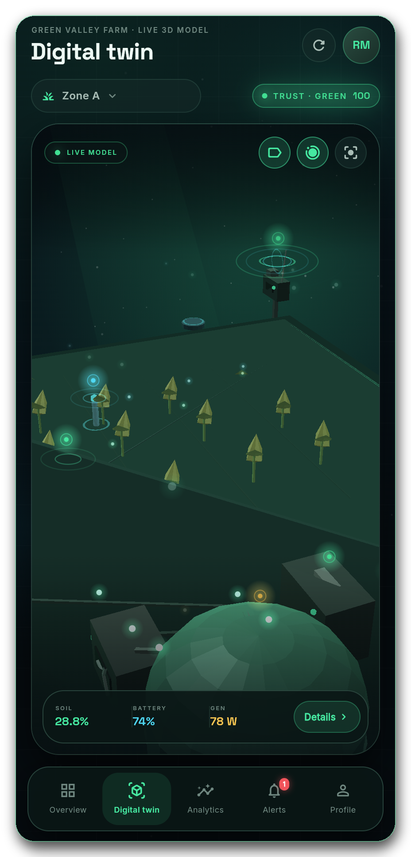
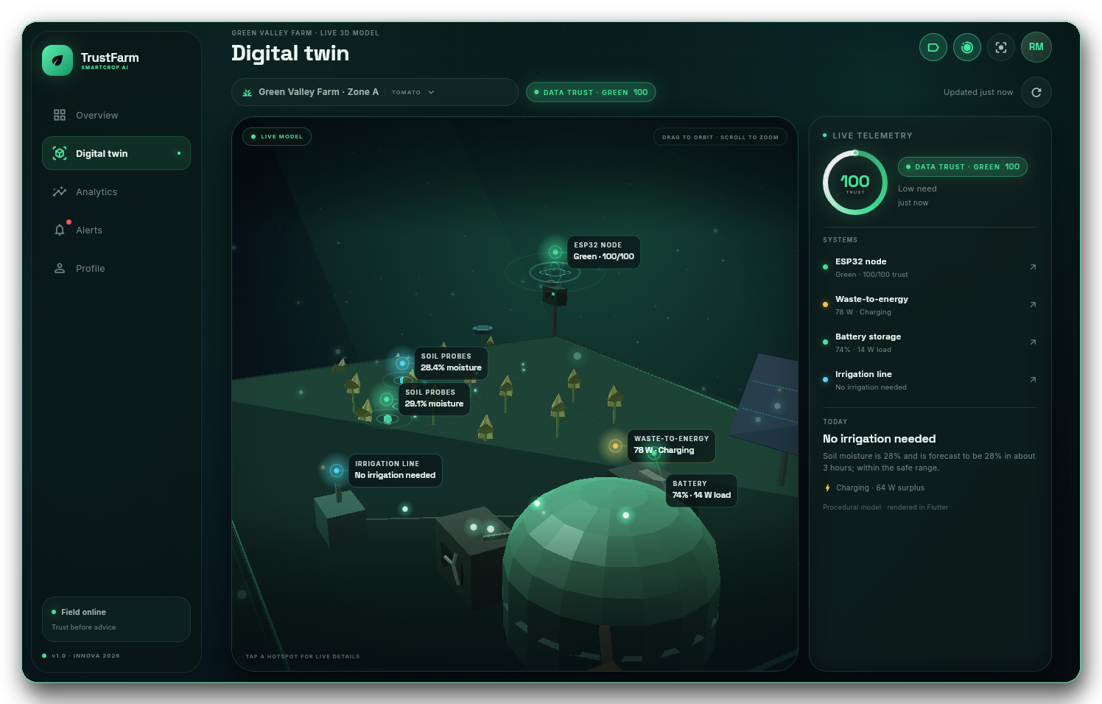
DIGITAL TWIN · MOBILE
The twin in your hand.
IMPLEMENTED · FLUTTER
The Flutter app uses the same telemetry, trust state and 3D language.
TAP A HOTSPOT
• ESP32 node · Green 100/100
• Soil probes · 28.4% and 29.1%
• Waste-to-energy · 78 W charging
• Battery · 74% with 14 W load
• Irrigation line · no action
OFFLINE BEHAVIOUR
The app keeps the last verified state and shows it as cached when the server is unreachable.
Preview rendered from the actual Flutter build with seeded demo data.
TrustFarm · INNOVA 2026 · ICBT
07 / 25
Notes:
The mobile twin is the same product logic in a smaller form factor. Drag to orbit, tap a hotspot, and the panel shows the same numbers as the desktop build. The offline cache is real; push notifications are not.

Slide 8
ARCHITECTURE
One system, two physical paths.
IMPLEMENTED + PROPOSED
Data flows from field to advice; energy flows from waste to farm loads.
DATA PATH
ESP32 + sensors
Mosquitto
FastAPI + DB
Trust + AI
Apps
soil ×2 · DHT22 · rain · flow
MQTT 1883 · user + password
ingest · SQLAlchemy · Postgres
checks · forecast · advice
React web · Flutter mobile
telemetry every 60 s
REST / JSON · JWT
ENERGY PATH
Organic waste
Digester
Generator
Controller + BMS
Battery → loads
farm + food waste
sealed anaerobic
gas cleaning + generator
charge · protect
12 V bank · sensors · pump
INA219 #1 generation + #2 load → FastAPI → energy mode and advice
Implemented in code: field ingest, trust gate, forecast, advice, monitoring and apps.
Proposed / supervised build: digester, gas cleaning, generator, charge controller and BMS. The code monitors; it does not control the physical energy plant.
TrustFarm · INNOVA 2026 · ICBT
08 / 25
Notes:
Keep the two paths visually separate. The data path is implemented end to end. The energy path is a supervised physical build; the software monitors generation, load and battery and uses that to gate advice.

Slide 9
TRUST ENGINE
Check the data before the model.
IMPLEMENTED
Three layers of checks produce a 0–100 trust score and a Green / Amber / Red decision.
01
Basic integrity
score = 100 − penalties
Missing values · impossible range · stale > 15 min · stuck for 12 readings · jump > 15 points.
GREEN
≥ 80
Advice allowed
02
Cross-sensor checks
AMBER
50–79
Predict, but ask for a manual check; no automatic irrigation
Two probes disagree by > 15 (warn) or > 25 (major) · soil falls while rain is detected.
RED
< 50
Advice paused; alert raised; no prediction
03
Learned anomaly
Isolation Forest scores the latest 5-minute window against normal behaviour.
Typical penalties: stale 60 · range 60 · missing 40 · mismatch 40/20 · stuck 35 · jump 30 · anomaly 25.
Penalties add up. The lowest score decides the level.
TrustFarm · INNOVA 2026 · ICBT
09 / 25
Notes:
Do not describe this as a black-box AI score. It is an additive penalty system plus an Isolation Forest. Green allows advice, Amber still calls the model but the advice becomes a manual-check request, and Red returns before prediction.

Slide 10
DECISION FLOW
From reading to recommendation.
IMPLEMENTED
Trust and energy both have veto power over the final advice.
READING
TRUST
FORECAST
ENERGY
ADVICE
soil1/2 · temp · rain
flow · battery · generation
Green / Amber / Red
score + flags
3 h soil moisture
Low / Medium / High
SoC · generation
PROTECT / CONSERVE
act · check · delay
or pause
GREEN
AMBER
RED
Advice allowed
Predict, but verify
Stop and alert
High + energy OK → “Irrigate now”.
Medium → “Prepare to irrigate soon”.
Model still runs; advice becomes “check the sensor manually”.
No automatic irrigation.
No prediction. Advice is “sensor data not trusted”.
Critical alert is raised.
Correction from the original deck: Amber still reaches the model. It is cautious guidance, not a blocked state.
TrustFarm · INNOVA 2026 · ICBT
10 / 25
Notes:
This corrects a common misreading of the pipeline. Amber is not blocked; it predicts but refuses automatic action. Red is the only state that returns before prediction. The energy gate can also downgrade an irrigation action.

Slide 11
AI FORECASTING
Three hours ahead, with safety rails.
IMPLEMENTED · SYNTHETIC-TRAINED
The forecast is useful only when its inputs and limits are visible.
1
5-min history
Recent soil, temperature, humidity, rain and flow from the last 7 hours.
SAFETY RAILS
High need < 25% soil moisture
Medium need < 35%
Wilting override < 20% forces High
2
10 features
soil · 15-min / 1-h / 6-h change · temp · humidity · rain 1 h / 6 h · hour-of-day.
3
3-hour forecast
36 steps at 5-minute resolution — corrected from the old “3 to 6 hours” claim.
STILL PLACEHOLDERS
4
Need class
RandomForest with balanced classes: Low / Medium / High.
These thresholds are global. Per-crop calibration, local soil data and SHAP explanations are explicitly future work.
5
Reason text
Rule/feature-based explanation, not SHAP. SHAP is a future extension.
Forecast target: 3 h at 5-min resolution · Baseline: persistence · Evaluation: MAE / RMSE.
TrustFarm · INNOVA 2026 · ICBT
11 / 25
Notes:
This slide fixes two old claims: the horizon is 3 hours, not 3–6, and SHAP is not wired. The explanation is generated from the feature values. The thresholds are placeholders and must be tuned per crop before field use.

Slide 12
HARDWARE
The node that produces the data.
FIRMWARE IMPLEMENTED
ESP32, two soil probes, DHT22, rain, flow and dual INA219 power sensing.
PIN / INTERFACE
SENSOR
GPIO 34
Soil probe 1 (analog)
GPIO 35
Soil probe 2 (analog)
GPIO 32
Rain sensor (wet/dry)
GPIO 27
YF-S201 flow (pulse)
GPIO 4
DHT22 temperature + humidity
I²C 0x40
INA219 generation / charger
I²C 0x41
INA219 farm load
60 s publish · 60-message ring buffer · NTP timestamps
Physical node not photographed. The image is the project’s interactive 3D wiring model; firmware is in firmware/esp32.
TrustFarm · INNOVA 2026 · ICBT
12 / 25
Notes:
Use the pin table as the technical anchor. The firmware publishes every 60 seconds and buffers 60 messages if the network drops. The physical build is not evidenced in the repository, so label it as firmware-complete but hardware-pending.

Slide 13
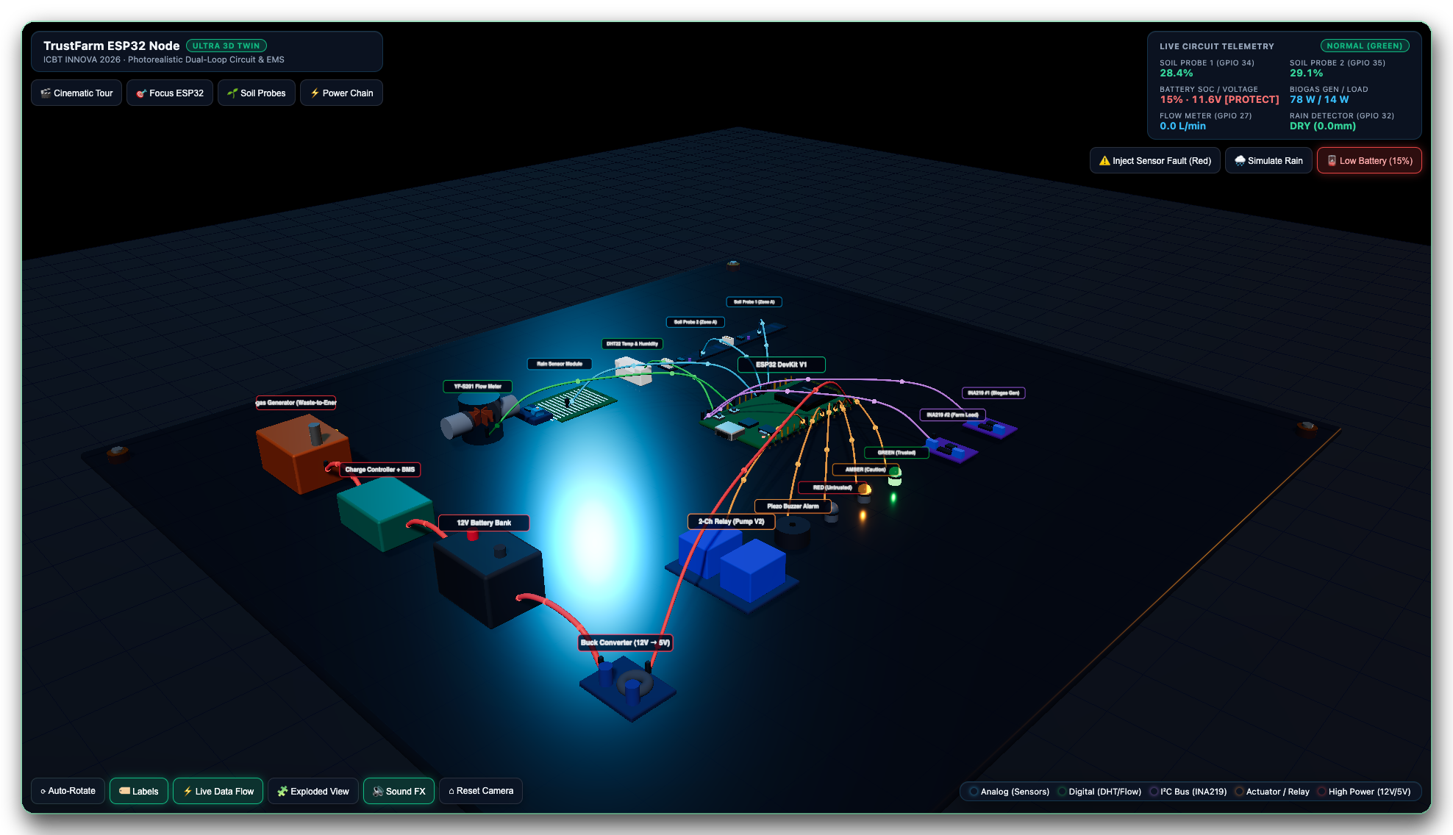
ENERGY
Monitor first. Automate later.
MONITORING IMPLEMENTED
The energy layer can delay irrigation — but the prototype does not switch the pump.
1
Organic waste
farm and food waste
2
Anaerobic digester
sealed, supervised
3
Gas cleaning + generator
biogas → electricity
4
Charge controller + BMS
charge and protect
5
12 V battery → loads
sensors · network · pump
Advice only: the code never actuates the pump. Digester, generator, BMS and wiring are a supervised physical build.
3D model shown in 15% battery PROTECT state.
< 20% · PROTECT
< 40% + low gen · CONSERVE
50 W pump · energy gate
TrustFarm · INNOVA 2026 · ICBT
13 / 25
Notes:
This is the honest energy story. The software reads generation, load and battery, then applies 20% PROTECT and 40% CONSERVE thresholds. It does not control a BMS or switch a pump. The digester and generator are a proposed, supervised build.

Slide 14
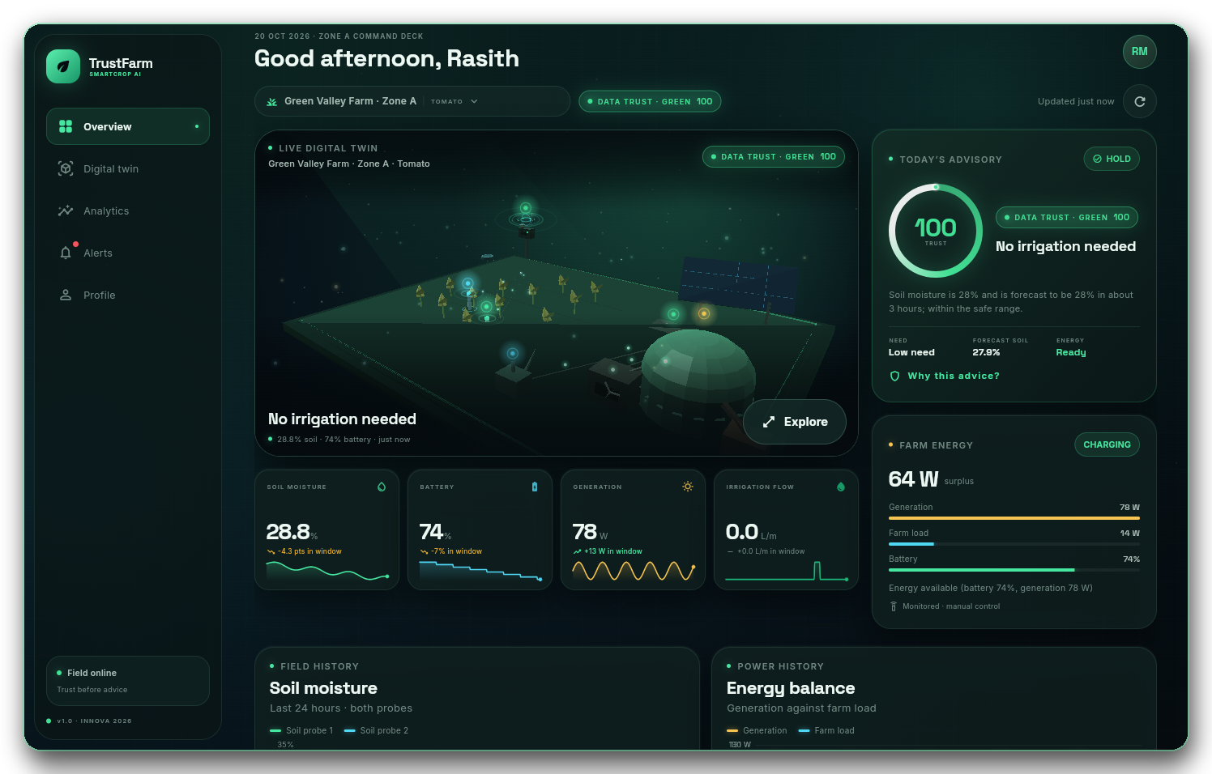
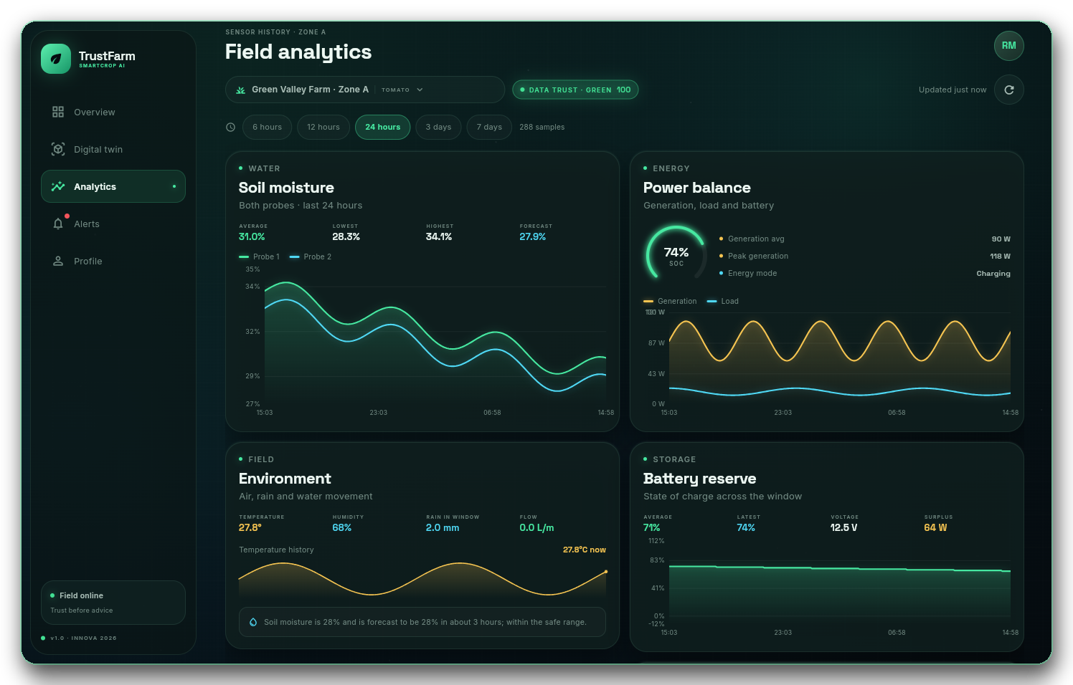
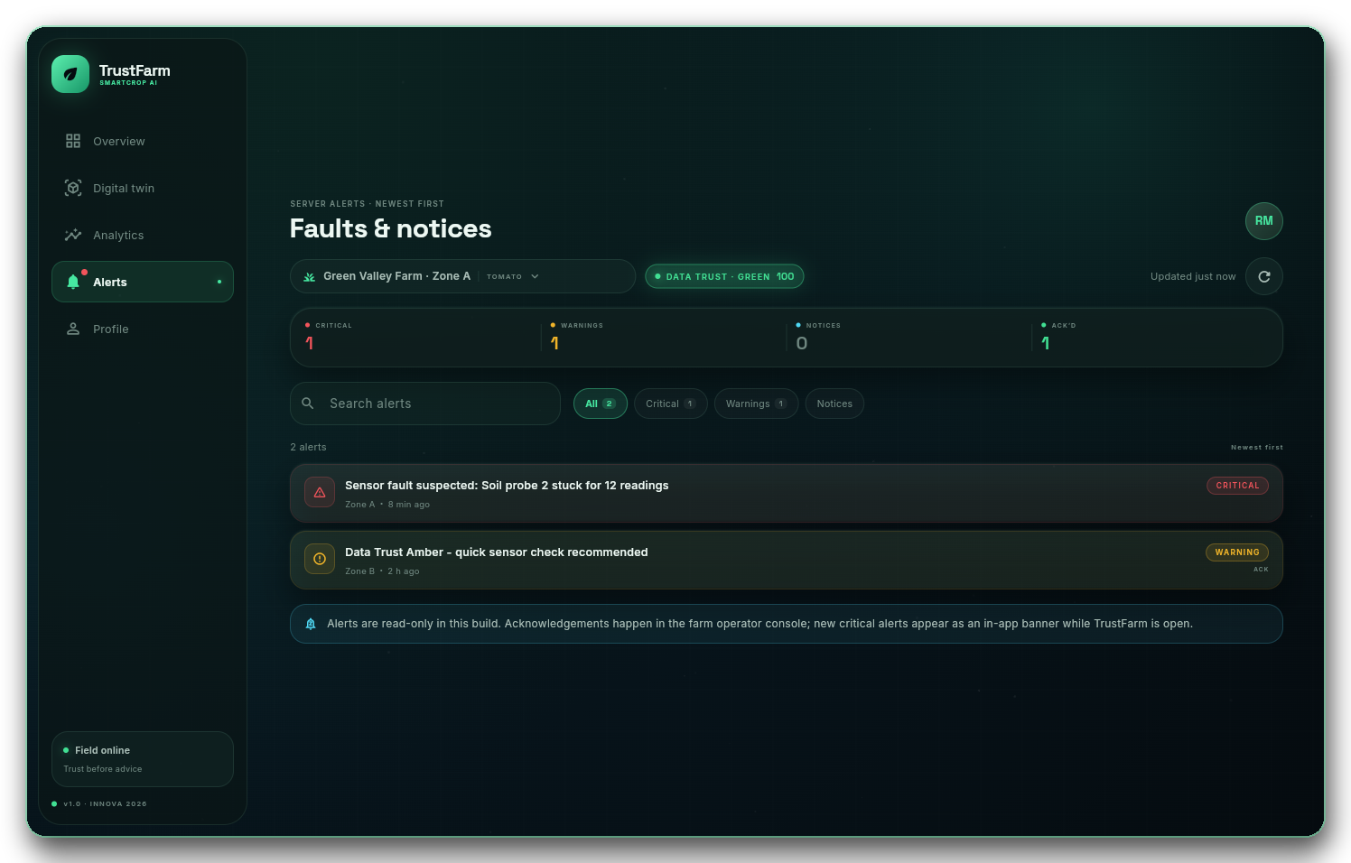
APPLICATIONS
One app, three views.
FLUTTER · RESPONSIVE
Live overview, 24-hour analytics and read-only alerts — on desktop and mobile.
Overview
Analytics
Alerts
Trust, advice, energy and the 3D hero.
Soil, power, environment and battery.
Critical and warning events.
IMPLEMENTED
NOT YET
Live dashboards · 3D twin · trust history · offline cache of last safe state.
Push notifications · automatic pump control · production TLS.
TrustFarm · INNOVA 2026 · ICBT
14 / 25
Notes:
These are real screenshots from the Flutter build with seeded demo data. The alerts screen is read-only in this build. Push notifications and automatic pump control are not implemented; do not claim them in the demo.

Slide 15
DATA FOUNDATION
Four datasets. One honest evidence label.
IEEE DATAPORT
Public data supports development. It is not a substitute for a field pilot.
AquaIntel
AgriField-Manipur
Biogas Swine Farm
Semantic-Aware IoT
MEASURED
SYNTHETIC / SIM.
SYNTHETIC / SIM.
SYNTHETIC / SIM.
10.21227/tt8w-qh19
10.21227/kbpa-7d35
10.21227/jd39-y840
10.21227/xnk1-yn46
Soil moisture, water level, flow, temperature, pump status, real faults.
Temperature, humidity, soil moisture, pH, rainfall, crop and district.
Biogas production, inflow, substrate and temperature time-series.
Soil, humidity, temperature, NPK, pH, energy and latency; 60k records.
USED FOR
USED FOR
USED FOR
USED FOR
Trust engine · anomaly checks · irrigation forecasting.
Classification features · crop/weather context.
Energy module · scenario generation.
IoT validation · network resilience benchmarks.
Only AquaIntel is measured hardware data. The other three are synthetic or simulated; they support development and testing, not field claims.
TrustFarm · INNOVA 2026 · ICBT
15 / 25
Notes:
This slide prevents dataset inflation. AquaIntel is the one measured hardware dataset. The other three are synthetic or simulated. All four are useful for development, but none is a local field pilot.

Slide 16
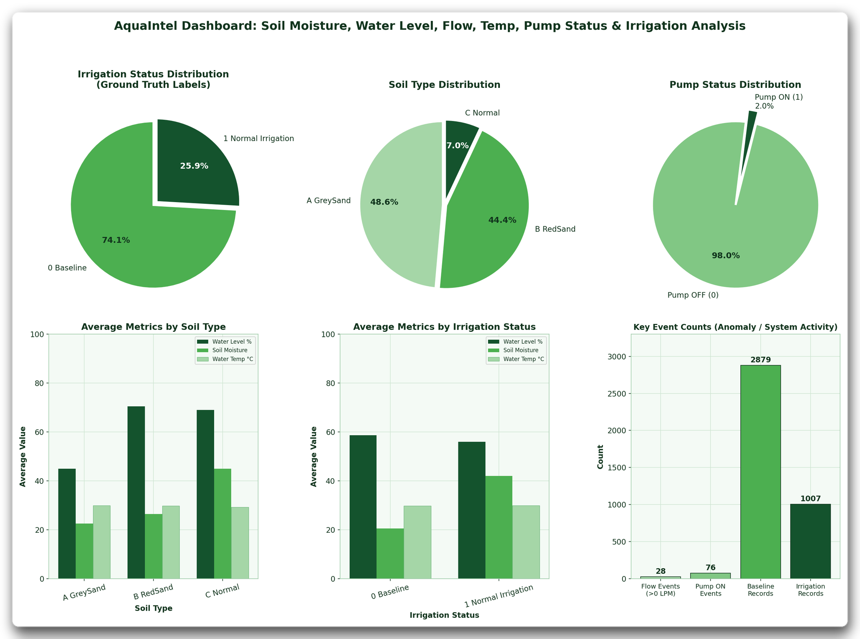
DATASET ANALYSIS · AQUAINTEL
Measured hardware data — and a very small pump signal.
MEASURED
AquaIntel is the strongest evidence in the current data stack.
WHAT THE DATASET SHOWS
2,879
1,007
baseline records
irrigation records
• Pump ON only 2% of records — a pump-state predictor would be dominated by “off”.
• Three soil types split 48.6% grey sand, 44.4% red sand, 7.0% normal; moisture and water level differ.
• Real fault labels support anomaly checks and trust-engine evaluation.
• Used for trust features, irrigation labels and forecast sanity checks.
Measured hardware dataset · IEEE DataPort 10.21227/tt8w-qh19
Charts generated from the AquaIntel dataset.
TrustFarm · INNOVA 2026 · ICBT
16 / 25
Notes:
AquaIntel is the only measured hardware dataset. The key insight is the extreme class imbalance: pump ON is only 2% of records. That is why the system focuses on trust and anomaly detection rather than claiming a strong pump predictor.

Slide 17
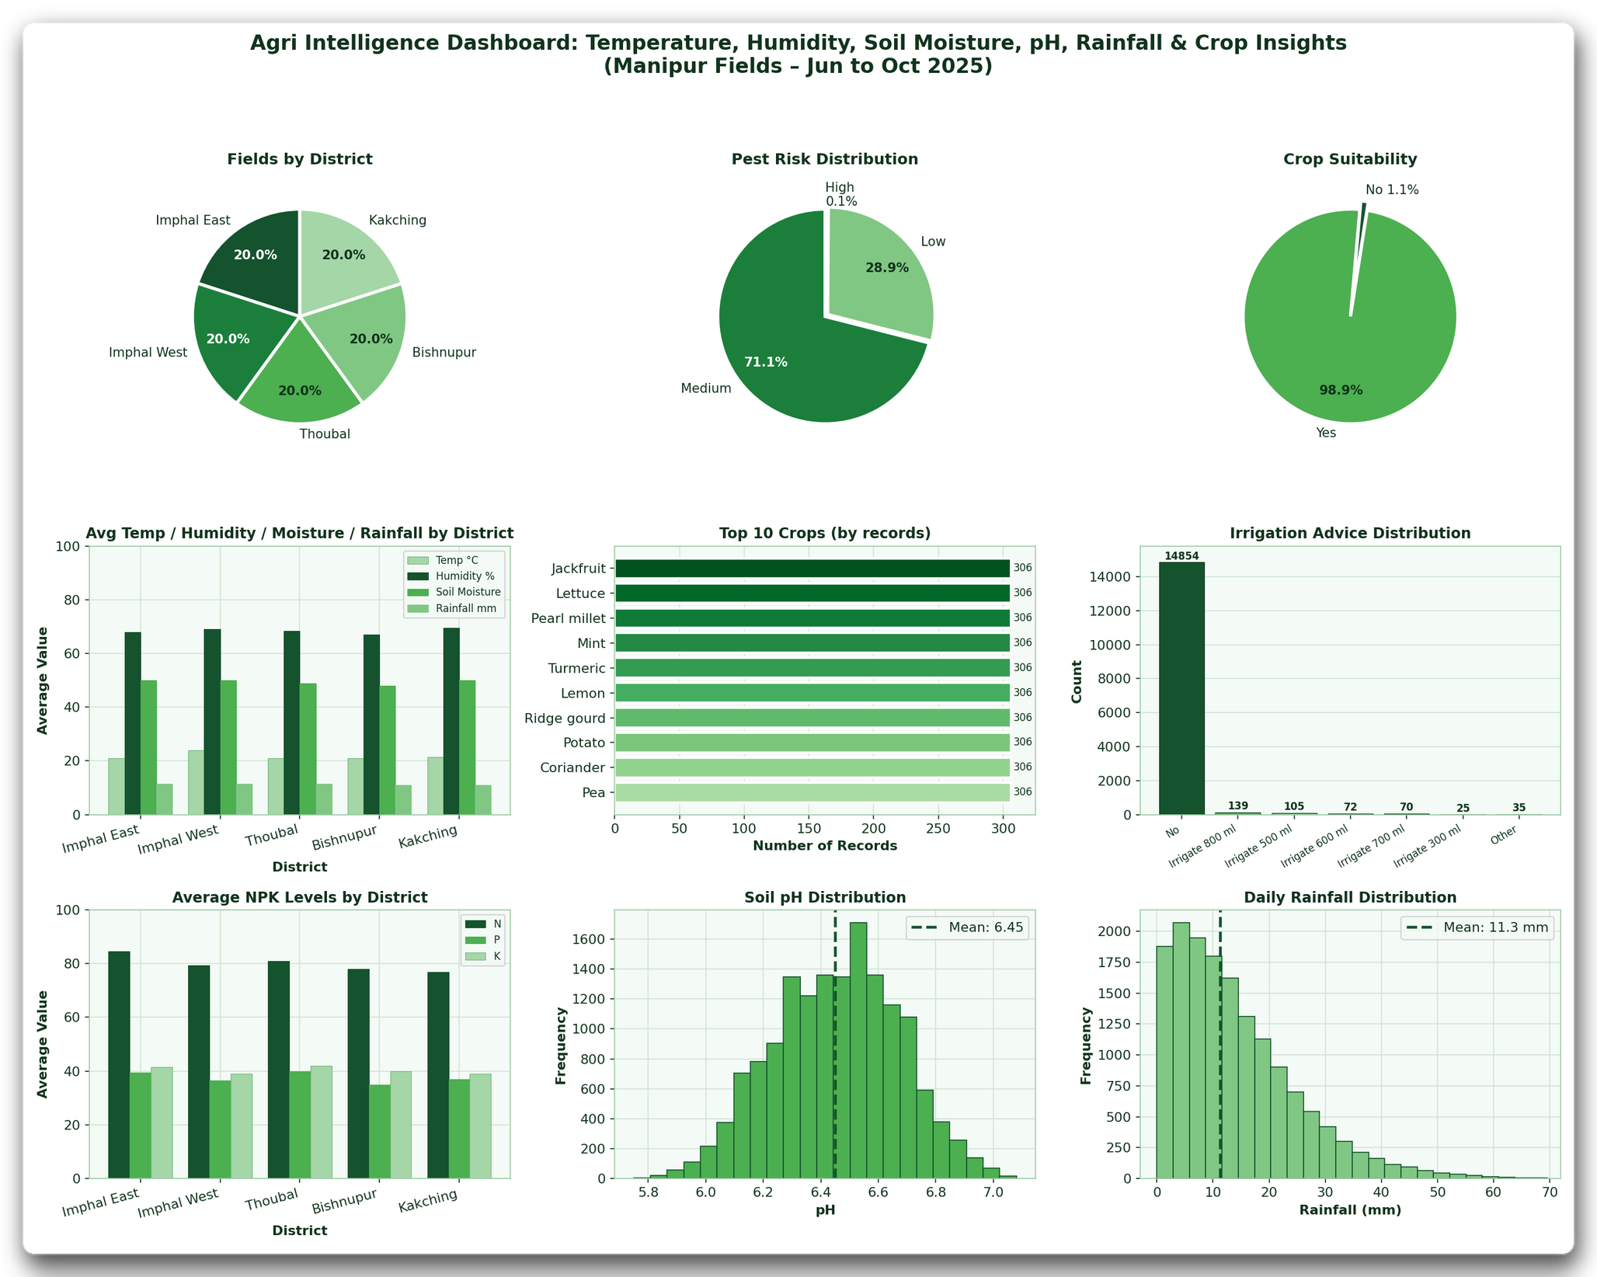
DATASET ANALYSIS · AGRIFIELD
Useful features, dangerous accuracy.
SYNTHETIC / SIMULATED
The irrigation labels are heavily imbalanced — so accuracy alone is misleading.
LABEL DISTRIBUTION
14,854
139
“No irrigation”
“Irrigate 800 ml”
• Rare positive class means recall and F1 matter more than headline accuracy.
• pH mean 6.45 and mean daily rain 11.3 mm — useful context, not a local calibration.
• Crop, district and weather features support classification and crop-aware rules.
• Synthetic / simulated data: use it to design the pipeline, not to claim field accuracy.
AgriField-Manipur · IEEE DataPort 10.21227/kbpa-7d35
Charts generated from the AgriField-Manipur dataset.
TrustFarm · INNOVA 2026 · ICBT
17 / 25
Notes:
The AgriField dataset has 14,854 no-irrigation labels against 139 irrigate-800 ml labels. A model can look accurate by always predicting no irrigation. That is why the deck talks about recall and F1, not just accuracy.

Slide 18
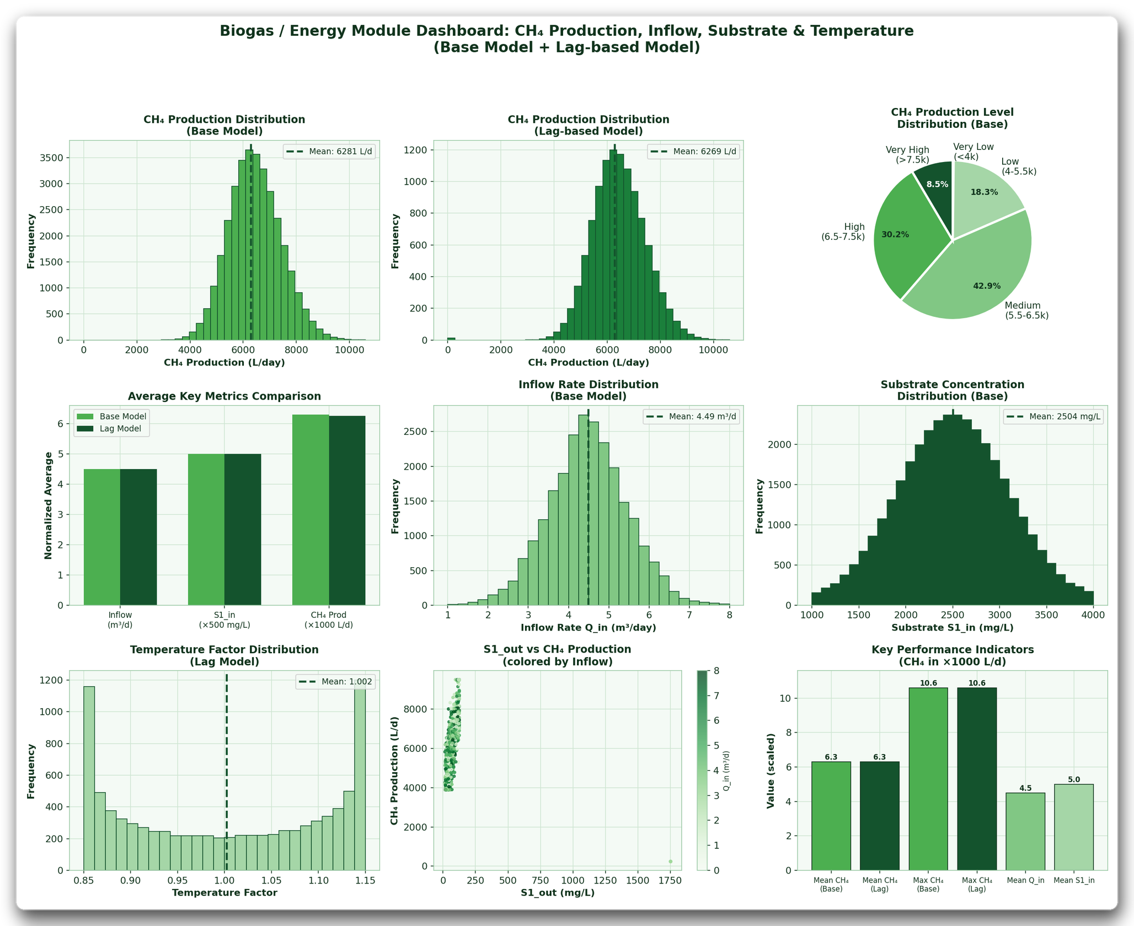
DATASET ANALYSIS · ENERGY + IOT
Two synthetic datasets, two design inputs.
SYNTHETIC / SIMULATED
Biogas gives an energy scenario; Semantic-Aware IoT gives a resilience benchmark.
BIOGAS SWINE FARM
6,281
6,269
L/day base
L/day lag model
Mean CH₄ production. Use as a scenario generator for energy-aware advice — not a yield guarantee.
SEMANTIC-AWARE IoT
60k
90.1%
55 ms
records
no migration
mean latency
Network-resilience benchmark: most records stay on the current node; latency is bounded.
Biogas charts: synthetic dataset 10.21227/jd39-y840.
TrustFarm · INNOVA 2026 · ICBT
18 / 25
Notes:
Neither of these datasets is a field validation of TrustFarm. Biogas production is a scenario input for the energy module. Semantic-Aware IoT is a benchmark for edge/cloud resilience. Keep those claims separate.

Slide 19
MODELLING
A small, auditable pipeline.
IMPLEMENTED
Cleaning, features, time-ordered split, training and evaluation — all in the repository.
CLEAN
FEATURES
SPLIT
TRAIN
EVALUATE
range · missing
stale · ordering
soil deltas · rain
hour-of-day
time-ordered
train / test
forecast · need
anomaly
MAE / RMSE
precision / recall
FORECAST
NEED + ANOMALY
GradientBoostingRegressor
RandomForest + IsolationForest
10 features · 36-step horizon · persistence baseline · MAE and RMSE on a held-out time block.
Balanced class weights for Low / Medium / High. Isolation Forest is trained on normal sensor behaviour only.
No future leakage: the split is chronological. Missing values are limited-interpolated and forward-filled before feature construction.
Training code: ai_service/train.py · Serving: ai_service/app/main.py
TrustFarm · INNOVA 2026 · ICBT
19 / 25
Notes:
Keep the pipeline defensible. It is not a deep-learning system. It is a gradient-boosted forecast, a balanced random forest and an isolation forest, with a chronological split and a same-as-now baseline.

Slide 20
RESULTS
What the numbers actually show.
SYNTHETIC HOLDOUT
Forecast error improves; fault detection is still below the target.
FORECAST ERROR · LOWER IS BETTER
47.5%
7.5%
baseline
model
sensor-fault detection
false-alarm rate
2.853
BELOW 90% TARGET
SYNTHETIC ANOMALY TEST
99.7%
3 h
1.056
1.157
classifier accuracy
forecast horizon
0.504
SYNTHETIC, THRESHOLD-ALIGNED
36 × 5-MIN STEPS
MAE
RMSE
The near-perfect classifier is expected: labels are threshold-derived. It is not evidence of field accuracy.
MAE falls 52.3% and RMSE falls 59.5% against persistence. These are synthetic held-out results, not field measurements.
Do not present synthetic metrics as field performance. The next gate is a pilot with labelled sensor faults.
TrustFarm · INNOVA 2026 · ICBT
20 / 25
Notes:
These numbers come from meta.json. The forecast is meaningfully better than persistence. Fault detection is 47.5%, well below the 90% target, so present it as a baseline to improve. The classifier is 99.7% on synthetic, threshold-aligned labels; that is not a field claim.

Slide 21
SECURITY & RELIABILITY
Useful prototype. Not production-secure yet.
PROTOTYPE
The honest gaps are part of the engineering plan.
Identity & access
Transport
IMPLEMENTED
GAP
JWT sessions · farmer / officer / admin roles · per-device MQTT credentials.
MQTT on 1883 with username/password · local HTTP. TLS, restricted CORS and secret rotation are required before deployment.
Field resilience
Control boundary
IMPLEMENTED
BY DESIGN
ESP32 ring buffer (60 messages) · stale-reading flag · app cache of the last verified state.
Advice only. The relay appears in the model, but the pipeline never actuates the pump.
Known gaps to say out loud: no TLS, no push notifications, no automatic pump control, voltage-based SoC only.
TrustFarm · INNOVA 2026 · ICBT
21 / 25
Notes:
This slide is deliberately blunt. The prototype has auth, roles, buffering and offline cache. It does not have TLS, push notifications, pump actuation or a proper BMS. Those are production gates, not hidden features.

Slide 22
VALIDATION
Planned evidence, risks and exit criteria.
TARGETS, NOT CLAIMS
The pilot is the next gate. No field results are claimed yet.
VALIDATION LADDER
RISK CONTROLS
1
Bench calibration
raw dry/wet, two probes per zone, repeatability
Sensor failure
two probes, calibration, trust gate
2
Fault injection
stuck, spike, drift, missing, network loss
Biogas / electrical
ventilation, gas detection, pressure relief, fuses, earthing, supervision
3
Model evaluation
MAE/RMSE vs persistence; High-need recall
Data mismatch
public data for development; local data for local conclusions
4
Energy test
generation, charge, load, SOC estimate
5
Two-zone pilot
labelled faults and measured water/energy
Security
TLS, secret rotation, restricted CORS before deployment
SUCCESS TARGETS · not achieved yet
≥ 95%
readings received
≥ 90%
faults detected
< 3 s
dashboard response
TrustFarm · INNOVA 2026 · ICBT
22 / 25
Notes:
The current synthetic fault detection is 47.5%, so the 90% target is honest but not achieved. The validation ladder moves from bench to fault injection to a two-zone pilot. Do not say 'tested in a two-zone pilot' until that actually happens.

Slide 23
INNOVA LIVE DEMO
Six beats. One story.
DEMO SCRIPT
Normal → fault → Red → recovery → energy constraint → 3D explanation.
0:00
0:30
1:00
Normal state
Inject a stuck probe
Advice pauses
Green trust, no irrigation, 3D twin live.
Soil probe 2 freezes; telemetry turns Red.
Red state stops the recommendation and raises an alert.
1:30
2:00
2:30
Restore the sensor
Low battery
Orbit the 3D twin
Trust returns to Green; advice resumes.
15% SOC → PROTECT; irrigation is delayed.
Show pins, data flow and the energy path.
Fallback: python tools/simulator.py → s (stuck) · j (spike) · b (low battery) · n (normal). Label simulator data as simulated.
TrustFarm · INNOVA 2026 · ICBT
23 / 25
Notes:
Rehearse this exact sequence. The strongest moment is not the normal dashboard; it is the transition from a plausible sensor value to a Red trust state and a paused recommendation. If hardware is unavailable, run the simulator and say so.

Slide 24
IMPACT & NEXT GATES
A useful prototype with a clear path.
HONEST STAGE
Impact is plausible; feasibility is demonstrated; field evidence is still ahead.
IMPACT
FEASIBILITY
ROADMAP
• Fewer wrong irrigations by stopping advice on untrusted data.
• Less wasted water — target, to be measured in the pilot.
• More trust in AI because the reason and the data state are visible.
• Energy visibility links water decisions to available power.
• 4-member team with clear ownership across AI, apps, IoT and integration.
• Open stack FastAPI, Postgres, scikit-learn, React, Flutter, Three.js.
• Local-first Docker deployment and simulator-based demos.
• Not yet a field pilot, production security or automatic pump control.
NOW
3D twin · trust gate · 3h forecast · monitoring
NEXT
TLS · push alerts · per-crop calibration · two-zone pilot
LATER
Pump control with hard limits · LoRa/SMS · multi-farm cloud
The current claim is a working prototype — not a deployed farm product.
Every next step has an explicit gate: measured evidence first, then automation.
TrustFarm · INNOVA 2026 · ICBT
24 / 25
Notes:
Close the argument with proportion. The impact is credible but not yet measured. Feasibility is real: the stack runs and the 3D twin works. The next gates are security, calibration and a two-zone pilot; automation comes after that.

Slide 25
THANK YOU
Trust before
advice.
Questions & live demo
Interactive 3D circuit:
ridma-kithara.github.io/TrustFarm_INNOVA/circuit.html
Source:
github.com/Ridma-kithara/TrustFarm_INNOVA
Team TrustFarm · ICBT · INNOVA 2026
Demo data unless hardware is connected.
Notes:
End on the product principle: trust before advice. Invite the judges to orbit the circuit model or open the mobile twin, then take questions. Be explicit that the demo data is seeded unless the hardware is connected.

