Slide 1
Project on CSE 4110 Black Jacks
BY
Dept. of Computer Science and Engineering, KUET.
Name | Roll No.
Md. Tawfiq Ibne Amin | 1707034
Naeem Mia | 1707041
Md. Shahidul Islam | 1707051

Slide 2
Outline
Introduction
Rules
Implementation

Slide 3
Introduction
We are interested in building a game as a project in this lab.
The game will be a multiplayer game.
The game we chose is a card game.
One player is human.
There are also a dealer and an Artificially Intelligent player.
According to the characteristics of the game, The game is named as “Black Jacks”

Slide 4
Outline
Introduction
Rules
Implementation

Slide 5
Rules
Objective:
The main objective of Black Jack game is to make point nearly or equal to 21. If one player can make 21 point, he is undoubtedly be winner. If point is greater than 21, he will be out of the game.

Slide 6
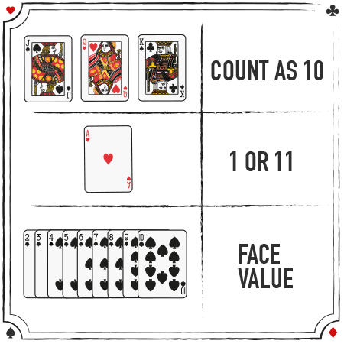
Rules
Point distribution:

Slide 7
Rules
Algorithm:
There are two ways to play the game.
One is Stand and another is Hit.
One player can hit if his point is not nearly 21.
The other player can hit if previous player stands.
If all players stand, the dealer will start playing.

Slide 8
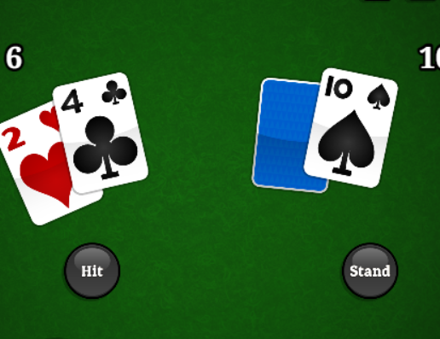
Rules
Hitting:
Players target is to obtain point 21.Untill he get nearly or equal to 21 players continue hitting.
Here player point is 6. There have large gap between 21and 6. So the player can hit until he got nearly or equal to 21.For one hit player get one random new card.

Slide 9
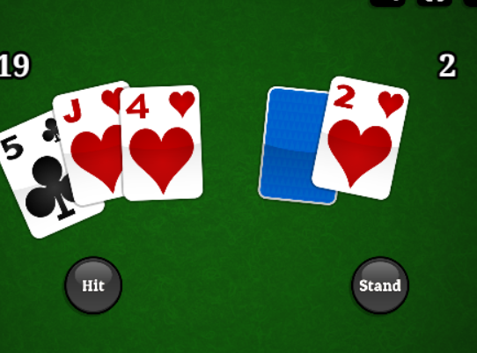
Rules
Stand:
If the point is nearly or equal 21 the player stands to skip playing. Then the other player find chance to play.
Here the point is 19. that is nearly 21. If the player take one hit then there has a chance to overflow of 21. So the player need to stand to skip his round.

Slide 10
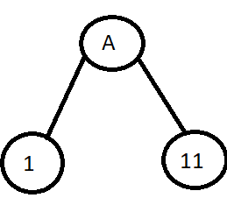
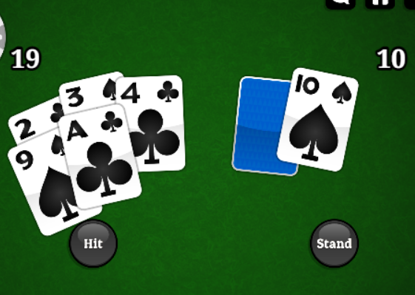
Rules
Technique:
There are two different values of card labeled as A. They are 1 and 11. In runtime player should decide what value should be taken.
If A=11 total=29 and the player will lose. So the player need to decide the value of A optimally.

Slide 11
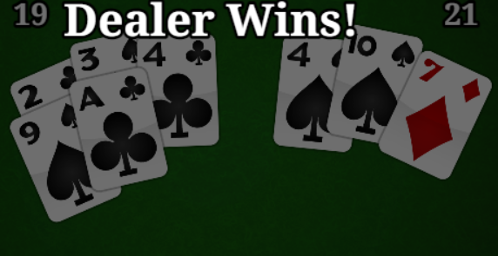
Rules
Dealer Hit:
If all players stand, now the dealer can hit. He can hit until points less than 17. If 17 or more is scored, the dealer stop hitting. If dealer has point more than 21 , dealer will bust.
Here the player stands then the dealer hit his card until found 17. The dealer has a significant role to detect the winner among players.

Slide 12
Rules
Result Decision:
If one player find 21 he will be called Black Jack and he wins.
If any player find more than 21, he will lose.
If all player stands, the dealer define the winner. The player having more point than dealer wins.
If no player has more points than dealer, the dealer wins.

Slide 13
Rules
Result Decision:
If one player has equal point to dealer, the match will be drawn.
If more than one player obtain 21 point, The match will also be drawn.
If the players have more points than the dealer, the players win.
If dealer is busted, players win.

Slide 14
Outlines
Introduction
Rules
Implementation

Slide 15
Implementation
To implement the black jack game, We want to use Python language and Jupyter Notebook or Spyder notebook as IDE.

Slide 16
Thank You

Slide 17

Any Question

