Slide 1
Project on CSE 4110
Black Jack
BY
Dept. of Computer Science and Engineering, KUET.
Name | Roll No.
Md. Tawfiq Ibne Amin | 1707034
Naeem Mia | 1707041
Md. Shahidul Islam | 1707051

Slide 2
Outline
Introduction
Rules
Implementation

Slide 3
Introduction
We are interested in building a game as a project in this lab.
The game will b a multiplayer game.
One player is human and other one should be computer or Artifitial Intallegence(AI).
The game we chose is a card game.
According to the characteristics of the game, The game is named as “Black Jacks”

Slide 4
Outline
Introduction
Rules
Implementation

Slide 5
Rules
Objective:
The main objective of Black Jack game is to make point nearly or equal to 21. If one player can make 21 point, he is undoubtedly be winner. If point is greater than 21, he will be out of the game.

Slide 6
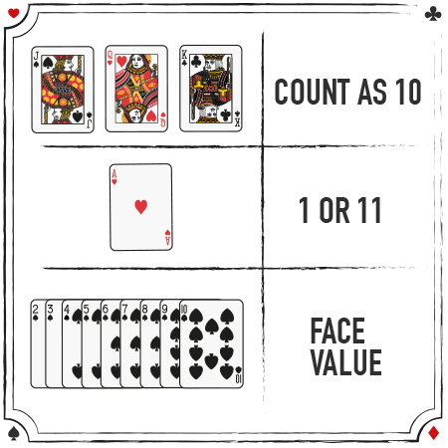
Rules
Point distribution:

Slide 7
Rules
Algorithom:
There are two ways to play the game.
One is Stand and another is Hit.
One player can hit if his point is not nearly 21.
The other player can hit if previous player stands.
If all players stand, the dealer will start playing.

Slide 8
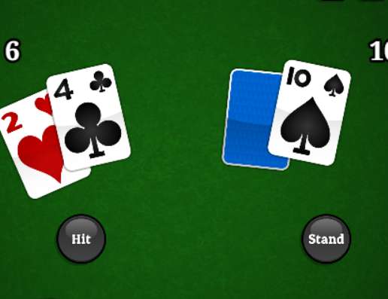
Rules
Hitting:
Players terget is to obtain point 21.Untill he get nearly or equal to 21 players continue hitting.
Here player point is 6. There have large gap between 21and 6. So the player can hit until he got nearly or equal to 21.For one hit player get one rendom new card.

Slide 9
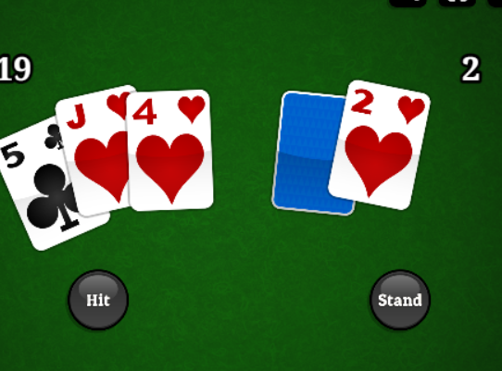
Rules
Stand:
If the point is nearly or equal 21 the player stands to skip playing. Then the other player find chance to play.
Here the point is 19. that is nearly 21. If the player take one hit then there has a chance to overflow of 21. So the player need to stand to skip his round.

Slide 10
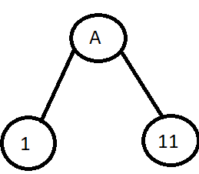
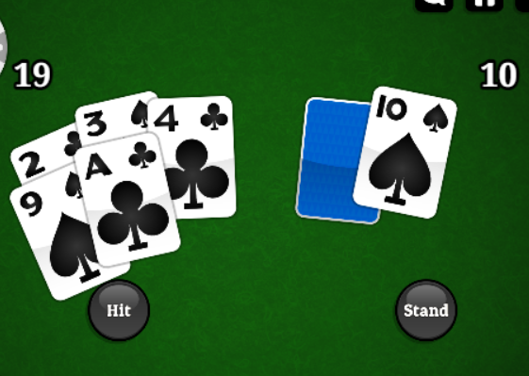
Rules
Technique:
There have two different values of card leveled by A. They are 1,11. In runtime player should decide what value should take.
If A=11 total=29 and the player will lose. So the player need to decide the value of A optimally.

Slide 11
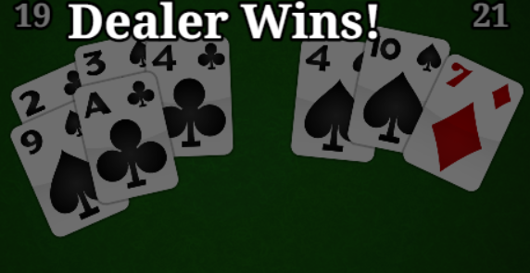
Rules
Dealer Hit:
If all player stands, There have a chance to hit by dealer. The dealer hit until he get 17. If 17 is scored, the dealer stop his hit.
Here the player stands then the dealer hit his card until found 17. The dealer has a significant role to detect the winner among players.

Slide 12
Rules
Result Dicision:
If one player find 21 he will be called Black Jack and he wins.
If any player find more than 21, he will lose.
If all player stands, the dealer define the winner. The player who has more point than dealer, he wins.
If no player has more points than dealer, the dealer wins.

Slide 13
Outlines
Introduction
Rules
Implementation

Slide 14
Implementation
To implement the black jack game, We want to use Python language and Jupyter Notebook or Spyder notebook as IDE.

Slide 15
Thank You

Slide 16

Any Question

