Slide 1



Edge Computing Innovation
TRINITY
REAL-TIME CONSTRUCTION SITE SAFETY MONITORING SYSTEM BASED ON EDGE COMPUTING AND COMPUTER VISION
Team members:
> Nguyen Nhat Phat – 23110053
> Tran Quoc Huy – 23110026
> Le Huu Truc – 23110068

Slide 2
PROJECT
1. Motivation
2. Objectives
3. Related works
4. Datasets
5. Methods
6. Results
OUTLINE
7. Conclusion
8. Application demo

Slide 3
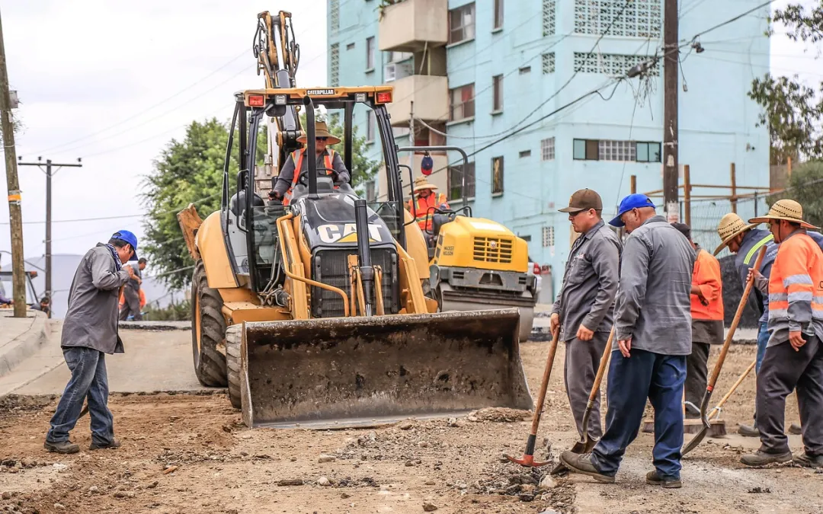
1. Motivations
Construction sites are highly dangerous environments that require strict safety monitoring.
7,004 occupational accidents / 658 fatalities in Vietnam, 2025 (MOLISA)
Manual CCTV monitoring suffers fatigue, misses real-time violations
Cloud AI: high latency, heavy bandwidth cost, privacy risk
PPE violated construction site

Slide 4
2. Objectives
Develop an Edge AI system for real-time construction site safety monitoring.
Detect PPE violations and hazardous situations automatically.
Provide low-latency on-site alerts.
Reduce false alarms through temporal verification.
Minimize bandwidth and preserve privacy using an edge-first architecture.

Slide 5
3. Related Works
Related Works | Research Gaps
YOLO-based PPE detection with attention modules [Z. Wu et al, 2025] | Object-focused detection without hazard context.
Edge computing for construction monitoring [X. Xiao et al., 2024 & M. Gugssa et al., 2024] | Bandwidth savings mainly reported as theoretical estimates.
Frame-by-frame vision monitoring [S. JoonOh et al.] | High false-positive rate caused by transient detections.
Model compression for edge AI [B. Tong et al.] | Limited validation in real-world deployment scenarios.

Slide 6
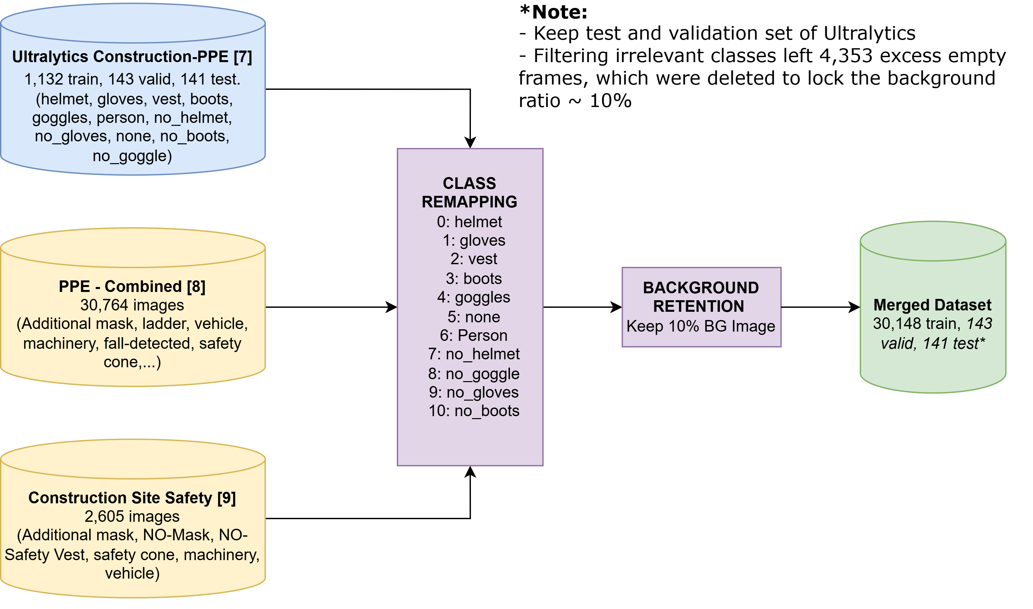
4. Dataset
The Ultralytics Construction-PPE dataset was used as the base dataset. Two additional public datasets were merged through class remapping to increase training samples and improve class balance.
Class Name | Ultralytics Train Instances | Merged Train Instances
helmet | 1357 | 33,482
gloves | 1162 | 4,527
vest | 1283 | 8,801
boots | 1251 | 1,235
goggles | 427 | 3,378
none | 654 | 651
Person | 1790 | 12,336
no_helmet | 400 | 12,423
no_goggle | 337 | 3,154
no_gloves | 442 | 4,722
no_boots | 88 | 88
Dataset preprocessing diagram
Original and merged dataset class distribution

Slide 7
5. Method

Slide 8
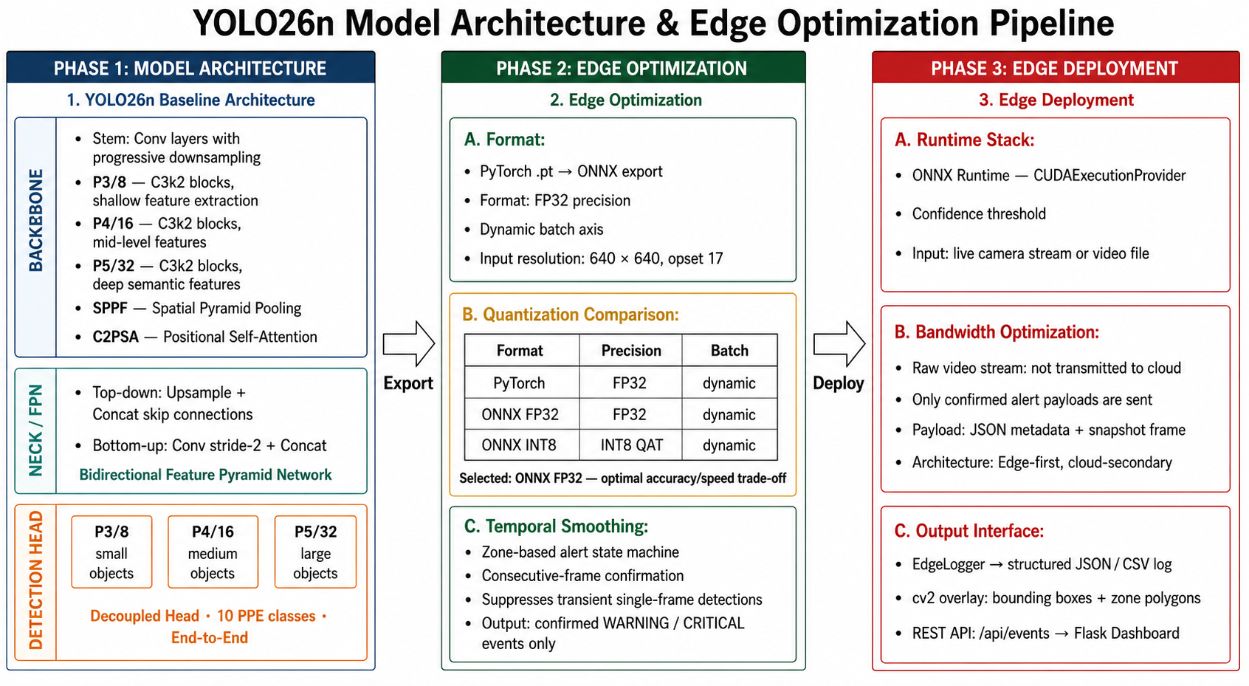
5.1. Overall method
Overall method of the project

Slide 9
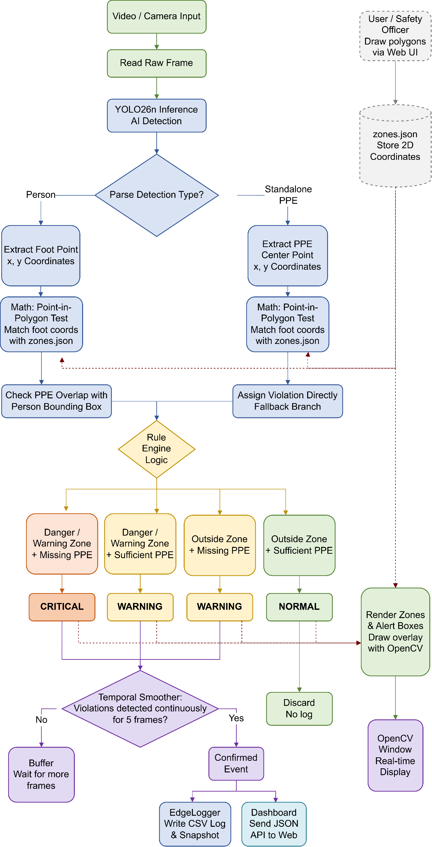
5.1. Workflow

Slide 10
6. RESULTS

Slide 11
6. Results
Model Format | Model Size | Latency (ms/img) | Throughput (FPS) | Overall mAP@0.5 | Violation mAP@0.5
ONNX FP32 (Dynamic B=8) | 10.3 MB | 7.61 | 131 | 0.749 | 0.671
ONNX FP16 (Dynamic B=4) | 5.7 MB | 9.05 | 110 | 0.750 | 0.671
Table: ONNX Quantization Results
The ONNX FP32 format with dynamic batching was selected as the optimal deployment configuration, achieving a high inference throughput of 131 FPS. This format perfectly balances real-time edge processing speed with a reliable violation detection accuracy of 0.671 mAP@0.5.

Slide 12
6. Results
Optimization Target | Baseline State | Edge-Optimized Result
Alert Reliability (baseline_yolo26n ONNX FP32) | 124 alerts (No temporal filter) | 6 alerts (N = 5 frames)
Network Efficiency | 1.897 GB/hr (Raw video) | 1.35 MB/hr (Logs + Snapshots)*
Implementing a 5-frame temporal smoothing algorithm significantly improved alert reliability by reducing transient false alarms by 94.6%.
Transmitting only event logs and snapshots rather than raw video slashed bandwidth consumption by 99.93%, enabling stable operation over standard mobile networks.
Table: Edge Optimization Result
*Note: Network efficiency assumes 1 event/min.

Slide 13
6. Results
Best results summary
01
02
03
mAP@0.5
Edge-Optimized
E-2-E Pipeline
Violated classes:
no_helmet 0.871
no_goggle 0.877
no_gloves 0.810
(yolo26n_base_onnx_f32 B=8)
>
Saved 99.93%
Bandwidth
Context-Aware Logic
Worker & PPE status
>
Reduced 94.6% False positives
Live Dashboard
Real-time telemetry,
snapshot logs,
and zone mapping.
>
Achieved 131 FPS
Edge throughput
*E-2-E: End-to-end

Slide 14
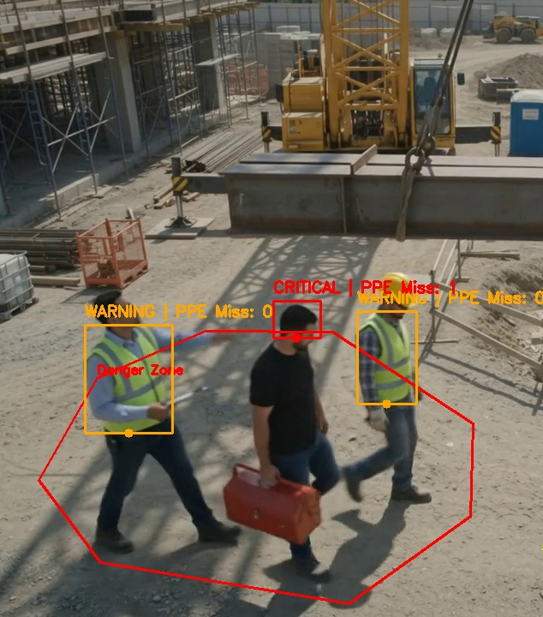
7. Conclusion
Successfully deployed an Edge AI pipeline for real-time PPE monitoring, eliminating cloud-related latency, bandwidth, and privacy issues.
The optimized baseline_yolo26n model (ONNX FP32) achieves 131 FPS at 2.93 ms/frame, enabling concurrent multi-camera processing.
A 5-frame temporal smoothing algorithm reduces false alarms by 94.6%. The edge-first architecture reduces bandwidth consumption by 99.93% (1.35 MB/hour).
Future Works: Enhance no_boots detection, integrate BIM for dynamic safety zones, and apply multi-modal sensor fusion for poor weather conditions.
CONSTRUCTION SITE SAFETY

Slide 15
8. APPLICATION DEMO

Slide 16
?
THANK YOU FOR LISTENING!
Q&A

