Slide 1

SpendWise – Smart Expense Tracker
Android Application with Java & Firebase

Slide 2
SpendWise – Smart Expense Tracker
Android Application with Java & Firebase
Developed By:
Riduan Aziz
0752220005101007
Regular-18th

Slide 3
SpendWise – Smart Expense Tracker
Android Application with Java & Firebase
Submitted to:
Md. Ishtiaq Iqbal
Assistant Professor & Chairman
Department of Computer Science and Engineering
Cox’s Bazar International University

Slide 4
THE CHALLENGE
The Problem with Expense Tracking
Inconsistent Tracking
Time-Consuming
Lack of Insights
People struggle with daily expense tracking.
Manual methods are slow and often lead to errors.
Users lack clear understanding of their spending habits.

Slide 5

THE SOLUTION
SpendWise: Your Financial Companion
Record Instantly
Categorize Spending
Quickly log expenses on the go.
Organize transactions for clarity.
Analyze & Visualize
Export Reports
Gain insights with intuitive charts.
Securely save and share data.

Slide 6






CORE CAPABILITIES
SpendWise Key Features
Manage Expenses
Track Spending
Add, Edit, & Delete
Daily, Monthly, All-Time
Offline Support
Category Analysis
Auto Data Sync
Visual Pie Charts
Secure Login
CSV & PDF Export
Firebase Authentication
Flexible Reporting

Slide 7
USER EXPERIENCE
Intuitive App Screens
Login & Registration
Filter Expenses
Dashboard Summary
Reports & Export
View / Add / Edit Expense
Profile Management

Slide 8
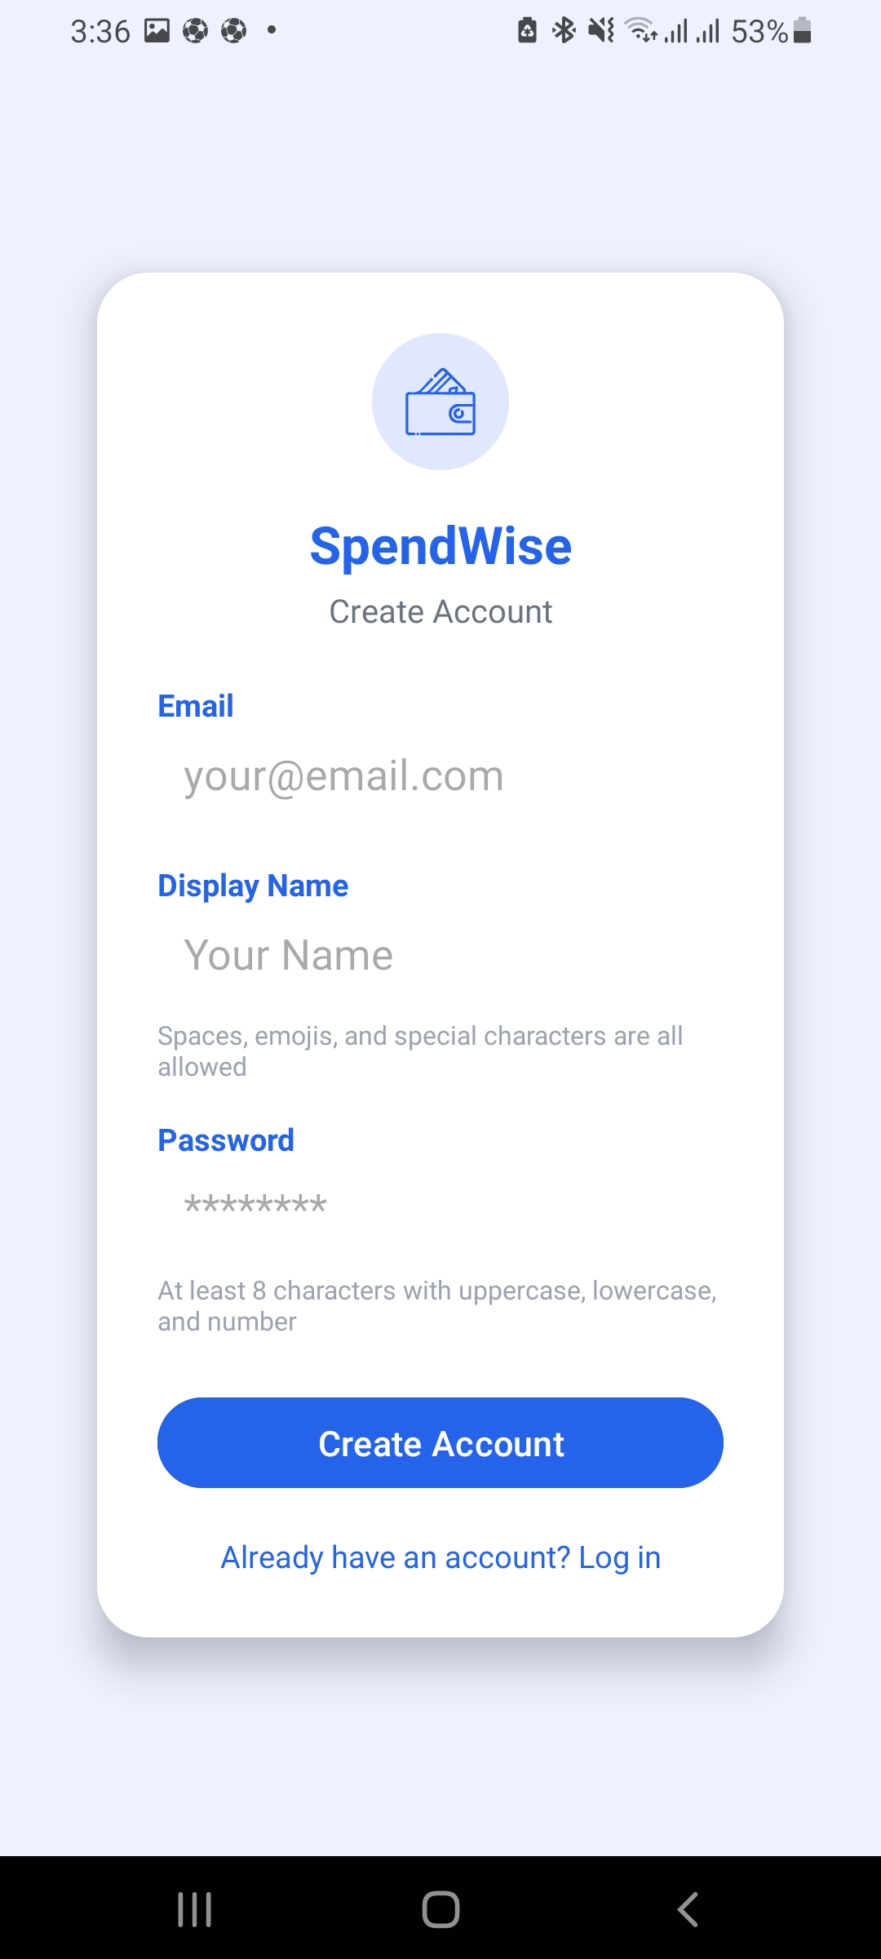
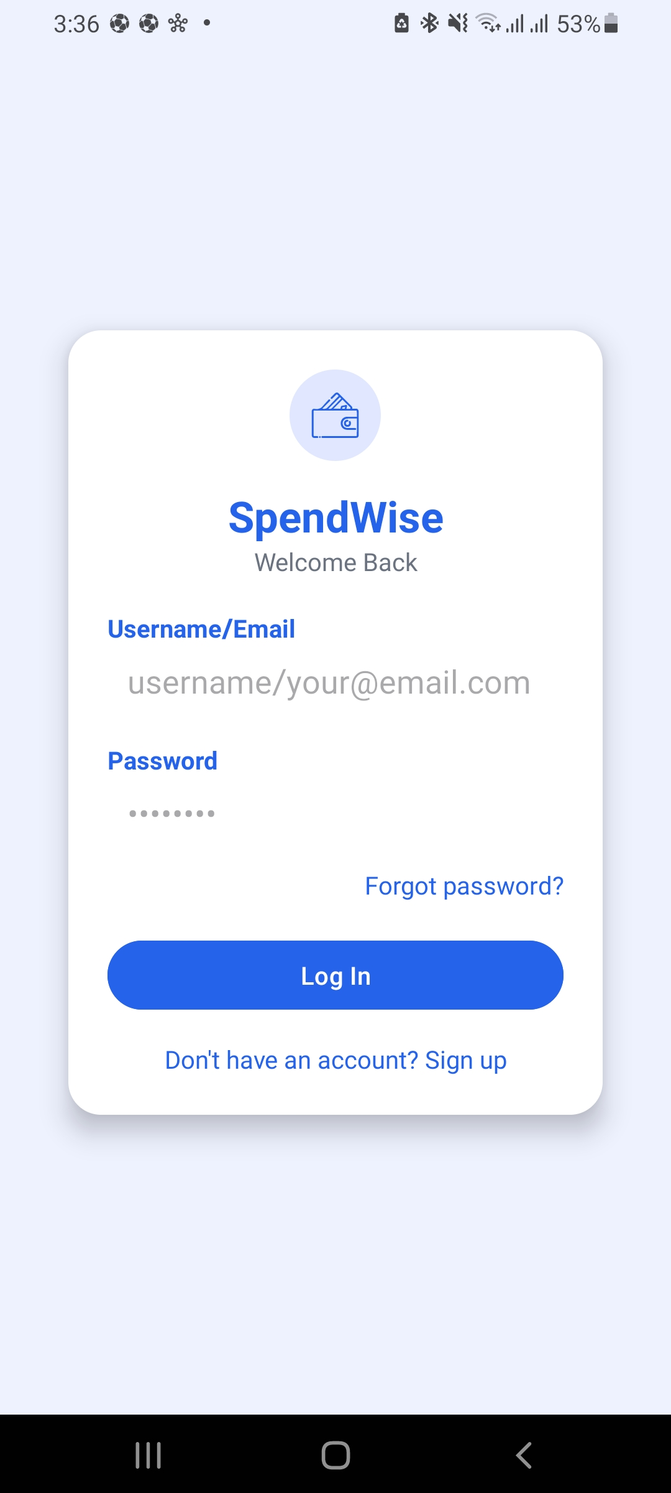
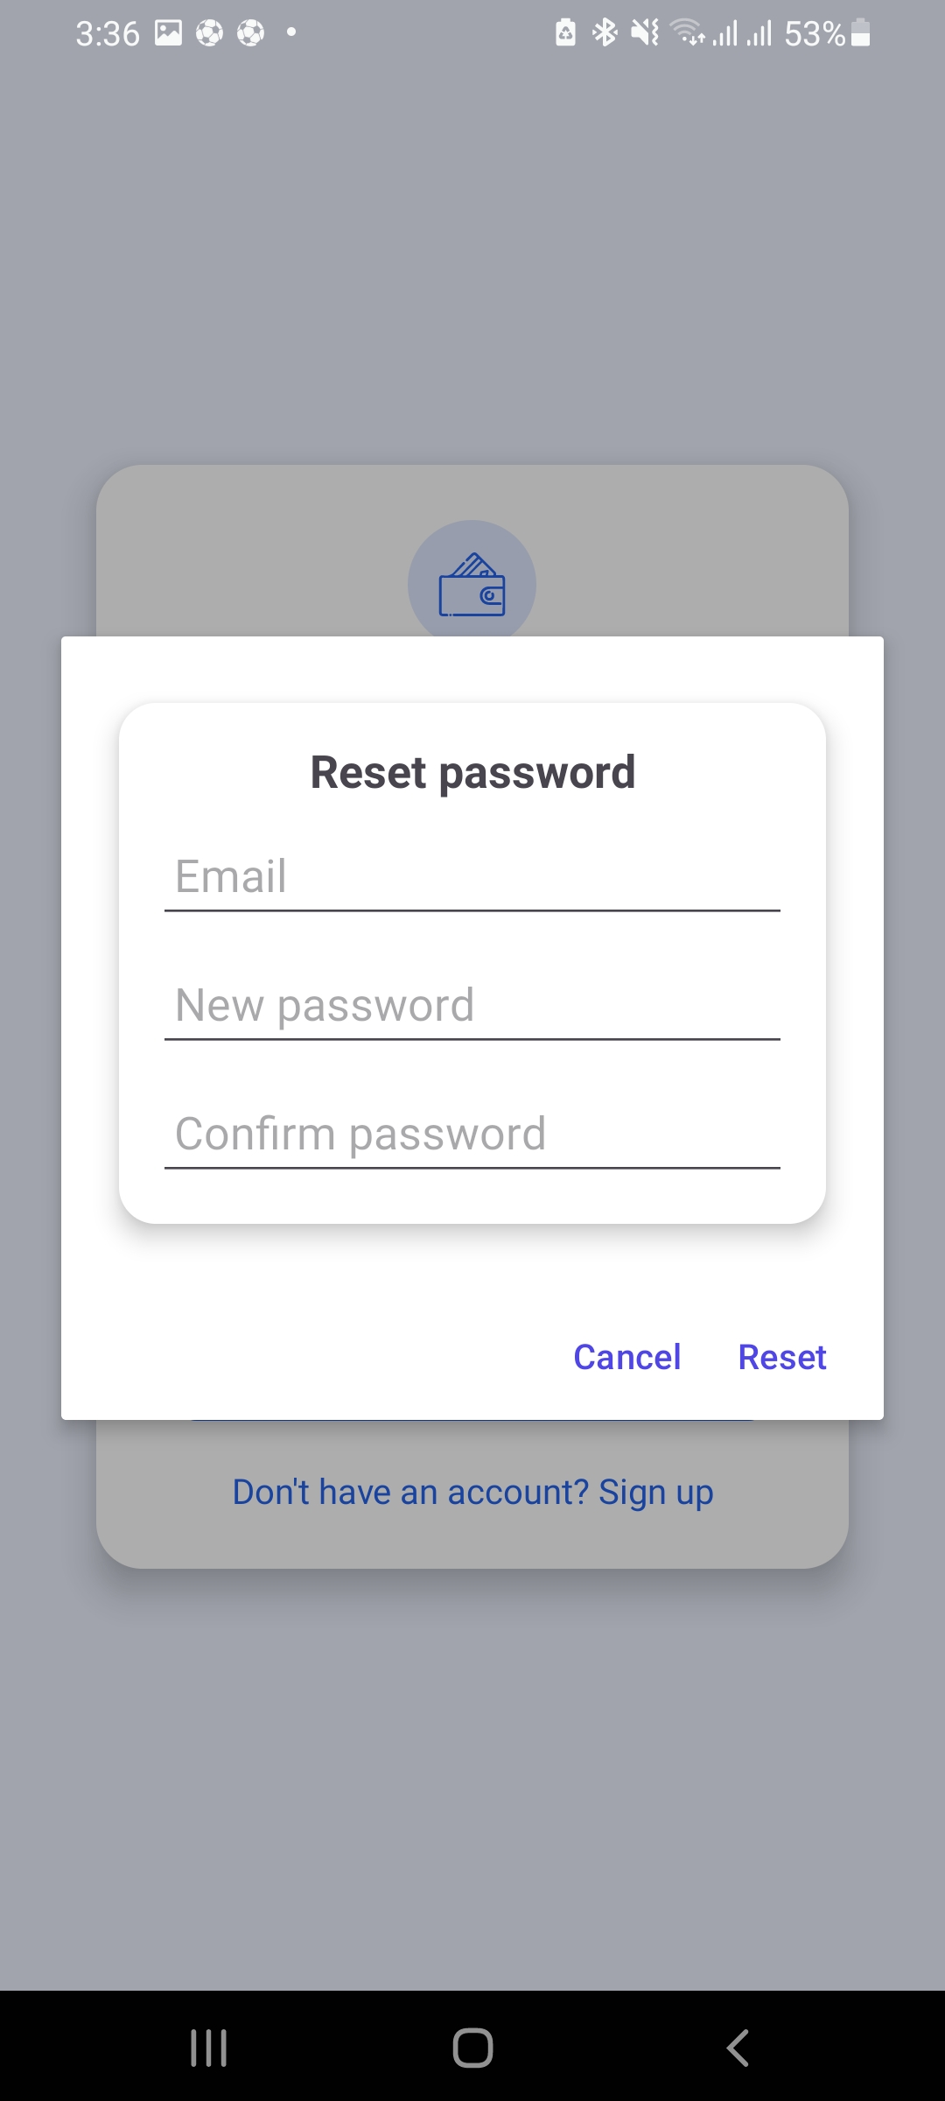
USER EXPERIENCE
Intuitive App Screens
Login & Registration

Slide 9
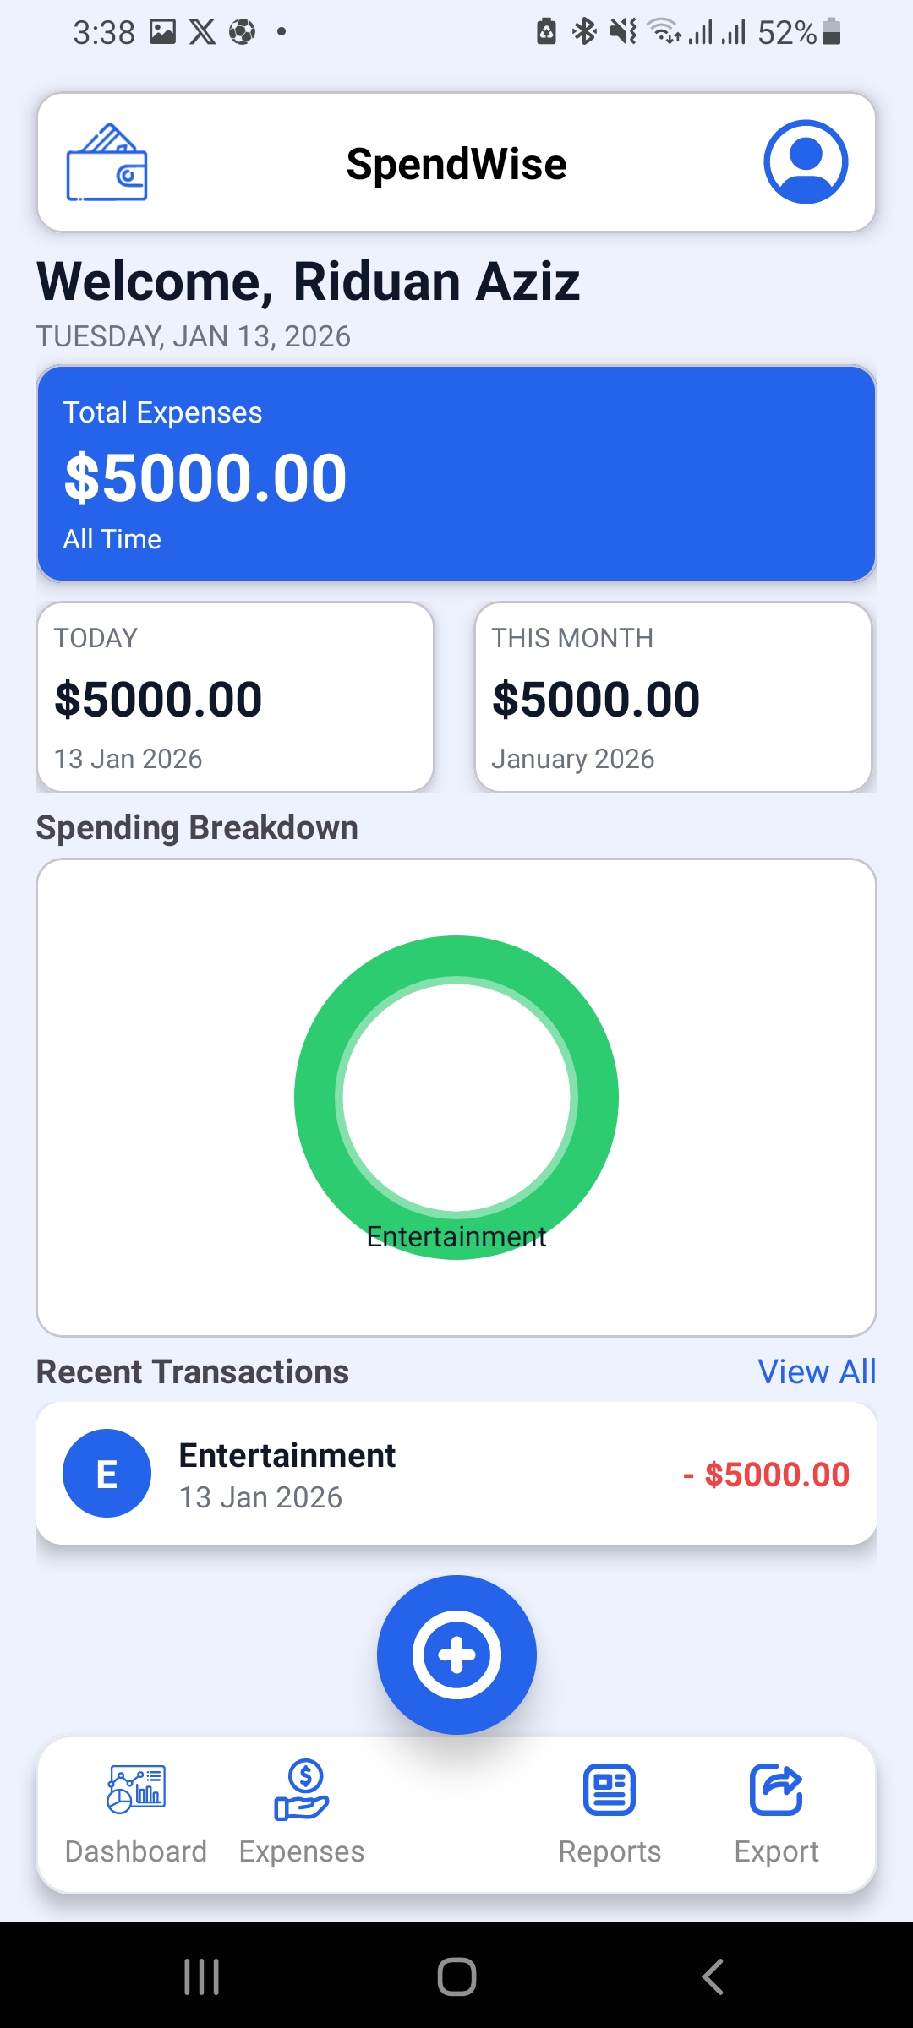
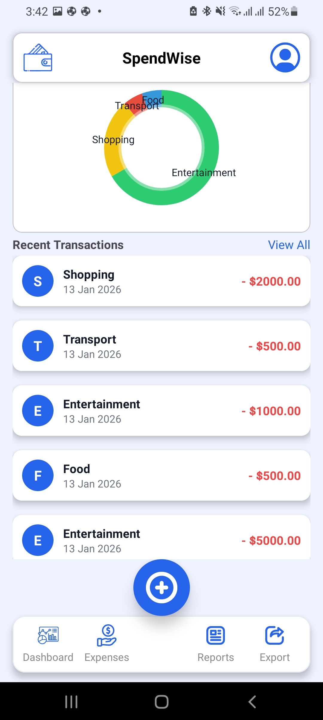
USER EXPERIENCE
Intuitive App Screens
Dashboard Summary

Slide 10
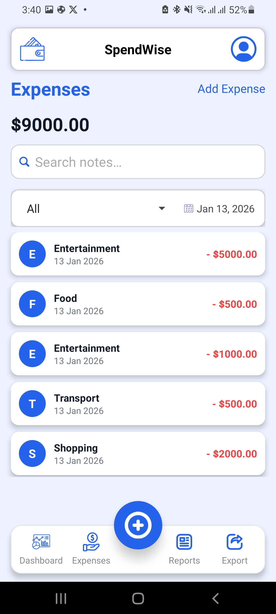
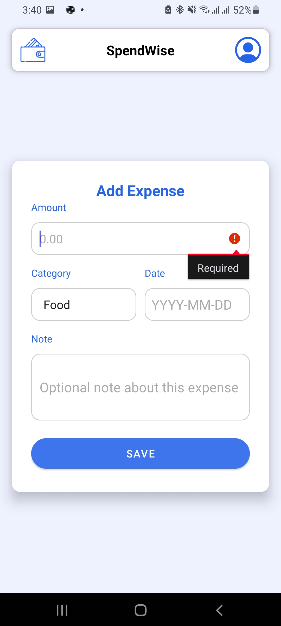
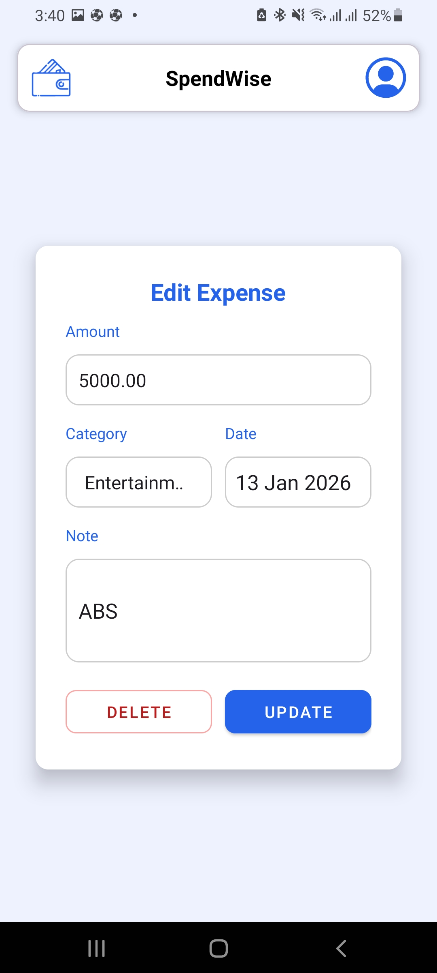
USER EXPERIENCE
Intuitive App Screens
View /Add / Edit Expense

Slide 11
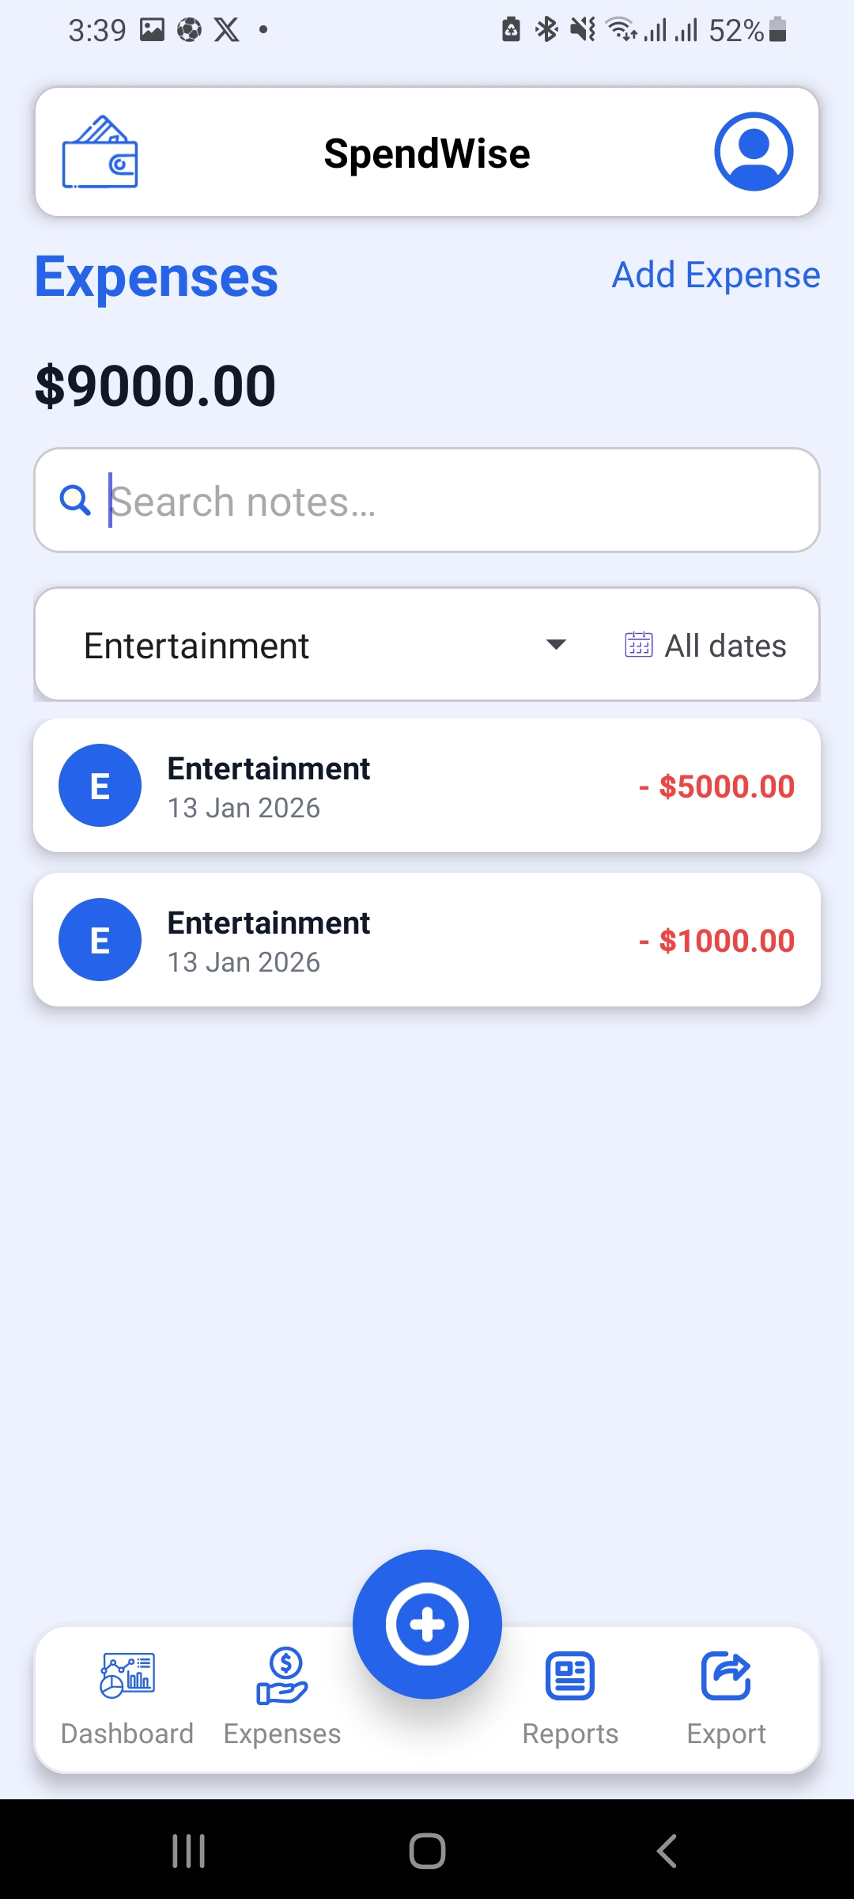
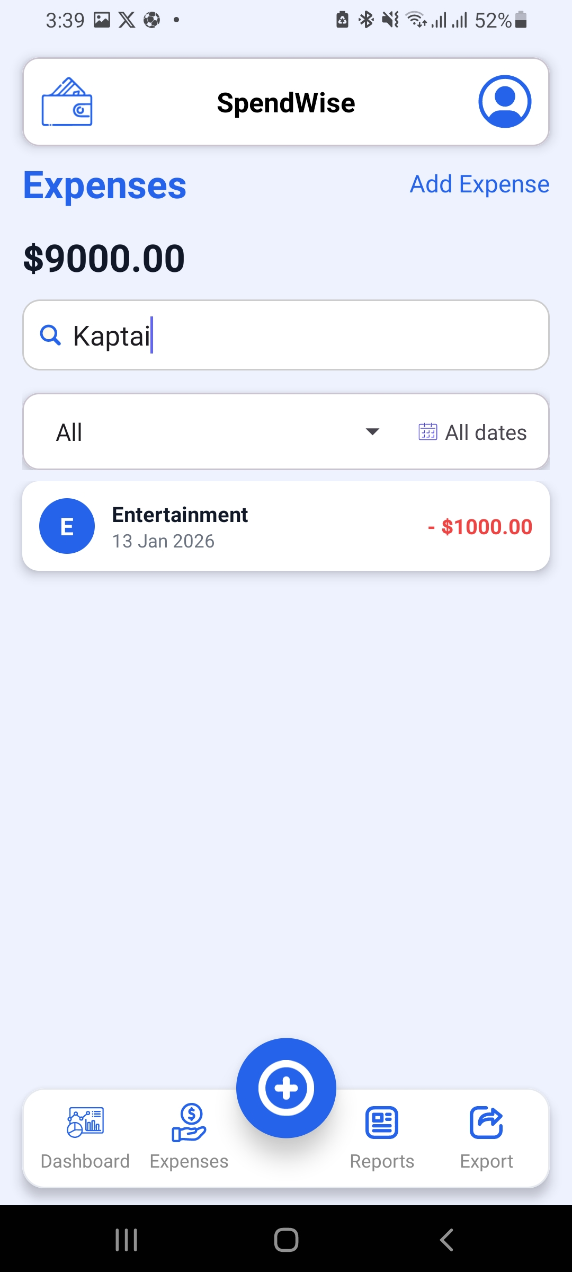
USER EXPERIENCE
Intuitive App Screens
Filter Expenses

Slide 12
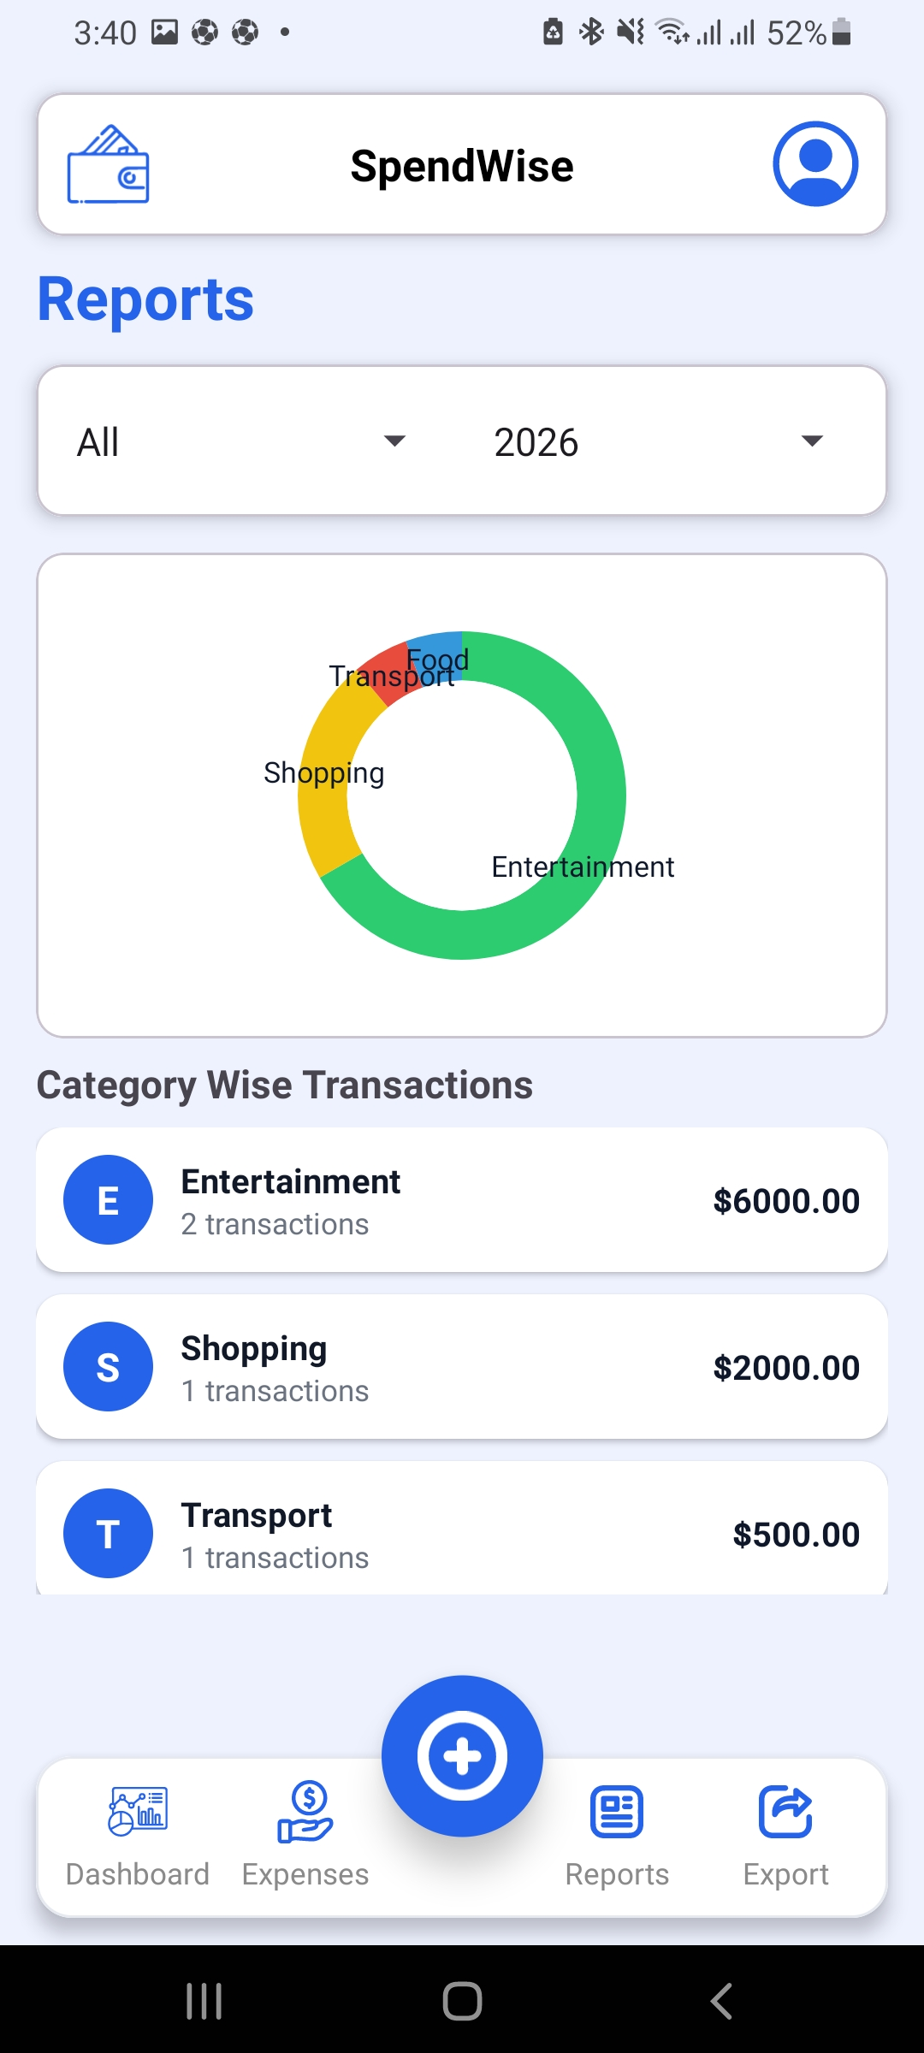
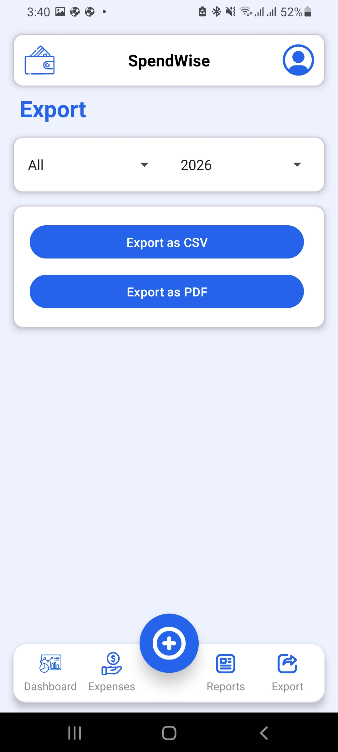
USER EXPERIENCE
Intuitive App Screens
Reports & Export

Slide 13
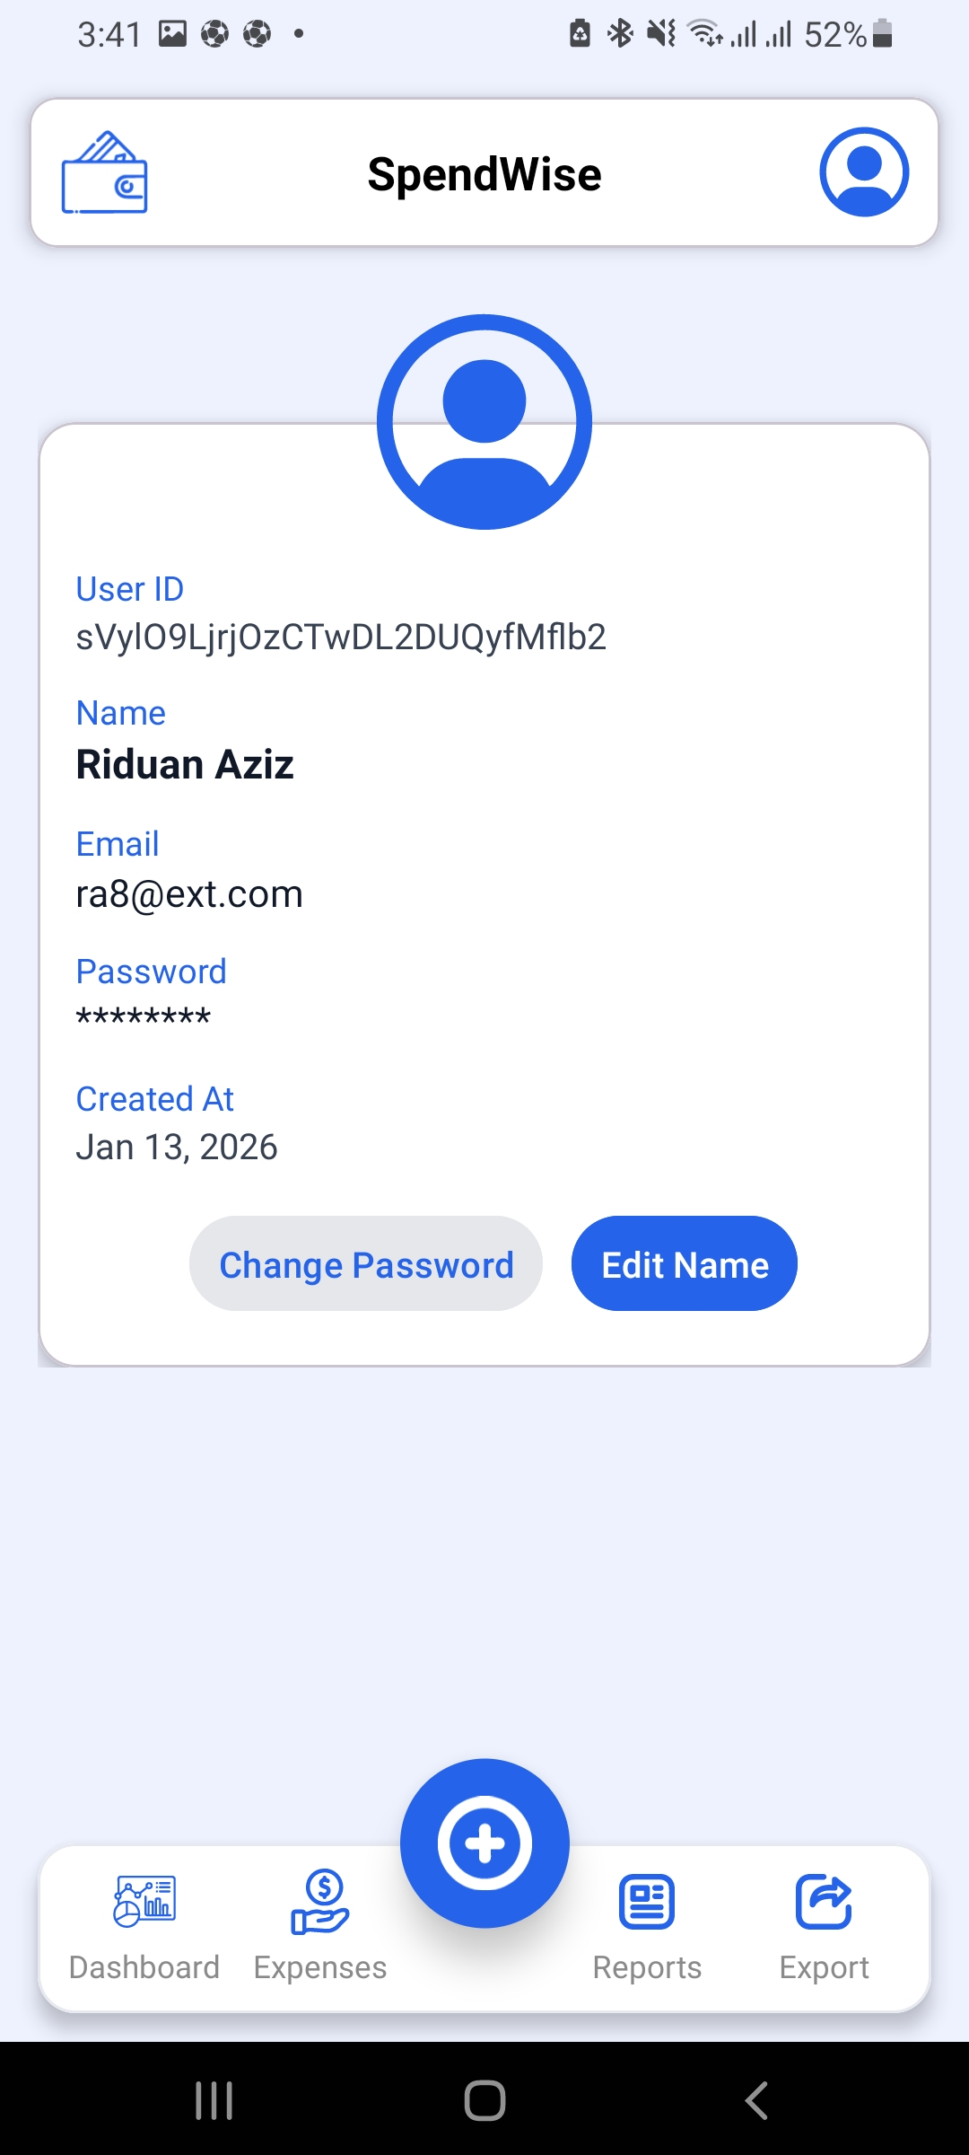
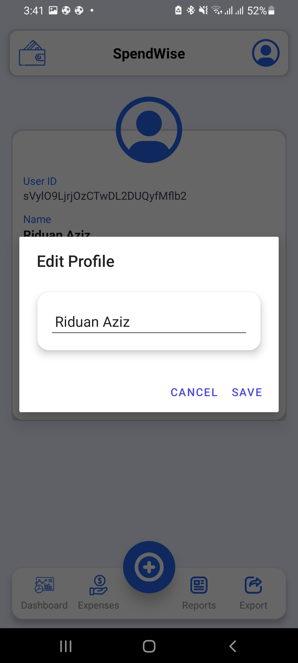
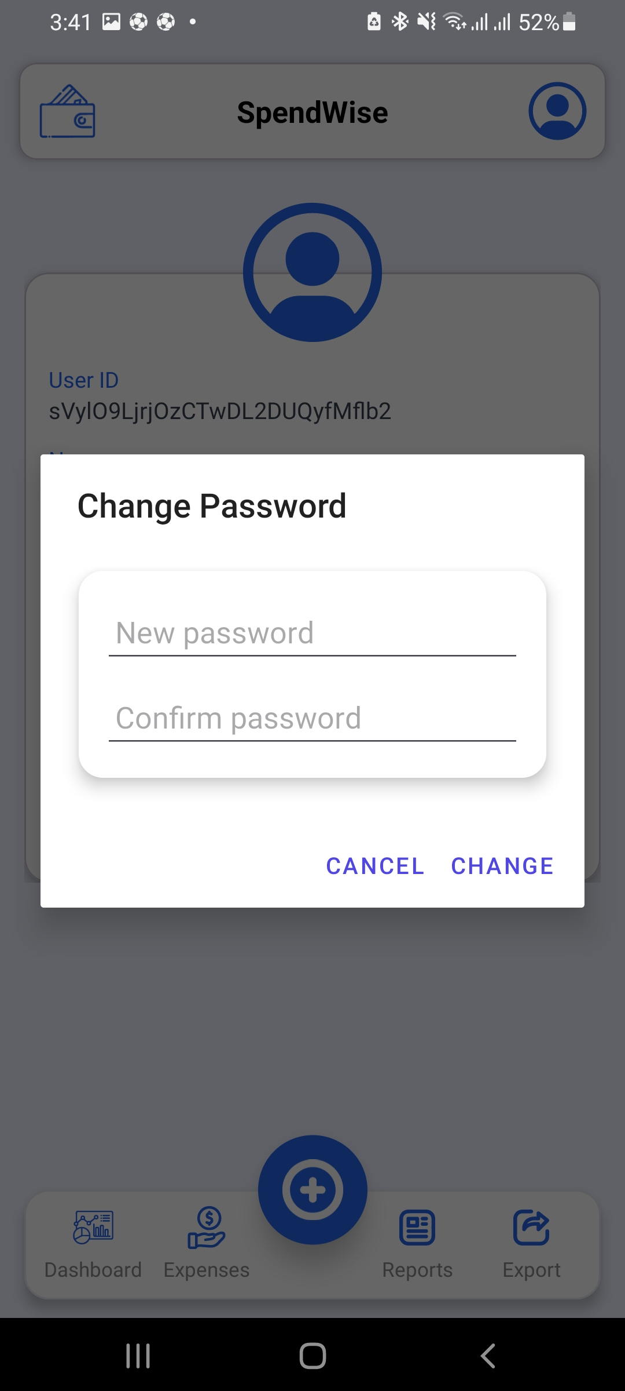
USER EXPERIENCE
Intuitive App Screens
Profile Management

Slide 14
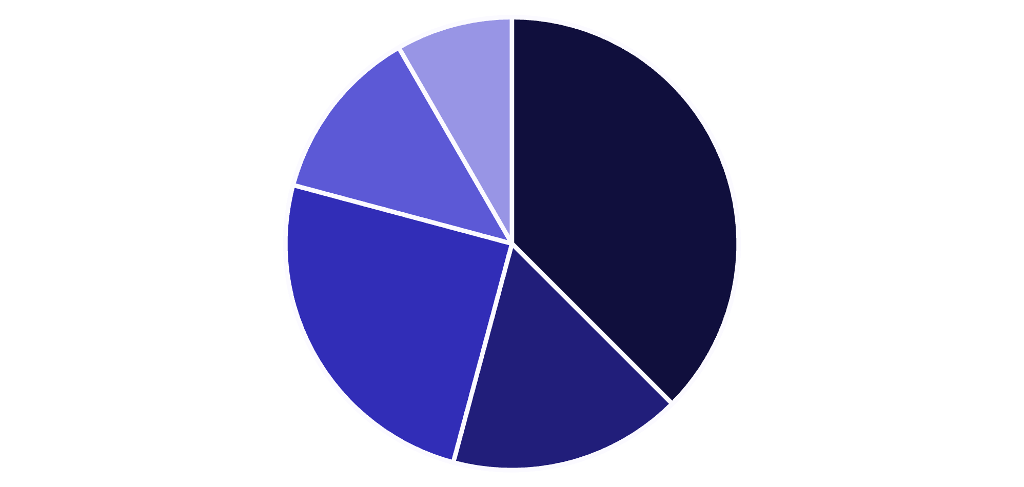
INSIGHTS AT A GLANCE
Dashboard & Analytics
Total Expenses Overview
Quick summary of your spending.
Daily & Monthly Summary
Track trends over time.
Recent Transactions
Stay updated on new entries.
Food
Transport
Shopping
Utilities
Entertainment
Category-wise pie chart provides a clear breakdown of where your money goes.

Slide 15
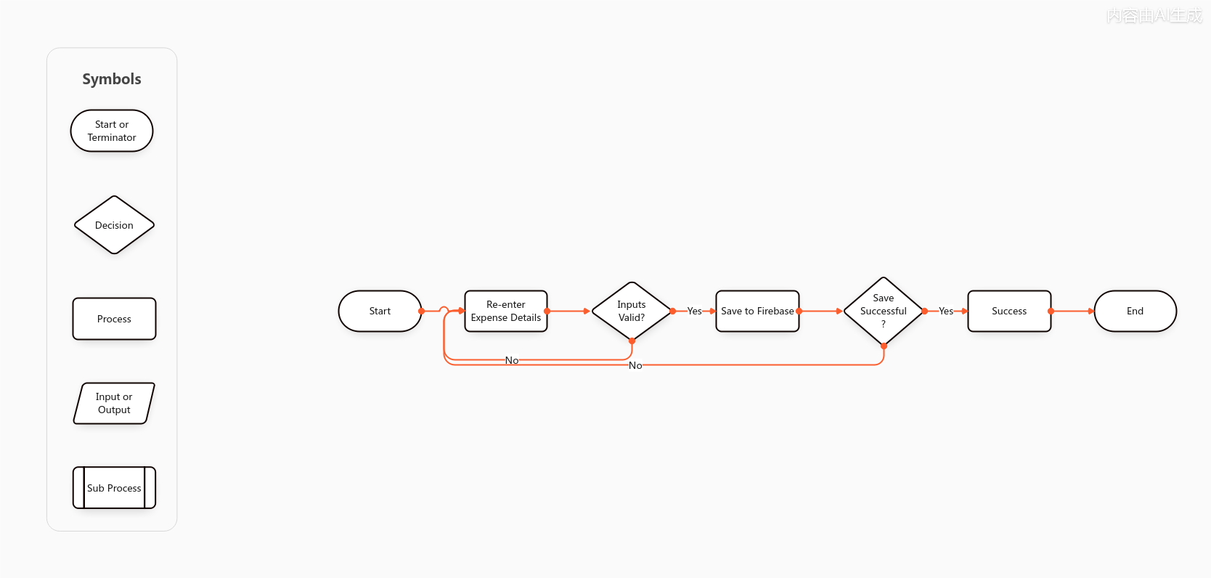
INSIGHTS AT A GLANCE
WorkFlow

Slide 16




DATA FLOW
Expense Management Flow
User Adds Expense
Data Validated
Simple input, intuitive interface.
Ensuring accuracy and integrity.
Stored in Firebase
Dashboard Updates
Realtime Database for instant access.
Reflects changes instantly.

Slide 17
ADVANCED CONTROL
Reports & Export Capabilities
CSV EXPORT
PDF EXPORT
Export detailed transaction data.
Generate professional summary reports.
CUSTOM DATE RANGE
SECURE STORAGE
Select specific periods for analysis.
Save locally or to Firebase Storage.

Slide 18
FOUNDATION
Robust Technology Stack
Android Native
Firebase Authentication
Developed in Java for optimal performance.
Secure and scalable user management.
Firebase Realtime DB
Firebase Storage
Synchronized data across devices.
Cloud storage for exports and backups.

Slide 19
ASSURANCE
Security & Reliability
Data Isolation
Secure Rules
User-level data protection.
Firebase security protocols.
Offline-First
Automatic Sync
Uninterrupted access.
Effortless data consistency.

Slide 20
ASSURANCE
Future Scope
Budget limit alerts
Backup and restore feature
Multi-currency support
Cloud Functions for automation

