Slide 1
File Manager Application
Ridvan Suleymanov

Slide 2
Project Description
This is a File Manager application designed for Android devices. It provides users with the ability to browse through their device's storage and access files and directories. The app also offers a variety of file management options, including the ability to copy, move, and delete single or multiple files at a time, rename, and open files as well.
System Calls:
Environment.getExternalStorageDirectory(): Returns the primary external storage directory.
onCreate(): It initializes various UI components and sets up listeners for button clicks and recycler view item clicks.
setContentView(): Sets the activity layout.
FileUtil(): Performs file operations such as listing files in a directory, copying, moving and deleting files.
startActivityForResult(): Starts a new activity and expects a result back from it.
onResume(): Called when the activity becomes visible to the user.
onStop(): Called when the activity is no longer visible to the user and has been stopped.
onDestroy(): Called when the activity is destroyed by the system.
android.permission.WRITE_EXTERNAL_STORAGE, android.permission.READ_EXTERNAL_STORAGE, and android.permission.MANAGE_EXTERNAL_STORAGE permission is used to grant an app the ability to manage all files on a user's external storage, including the ability to read, write, delete, and modify any files stored there

Slide 3
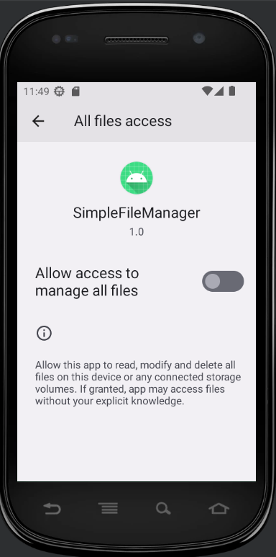
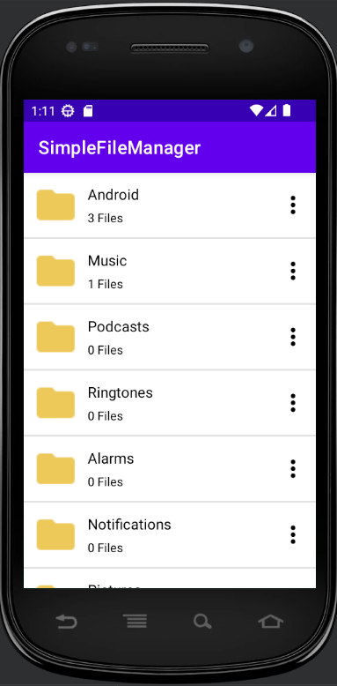
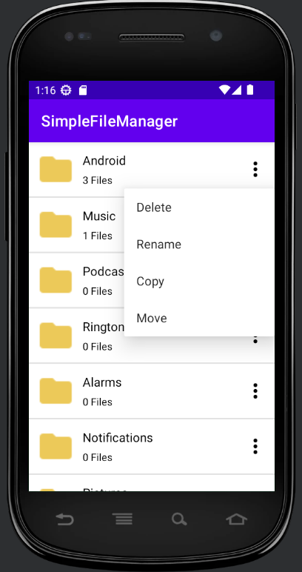
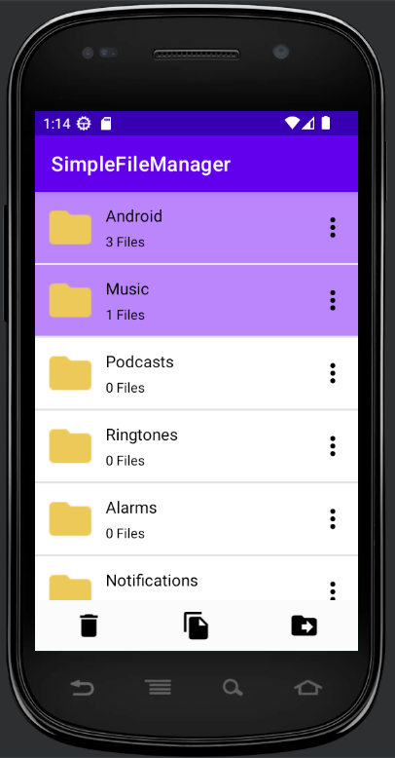
App Snapshots

