Slide 1
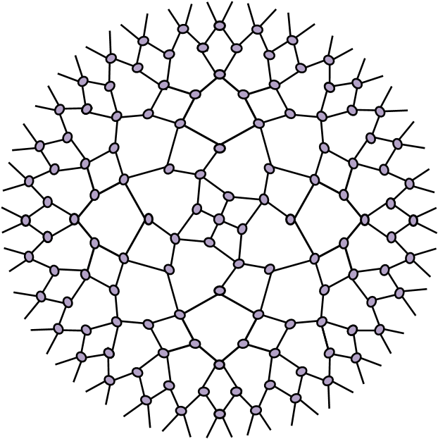
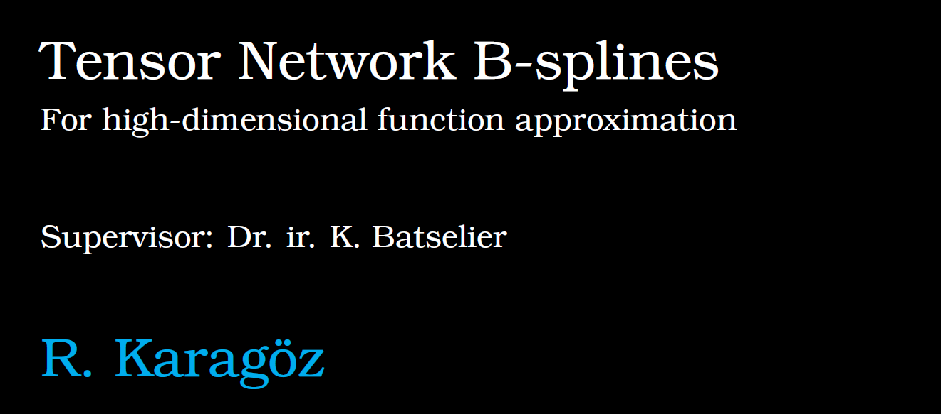

Slide 2
Contents
Background
B-splines
Tensor Networks
TNBS
Applications
Future Work

Slide 3
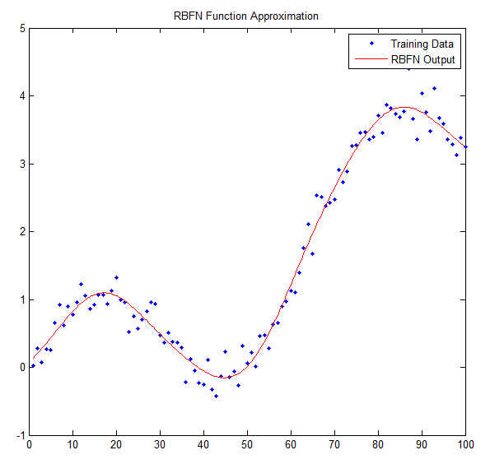
Background – Function approximation
Background
B-splines
Tensor Networks
TNBS
Applications
Future Work
Many domains
Machine learning
Nonlinear System Identification
Control
Alternatives
Neural Networks
Radial Basis Function Networks
SVM

Slide 4
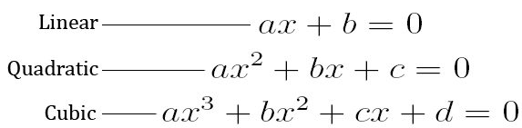
Background - Polynomials
Background
B-splines
Tensor Networks
TNBS
Applications
Future Work
Stone-Weierstrass theorem:
Any continuous function on the closed interval [a, b] may be arbitrarily closely approximated by polynomials.
Building block of many numerical techniques
The good:
Simple form
Arbitrary flexibility
Linear in parameters
Easy generalization to multiple dimensions

Slide 5
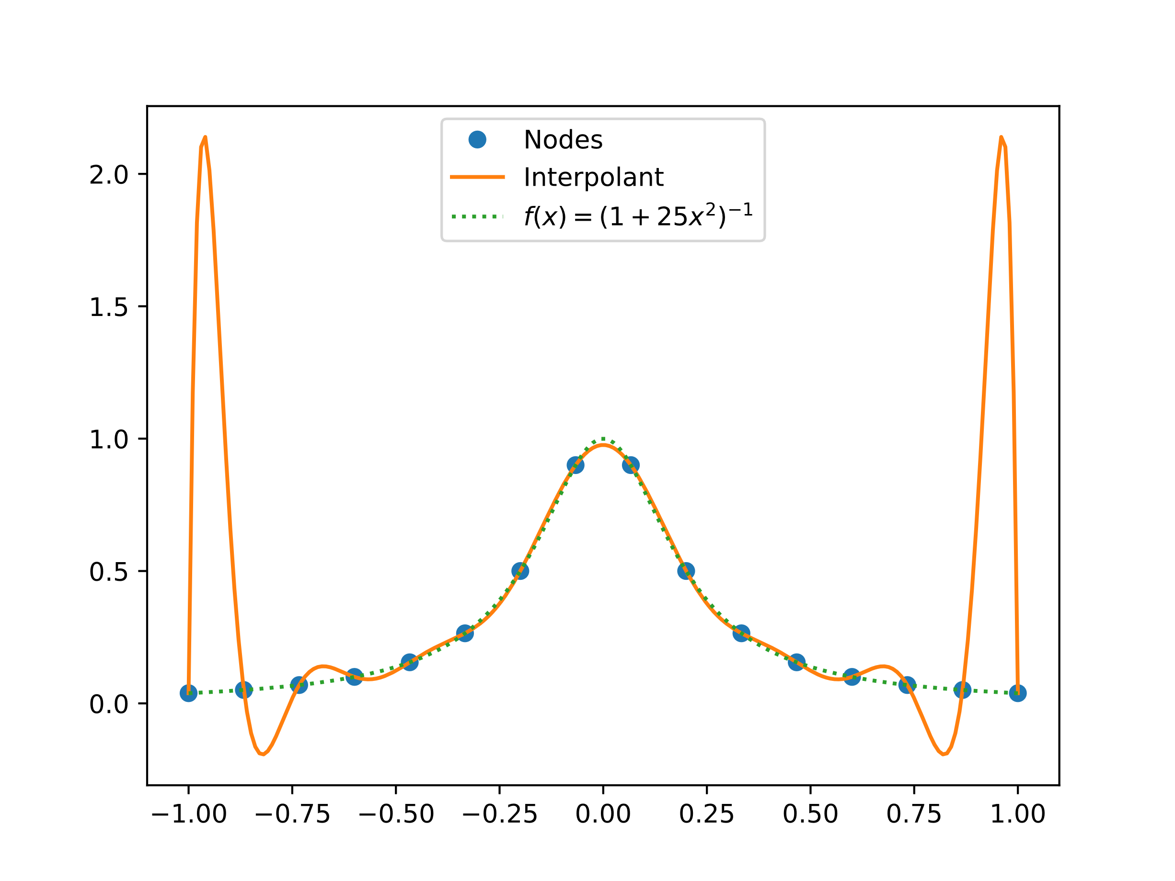
Background
B-splines
Tensor Networks
TNBS
Applications
Future Work
The ugly:
Poor interpolators/extrapolators
Large exponents cause numerical issues
Curse of dimensionality, O((1+n)^{d}):
Storing, fitting and analyzing becomes impractical

Slide 6
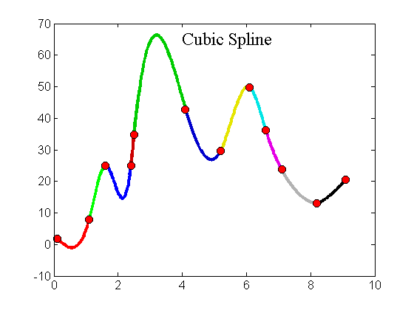
Splines
Background
B-splines
Tensor Networks
TNBS
Applications
Future Work
Defined piece-wise by polynomials
Polynomials meet at knots
Much better control of flexibility
Better at interpolation and smoothing
Many representations
Bézier curves
Hermite splines
Box splines
B-splines

Slide 7
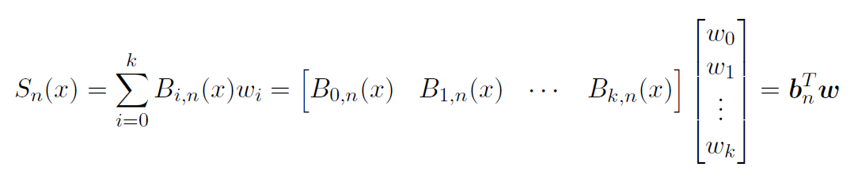
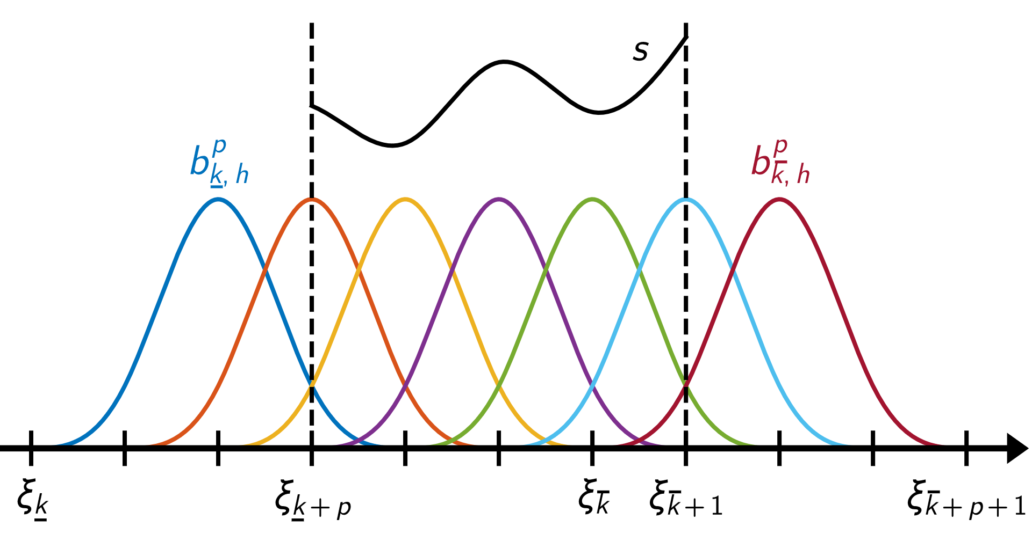


Univariate B-splines
Background
B-splines
Tensor Networks
TNBS
Applications
Future Work
Represent splines as a linear combination of basis functions

Slide 8
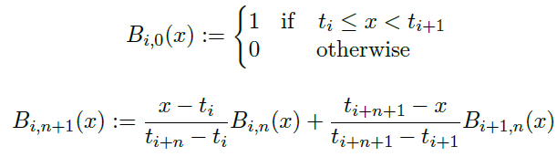
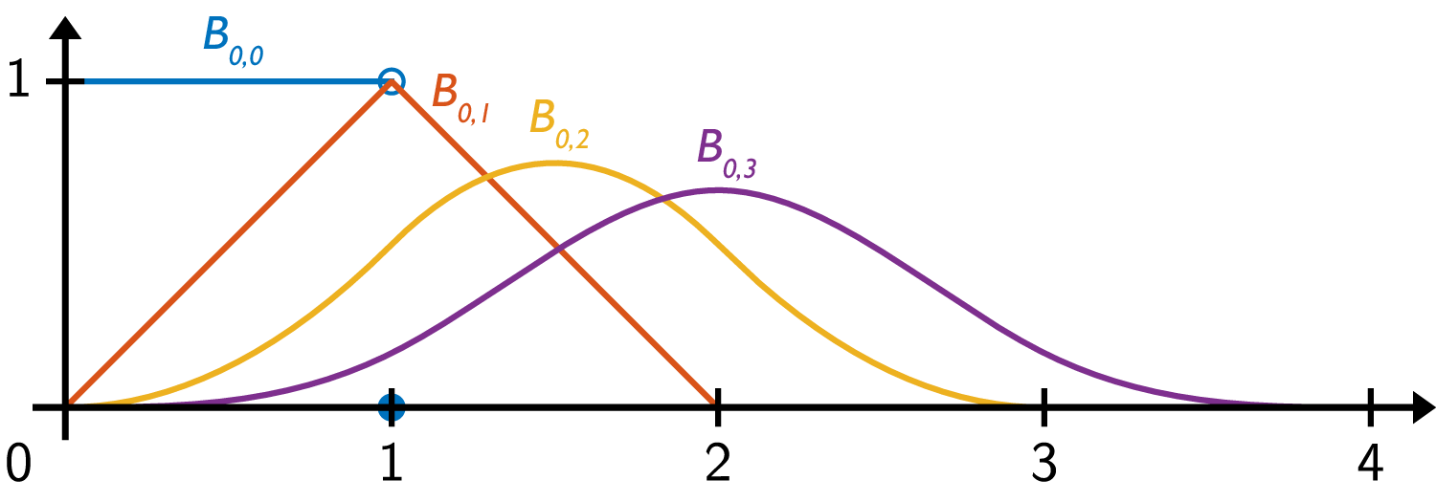
Constructing B-splines
Background
B-splines
Tensor Networks
TNBS
Applications
Future Work
Basis functions are constructed recursively

Slide 9

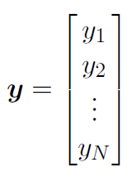
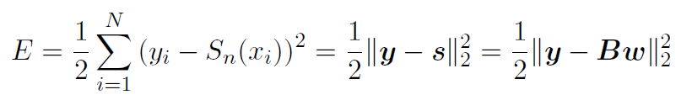
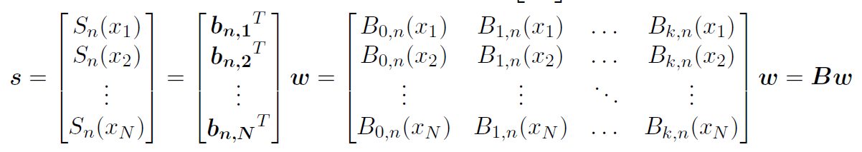

B-splines curve fitting
Background
B-splines
Tensor Networks
TNBS
Applications
Future Work
Fitting a spline to a set of data points

Slide 10
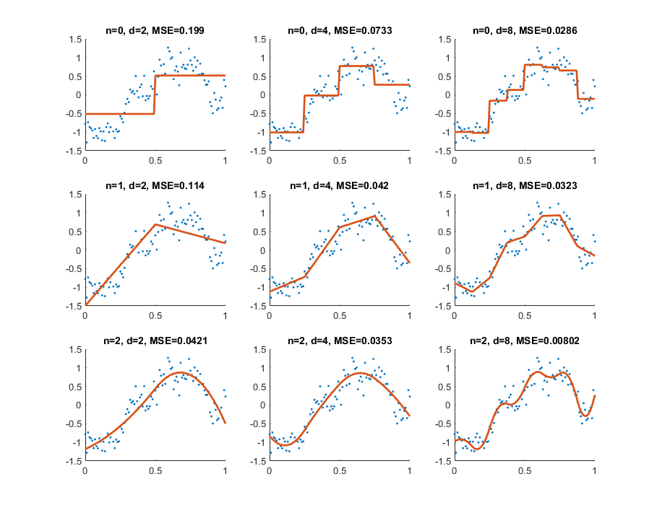
B-Splines curve fitting
Background
B-splines
Tensor Networks
TNBS
Applications
Future Work
Degree
Knot intervals

Slide 11


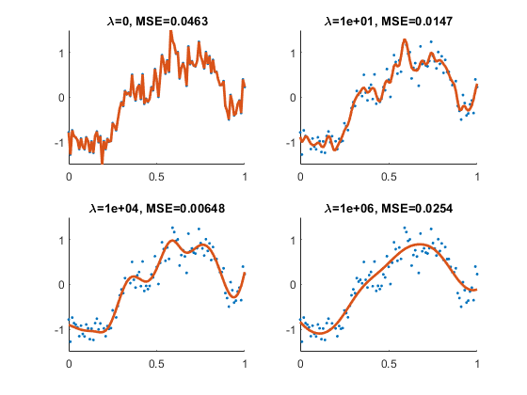
B-Splines regularization
Background
B-splines
Tensor Networks
TNBS
Applications
Future Work

Slide 12
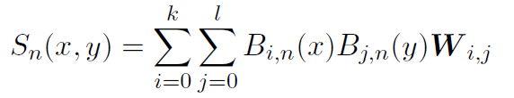
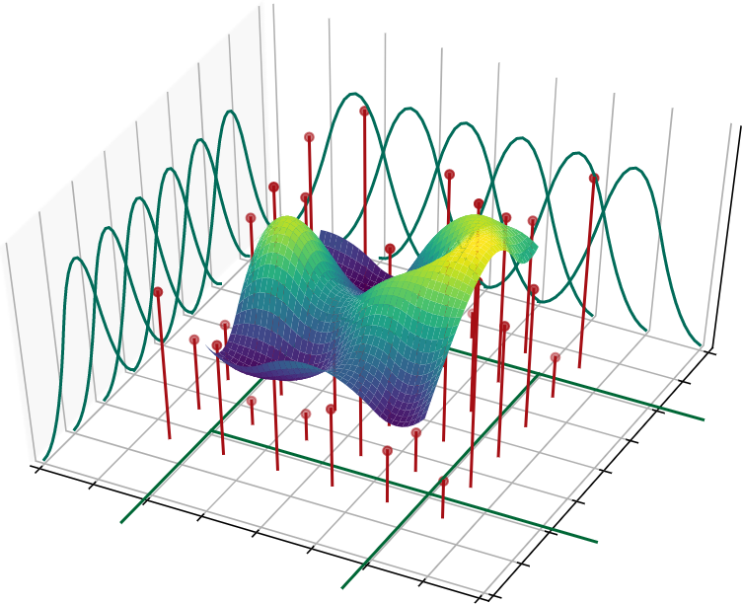
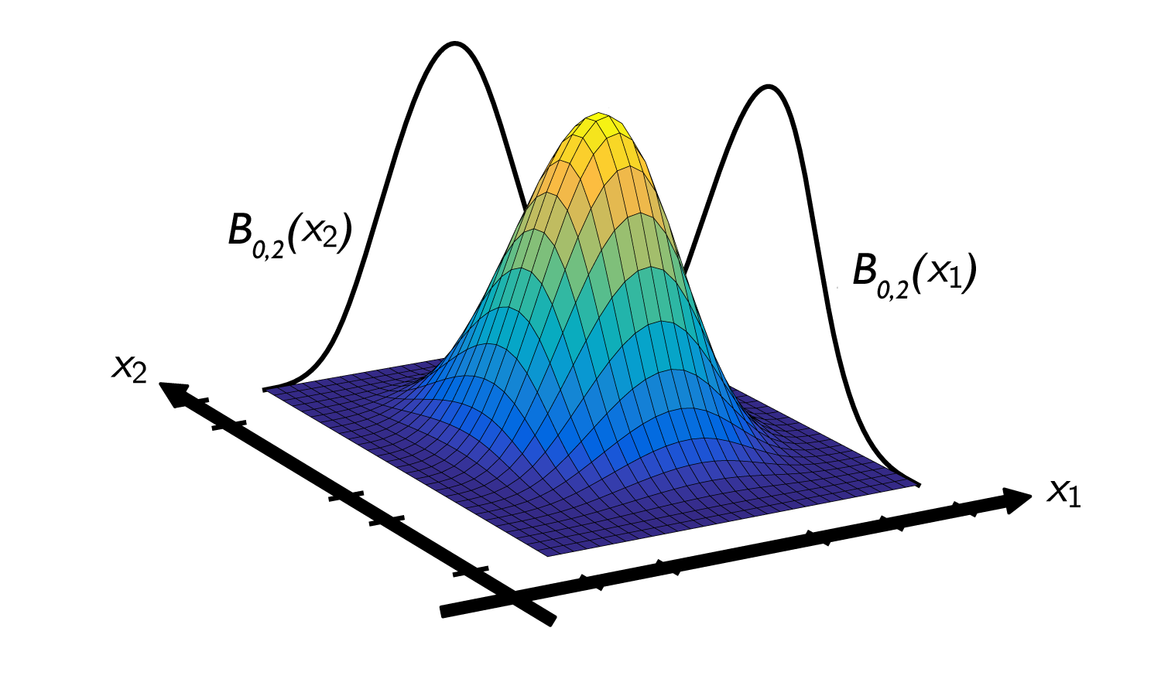
Multivariate B-splines
Background
B-splines
Tensor Networks
TNBS
Applications
Future Work

Slide 13
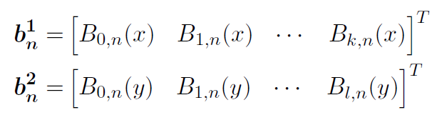
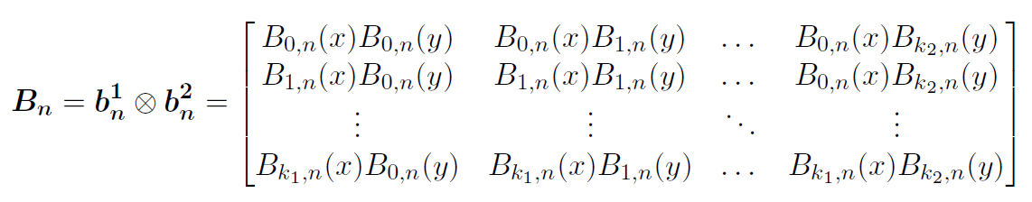

Multivariate B-splines
Background
B-splines
Tensor Networks
TNBS
Applications
Future Work

Slide 14
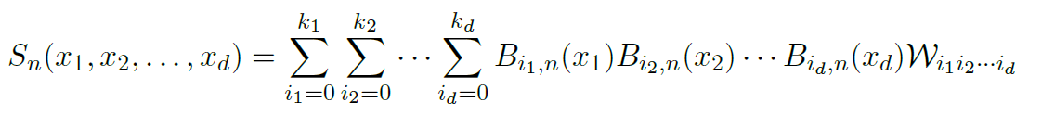

Multivariate B-splines
Background
B-splines
Tensor Networks
TNBS
Applications
Future Work

Slide 15
Curse of Dimensionality
Background
B-splines
Tensor Networks
TNBS
Applications
Future Work
B_{n} is defined by a tensor product of univariate B-spline vectors b_{n}
Exponential increase in basis functions and weights
e.g., Spline with 10 inputs and 6 basis functions per dimension has a total of 6^10 = 60,466,176 weights and basis functions.
Data becomes sparse
Solving the least square solution becomes computationally infeasible

Slide 16
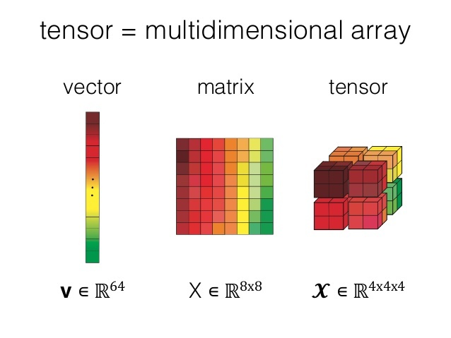

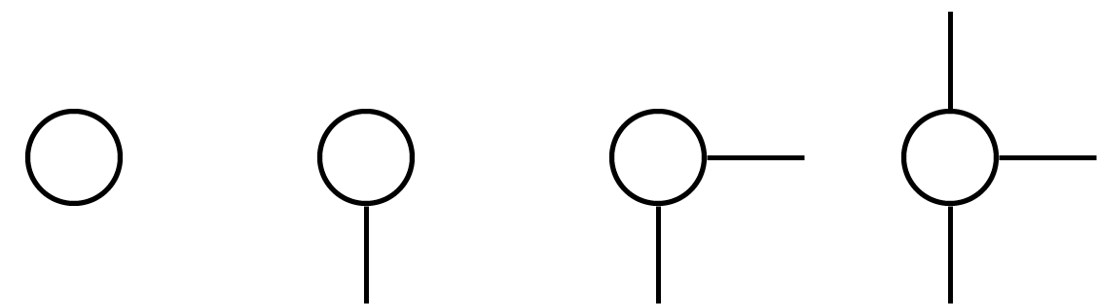
Tensor Networks - preliminaries
Background
B-splines
Tensor Networks
TNBS
Applications
Future Work

Slide 17
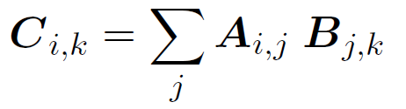

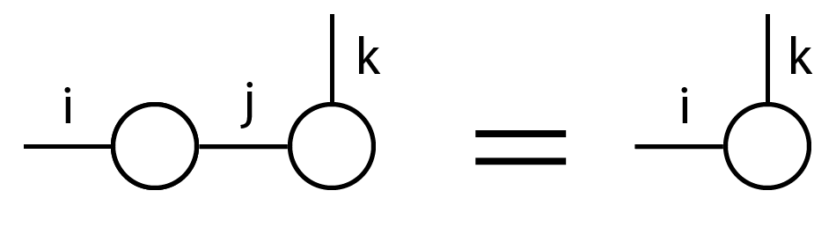



Tensor operations
Background
B-splines
Tensor Networks
TNBS
Applications
Future Work
Tensor contraction: generalization of matrix product and trace

Slide 18
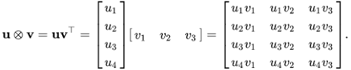
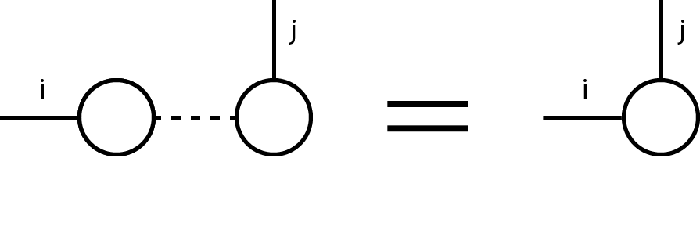
Tensor operations
Background
B-splines
Tensor Networks
TNBS
Applications
Future Work
Tensor product: generalization of outer product

Slide 19

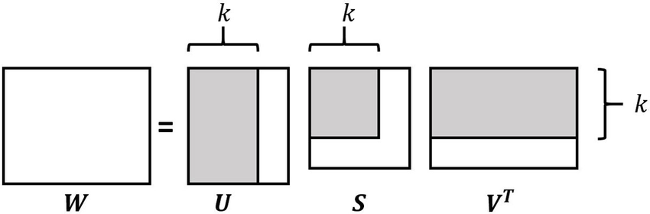
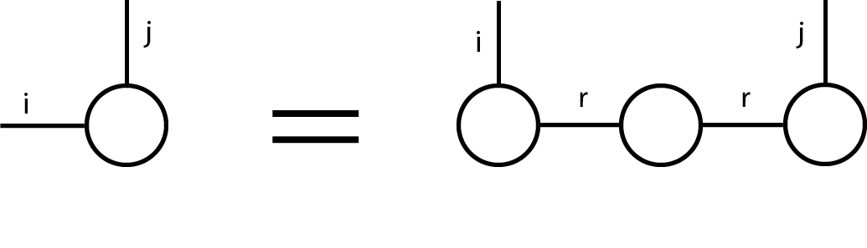




Tensor decompositions
Background
B-splines
Tensor Networks
TNBS
Applications
Future Work
Truncated SVD

Slide 20
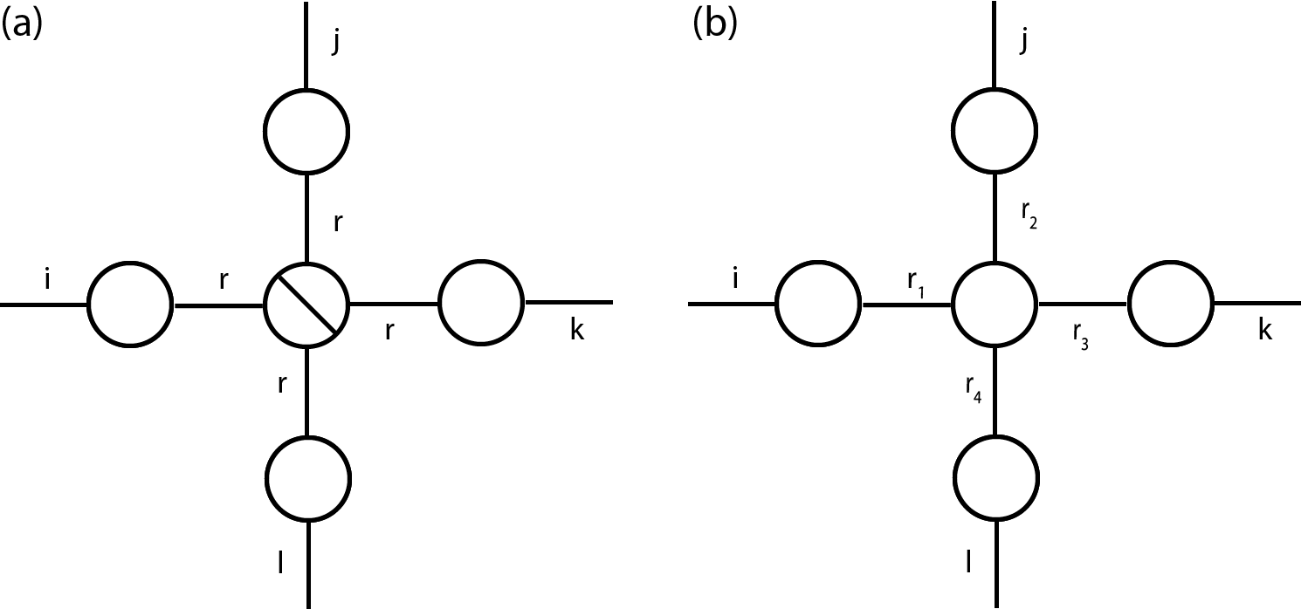
Tensor decompositions
Background
B-splines
Tensor Networks
TNBS
Applications
Future Work
CP decomposition
Tucker Decomposition
Ranks r

Slide 21
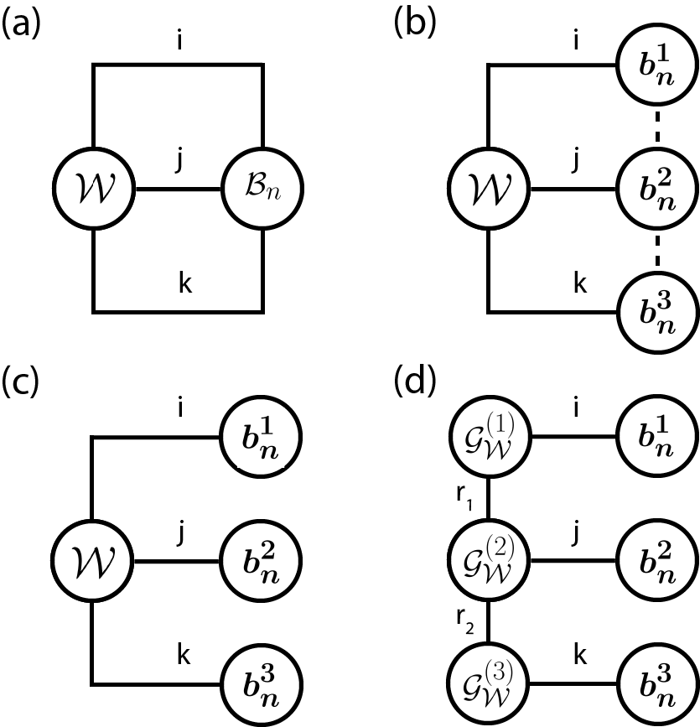

Tensor Network B-splines
Background
B-splines
Tensor Networks
TNBS
Applications
Future Work

Slide 22
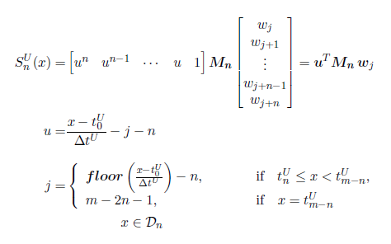
Uniform B-splines Matrix Form

Slide 23
Applications
Background
B-splines
Tensor Networks
TNBS
Applications
Future Work

Slide 24
Future Work
Background
B-splines
Tensor Networks
TNBS
Applications
Future Work

Slide 25
Applause
Background
B-splines
Tensor Networks
TNBS
Applications
Future Work

