Slide 1

ENGINEERING EXPLORATION
TEAM NUMBER : 3
Engineering Projects in Solving Campus Problems (EPIP)
TEAM MEMBER
Ridhav(1710991651)
Rajat(1710991635)
Pulkit(1710991609)
Sanskar(1710991929)
GUIDED BY
Ms. GULSAN DHILLON

Slide 2
NEED STATEMENT
  At Chitkara International School, kid of 4-7 years are provided with different learning toys. Students have access to various learning and playing toy that enhance the learning. It has been observed that the kids are attracted most to the automobile i.e. cars, bikes. Design an educational toy car for the kids of this age group

Slide 3

PROBLEM STATEMENT
In Chitkara International School, there is a need of a toy car which can have enhance learning system for the children of age group(4-7) years old. The toy must be made of non-toxic product where the cost of the toy car should be less expensive and portable than the toy cars available in the market. Toy car must be colourful which will have good lighting system for good looks of toy car. It will have 3-4 types where the toy car body have no any sharp edges and made fully remote controlled. It is operated by batteries, which can be recharged and use again. As, the toy car will be of low weight with enhance learning system the car will be more user friendly. Here safety has been given a more priority in toy car for the safety of children

Slide 4

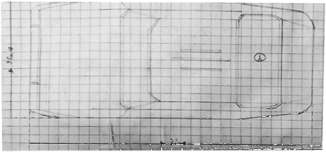
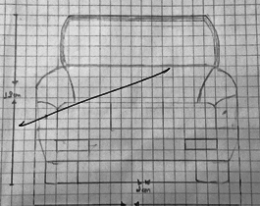
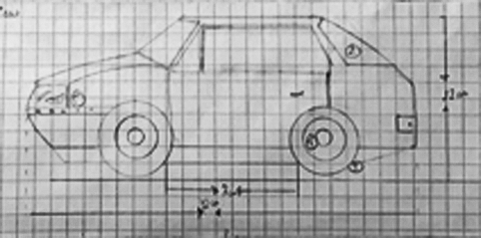
ENGINEERING DESIGN

Slide 5

MECHANISM
In this toy car we have used two motor of 200 rpm. Both the motors are been placed in the back wheels of the toy car. Both the motors are connected to motor driver(i.e.L298). A 12 V rechargeable battery is used to supply power to the motors and Arduino. Front wheels are attached with a excel. While turning right, left side motors is stopped, so that there is rotation on the wheels as same as for the left turn of the car, right side motor is stopped .

Slide 6
PLATFORM BASE LEARNING
In this toy car we have used two Arduino (i.e. Arduino Mega 2560 and Arduino UNO), RF module, 200 rpm dc motors, LCD, joystick for platform base learning. Our toy car has been divided into two parts i.e. Toy Car part and Remote part( as our toy car is wireless).
In remote, we have used Arduino UNO in a PCV board which is run with the power supply of 9V battery. We have connected LCD with in remote where LCD contains alphabets for learning purpose and connect RF module transmitor where its send the value of our joystick.
In toy car, we have used a Arduino Mega 2560 which connects Motor driver(i.e. L298) and RF module reciever.12V battery is used to supply power to both Arduino and Motor driver. Here receiver receives the value from transmitor and help to move the car in the particular directions. We have used 2 dc motors of 200 rpm in toy car.

Slide 7
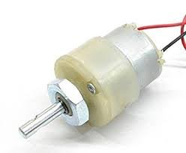
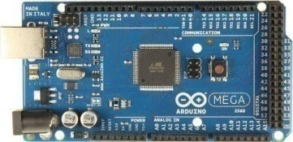
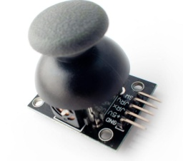
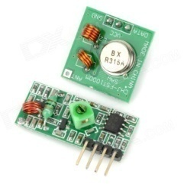
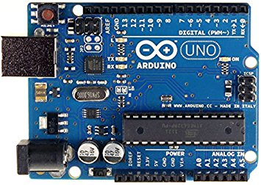
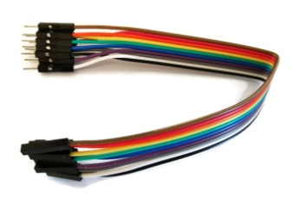
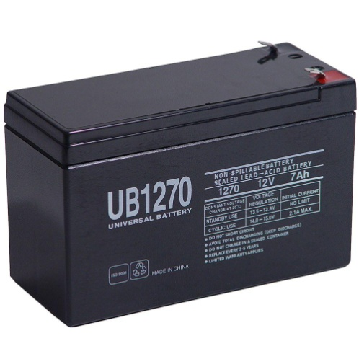
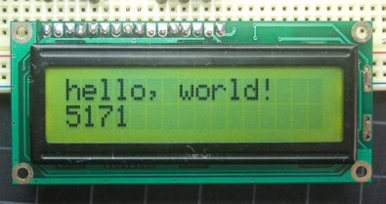
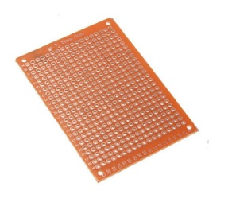
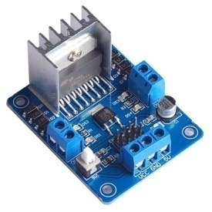
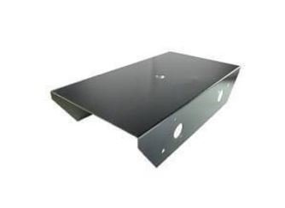
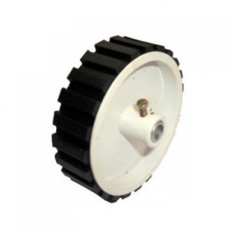
COMPONENTS
Arduino Mega 2560
Joystick button
DC Motors
RF Module
Arduino UNO
Jumper wires
LCD
PCV Board
Motor Driver
12 V Batteries
Frame
Wheels

Slide 8
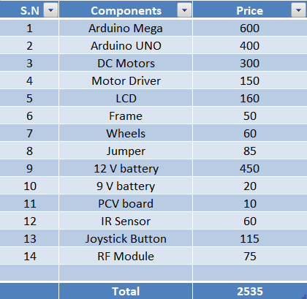
COST

Slide 9

PICTURES AND VIDEO
SHORT TIMEPLASE VIDEO OF MAKING

Slide 10

WORKING VIDEO 1
VIDEO OF TOY CAR WORKING

Slide 11
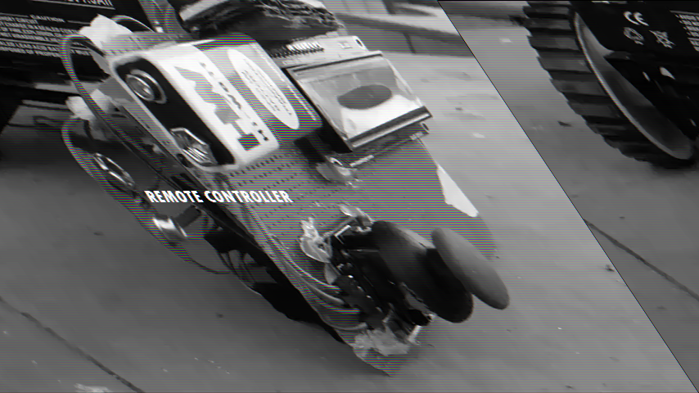
WORKING VIDEO 2
VIDEO OF REMOTE CONTROLLER

Slide 12
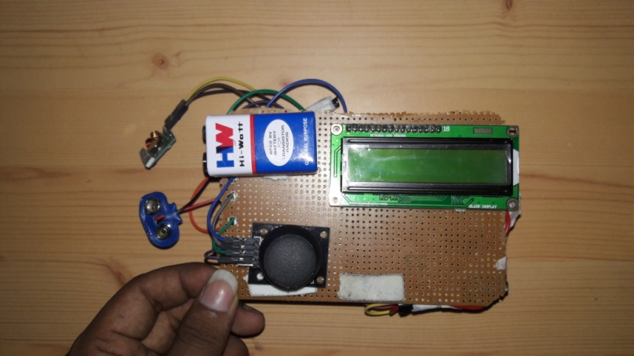
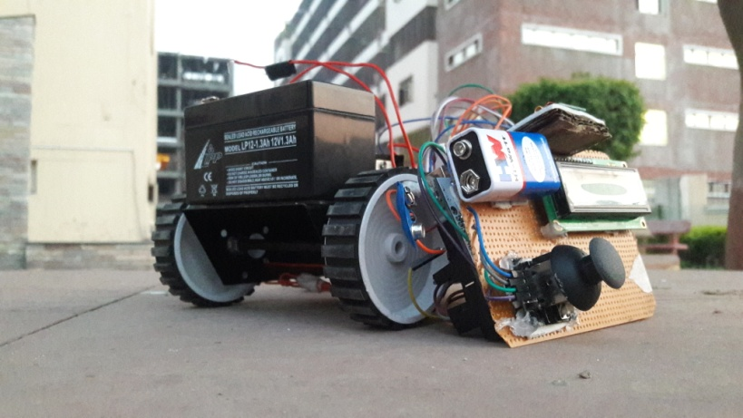
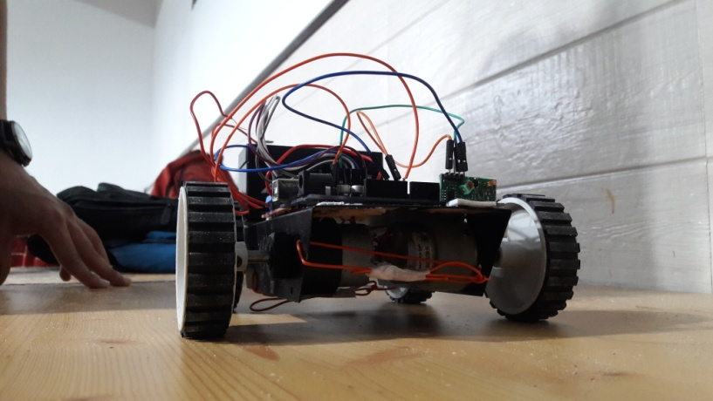
PICTURES
Remote controller
Test run photo
Front view

Slide 13
REFERENCES
https://maker.pro/pcb/projects/remote-control-car
http://www.instructables.com/id/Make-a-mini-toy-car-with-Arduino/

