Slide 1

SPL-I PRESENTATION
19 / 03 / 2025
Project Blood
Aid
01

Slide 2




SPL Team -2
Team Members:
Ridwan Raish Khan
220042120
Golam Mahadi Ahmed
220042163
Nuren Fahmid
220042121
02

Slide 3

Project Overview
This Java application provides a user-friendly platform that connects blood donors and recipients, helping to meet the increasing demand for blood donations.
Improves response rates, especially for urgent needs.
Consolidates scattered requests and donors into a single, efficient platform.
Ensures quick access to donors for emergency situations.
Allows donors to be filtered based on area and blood type.
Eliminates the need for third-party intermediaries in the donation process.
03

Slide 4





Key Functionalities
Smart Donor-recipient matching
Multi-type donation support
Real time Chat System
Badge system
History Tracking
Rewards donors with badges like "First Drop", "Frequent Donor", "Life Saver", "Pioneer", and "Rare Blood Hero"
Efficiently connects blood donors with recipients based on blood type, location, and availability
Manages various donation types including Whole Blood, Platelets, Plasma, and Power Red
Built-in messaging system for direct communication between donors and recipients
Maintains comprehensive records of donations and requests
04

Slide 5




Key Functionalities
Eligibility Tracking
User Authentication
Analytics Report
Notification
Automatically tracks donor eligibility periods for different donation types
User must go through a strong authentication process while signup or login.
Users will get notified if any donor responds to their requests
Gives an all through stats of registered donors, recipient and all previous donations
05

Slide 6
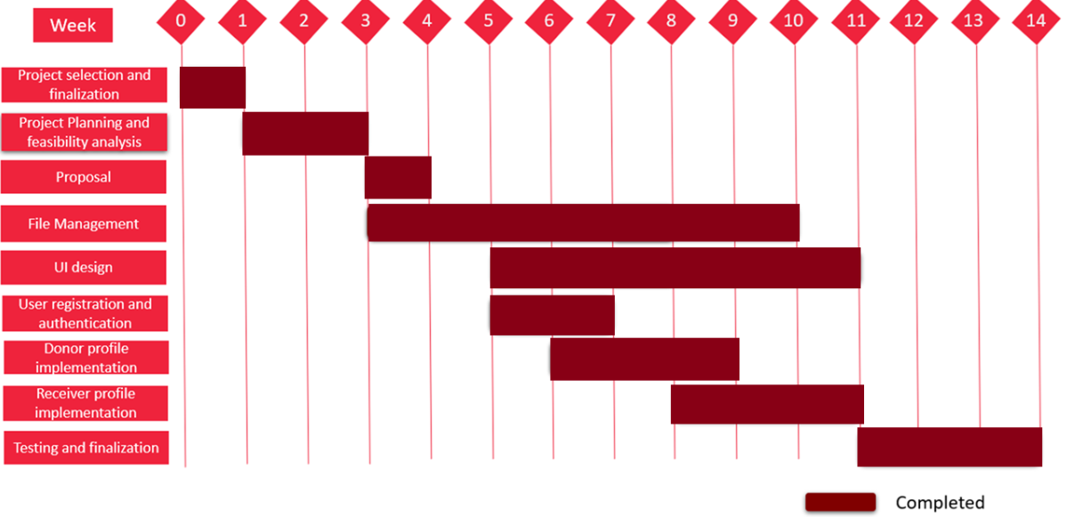

Project Timeline
06

Slide 7



Tools and Technologies
Git
Language: Java
IntelliJ IDEA
07

Slide 8
PROJECT
DEMONSTRATION
08

Slide 9
A presentation
by
SPL TEAM - 2
Thank
You
GITHUB PROJECT LINK - https://github.com/Ridwan-github/Blood-Aid.git
09

Slide 10
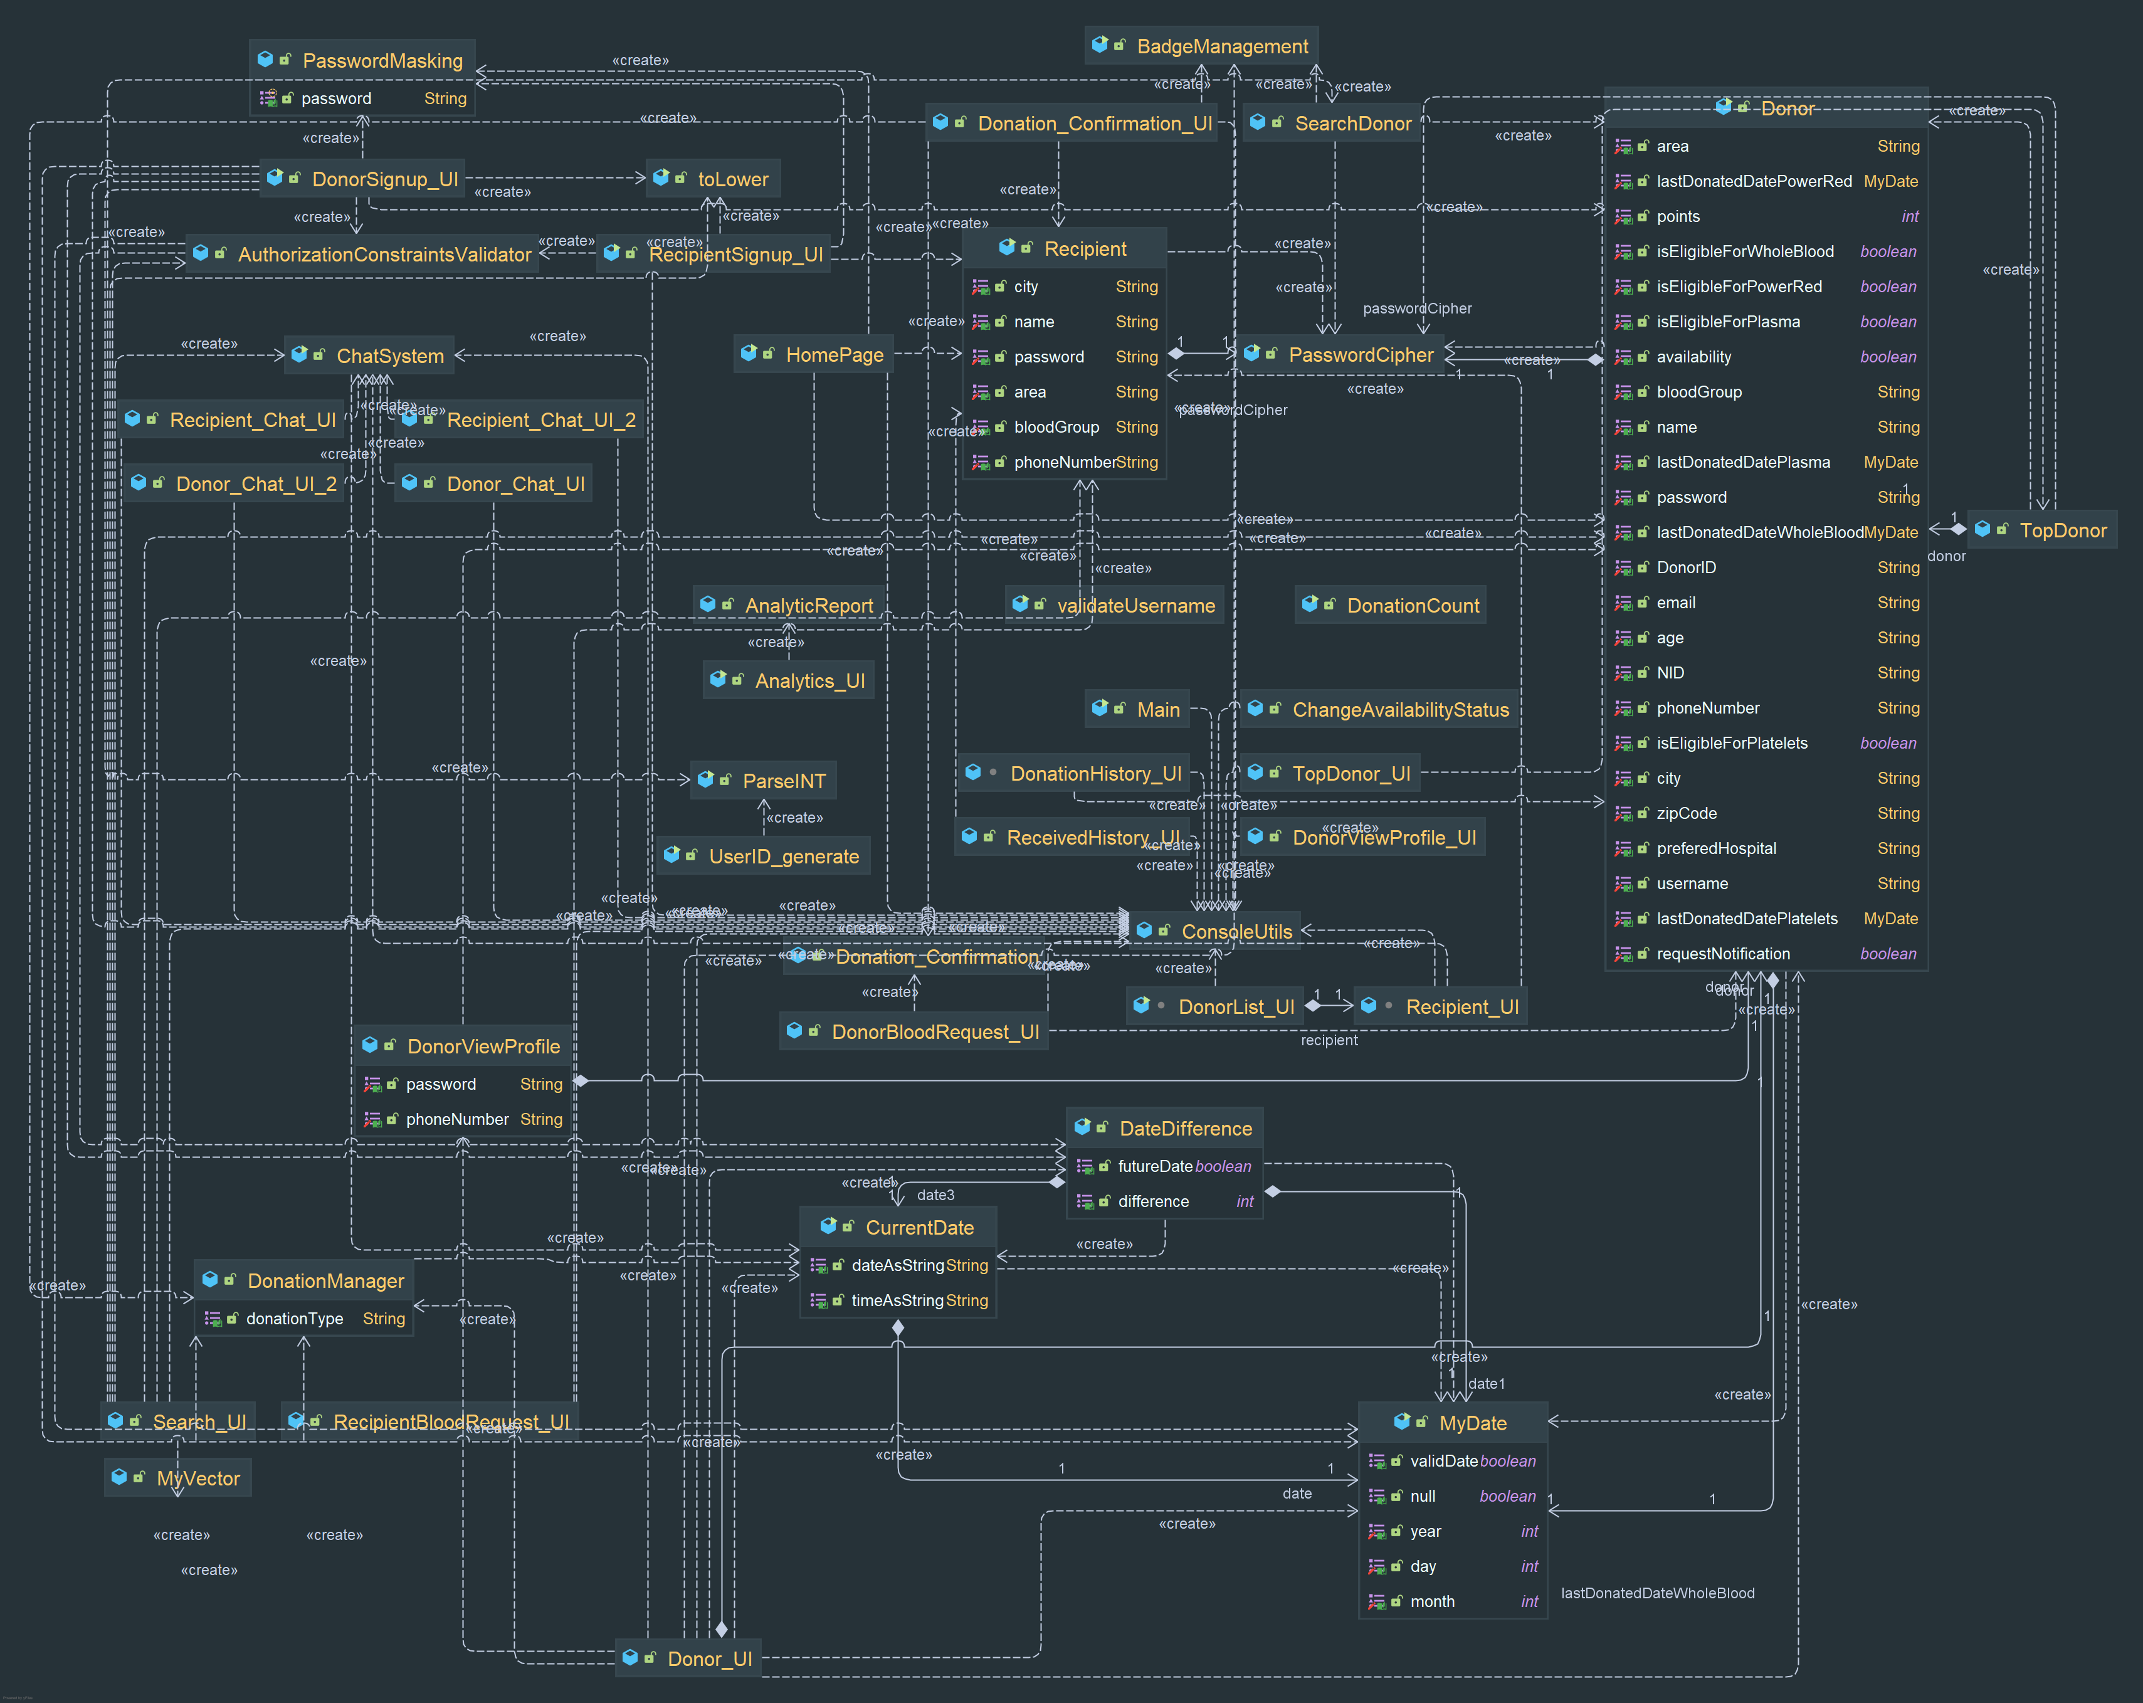

Slide 11
Library Functions Used
Character
isDigit
isAlphabetic
isUpperCase
isLowerCase
isLetterOrDigit
String
length
charAt
IndexAt
substring
matches
equals
split
File
FileReader
IOException
printStackTrace
Sout
Scanner
BufferedReader
BufferedWriter

