Slide 1
Honey Hoarder
An interactive web game built using three.js
by
S M Ridwanul Haque and Md Golam Mahmud Chowdhury

Slide 2
Categories Chosen
Flocking
Flow Field Pathfinding
State Machine
Depth First Backtracking Maze Generation
Halton Sequence

Slide 3
Flocking
Bees exhibit flocking behavior when chasing the bear.
Aims to simulate swarm behavior of insects of Hymenoptera order (Bees, Wasps, etc).
Combines simple behaviours like align, separate and cohesion to create a complex flocking behaviour.

Slide 4
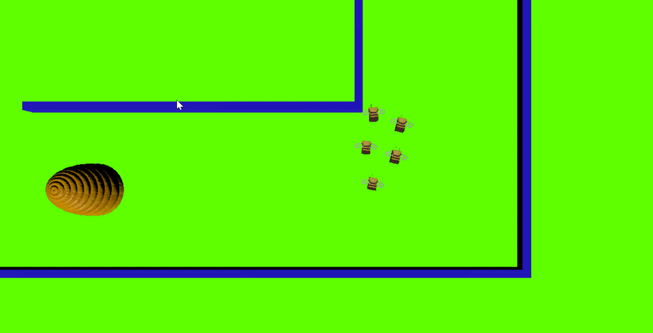
Flocking

Slide 5
Flow Field Vector
Assigned a direction to move from each tile to get to the current position of the player(bear).
Benefit of using flow field vectors is that we don't need to calculate path for each bees. The flowfield is updated when a player moves and the bees follow the vector directions from each tile.

Slide 6
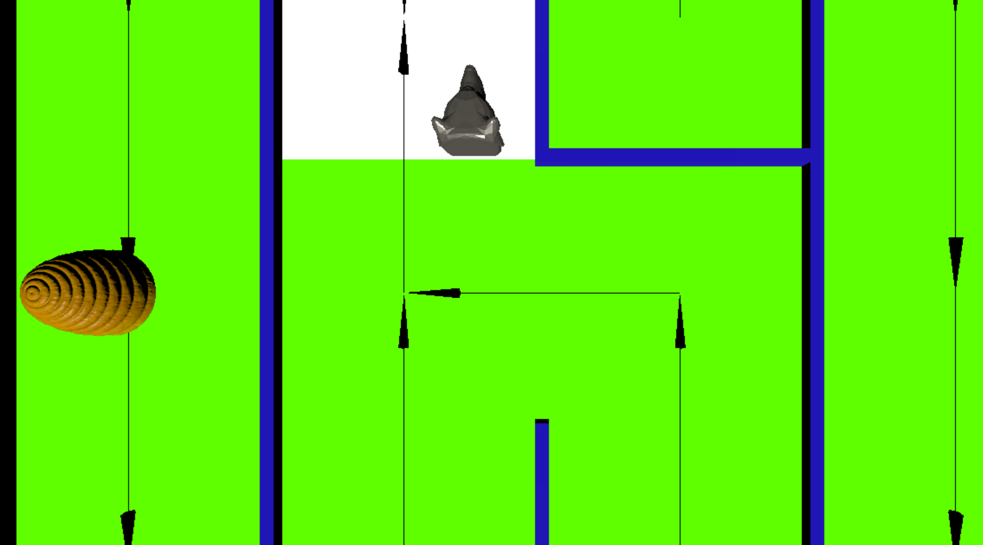
Flow Field Vector

Slide 7
State Machine
Assigned behavior for each state for both bees and bear
Switch between different states depending on user input and bear movement.
The code is more intuitive than using nested if statements and easier to debug.
For bees the states are InitialState(), ChasingState(), TransitionState()
For bear the states are IdleState() and MovingState()

Slide 8
Depth-First Backtracking maze generation
It is a connected graph therefore no space is wasted and the whole game environment is accessible to the bear to move around.
Generates a new maze for each iteration

Slide 9
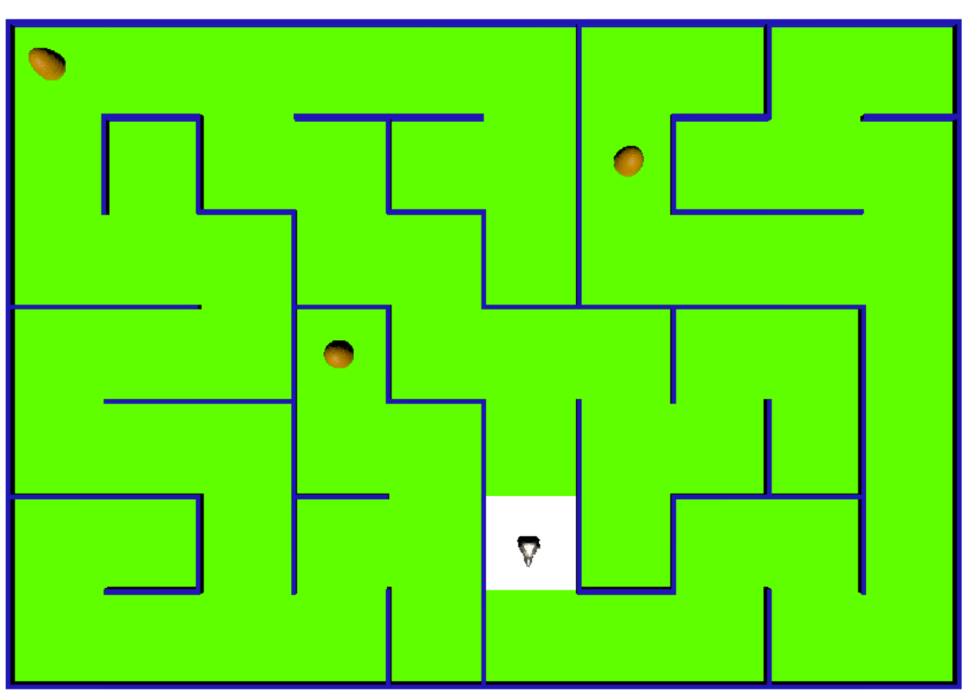
Depth-First Backtracking maze generation

Slide 10
Halton Sequence
Instead of spawning beehives at random location which can cause clustering, we spread them out around the maze using halton sequence.
Halton sequence ensures an even distribution of the beehives. It also avoids beehive generation in the same position at short intervals.

Slide 11
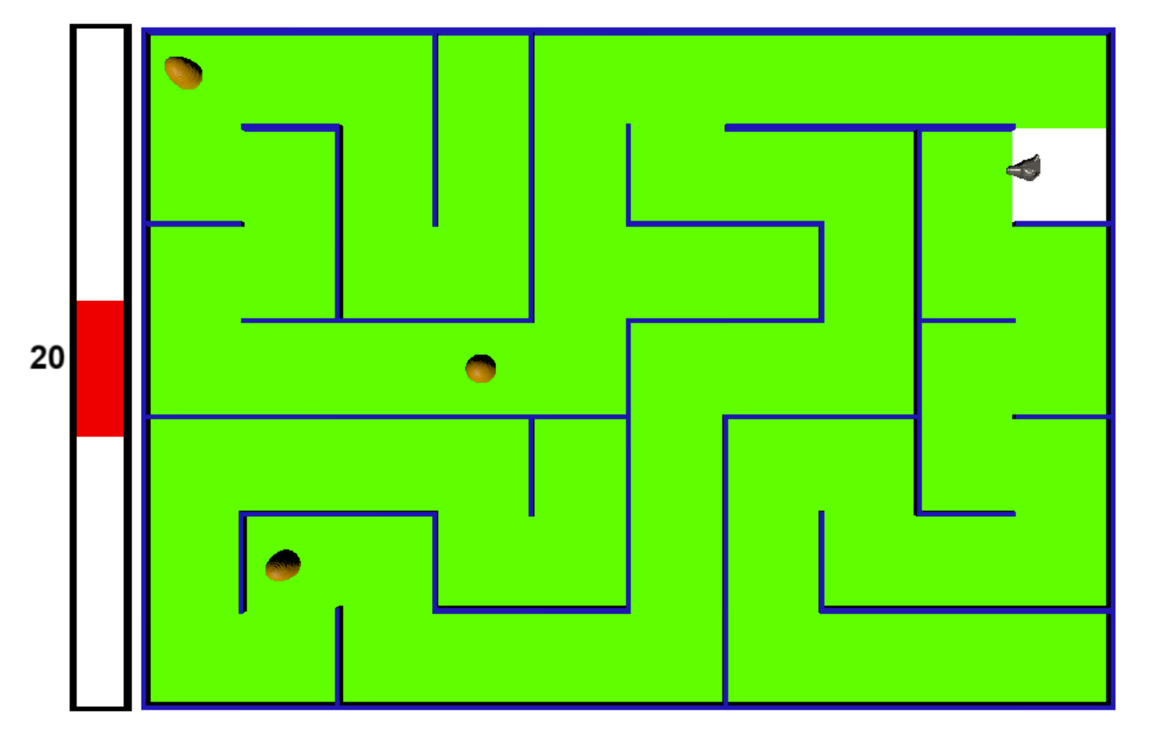
Halton Sequence

Slide 12
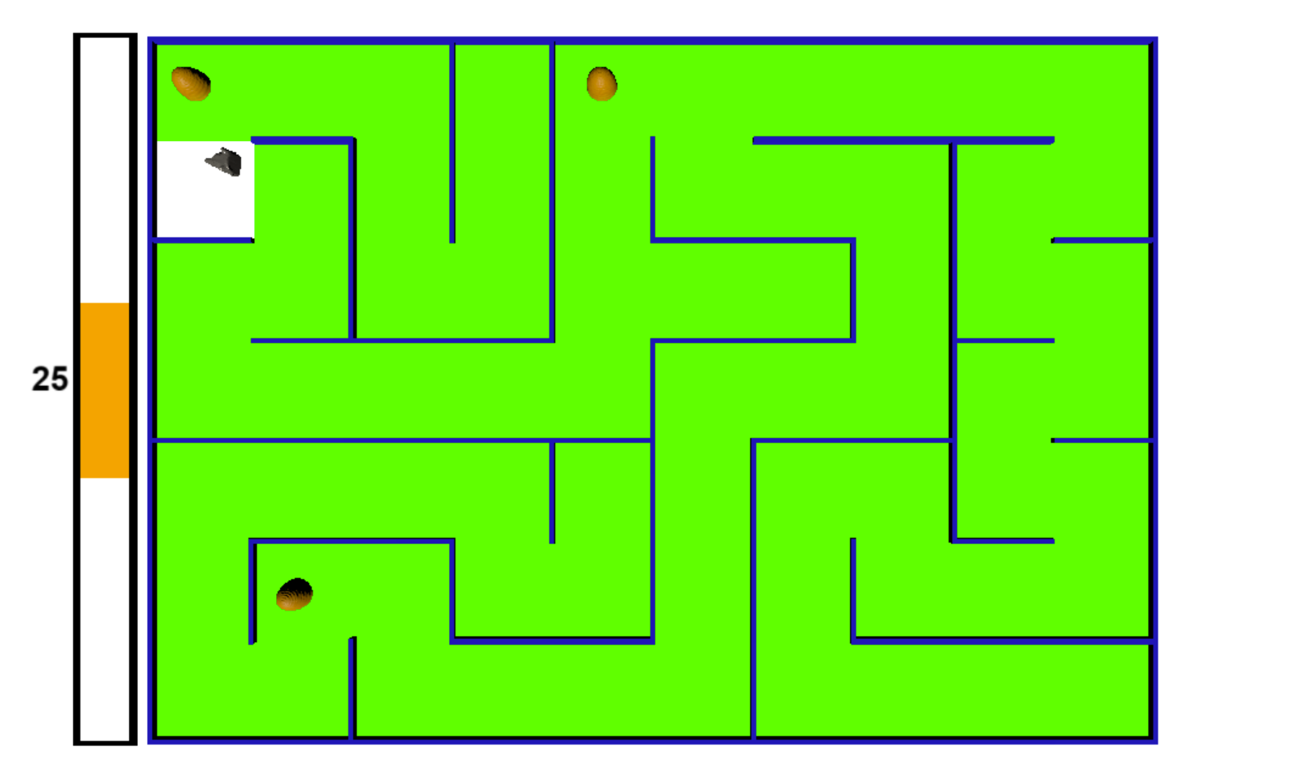
Halton Sequence

Slide 13
Thank You
Hope you enjoy the game!

