Slide 1
ECONOMETRIC ANALYSIS · NIGERIA · 2005–2024
Determinants and Dynamics of
Nigeria's External Reserves
A Cointegration and Vector Error Correction (VECM) Approach to Exchange Rate, Interest Rate, Remittance, and FDI Linkages
Ridwan Okeshola
Financial/ Economic Analyst
September 2026

Slide 2
ROADMAP
What This Analysis Covers
01
Background & Objective
02
Data & Methodology
Why reserves matter for Nigeria, and the question this study asks
Five macro variables, 2005–2024, and a seven-step econometric pipeline
03
Stationarity & Cointegration
04
The VECM System
Unit root testing and the Johansen test for long-run equilibrium
Short-run drivers of reserves and the speed of adjustment to equilibrium
05
The 2023 FX Float
06
Shock Propagation
Isolating a structural break with a policy dummy variable
Impulse responses and variance decomposition
07
Findings & Policy Implications
What it means for reserve resilience going forward
2

Slide 3
BACKGROUND
How External Reserves Shape National Policy
External reserves are the buffer Nigeria draws on to defend the naira, settle import bills, and service external obligations when oil revenue or capital inflows fall short. Between 2005 and 2024, that buffer was tested by debt relief, the Global Financial Crisis, the 2014–16 oil price collapse, a pandemic shock, and most recently, the 2023 unification of the exchange rate.
NIGERIA'S MACRO TIMELINE
2006
Paris Club debt relief
2008
Global Financial Crisis
2014
Oil price collapse
This analysis asks a focused question:
2016
Naira devaluation & recession
How do the exchange rate, lending rate, remittances, and FDI shape the level and short-run movement of Nigeria's external reserves — and did the 2023 FX float change those relationships?
2020
COVID-19 shock
2023
FX float & subsidy removal
3

Slide 4
DATA
Five Variables, Twenty Annual Observations
Source: World Bank World Development Indicators (WDI), Nigeria, 2005–2024. Gaps were closed by linear interpolation and forward/backward fill; monetary variables are expressed in billions of US dollars.
Variable | Role | Definition | Unit | WDI Code
Reserves | Focal / dependent | Total reserves, including gold | US$ billions | FI.RES.TOTL.CD
Exchange Rate | System variable | Official exchange rate (period average) | ₦ per US$ | PA.NUS.FCRF
Lending Rate | System variable | Bank lending interest rate | % per annum | FR.INR.LEND
Remittances | System variable | Personal remittances received | US$ billions | BX.TRF.PWKR.CD.DT
FDI | System variable | Net inflows of foreign direct investment | US$ billions | BX.KLT.DINV.CD.WD
Variable
Role
Definition
Unit
WDI Code
Reserves is treated as the focal series; the remaining four enter the system as jointly-determined macro-financial variables within the VECM.
4

Slide 5
METHODOLOGY
A Seven-Stage Econometric Pipeline
1
2
3
4
5
6
7
Data sourcing & cleaning
Exploratory analysis
Unit root testing
Johansen cointegration
VECM estimation
Structural break test
IRF & FEVD
→
→
→
→
→
→
Fetch WDI panel; interpolate gaps; scale to billions
Time trends, distributions, descriptive statistics
ADF & KPSS across three trend specifications
Trace test for long-run equilibrium relationships
Short-run dynamics + error-correction speed
Exogenous 2023 FX-float dummy in the VECM
How shocks propagate and what drives forecast variance
Levels of Reserves, the exchange rate, the lending rate, remittances, and FDI are each tested for a unit root before any relationship between them is estimated — otherwise the regression risks being spurious.
5

Slide 6
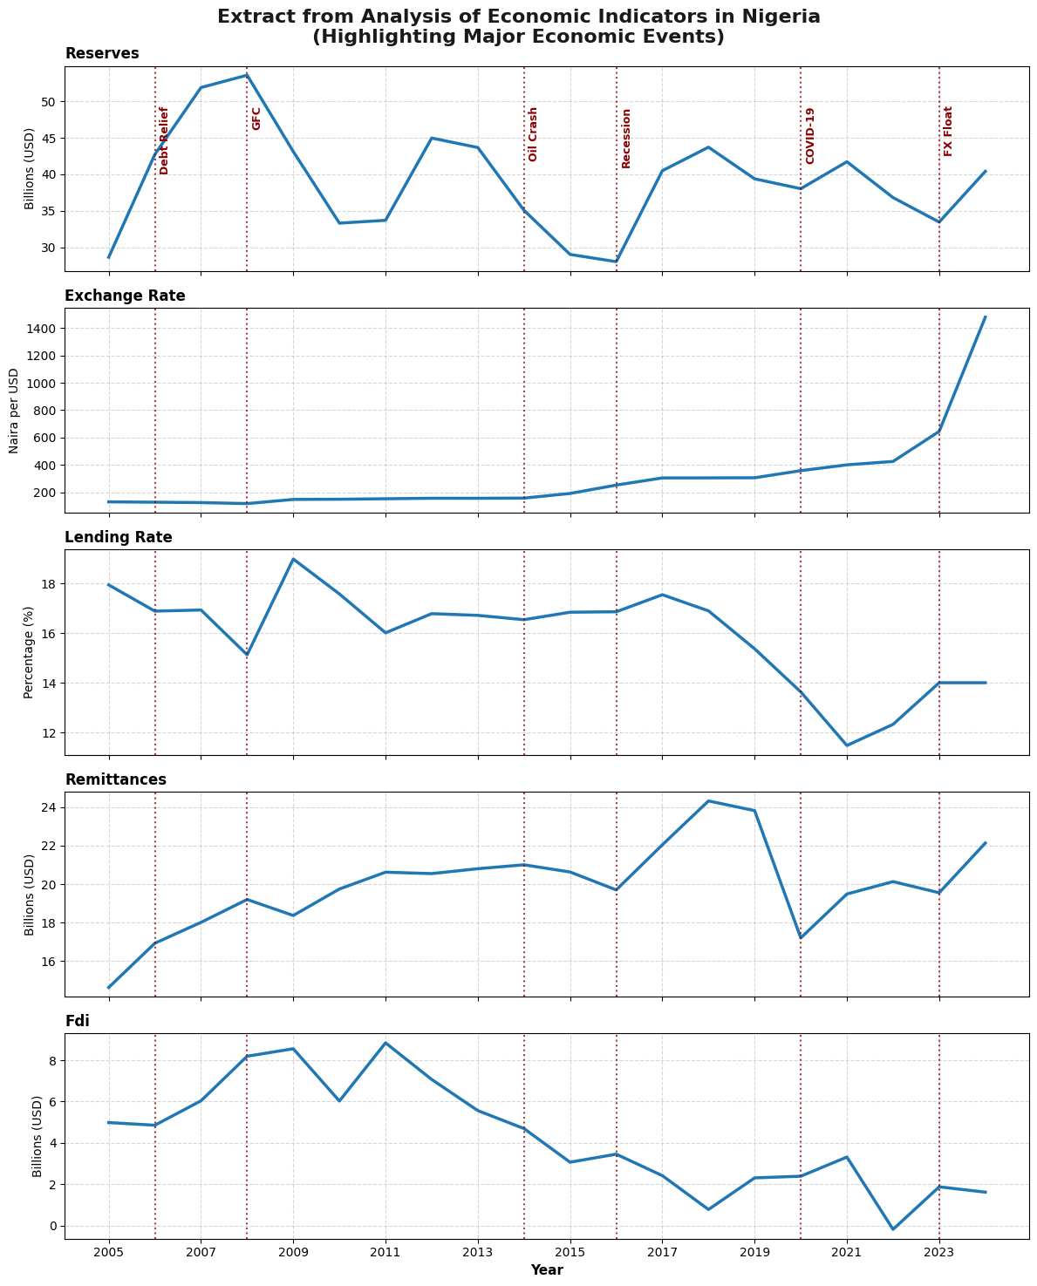
EXPLORATORY ANALYSIS
Twenty Years of Nigeria's External Sector
Reserves swing widely: a post-debt-relief climb to ~$54bn by 2008, a slide to ~$28bn around the 2016 recession, and renewed pressure after 2020.
The exchange rate is flat for most of the sample, then breaks sharply upward after the 2023 float — from roughly ₦460 to over ₦1,400 per dollar.
Lending rates and FDI show the opposite drift: rates ease post-2020 while FDI trends down across most of the sample.
Remittances grow steadily but dip sharply in 2020, consistent with a pandemic-year shock to diaspora income.
6

Slide 7
EXPLORATORY ANALYSIS
Descriptive Statistics, 2005–2024
Variable | Mean | Std Dev | Min | Median | Max | Skew | Kurtosis
Reserves ($bn) | 39.09 | 7.04 | 28.02 | 39.89 | 53.60 | 0.26 | -0.18
Exchange Rate (₦/$) | 305.28 | 307.82 | 118.57 | 175.50 | 1,478.97 | 3.24 | 11.90
Lending Rate (%) | 15.93 | 1.94 | 11.48 | 16.76 | 18.99 | -0.88 | 0.23
Remittances ($bn) | 19.94 | 2.27 | 14.64 | 19.94 | 24.31 | -0.22 | 0.73
FDI ($bn) | 4.29 | 2.62 | -0.19 | 4.07 | 8.84 | 0.24 | -0.83
Variable
Mean
Std Dev
Min
Median
Max
Skew
Kurtosis
Explaining the distribution: the exchange rate's skewness (3.24) and kurtosis (11.90) are far outside a normal range — a fingerprint of the 2023 regime shift, not measurement noise. FDI's minimum of –$0.19bn marks a rare year of net outflow (around 2022). Reserves and remittances are comparatively well-behaved, near-symmetric series.
7

Slide 8
STAGE 1 · STATIONARITY
Testing for a Unit Root (ADF & KPSS)
Each series was tested at levels under three trend specifications (none, constant, constant + trend), then retested on first differences. The two tests disagree in places — expected in a 20-year annual sample — but the pattern is consistent with each series being integrated of order one, I(1).
Variable | At Levels | After First Differencing
Reserves | Unit root (N); stationary (C); mixed (CT) | Stationary across N and C
Exchange Rate | Unit root across all three specs | Stationary at N; unit root persists at C / CT
Lending Rate | Unit root across all three specs | Stationary at N and C
Remittances | Unit root (N); stationary (C); unit root (CT) | Stationary across N and C
FDI | Unit root across all three specs | Stationary at N and C
Variable
At Levels
After First Differencing
Conclusion: the weight of evidence treats all five series as I(1) — non-stationary in levels, stationary once differenced. That is the precondition for testing cointegration rather than running a regression that could be spurious.
8

Slide 9
STAGE 2 · LONG-RUN EQUILIBRIUM
The Johansen Cointegration Test
If I(1) variables are cointegrated, a linear combination of them is stationary — meaning they share one or more stable, long-run relationships even while each wanders individually. The trace test compares against a chain of null hypotheses on the number of such relationships, r.
COINTEGRATING RANK
r = 3
Null Hypothesis | Trace Statistic | 5% Critical Value | Decision
r ≤ 0 | 116.23 | 33.88 | Reject
r ≤ 1 | 48.40 | 27.59 | Reject
r ≤ 2 | 21.75 | 21.13 | Reject
r ≤ 3 | 5.43 | 14.26 | Fail to reject
r ≤ 4 | 0.29 | 3.84 | Fail to reject
Null Hypothesis
Trace Statistic
5% Critical Value
Decision
Three independent long-run equilibrium relationships bind reserves, the exchange rate, the lending rate, remittances, and FDI together.
This justifies a Vector Error Correction Model (VECM) rather than a VAR in differences — the system has genuine long-run "anchors" worth modelling explicitly.
9

Slide 10
STAGE 3 · THE VECM SYSTEM
How Fast Do Reserves Return to Equilibrium?
The VECM decomposes each variable's change into (i) a pull back toward the long-run relationships (the error-correction terms) and (ii) short-run feedback from the system's own recent past. For reserves, all three error-correction terms are statistically significant:
ec1
ec2
ec3
-0.963
0.062
2.624
coefficient · p < 0.001
coefficient · p < 0.001
coefficient · p < 0.001
Reserves close roughly 96% of a deviation from this long-run relation within a single year — a very fast adjustment.
A smaller, opposing correction from a second long-run relation.
A third relation with a large, significant loading — reserves respond strongly to this equilibrium as well.
System diagnostic: a Jarque–Bera normality test on the VECM residuals returns a system p-value of 0.95 — no evidence against normally distributed errors, supporting the model's specification.
10

Slide 11
STAGE 3 · THE VECM SYSTEM
Short-Run Drivers in the Reserves Equation
Lagged Driver (t-1) | Coefficient | p-value | Reading
Own lag (reserves) | 0.651 | < 0.001 | Strong persistence — reserves carry over from year to year
Exchange rate | -0.093 | < 0.001 | A weaker naira in year t-1 is followed by a reserve drawdown — consistent with FX intervention
Lending rate | -1.028 | 0.057 | Weak, borderline-significant negative association
Remittances | -0.154 | 0.617 | Not statistically significant in the short run
FDI | 1.282 | 0.001 | Higher prior-year FDI is followed by reserve accumulation
Lagged Driver (t-1)
Coefficient
p-value
Reading
Explanation: the system's own recent past dominates FDI and the exchange rate as short-run predictors of reserves, while remittances and the lending rate show weaker short-run linkages once the error-correction terms are already accounting for the long-run relationship.
11

Slide 12
STRUCTURAL BREAK
Isolating the 2023 FX Float
A dummy variable (0 before 2023, 1 from 2023 onward) was added to the VECM as an exogenous regressor, isolating the policy regime shift from the system's ordinary dynamics.
Reserves
Exchange Rate
Lending Rate
Remittances
FDI
+12.80
+357.99
+2.44
-0.54
+6.43
$bn shift
₦/$ shift
pp shift
not significant
$bn shift
p < 0.001
p < 0.001
p 0.039
p 0.798
p < 0.001
Every equation except remittances shows a significant shift — the float was a genuine regime change for the system, not a continuation of pre-2023 trends. The FDI coefficient's sign is discussed alongside the pre/post mean comparison on the next slide.
12

Slide 13
STRUCTURAL BREAK
Pre- vs Post-Float Level Comparison (≤2022 vs ≥2023)
Variable | Pre-Float Mean | Post-Float Mean | Change
Reserves ($bn) | 39.33 | 36.93 | -2.40
Exchange Rate (₦/$) | 221.19 | 1,062.08 | +840.89
Lending Rate (%) | 16.14 | 14.01 | -2.13
Remittances ($bn) | 19.84 | 20.84 | +1.00
FDI ($bn) | 4.57 | 1.74 | -2.83
Variable
Pre-Float Mean
Post-Float Mean
Change
READING THE FDI SIGNAL
Unconditional means show FDI falling after the float (-$2.83bn), yet the VECM's dummy coefficient is positive.
These are not contradictory: the mean compares raw averages, while the VECM coefficient is a shift estimated after controlling for lagged system dynamics. Both are reported so the reader can judge the balance of evidence.
Reserves and FDI both sit lower post-float in raw terms, while lending rates eased and remittances edged up — a mixed picture rather than a uniform "improvement" or "deterioration."
13

Slide 14
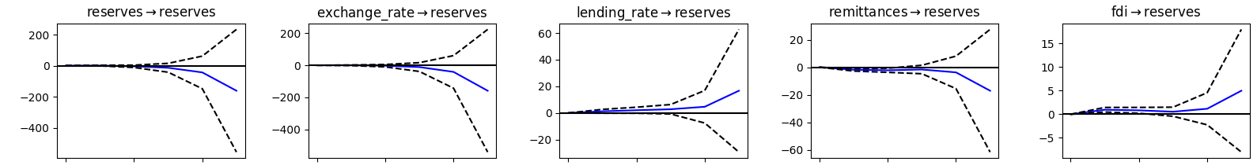
STAGE 4 · SHOCK PROPAGATION
How Shocks Ripple Into Reserves (5-Year Horizon)
Each panel traces reserves' response to a one-time shock in the labelled variable, with a 95% confidence band (orthogonalised responses).
Horizon runs left to right within each panel, Year 0 to Year 5.
Explanation: shocks to the exchange rate move reserves almost as strongly as reserves' own shocks do, and the effect builds rather than fades over the horizon — a signature of the cointegrated, I(1) system. FDI and lending-rate shocks matter too, but on a far smaller scale. Confidence bands widen quickly, reflecting the sample's modest 20-year length, so treat magnitudes as directional rather than precise. The full 25-panel system grid (every variable's response to every shock) appears in the companion report.

Slide 15
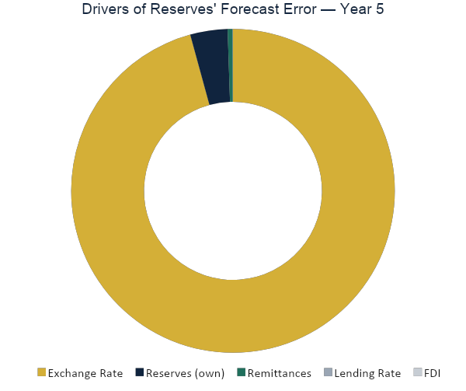
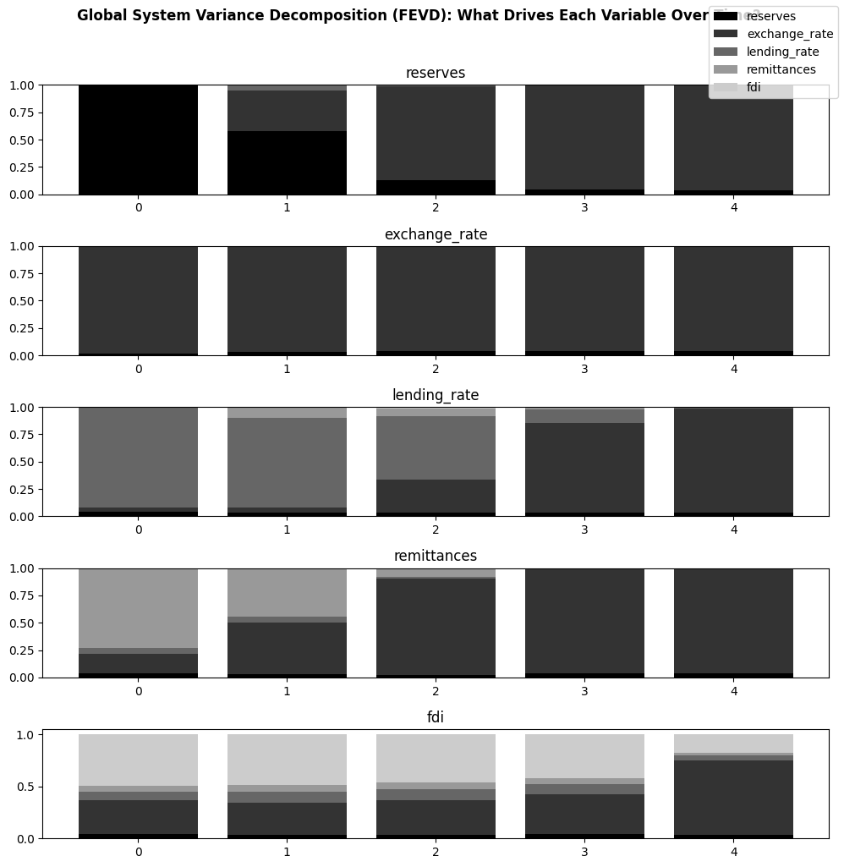
STAGE 4 · SHOCK PROPAGATION
What Drives the Forecast Error in Reserves?
95.7%
from the exchange rate alone
The exchange rate explains 95.7% of the 5-year-ahead forecast error variance in reserves — reserves' own shocks explain only 3.7%. The same pattern (right) repeats across nearly every variable, except FDI, where own-shocks retain a larger 17.8% share.

Slide 16
SYNTHESIS
Five Key Findings
1
Fast equilibrium correction
Reserves close the bulk of any deviation from their long-run relationships within about a year — active management, not drift.
2
The exchange rate leads reserves
A weaker naira precedes reserve drawdowns the following year, consistent with reserves being spent to defend the currency.
3
A genuine 2023 regime change
The FX-float dummy is significant in four of five equations — pre- and post-2023 dynamics should be pooled with care.
4
One dominant shock channel
The exchange rate explains 95%+ of the forecast-error variance in reserves, the lending rate, and remittances alike.
5
FDI behaves differently
It is the only variable substantially driven by its own shocks (17.8%) rather than the exchange rate — and it weakened after the float.
16

Slide 17
SYNTHESIS
Policy Implications
Diversify the shock exposure
With one channel driving nearly all forecast-error variance, reserve resilience depends on developing inflow sources whose shocks aren't perfectly correlated with the exchange rate — formal remittance channels and non-oil FDI are candidates.
Treat 2023 as a hard break in modelling
Forecasting or stress-testing exercises that pool pre- and post-float data without a structural adjustment risk misstating both the mean levels and the short-run dynamics of the system.
Watch the FDI–reserves link post-float
FDI's weaker post-float showing, alongside its still-significant short-run contribution to reserve accumulation, makes it a variable worth monitoring closely as the new FX regime matures.
17

Slide 18
CAVEATS
Limitations of the Analysis
Twenty annual observations is a small sample for a five-variable VECM/VAR system; coefficient and variance-decomposition estimates carry wide uncertainty, visible in the IRF confidence bands.
Unit root evidence is mixed for some series under the constant-and-trend specification; classifying every series as strictly I(1) is a working assumption, not a certainty.
Missing WDI data points were filled by linear interpolation, which can understate genuine short-run volatility in the interpolated years.
The series used throughout are levels in original units (US$ billions, ₦ per US$, %), not log-transformed. Hence, coefficients should be read as level effects, not elasticities.
USD-denominated reserve, remittance, and FDI figures can be mechanically affected by 2023–24 valuation and reporting changes tied to the exchange-rate unification itself.
The VECM is a reduced-form, associational model; its coefficients describe statistical relationships, not verified causal policy effects.
18

Slide 19
CONCLUSION
Reserves Are Anchored, but Anchored
to One Dominant Channel
Nigeria's external reserves are cointegrated with the exchange rate, lending rate, remittances, and FDI across three distinct long-run relationships, and adjust quickly, within about a year, when those relationships are disturbed. The 2023 FX float marks a clear structural break in the system, and the exchange rate stands out as the dominant transmission channel for shocks reaching reserves. Reserve resilience going forward will depend less on managing the exchange rate alone, and more on diversifying the inflow channels (remittances and FDI), that currently move in its shadow.
19

Slide 20
Thank You
Full data pipeline, diagnostics, and estimation python code available on request.
Ridwan Okeshola
Financial / Economic Analyst
20

