Slide 1
CUSTOMER SEGMENTATION
Capstone Project by Group Nine

Slide 2
CONTENT
Introduction to customer segregation and possible outcomes using data science.
Performing Exploratory Data Analysis on the data while presenting insights from different visualization studios
Proffering Solutions and the way forward.

Slide 3
Overview
One of the roadmaps for a successful company is a customer centric experience. In building an excellent customer experience it is important to know what every customer needs through the available information, insights as well as feedbacks collated over the years of business. A proper analysis of these outputs will give rise to the Customer segregation promoting an efficient service delivery. Customers in each segment should share characteristics that distinguish them from other users.
KNN is a supervised learning approach which uses proximity to make classification or predictions about the grouping of an individual data point. Classification problems are what we intend to solve in this project by process of recognition, understanding, and grouping of ideas into preset categories and possibly predict future outcomes. This is important to find groups of potential new customers also giving directions into a right marketing campaign

Slide 4
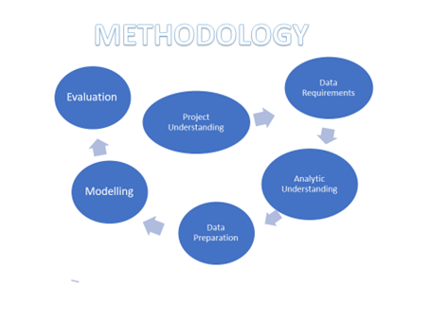

Slide 5
Dataset Description
The Dataset used for this project was gotten from Kaggle. The dataset is titled 'Customer Segmentation'. It shows multiclass classification of an automobile company with plans to enter new markets with their existing products (P1, P2, P3, P4 and P5). The data set have identified 2627 new potential customers.

Slide 6
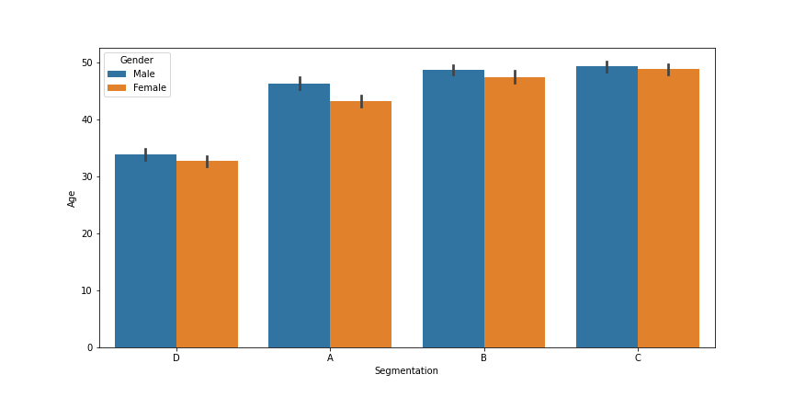
CATEGORICAL DATA
FINDING 1
From the histogram,every of the segments with respect to different ages has both males and females showing that gender does not determine their customer segregation and products can cut across sexes as well as all ages.

Slide 7
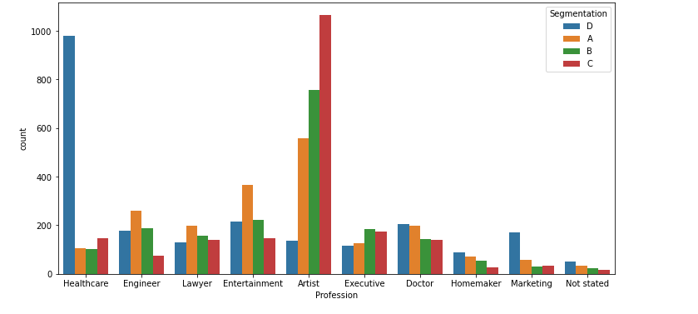
CATEGORICAL DATA
FINDING 2
Segmentation through Profession also shows that for every profession we have the four segments duly represented even though in varrying numbers

Slide 8

As your customer or client base grows, it can be difficult to keep up with each of them on an individual level. Often, it helps to segment your clients with similar needs to maximize interaction efforts and increase retention. This can help you and your team feel more organized and productive when communicating with clients, while ensuring each one has their expectations met. Forbes 2020

Slide 9
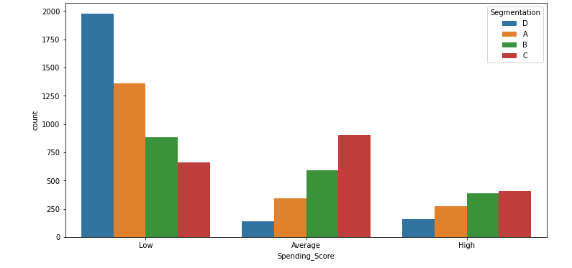
CATEGORICAL DATA
FINDING 3
Segmentation with the Spending_score shows that those with low Spending_scores have higher numbers.
Visualizations do not completely show much information about what feature dominates a particular segmentation. So, we would need an algorithm like KNN or other deep learning models to get the insights.

Slide 10
DATA PREPARATION
KNN model does not do well with high dimensional data. Data with high dimensions are the ones with a lot of features. To avoid this, we tried to reduce the dimension of our data by dropping irrelevant features.
The features that were not needed such as ID number of the customers and other anonymized categories were dropped. Features such as gender and profession were label encoded because our model would not be able to work with strings. Age and work experience columns were also scaled, so the model does not assign too much importance to them because of their relatively large values. Some missing values were dropped, and some were filled.
Pandas was imported to read the csv files and numpy was also imported to fix missing values. Label encoder was imported from ‘sklearn.preprocessing’ to convert string values to numeric.

Slide 11
MODELLING AND EVALUATION
The KNN model were fitted with 4 neighbours as we have 4 different groups. For every other parameters, the default values were used. The features (independent variable) to be used were stored in the variable ‘X’, and the target variable, which was segmentation was stored in the variable ‘Y’.
The dataset was divided into training and testing data. The model was fitted on the training data and tested for accuracy on the testing data. KNearestNeighbours was imported from the neighbours module of sklearn.
After fitting our model, the model was evaluated by scoring both the training data and the testing data. Accuracy score and classification score were used to test our model

Slide 12
CONCLUSION
After trying several other combinations of features, the combination that resulted in the highest testing score was one that used all the relevant features with scaling and encoding where appropriate. The scores we got are still low.
Visualizations didn't show any distinct segment where a feature dominates
Training score is usually low when we do not have enough entries in our dataset but that isn't the case here. It's likely that the segmentation was done randomly, or the dataset have missing information.

Slide 13
Thank You
Group Members (9)
Paul Madu
Ekechukwu Paul
Hilary Ekwebele
Bukola Adekoya
Ridwan Tiamiyu
Ogunleye Anuoluwapo
Grace Ameh

