Slide 1



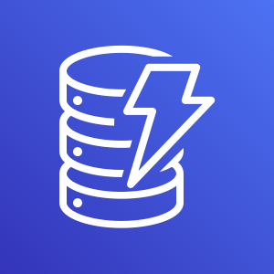




AWS Cloud
Amazon API
Gateway
AWS Lambda
Amazon DynamoDB
Amazon CloudFront
Amazon S3

