Slide 1
A Novel Approach to Detecting Covert DNS Tunnels Using Throughput Estimation
by
Michael Himbeault

Slide 2
Context: Motivation
DNS tunnels uses:
Malware and botnet command-and-control channels
In/ex-filtration channels for transporting data through corporate security layers
The ability to monitor the existence of these channels is important when securing a network.
Currently quite difficult

Slide 3
Context: Goals and Objectives
Be able to identify DNS tunnels that do not violate DNS RFCs or specifications in near real time with high accuracy on commodity hardware.
Low false-positive rate

Slide 4
Background: Domain Name System (DNS)
Translates text references to other forms of records. For example:
IP or IPv6 address (A or AAAA)
Another domain name (CNAME)
IP address to name (PTR)
Name to bulk data (TXT)
Provides the human-interaction layer for the Internet
Offers a great deal of flexibility for deploying automated services over existing infrastructure
For example: spam, malware, and address blacklists.

Slide 5
Background: Covert Channels
Utilize standard means of transportation in non-standard ways
Often transporting unintended data types over existing protocols
Occasionally involves new custom protocols built on existing ones
Intention is rarely benign, often circumventing existing security layers

Slide 6
Background: Covert Channels
May or may not modify the standard protocols in ways that are conforming to specifications.
May sacrifice ‘common’ features such as bidirectionality
Examples:
IP timing channels
May use third party services such as Twitter, Facebook, or image hosting providers
Encoding information in JPEG headers
DNS tunnels

Slide 7
Background: Entropy
Rough measure of the amount of information contained in a collection, C:

Slide 8
Background: DNS Tunnels
Existing implementations are commonplace
Iodine
OzymanDNS
Dns2tcp
DNScat
DeNiSe
PSUDP
A custom implementation was built to simulate a next-generation tunnel

Slide 9
Background: DNS Tunnels
Raw DNS tunnels
Utilize UDP/TCP port 53 for transmitting arbitrary data without respect for DNS protocol specifications
Not difficult to block
Conforming DNS tunnels
Makes use of DNS packets that do not violate the protocol specifications to transmit arbitrary data
Can be very difficult to identify and block
The focus of this work

Slide 10
Custom DNS Tunnel Application
Prototype proof-of-concept implementation
Implements encoding to match character frequencies to circumvent detections approaches that tune to that statistic.
Limited to client-to-server transfer only

Slide 11
State of the Art: DNS Tunnel Detection
Fall into several categories
Signature based
Domain hash/blacklist
Flow data based
Character frequency analysis on queries
Behaviour of DNS queries on a per-domain basis
The proposed approach falls into the last category

Slide 12
Proposed Approach: Assumptions
DNS tunnels move more data than benign traffic
Attempt to detect this increase in data transmission volume

Slide 13
Proposed Approach: Theory
Collect DNS queries into temporal buckets
Ten-second windows were used in the analysis
Further group queries by top-level domain (TLD)
google.com
cbc.ca
Etc…
For each TLD (in the current window), compute a measure of how much data was transmitted

Slide 14
Proposed Approach: Measuring Data Volume
Since common domains may appear more than uncommon, simple character count is insufficient
Modulo caching effects as described in section 5.1.3
Average character count is similarly uninformative
Tunnels can use any length queries, including modelling a length distribution of legitimate traffic

Slide 15
Proposed Approach: Measuring Data Volume
DNS tunnels can be expected to have very few queries that appear more than once
Since they are transmitting arbitrary data
Benign domains can have many queries that appear a great number of times
Such as www.google.com

Slide 16
Proposed Approach: Domain Length-Weighted Entropy (DLWE)
Consider the collection of queries to a TLD in an interval
Treat each query as a symbol, and compute the entropy of the collection.
Multiply the result by the average query length for the TLD in the interval.
Expect large values for tunnel domains, small values for benign domains.

Slide 17
Evaluation: Literature Candidates and Test Data
Proposed approach was tested against candidates from the literature
N-gram detection proposed by Born
Gzip compression detection proposed by Paxson
Naïve counting of characters
All approaches were implemented on a common Python framework
Analysis was done on approximately one billion UDP port 53 packets from a live ISP network as well as intentionally generated tunnel traffic

Slide 18
Evaluation Criteria
Packet processing performance
A relative comparison, due to lack of optimized implementations no absolute target is chosen
False positive rate
A relative ranking is employed
Intuitively, a false-positive rate of 1% will result in up to fifty alerts per second during average daytime traffic of the captured sample.

Slide 19
Sample Data
May contain malicious traffic
In particular, DNS tunnels which will affect the false-positive rates of the detection methods.

Slide 20
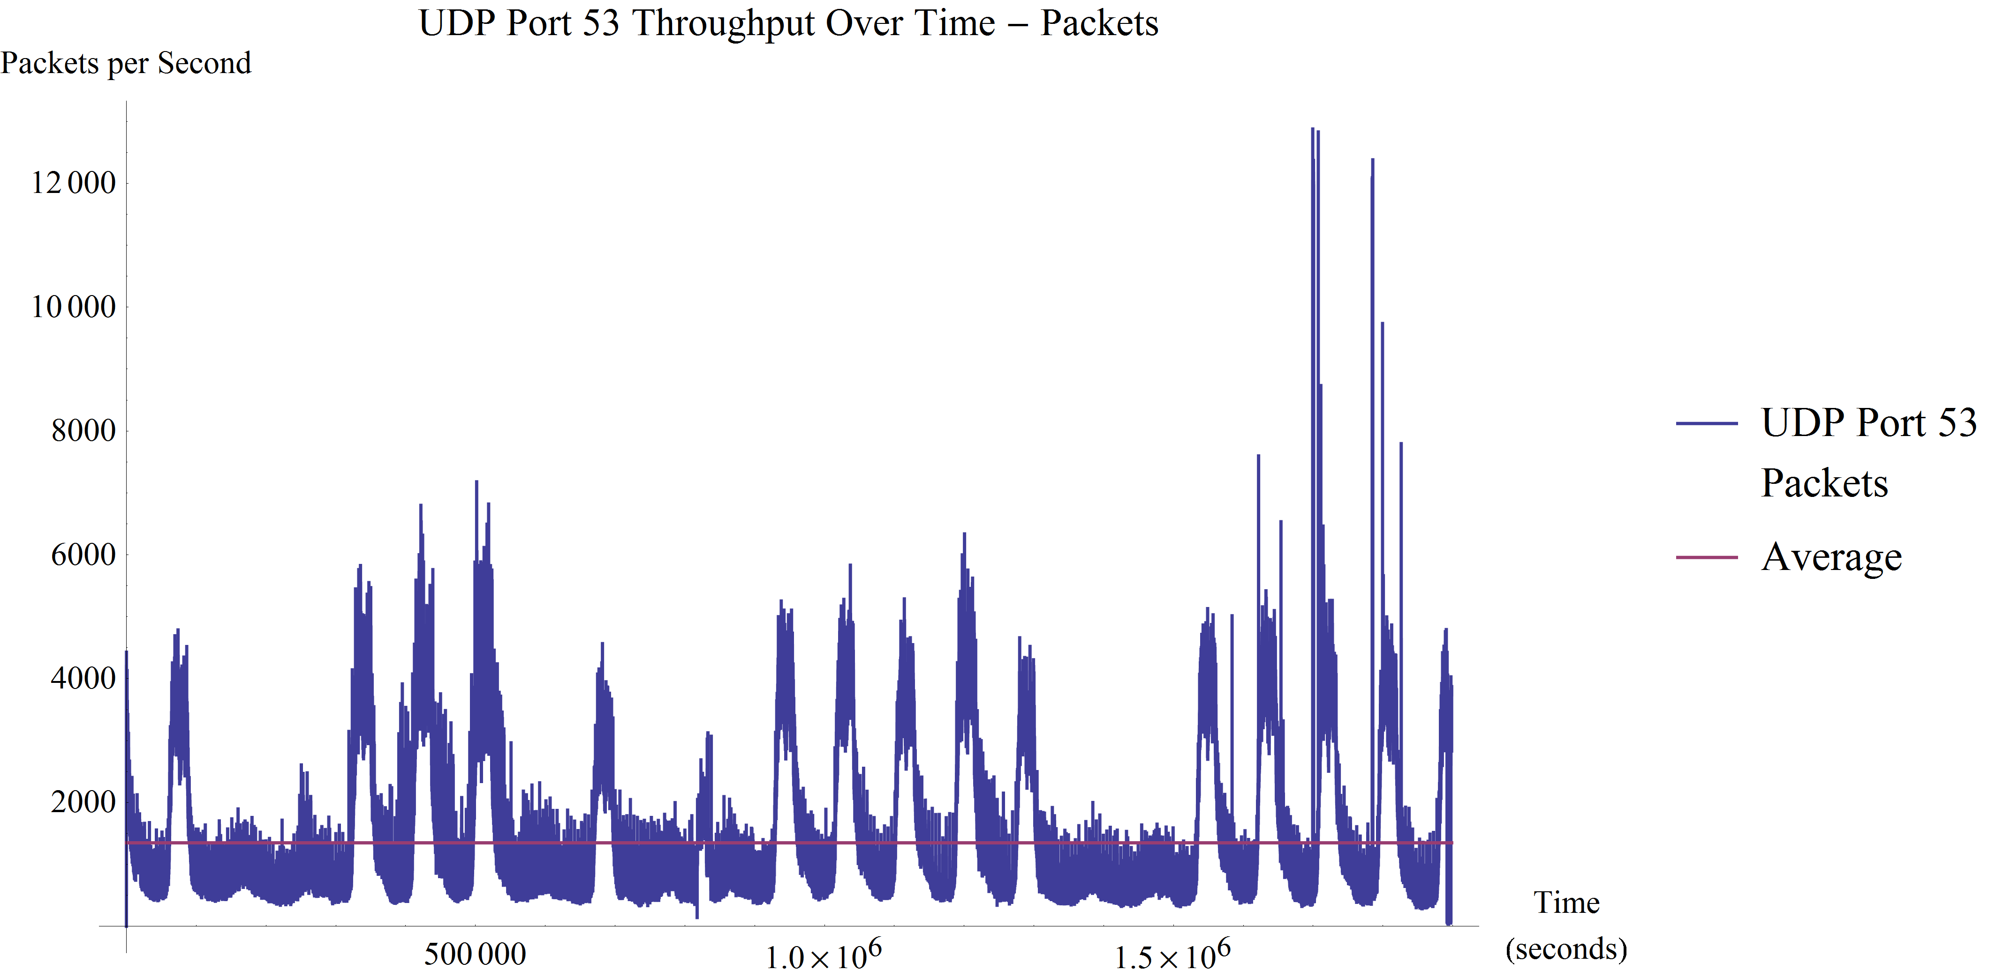
Sample Data: Packets per second

Slide 21
Confounding Factor: Effect of DNS Caching

Slide 22
Processing Performance

Slide 23
Processing Performance

Slide 24
Processing Performance: Naïve Method

Slide 25
Processing Performance : Born Method

Slide 26
Processing Performance : Paxson Method

Slide 27
Processing Performance : Proposed Method

Slide 28
Processing Performance: Conclusions
The naïve and proposed methods far outperform the other methods
As throughput increases, both Paxson and Born approaches suffer severe degradation in performance.

Slide 29
Detection Performance : Naïve Method

Slide 30
Detection Performance : Naïve Method

Slide 31
Detection Performance : Born Method

Slide 32
Detection Performance : Born Method

Slide 33
Detection Performance : Paxson Method

Slide 34
Detection Performance : Paxson Method

Slide 35
Detection Performance : Paxson Method

Slide 36
Detection Performance : Proposed Method

Slide 37
Detection Performance : ProposedMethod

Slide 38
Detection Performance : Proposed Method

Slide 39
Detection Performance: Comparison of False Positive Rates

Slide 40
Detection Performance: Comparison of False Positive Rates

Slide 41
Detection Performance: Comparison of False Positive Rates

Slide 42
Detection Performance: Conclusions
The proposed approach achieves categorically lower false positive rates than all other approaches.
The prototype next-gen tunnel is the most difficult tunnel to detect by far.
Born’s approach has a false-positive rate little better than random chance.

Slide 43
Conclusions
Proposed method:
Achieves the best detection performance, and nearly the best processing performance.
Represents a notable and novel contribution to the field.
Is already implemented in high-performance C/C++, making deployment possible.

Slide 44
Potential Future Work
Test on more strictly curated data sets to remove confounding factors.
Identify ways of improving false positive rate
Potentially with a more tailored metric
Potentially with more temporal knowledge and correlation

Slide 45
Thank you
Questions

