Slide 1
Data Science Capstone project
<Yiman Li>
<2021.08.31>

Slide 2

Outline
Executive Summary
Introduction
Methodology
Results
Conclusion
Appendix

Slide 3

Executive Summary
This is the presentation slides of the Project “SpaceX Falcon9 first stage Landing Prediction”
All the projects can be find in my GitHub

Slide 4

Introduction
In this section, we will predict if the Falcon 9 first stage will land successfully.
SpaceX advertises Falcon 9 rocket launches on its website with a cost of 62 million dollars; other providers cost upward of 165 million dollars each, much of the savings is because SpaceX can reuse the first stage. Therefore if we can determine if the first stage will land, we can determine the cost of a launch.

Slide 5

Methodology
Data collection methodology:
  Request to the SpaceX API
Perform data wrangling
  Implementing functions on pandas Dataframe
Perform exploratory data analysis (EDA) using visualization and SQL
Perform interactive visual analytics using Folium and Plotly Dash
Perform predictive analysis using classification models
  How to build, tune, evaluate classification models

Slide 6
Methodology

Slide 7
Data collection
We first define several functions, like getBoosterVersion, gerLaunchSite and use these functions to extract the information contained in the static url (API).
The extracted information is then converted to pandas Dataframe for further cleaning and analysis.

Slide 8
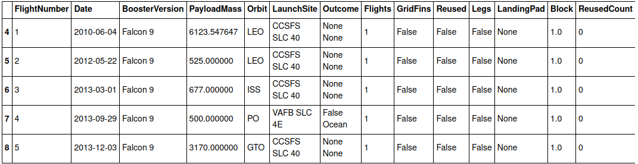
Data collection – SpaceX API
Added a flowchart of SpaceX API calls here
Description r.t. previous page
URL

Slide 9
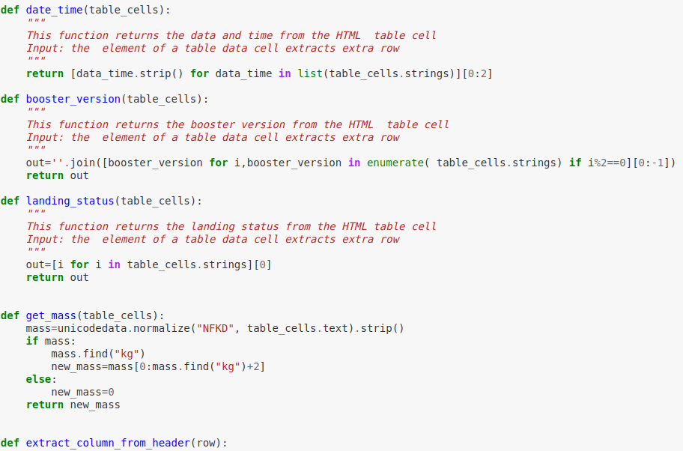
Data collection – Web scraping
Add a flowchart of web scraping here
We first define several functions to extract information from the website (especially rely on the package BeautifulSoup), then parse the HTML file to extract details, like table and head inforamtion
URL

Slide 10
Data wrangling
Based on the previous notebook, we can extract information and convert it to pandas Dataframe.
Here we main manipulate with pandas function to convert between feature, like one-hot coding, or give certain values based on given conditions.
URL

Slide 11
EDA with data visualization
Here we mostly use scatter plot to show the distribution and line plot to show the trend with time.
URL

Slide 12
EDA with SQL
Here we mainly create a bounding between the SQL and python notebook, then implementing SQL queries in notebook.
URL

Slide 13
Build an interactive map with Folium
According to the instructions, here we have added the marker, icon, circle to the maps to visualize the Launch Sites.
URL

Slide 14
Build a Dashboard with Plotly Dash
Summarize what plots/graphs and interactions you have added to a dashboard
Explain why you added those plots and interactions
Add the GitHub URL of your completed Plotly Dash lab, as an external reference and peer-review purpose

Slide 15
Predictive analysis (Classification)
We built the LR, kNN, DT and SVM models, find the best parameters using grid search, and evaluate by using confusion matrix and computing confusion matrix
URL

Slide 16
Results
Exploratory data analysis results
Interactive analytics demo in screenshots
Predictive analysis results

Slide 17
EDA with Visualization
URL

Slide 18
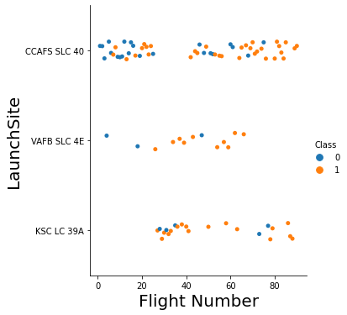
Flight Number vs. Launch Site
Show a scatter plot of Flight Number vs. Launch Site
Most Launch with class 0 locate in “CCAFS SLC 40”;
Launch with class 1 are in 3 sites all evenly visible.

Slide 19
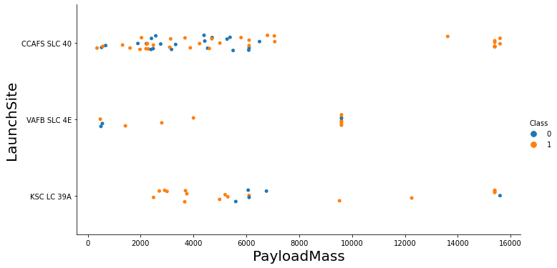
Payload vs. Launch Site
Show a scatter plot of Payload vs. Launch Site
Most Launch with class 0 has payload lower than 8000Kg;

Slide 20
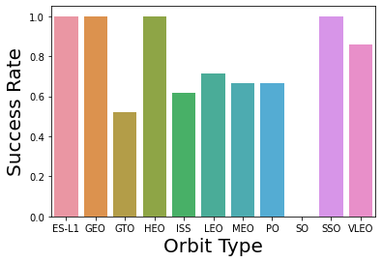
Success rate vs. Orbit type
Show a barchart for the success rate of each orbit type
ES-L1, GEO, HEO, SSO seem always have very high success rate, while SO always fails.

Slide 21
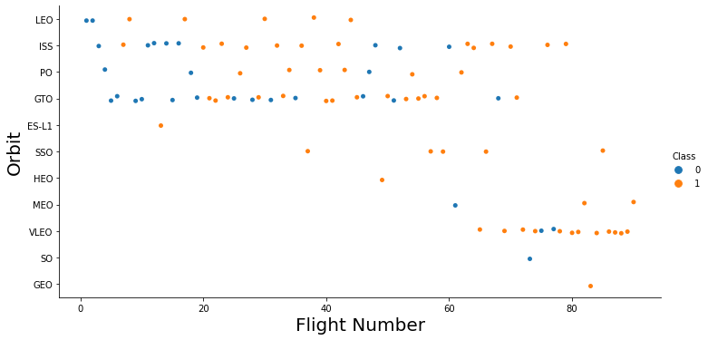
Flight Number vs. Orbit type
Show a scatter point of Flight number vs. Orbit type
The Launch with class 0 is mostly in orbit LEO, ISS and GTO;
The data here is very chaos, there seems no clear relation here.

Slide 22
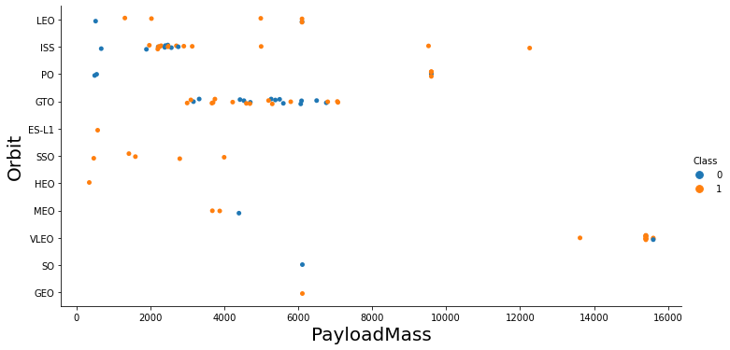
Payload vs. Orbit type
Show a scatter point of payload vs. orbit type
The Launch with class 0 is mostly in orbit LEO, ISS and GTO and under the payload mass of 8000kg;

Slide 23
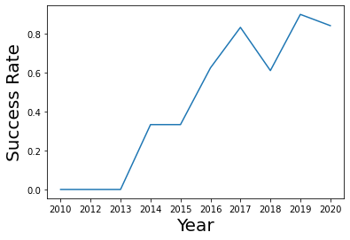
Launch success yearly trend
Show a line chart of yearly average success rate
In total the success rate is gradually increasing with time, only that in 2018, there showed a very obvious decrease.

Slide 24
EDA with SQL
URL

Slide 25
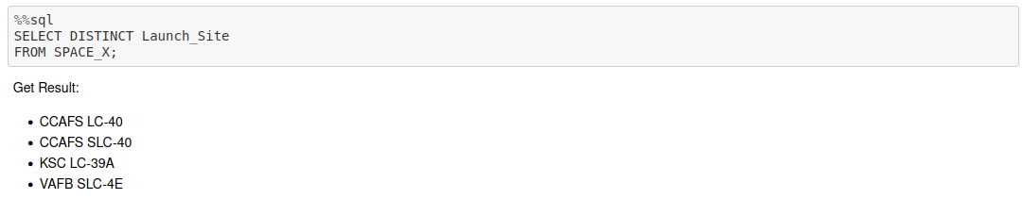
All launch site names
Find the names of the unique launch sites
Present your query result with a short explanation here

Slide 26
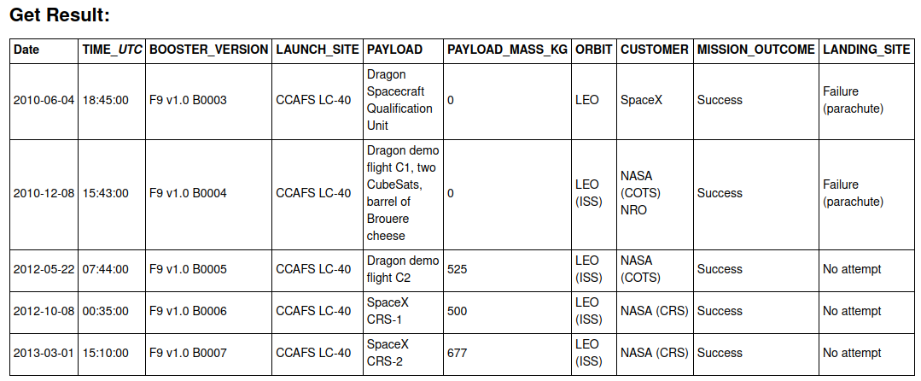
Launch site names begin with `CCA`
Find all launch sites begin with `CCA`
Present your query result with a short explanation here

Slide 27

Total payload mass
Calculate the total payload carried by boosters from NASA
Present your query result with a short explanation here

Slide 28

Average payload mass by F9 v1.1
Calculate the average payload mass carried by booster version F9 v1.1
Present your query result with a short explanation here

Slide 29
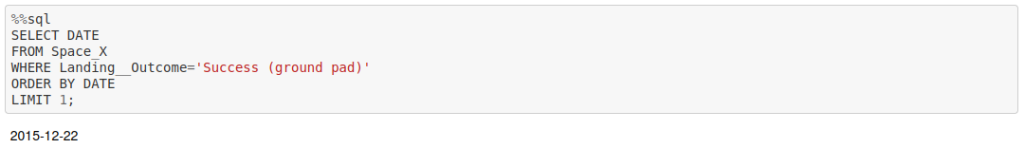
First successful ground landing date
Find the date when the first successful landing outcome in ground pad
Present your query result with a short explanation here

Slide 30
Successful drone ship landing with payload between 4000 and 6000
List the names of boosters which have success in drone ship and have payload mass greater than 4000 but less than 6000
Present your query result with a short explanation here

Slide 31

Total number of successful and failure mission outcomes
Calculate the total number of successful and failure mission outcomes
Present your query result with a short explanation here

Slide 32
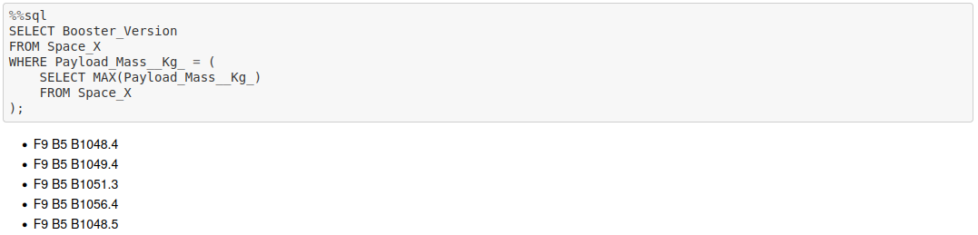
Boosters carried maximum payload
List the names of the booster which have carried the maximum payload mass
Present your query result with a short explanation here

Slide 33

2015 launch records
List the records which will display the month names, failure landing_outcomes in drone ship ,booster versions, launch_site for the months in year 2015
Present your query result with a short explanation here

Slide 34
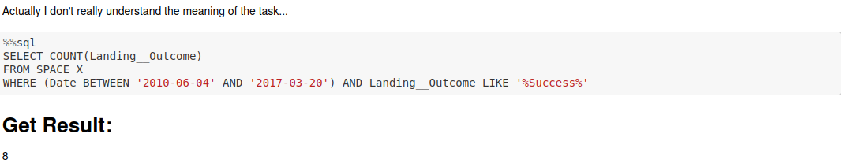
Rank success count between 2010-06-04 and 2017-03-20
Rank the count of successful landing_outcomes between the date 2010-06-04 and 2017-03-20 in descending order.
Present your query result with a short explanation here

Slide 35
Interactive map with Folium
URL

Slide 36
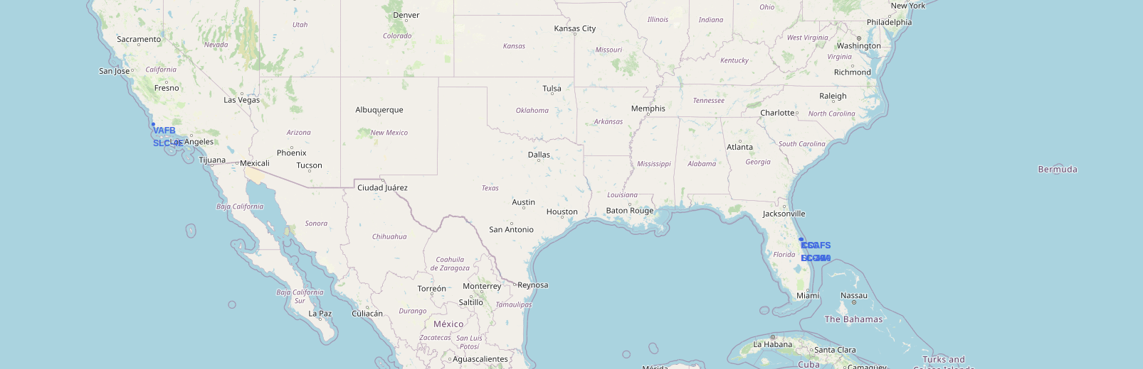
Launch Sites with name
We can see that all these sites are located on the coast.

Slide 37
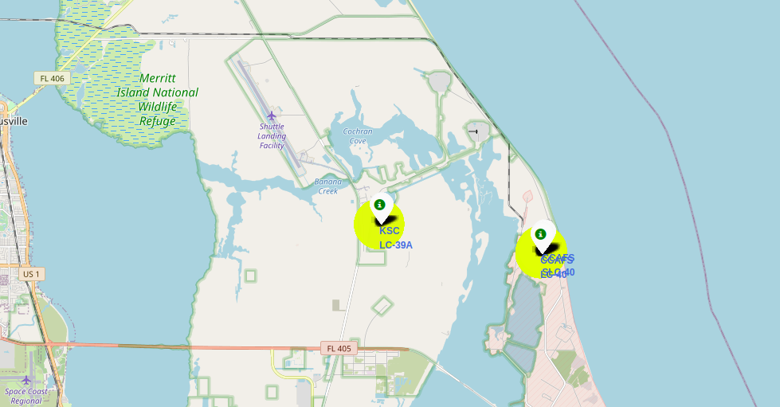
Launch Site with icon
From the previous file, we can only see 3 sites, but actually there are multiple small sites in the 3 places.

Slide 38
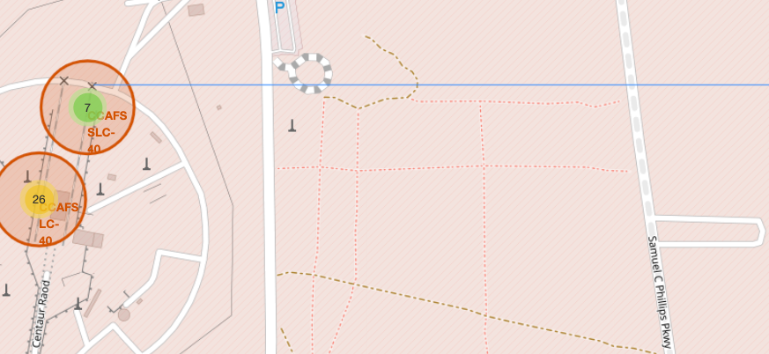
Launch Site with distance
Now we can use the function to compute the distance an annotate in the map.

Slide 39
Build a Dashboard with Plotly Dash

Slide 40
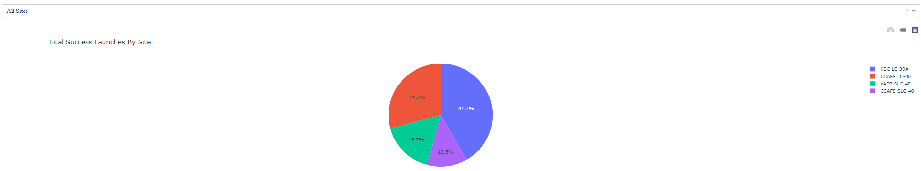
Success Ration – Launch Site
The most successful sites seems to be KSC and CCAFS

Slide 41
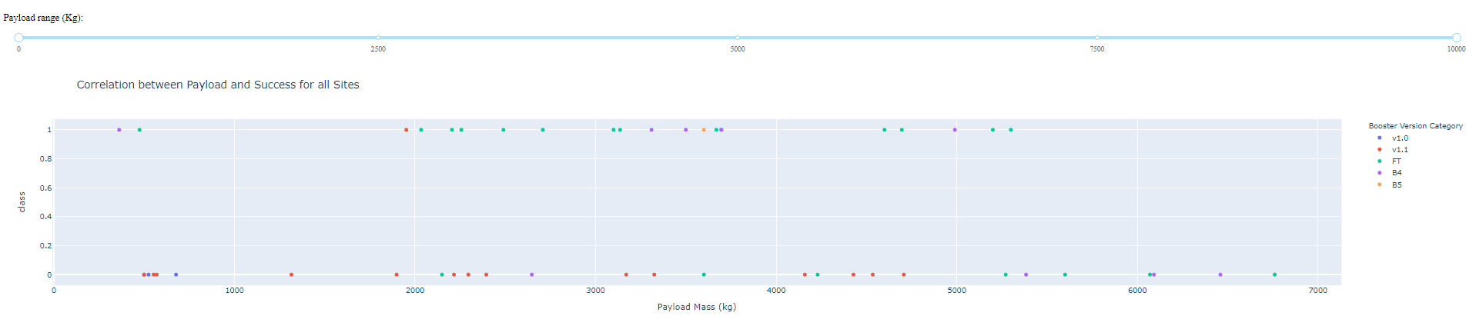
PayLoad – Launch Outcome
It seems that Payload in the middle has the higher success rate, e.g. between 2000-5000 kg

Slide 42
Predictive analysis (Classification)
URL

Slide 43
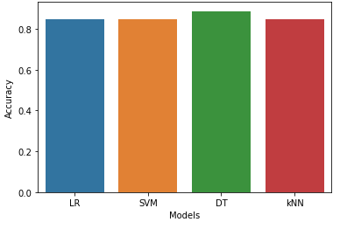
Classification Accuracy
Visualize all the built model accuracy for all built models, in a barchart
All models have the same score, DT model has the highest accuracy (0.8875)

Slide 44
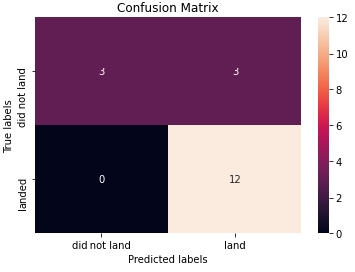
Confusion Matrix
Since there are only 18 test samples, almost all the model show the same quality, with the best confusion matrix as right.

Slide 45

CONCLUSION
We have extrace information from API and convert it to the pandas Dataframe.
Use Folium, we can visualize launch site on the maps.
Using the dashboard, we can achieve a good interactivity.
In the ML part, we see that all models are very strong, in this case, DT seems the most suitable for out analysis.

Slide 46

APPENDIX
Pandas Reference
Seaborn Reference
Sklearn Reference

