Slide 4
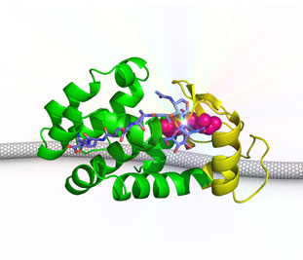
http://www.calit2.net/images/articles/2012/01_20_12_Lysozyme_CNT.jpg

