Slide 1

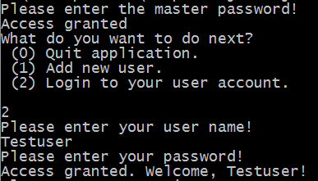
Manual (Registration)
Enter master password to enter application
Login with user account
Add new user account

Slide 2
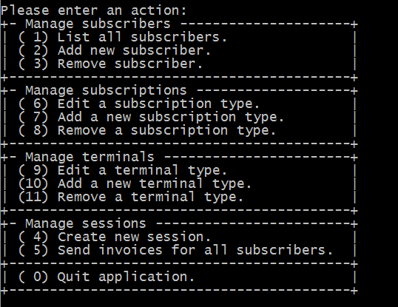
Manual (Main menu)
Main menu including all functionalities on first level
Grouped by functionality

Slide 3
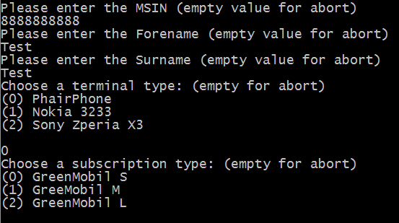
Manual (Add new subscriber)
MSIN (10 digit)
Forename
Surname
Terminal type
Subscription type

Slide 4
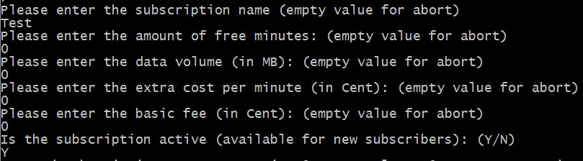
Manual (Add new subscription type)
Subsription name
Amount of free minutes
Data volume
Extra cost per minute
Basic fee amount
Select if active

Slide 5
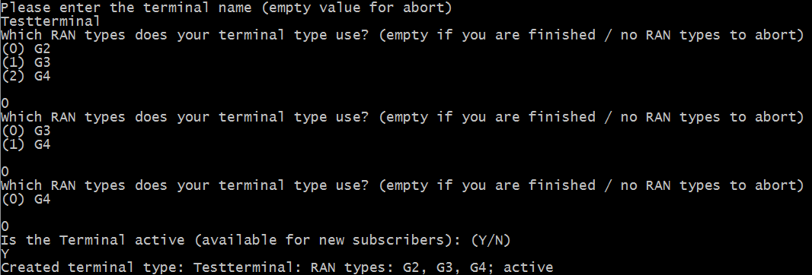
Manual (Add new terminal)
Terminal name
Select available connection types
Select if active

Slide 6
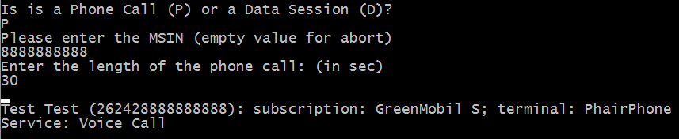
Manual (New phone session)
Session type
MSIN of customer
Length of the session

Slide 7
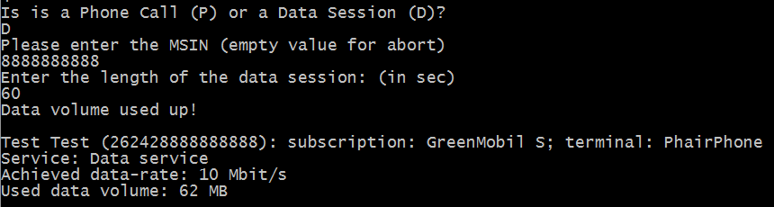
Manual (New data session)
Session type
MSIN of customer
Length of the session

Slide 8
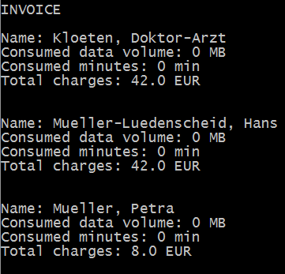
Manual (New data session)
Invoice

Slide 9
Testing
Data persistance tests worked
Manual black box testing
Lack of time
Setup difficulties at the beginning
Fewer test coverage

