Slide 1

Customer Related Applications and Programs
Flexible solutions for telecommunication systems

Slide 2
Contact
CEO: Martin Geßenich
Martin.gessenich@crap.com
+49241 79123789
CTO: Florian Schaar
Florian.schaar@crap.com
+49241 79123689
Sales Manager: Christoph Gröger
Christoph.groeger@crap.com
+49241 79128902
Project Manager: Caroline Lehmann
Caroline.lehmann@crap.com
+49241 79128901
Dev. Manager: Felix Batke
Felix.batke@crap.com
+49241 79128905

Slide 3
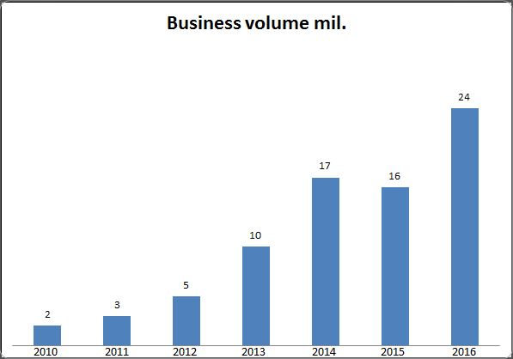
Company facts
Founded 1988
Steadily growing
230 employees
Site: 52064 Aachen, Mariabrunnstraße 1

Slide 4
Company philosophy
Direct and lasting customer contact
Extensibility
Training and support

Slide 5




References
“We have never worked together with a more flexible company.”
- Urs Schaeppi, Swisscom
“Reliable. Accurate. Running steadily with a quick maintenance
response time during all that years.”
- Hannes Ametsreiter, Vodafone

Slide 6
Cost Plan
Man hour rate 90 €
Approximation of 175 man hours
Overall fix cost of 15750 € to meet all initial requirements
New budget negotiations for any additional requirements

Slide 7
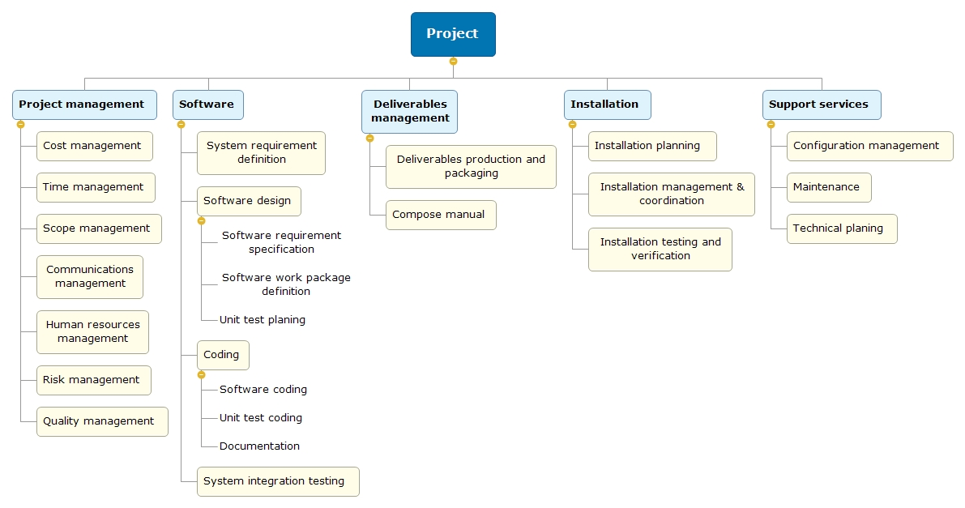
Scope Plan

Slide 8
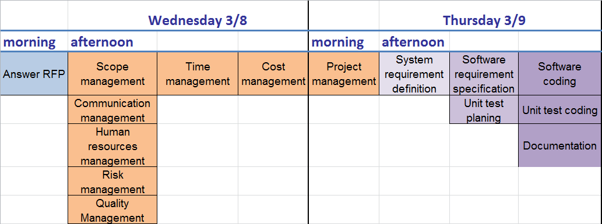
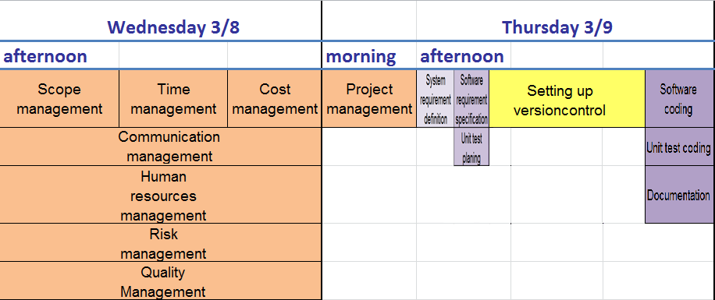
Time Plan

Slide 9
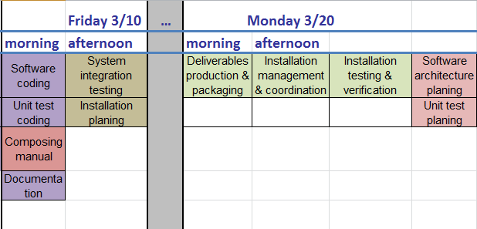
Time Plan

Slide 10
Quality management
Early interaction testing to ensure basic roundtrip functionality
Early definition of interfaces
Continuous unit testing

Slide 11
Human resources management
Martin (CEO) | Florian (CTO) | Christoph (SM) | Caroline (PM) | Felix (DM)
Testing | Testing | Testing | Testing | Testing
User management | User interface | Authentication | Invoice service | Data storage
 | Session simulation |  | Manual

Slide 12
Communication Plan
Event | Level | Purpose | Media | Responsible Persons | Date | Status
Presentation of Information | Pre-Project | Delivery of company information | Presentation and Email | CEO, Head of Sales | 2017-03-07 | Complete
Presentation of proposal | Conception | Delivery of proposal | Presentation and Email | CTO, Head of Sales | 2017-03-08 | Complete
Presentation of project planning | Planning | Delivery of project planning | Presentation and Email | Company management | 2017-03-09 | Ongoing
Information requests | Development | To share information | Email | Project manager | On demand | Ongoing
Change request | Development | Request of requirement changes | Email/Phone/Meeting | Company management | On demand | Ongoing
Status meeting | Development | To share information | Meeting | Company management | Daily | Ongoing
Presentation of final product | Finalization | Delivery of Software | Presentation | Company management | 2017-03-20 | In planning

Slide 13
Internal Communication
Version control by Github
Easy work coordination by centralization of developer team in one office

Slide 14
Risk Plan
risk | monitoring/control | response | impact | likelihood
Matsecom goes bankrupt | - | immediately stop or pause development and look for components, that can be used in future projects | very high / cost | very low
Illness | Make your employees have a healthy lifestyle | overtime for other employees / hire external sources | medium / time | high
Code loss | Use version control (git) | write new code | very high / time | very low
New requirement | Test requirement and get an estimate | implement or reject requirement | high / time | high
Existing requirement proves to be wrong | During development test all requirements | change existing requirement and adapt code | high / time | high
Hardware defect | Use fairly new and maintained hardware | Buy new hardware | low /cost | low
Wrong time estimates | Check development according to time plan | Edit time plan | high / time | high
Data leak | Secure data storage via authentication and encryption | Use legal measures | medium / cost | very low

Slide 15
Contact
CEO: Martin Geßenich
Martin.gessenich@crap.com
+49241 79123789
CTO: Florian Schaar
Florian.schaar@crap.com
+49241 79123689
Sales Manager: Christoph Gröger
Christoph.groeger@crap.com
+49241 79128902
Project Manager: Caroline Lehmann
Caroline.lehmann@crap.com
+49241 79128901
Dev. Manager: Felix Batke
Felix.batke@crap.com
+49241 79128905

