Slide 1

Customer Related Applications and Programs
Flexible solutions for telecommunication systems

Slide 2
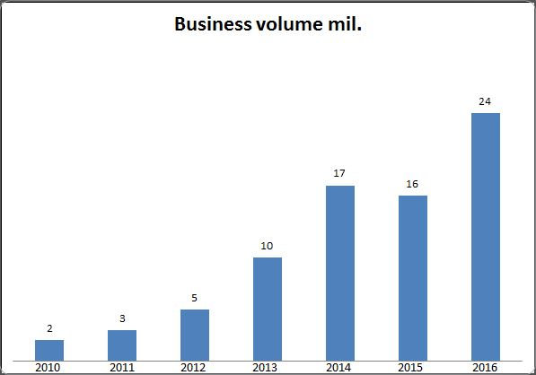
Company facts
230 employees
Founded 1988
Site: 52064 Aachen, Mariabrunnstraße 1

Slide 3



References
“We have never worked together with a more flexible company.”
- Urs Schaeppi, Swisscom
“Reliable. Accurate. Running steadily with a quick maintenance
response time since installation.”
- Hannes Ametsreiter, Vodafone

Slide 4

Previous Projects with Telstra
Automated collection of business data
Report service for invoices
Close collaboration with our customer Telstra

Slide 5
Contact
CEO: Martin Geßenich
Martin.gessenich@crap.com
+49241 79123789
Sales Manager: Christoph Gröger
Christoph.groeger@crap.com
+49241 79128902

