Slide 1

Customer Related Applications and Programs
Flexible solutions for telecommunication systems
CEO: Martin Geßenich
Sales Manager: Christoph Gröger

Slide 2
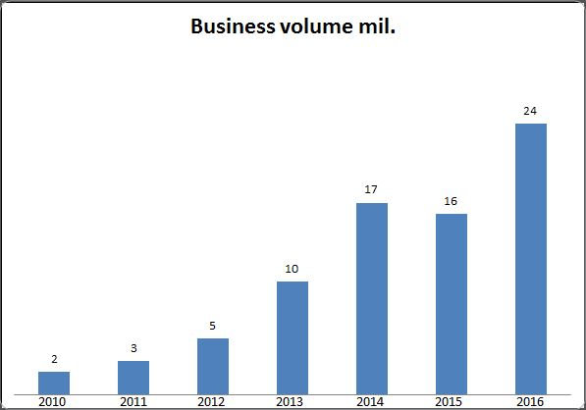
Company facts
Founded 1988
Steadily growing
230 employees
Site: 52064 Aachen, Mariabrunnstraße 1

Slide 3
Company distribution

Slide 4
Company philosophy
Direct and lasting customer contact
Extensibility
Reliable quality management
Easy understandable documentation
Training and support

Slide 5



References
“We have never worked together with a more flexible company.”
- Urs Schaeppi, Swisscom
“Reliable. Accurate. Running steadily with a quick maintenance
response time during all that years.”
- Hannes Ametsreiter, Vodafone

Slide 6

Previous Projects with
Project started in 2002
Automated collection of business data
Report service for invoices
Continuous maintenance since installation
Including upgrades and trainings
Close collaboration with our customer Telstra during all stages

Slide 7
Technical Proposal
Delivery: one executable jar file
Persistent storage of data
Slim command Line interface
Each user gets a unique account to ensure verification

Slide 8
Time Plan
3 x 4 hours
Wednesday 03/08 to Friday 03/10

Slide 9
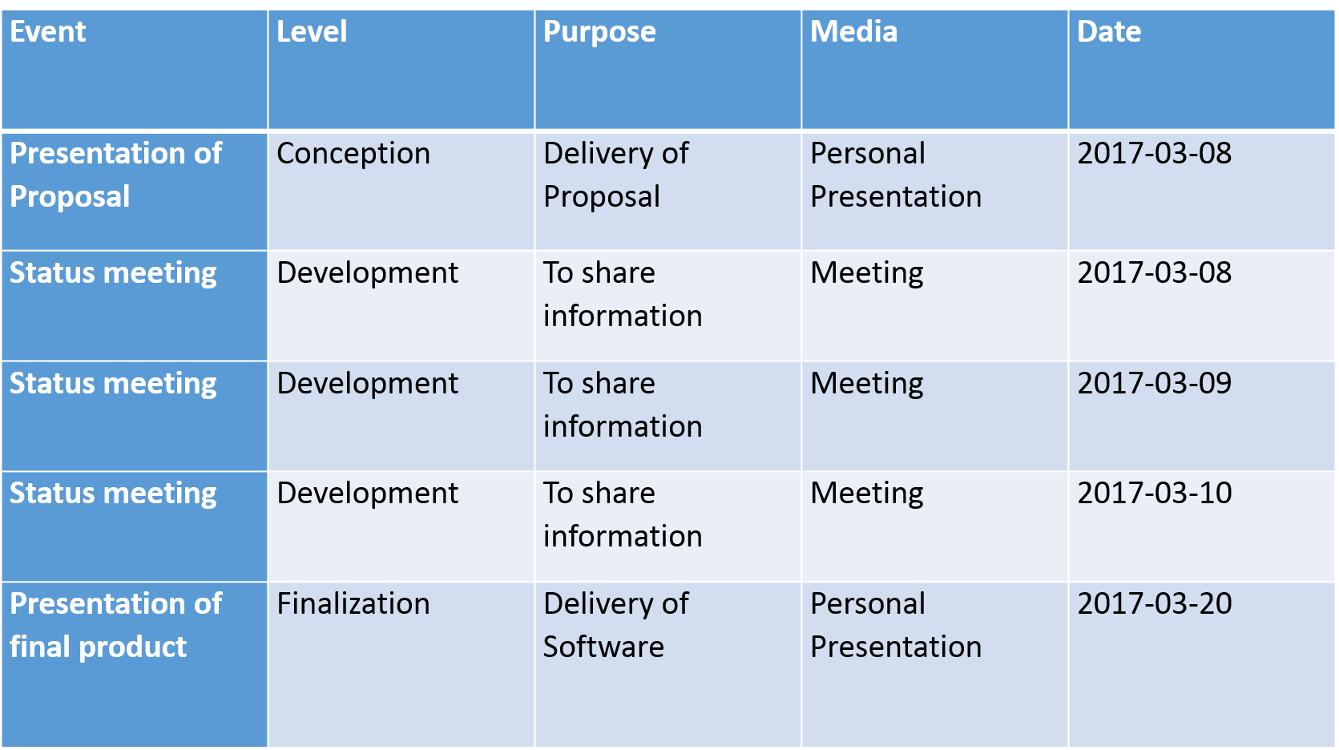
Communication Plan

Slide 10
Cost Plan
Man hour rate 120 €
Approximation of 60 man hours
Mark-up 25 %
Overall fix cost of 9000 €

Slide 11
Contact
CEO: Martin Geßenich
Martin.gessenich@crap.com
+49241 79123789
CTO: Florian Schaar
Florian.schaar@crap.com
+49241 79123689
Sales Manager: Christoph Gröger
Christoph.groeger@crap.com
+49241 79128902
Project Manager: Caroline Lehmann
Caroline.lehmann@crap.com
+49241 79128901
Dev. Manager: Felix Batke
Felix.batke@crap.com
+49241 79128905

