Slide 1

Human resources management
Martin (CEO) | Florian (CTO) | Christoph (SM) | Caroline (PM) | Felix (DM)
Testing | Testing | Testing | Testing | Testing
User Management | User Interface | Authentication | Invoice Service | Data Storage
Session Management |  |  | Session Management

Slide 2
Contents
Follow-up time plan
Follow-up human resources management
Follow-up risks
Follow-up communication management
Final product

Slide 3
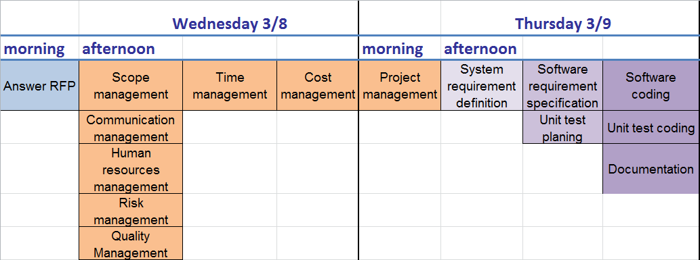
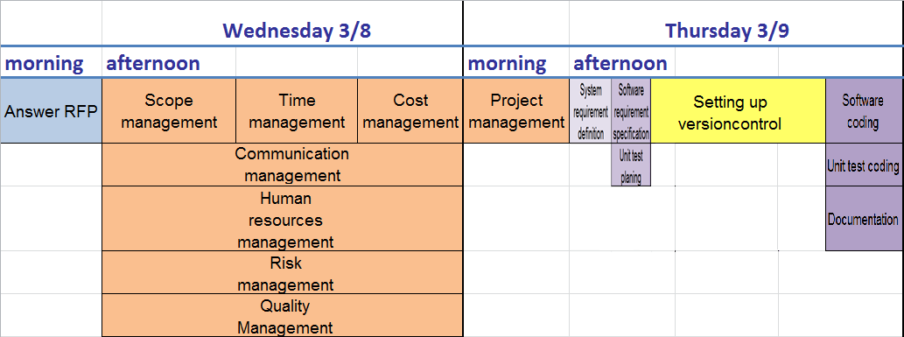
Time Plan

Slide 4
Conclusion

