Slide 1
Chapter 12
Analysis Modeling

Slide 2
Analysis Modeling:
Where to Begin?
A statement of scope can be acquired from:
  the FAST working document
  A set of use-cases
the statement of scope must be “parsed” to extract data, function and behavioral domain information

Slide 3
Statement of Scope
a relatively brief description of the system to be built
  indicates data that are input and output and basic functionality
  indicates conditional processing (at a high level)
  implies certain constraints and limitations

Slide 4
Identifying Objects and Operations
define “objects” by underlining all nouns in the written statement of scope
    producers/consumers of data
    places where data are stored
    “composite” data items
define “operations” by double underlining all active verbs
    processes relevant to the application
    data transformations
consider other “services” that will be required by the objects

Slide 5
Data Modeling and
Entity Relationship (E-R)
Diagramming

Slide 6
Why Data Modeling?
examines data objects independently of processing
focuses attention on the data domain
creates a model at the customer’s level of abstraction
indicates how data objects relate to one another

Slide 7
What is a Data Object?
Object
—something that is described by a set
of attributes (data items) and that will be
manipulated within the software (system)
each
instance
of an object (e.g., a book)
can be identified uniquely (e.g., ISBN #)
each plays a necessary role in the system
i.e., the system could not function without
access to instances of the object
each is described by attributes that are
themselves data items

Slide 8
Typical Objects
external entities (printer, user, sensor)
things
(e.g, reports, displays, signals)
occurrences or events (e.g., interrupt, alarm)
roles
(e.g., manager, engineer, salesperson)
organizational units
(e.g., division, team)
places
(e.g., manufacturing floor)
structures (e.g., employee record)

Slide 9
Data Objects and Attributes
A data object contains a set of attributes that act as an aspect, quality, character-istic, or descriptor of the object
object: automobile
attributes:
make
model
body type
price
options code

Slide 10
What is a Relationship?
relationship
—indicates “connectedness”;
a "fact" that must be "remembered"
by the system and cannot or is not computed
or derived mechanically
several instances of a relationship can exist
objects can be related in many different ways

Slide 11
ERD Notation
One common form:
(0, m)
object
relationship
object
1
(1, 1)
2
attribute
Another common form:
object
relationship
object
1
2
(0, m)
(1, 1)

Slide 12
Building an ERD
Level 1—model all data objects (entities) and their “connections” to one another
Level 2—model all entities and relationships
Level 3—model all entities, relationships, and the attributes that provide further depth

Slide 13
The ERD: An Example
request
for service
Customer
places
(1,1)
(1,m)
(1,1)
standard
task table
generates
(1,n)
work
order
(1,1)
(1,1)
(1,1)
selected
from
work
tasks
(1,w)
consists
of
(1,w)
(1,i)
materials
lists

Slide 14
Creating a Flow Model

Slide 15
The Flow Model
Every computer-based system is an
information transform ....
computer
based
system
input
output

Slide 16
Flow Modeling Notation
external entity
process
data flow
data store

Slide 17
External Entity
A producer or consumer of data
Examples: a person, a device, a sensor
Another example: computer-based
system
Data must always originate somewhere
and must always be sent to something

Slide 18
Process
A data transformer (changes input
to output)
Examples: compute taxes, determine area,
format report, display graph
Data must always be processed in some
way to achieve system function

Slide 19
Data Flow
Data flows through a system, begins
as input and is transformed into output.
base
compute
triangle
area
area
height

Slide 20
Data Stores
Data is often stored for later use.
sensor #
sensor #, type,
location, age
look-up
sensor
data
report required
type,
location, age
sensor number
sensor data

Slide 21
Data Flow Diagramming:
Guidelines
all icons must be labeled with meaningful names
the DFD evolves through a number of levels of detail
always begin with a context level diagram (also called level 0)
always show external entities at level 0
always label data flow arrows
do not represent procedural logic

Slide 22
Constructing a DFD—I
review ERD to isolate data objects and grammatical parse to determine “operations”
determine external entities (producers and consumers of data)
create a level 0 DFD

Slide 23
Level 0 DFD Example
processing
request
user
requested
video
signal
digital
video
processor
monitor
video
source
NTSC
video signal

Slide 24
Constructing a DFD—II
write a narrative describing the transform
parse to determine next level transforms
“balance” the flow to maintain data flow continuity
develop a level 1 DFD
use a 1:5 (approx.) expansion ratio

Slide 25
The Data Flow Hierarchy
a
b
x
P
y
level 0
level 1
a
c
p2
f
p1
p4
b
d
5
p3
e
g

Slide 26
Flow Modeling Notes
each bubble is refined until it does just one thing
the expansion ratio decreases as the number of levels increase
most systems require between 3 and 7 levels for an adequate flow model
a single data flow item (arrow) may be expanded as levels increase (data dictionary provides information)

Slide 27
DFDs: A Look Ahead
analysis model
Maps into
design model

Slide 28
Real-Time Analysis Methods
each introduces its own notation, but all
  propose an approach for representing control and separating it from data
  provide a mechanism for specifying events, states, and distributed processing
  begin at the analysis level and work to derive processor assignments, tasks and program architectures

Slide 29
Real-Time Analysis
& Design Methods
Gomaa, H., Software Design Methods for Concurrent and Real-Time Systems, Addison-Wesley, 1995.
Harel, D. et al, "STATEMATE: A Working Environment for the Development of Complex Reactive Systems, IEEE Trans. Software Engineering, vol. 16, no. 3, April, 1990, pp. 403-414.
Hatley, D.J. and I.A. Pirbhai, Strategies for Real-Time System Specification, Dorset House, 1987.
Selic, B., G. Gullekson, and P. Ward, Real-Time Object-Oriented Modeling, Wiley, 1994.
Shumate, K. and M. Keller,, Software Specification and Design—A Disciplined Approach For Real-Time Systems, Wiley 1992.
Ward, P.T. and S.J. Mellor, Structured Development for Real-Time Systems, 3 volumes, Yourdon Press, 1985, 1986.

Slide 30
Behavioral Modeling and Process Specification

Slide 31
Behavioral Modeling
events
behavior
Outside
world
Application

Slide 32
The States of a System
state—a set of observable circum-stances that characterizes the behavior of a system at a given time
state transition—the movement from one state to another
event—an occurrence that causes the system to exhibit some predictable form of behavior
action—process that occurs as a consequence of making a transition

Slide 33
Behavioral Modeling
make a list of the different states of a system (How does the system behave?)
indicate how the system makes a transition from one state to another (How does the system change state?)
  indicate event
  indicate action
draw a state transition diagram

Slide 34
State Transition Diagram
Notation
state
event causing transition
action that occurs
new state

Slide 35
State Transition Diagram
full and start
invoke manage-copying
reading
operator
commands
full
invoke read-op-input
copies done
invoke read-op-input
making copies
reloading paper
empty
invoke reload paper
jammed
invoke problem-diagnosis
not jammed
problem state
invoke read-op-input

Slide 36
The Control Model
the control flow diagram is "superimposed" on the DFD
and shows events that control the processes noted in
the DFD
control flows—events and control items—are noted by
dashed arrows
a vertical bar implies an input to or output from a control
spec (CSPEC) — a separate specification that
describes how control is handled
a dashed arrow entering a vertical bar is an input to the
CSPEC
a dashed arrow leaving a process implies a data
condition
a dashed arrow entering a process implies a control
input read directly by the process
control flows do not physically activate/deactivate the
processes—this is done via the CSPEC

Slide 37
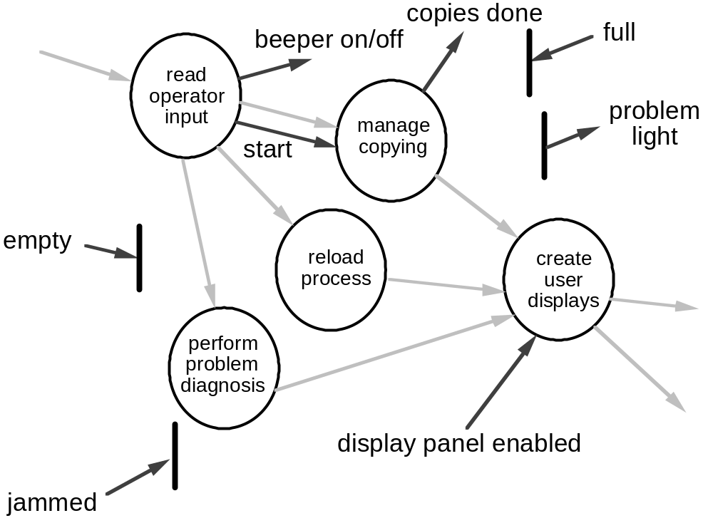
Control Flow Diagram

Slide 38
Control Specification (CSPEC)
The CSPEC can be:
state transition diagram
(sequential spec)
state transition table
combinatorial spec
decision tables
activation tables

Slide 39
Guidelines for Building a CSPEC
list all sensors that are "read" by the software
list all interrupt conditions
list all "switches" that are actuated by the operator
list all data conditions
recalling the noun-verb parse that was applied to the
software statement of scope, review all "control items"
as possible CSPEC inputs/outputs
describe the behavior of a system by identifying its
states; identify how each state is reached and define
the transitions between states
focus on possible omissions ... a very common error in
specifying control, e.g., ask: "Is there any other way I
can get to this state or exit from it?"

Slide 40
Process Specification (PSPEC)
bubble
PSPEC
narrative
pseudocode (PDL)
equations
tables
diagrams and/or charts

Slide 41
A Design Note
PSPEC
one or more ”components"
in the software design

Slide 42
Creating Mini-Specs
Software
Specification

Slide 43
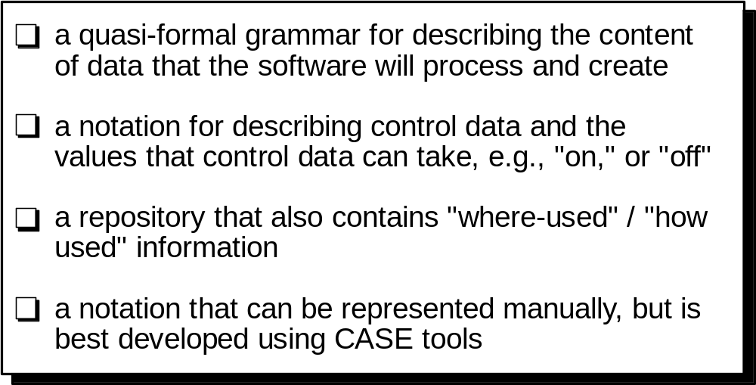
The Data Dictionary

Slide 44
Building a Data Dictionary
Name:
the primary name of the composite data item
Aliases:
other names for the data item
Where used:
data transforms (processes) that use the
composite data item
How used:
the role of the data item (input, output,
temporary storage, etc.)
Description:
a notation for representing content (presented
on next slide)
Format:
specific information about data types, pre-set
values (if known)

Slide 45
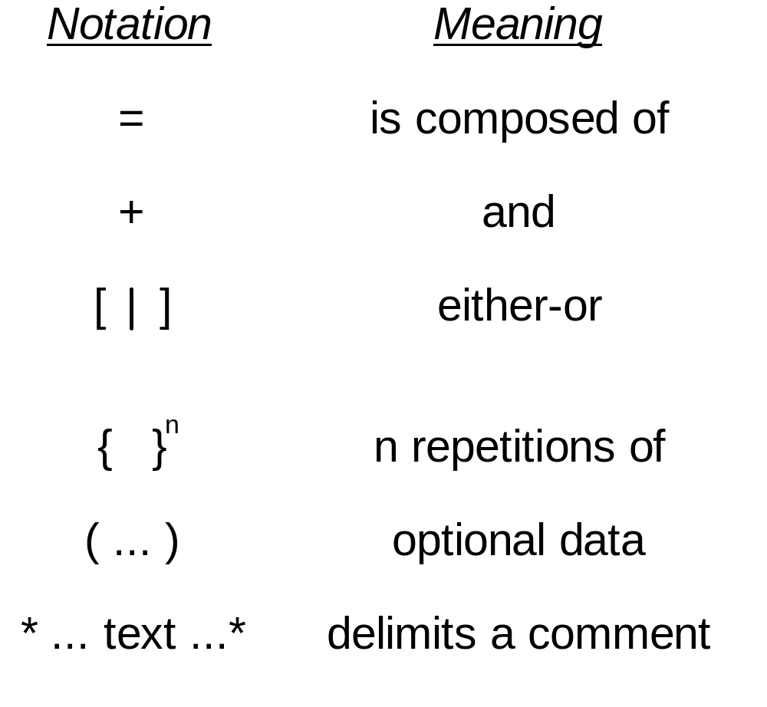
Data Dictionary Notation

Slide 46
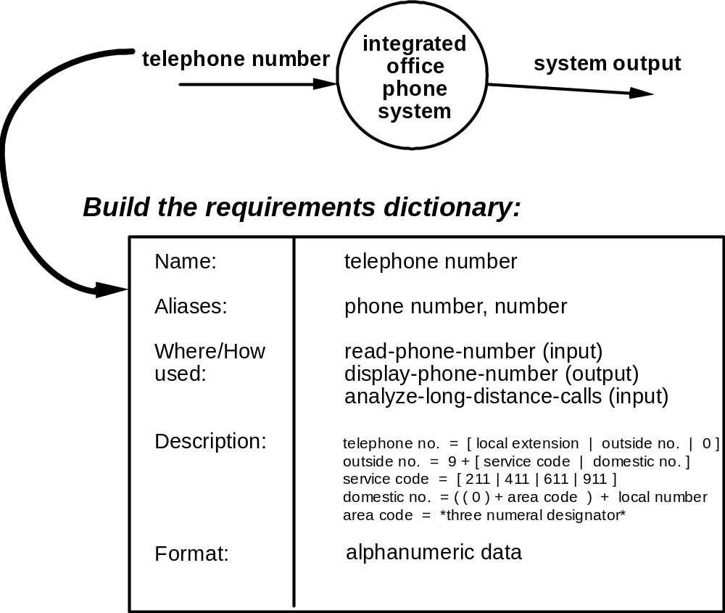
Data Dictionary Example

Slide 47
Writing the Software Specification
Everyone knew exactly
what had to be done
until someone wrote it
down!

Slide 48
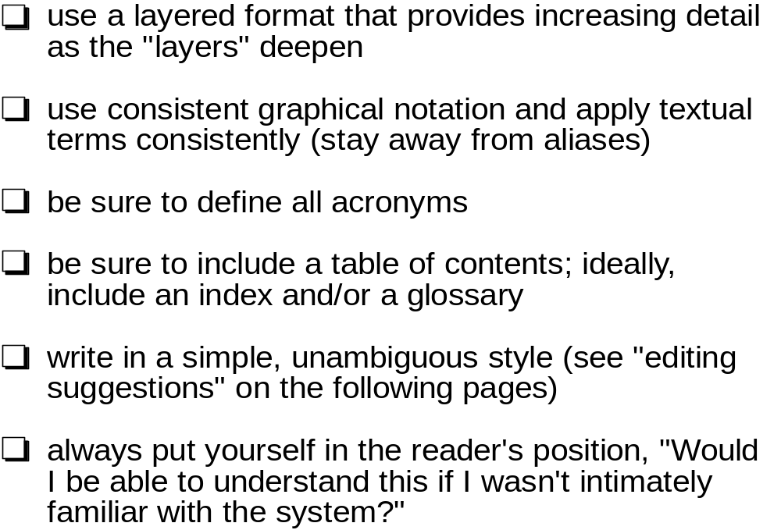
Specification Guidelines

Slide 49
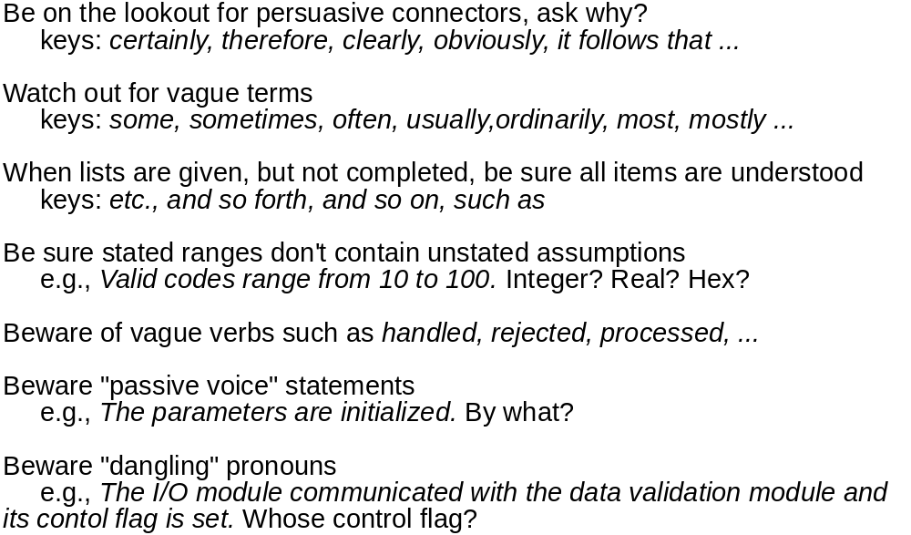
Specification Guidelines

Slide 50
Specification Guidelines
When a term is explicitly defined in one place, try
substituting the definition for other occurrences of the term
When a structure is described in words, draw a picture
When a structure is described with a picture, try to redraw
the picture to emphasize different elements of the structure
When symbolic equations are used, try expressing their
meaning in words
When a calculation is specified, work at least two
examples
Look for statements that imply certainty, then ask for proof
keys: always, every, all, none, never
Search behind certainty statements—be sure restrictions
or limitations are realistic

