Slide 1
AI: Introduction
Course Code: CSC4226
Course Title: Artificial Intelligence and Expert System
Dept. of Computer Science
Faculty of Science and Technology
Lecture No: | Theory-01 | Week No: | 1 | Semester: | Spring: 2023-24
Lecturer: | Professor Dr. Firoz Ahmed Mail: fahmed@aiub.edu

Slide 2
About Me
Professor Dr. Firoz Ahmed
Department of Computer Science
Mail: fahmed@aiub.edu
Research Interest
Internet of Things (IoT)
Mobile Ad Hoc Networks (MANETs)
Wireless Sensor Networks (WSNs)

Slide 3
Lecture Outline
Vision and Mission
Course Evaluation
Class Policies
About the Course
What is AI?
The Foundations of AI.
Brief History of AI
Course Outline by Topics and Weeks.

Slide 4
Vision & Mission of AIUB
Vision
AMERICAN INTERNATIONAL UNIVERSITY-BANGLADESH (AIUB) envisions promoting professionals and excellent leadership catering to the technological progress and development needs of the country.
Mission
AMERICAN INTERNATIONAL UNIVERSITY-BANGLADESH (AIUB) is committed to provide quality and excellent computer-based academic programs responsive to the emerging challenges of the time
It is dedicated to nurture and produce competent world class professional imbued with strong sense of ethical values ready to face the competitive world of arts, business, science, social science and technology.

Slide 5
Goals of AIUB
Sustain development and progress of the university
Continue to upgrade educational services and facilities responsive of the demands for change and needs of the society
Inculcate professional culture among management, faculty and personnel in the attainment of the institution's vision, mission and goals
Enhance research consciousness in discovering new dimensions for curriculum development and enrichment
Implement meaningful and relevant community outreach programs reflective of the available resources and expertise of the university
Establish strong networking of programs, sharing of resources and expertise with local and international educational institutions and organizations
Accelerate the participation of alumni, students and professionals in the implementation of educational programs and development of projects designed to expand and improve global academic standards

Slide 6
Vision & Mission of CS Dept.
Vision
Provides leadership in the pursuit of quality and excellent computer education and produce highly skilled and globally competitive IT professionals.
Mission
Committed to educate students to think analytically and communicate effectively; train them to acquire technological, industry and research-oriented accepted skills; keep them abreast of the new trends and progress in the world of information communication technology; and inculcate in them the value of professional ethics.

Slide 7
Goals of CS Department
Enrich the computer education curriculum to suit the needs of the industry- wide standards for both domestic and international markets
Equip the faculty and staff with professional, modern technological and research skills
Upgrade continuously computer hardware's, facilities and instructional materials to cope with the challenges of the information technology age
Initiate and conduct relevant research, software development and outreach services.
Establish linkage with industry and other IT-based organizations/institutions for sharing of resources and expertise, and better job opportunities for students

Slide 8
Course Evaluation
Mid Term | Class Quizzes | 20
 | Laboratory Performance/Viva/Exam | 30
 | Class Attendance/Performance | 10
 | Midterm Written Exam | 40
 | Mid Term Total | 100 | 40%
Final Term | Class Quizzes | 20
 | Laboratory Performance/Viva/Exam | 30
 | Class Attendance/Performance | 10
 | Final Written Exam | 40
 | Final Term Total | 100 | 60%
Grand Total | Final Grade of the Course |  | 100%

Slide 9
Classroom Policies
Must be present inside the class in due time.
Class Break: I would prefer to start the class in due time, giving a break 5/10 minutes. and leave the class in 5/10 minutes early for theory/Laboratory class respectively
Every class will start with a question-answer session about the last lecture. So, students must be prepared with the contents and exercises from the last lecture.
Students are suggested to ask questions during or after the lecture.
Late in Class:
Student coming after 10 minutes of due time is considered late.
1 late attendances are considered as one absent.
Late during quiz is not given additional time.
Students who are regularly late might have additional deduction of marks.
A late student will be allowed to enter the class.
Don’t ask permission to enter the class, just get in slowly and silently.
To leave class you will need to ask for permission.

Slide 10
Attendance
At least 80% presence is required by the student. Absent classes must be defended by the student through application and proper documentation to the course teacher.
Long absences/irregular presence/absences out of 25% range must go through application procedures via department Head (+ probation office, if student is in probation) to attend the following classes.
Acceptance of an application for absence only gives permission to attend the following classes. This might still result in deduction of marks (for attendance) which will be judged by the course teacher.

Slide 11
Makeup Evaluation
Makeup for missing evaluations like quizzes/assignment submission date/presentation date/viva date/etc., (If somebody does not attend any quiz, it is applicable for him/her. If he/she attends one quiz, he/she does not allow this condition) must go through valid application procedure with supporting document within the deadline of the actual evaluation date.
Makeup for missing Midterm/Final term must go through Set B form along with the supporting document within the 1st working day after exam week. The set B exam is generally scheduled from the 2nd working day after the exam week. Must get signature and exam date from the course teacher and get it approved by the department Head (monetary penalty might be imposed).
The course teacher will be the judge of accepting/rejecting the request for makeup.

Slide 12
Grading Policies
All the evaluation categories & marks will be uploaded to the VUES within one week of the evaluation process except the attendance & performance, which will be uploaded along with the major (mid/final term) written exam marks.
Letter grades ‘A+’ through ‘F’ is counted as grades. Other grades ‘I’ and ‘UW’ are considered as temporary grades which are counted/calculated as ‘F’ grade in the CGPA. These grades must/will be converted to the actual grades, i.e. ‘A+’ through ‘F’.
‘I: INCOMPLETE’ is given to students who have missed at most 30% of evaluation categories (quiz/assignment/etc.). Students must contact the course teacher for makeup, through valid application procedures immediately after grade release.
‘UW: UNOFFICIAL WITHDRAW’ is given when the missing evaluation categories are too high (more than 30%) to makeup. A student getting ‘UW’ has no option but to drop the course immediately after grade release

Slide 13
Grading Policies…
Once a student’s gets ‘I’ or ‘UW’ and unable to fulfill the requirements with the course teacher for makeup, must drop the course within officially mentioned time period from the registration department.
Students in probation or falls into the probation due to ‘I’/’UW’ grade are not allowed to drop the course.
Unable to do so will result in the automatic conversion of the grades ‘I’/’UW’ to ‘F’ grade after the 4th week of the following semester.
Any problem with the mark/grade must be consulted with the course teacher within one week of the release of grades.

Slide 14
Dropping Course
Must fill up the drop form and get it signed by the course teacher, write an application to the vice chancellor and get it signed by the department Head, and finally submit the form & application to the registration department.
The course teacher must write down the grades (if any) obtained in midterm, final, and grand total on the drop form.
No drop is accepted during the following periods:
One week before midterm exam – grade release date of midterm exam.
One week before final term exam – grade release date of final grade.
Student with ‘F’ grades in midterm, final term, or grand total cannot drop.
Probation student are not allowed to drop any course.

Slide 15
Contacts
Contact information (email, Teams, office location, consulting hours, etc.) of the course teacher must be stored by the students.
It is mandatory to contact/notify (preferably consulting hour/email) the course teacher for/of any problems/difficulties at the earliest possible. Late notification might not be considered.
Update & correct your email address & phone number at VUES, as the teacher will contact/notify you of anything regarding the course through these information in VUES.

Slide 16
Finally
For any problems that could not be solved/understood during the lecture, students are advised to contact during the consultation hours and solve the problem
Any kind of dishonesty, plagiarism, misbehavior, misconduct, etc. will not be tolerated. Might result in deduction of marks, ‘F’ grade, or reported to the AIUB Disciplinary Committee for drastic punishment
Always check/visit the AIUB home page for notices, rules & regulations of academic/university policies and important announcement for deadlines (Course drop, Exam permit, Exam Schedule, etc.).

Slide 17
Course Prerequisite
Representing information in computers, Binary Number Systems, Conversions.
Programming Languages (C/C++/Python)
Using C/C++/Python editors, debugging (Colab)
Data Storage Concept & Data types in Programming languages,
Variable, Array (single & multidimensional), String, List, Dictionaries
Functions, Scope of variable & function
Design and Analysis of Algorithms

Slide 18
Course Objective
Get an overview of artificial intelligence (AI) principles and approaches.
Develop a basic understanding of the building blocks of AI as presented in terms of intelligent agents: Search, Knowledge representation, inference, logic, learning.
Develop a brief overview of AI applications: Expert Systems and Planners.
Follow AI literature with the ability to go on to independent work in the field.

Slide 19
Importance of the course
Studying artificial intelligence opens a world of opportunities
At a basic level, you’ll better understand the systems and tools that you interact with daily. And if you stick with the subject and study more, you can help create cutting edge AI applications, like the Google Self Driving Car, or IBM’s Watson
In the field of artificial intelligence, the possibilities are truly endless
Studying AI now can prepare you for a job as a researching neural networks, human-machine interfaces, and quantum artificial intelligence.
Or you could work as a software engineer in industry working for companies like Amazon to shopping list recommendation engines or Facebook analyzing and processing big data.
You could also work as a hardware engineer developing electronic parking assistants or home assistant robots

Slide 20
Course Content
Introduction to Artificial Intelligence
Intelligent Agent
Problem Solving, Search and Control Strategies
Knowledge Representation Issues, Predicate Logic, Rules
Reasoning System: Symbolic, Statistical
Learning Systems
Expert System
Neural Networks: Fundamental
Genetic Algorithms: Fundamental

Slide 21
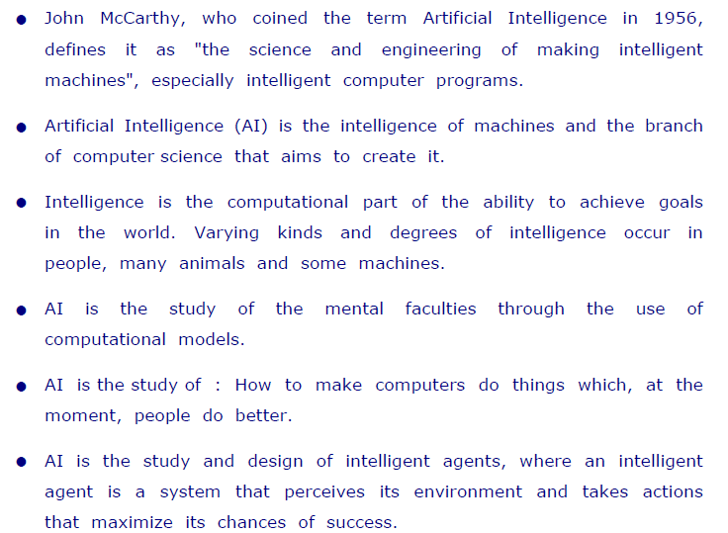
What is Artificial Intelligence ?

Slide 22
What is Artificial Intelligence ?
Artificial Intelligence is composed of two words
Artificial and Intelligence
where Artificial defines "man-made," and
intelligence defines "thinking power“
Hence AI means "a man-made thinking
So, we can define AI as:
"It is a branch of computer science by which we can create intelligent machines which can behave like a human, think like humans, and able to make decisions." power.“
Artificial Intelligence exists when a machine can have human based skills such as learning, reasoning, and solving problems

Slide 23
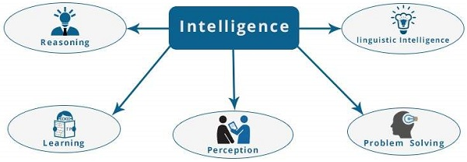
What is Artificial Intelligence ?
Intelligence is composed of:
Reasoning
Learning
Problem-Solving
Perception
Linguistic Intelligence
According to the father of Artificial Intelligence, John McCarthy, it is
“The science and engineering of making intelligent machines, especially intelligent computer programs”.

Slide 24
What is Artificial Intelligence ?
Artificial Intelligence suggest that machines can mimic humans in:
Talking
Thinking
Learning
Planning
Understanding
Artificial Intelligence is also called Machine Intelligence and Computer Intelligence.

Slide 25
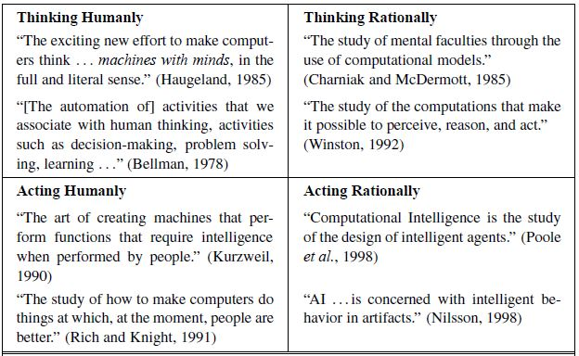
Definitions of AI

Slide 26
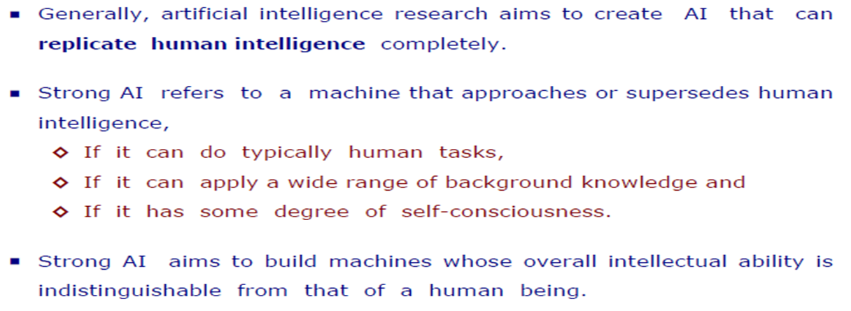
Types of AI
Hard or Strong AI

Slide 27
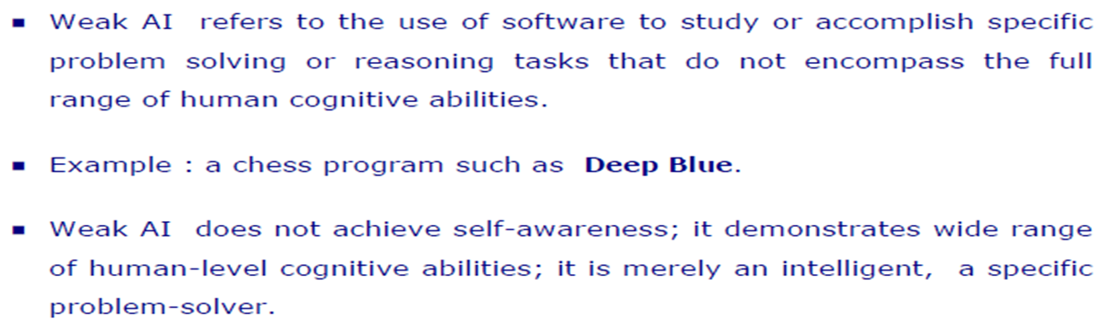
Types of AI
Soft or Weak AI

Slide 28
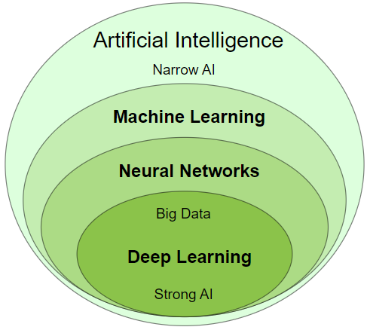
Types of AI
Artificial Intelligence is a scientific discipline embracing several Data Science fields ranging from narrow AI to strong AI, including machine learning, deep learning, big data and data mining.

Slide 29
Types of AI
Narrow AI
Narrow Artificial Intelligence is limited to narrow (specific) areas like most of the AI we have around us today:
Email spam Filters
Text to Speech
Speech Recognition
Self Driving Cars
E-Payment
Google Maps
Text Autocorrect
Automated Translation
Chatbots
Social Media
Face Detection
Visual Perception
Search Algorithms
Robots
Automated Investment
NLP - Natural Language Processing
Flying Drones
IBM's Dr. Watson
Apple's Siri
Microsoft's Cortana
Amazon's Alexa
Netflix's Recommendations
Narrow AI is also called Weak AI.

Slide 30
Types of AI
Narrow AI is also called Weak AI.
Weak AI
It is Built to simulate human intelligence.
It is an AI that is created to solve a particular problem or perform a specific task.
It is not a general AI and is only used for specific purpose.
For example, the AI that was used to beat the chess grandmaster is a weak AI as that serves only 1 purpose but it can do it efficiently.
Strong AI
It is Built to copy human intelligence
It is difficult to create than weak AI
It is the type of AI that mimics human intelligence.
It indicates the ability to think, plan, learn, and communicate.
It is the theoretical next level of AI: True Intelligence.
It moves towards machines with self-awareness, consciousness, and objective thoughts.

Slide 31
Goal of AI
To Create Expert Systems −
The systems which exhibit intelligent behavior, learn, demonstrate, explain, and advice its users.
To Implement Human Intelligence in Machines −
Creating systems that understand, think, learn, and behave like humans.

Slide 32
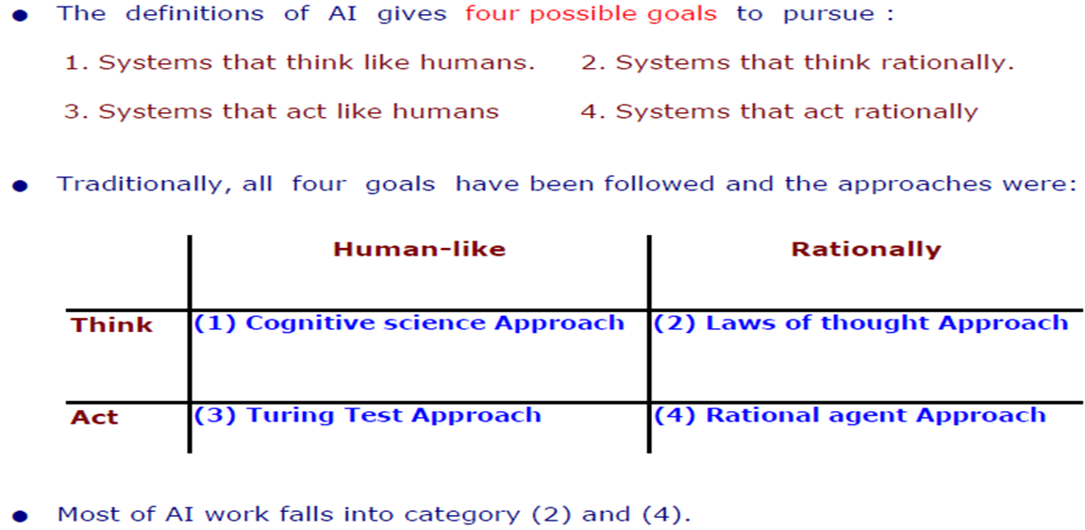
Goals of AI

Slide 33
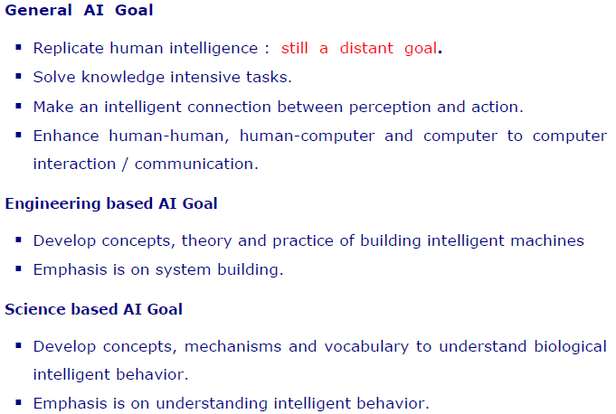
Goal of AI
Continued…

Slide 34
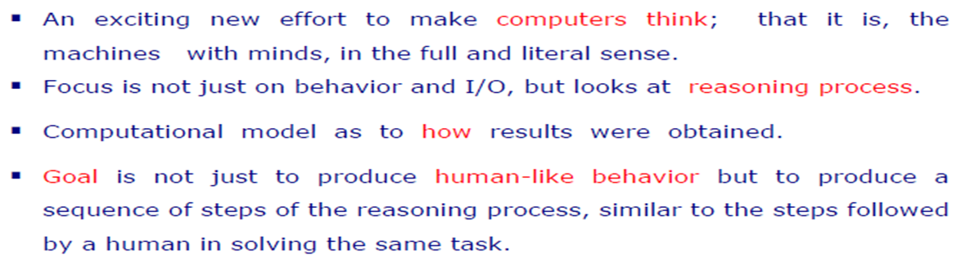
AI Approaches
Cognitive Science : Think Humanly

Slide 35
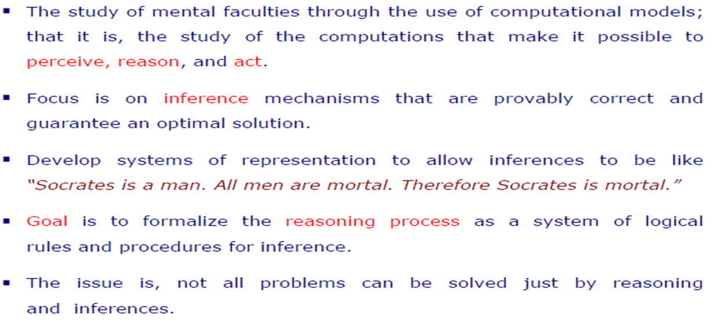
AI Approaches
Laws of Thought: Think Rationally

Slide 36
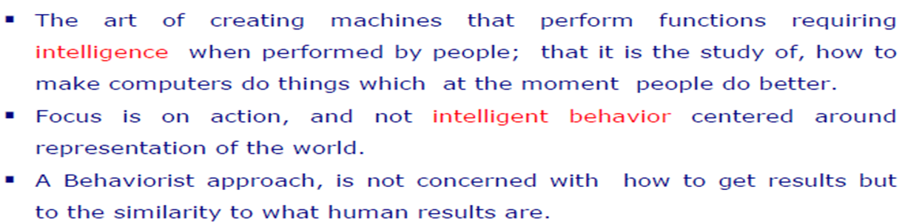
AI Approaches
Turing Test: Act Humanly

Slide 37
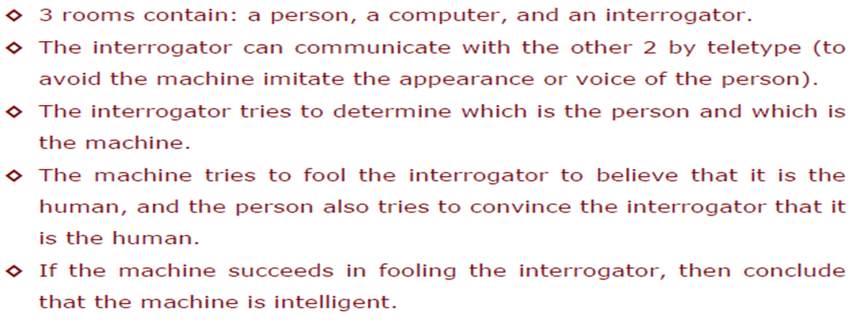
AI Approaches
Turing Test

Slide 38
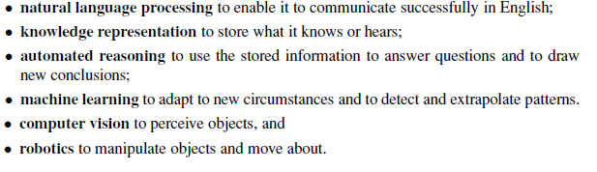
AI Approaches
Turing Test : Capabilities Required to Pass Complete Turing Test

Slide 39
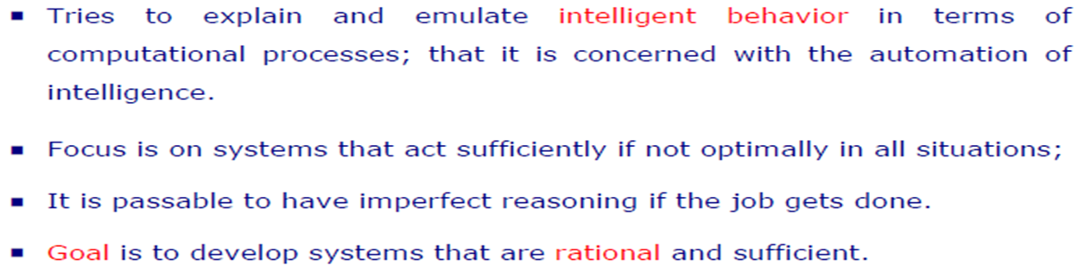
AI Approaches
Rational Agent: Act Rationally

Slide 40
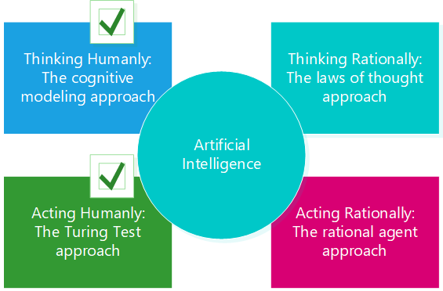

AI Approaches

Slide 41
AI Approaches
Acting Humanly
The Turing Test approach – Acting like a human.
Thinking Humanly
The cognitive modeling approach – Thinking like a person.
Thinking Rationally
The laws of thought approach – Thinking rationally is a logical process and it concludes based on symbolic logic
The famous syllogisms, “Socrates is a man; all men are mortal; therefore, Socrates is mortal.”
Acting Rationally
The rational agent approach – Rational agent acts to achieve high value and brings the best possible outcome for any given task.

Slide 42
The Foundation of AI
Philosophy
Mathematics
Economics
Neuroscience
Psychology
Computer engineering
Control theory and cybernetics
Linguistics

Slide 43
The History of AI
The inception of artificial intelligence (1943-1956)- Artificial Neuron, Hebbian Learning
Early enthusiasm, great expectations (1952-1969)- Physical Symbol System, Lisp
A dose of reality (1966-1973)
Expert systems (1969-1986)
The return of neural networks (1986-present)
Probabilistic reasoning and machine learning (1987-present)- HMM, Bayesian Network
Big data (2001-present)
Deep learning (2011-present)

Slide 44
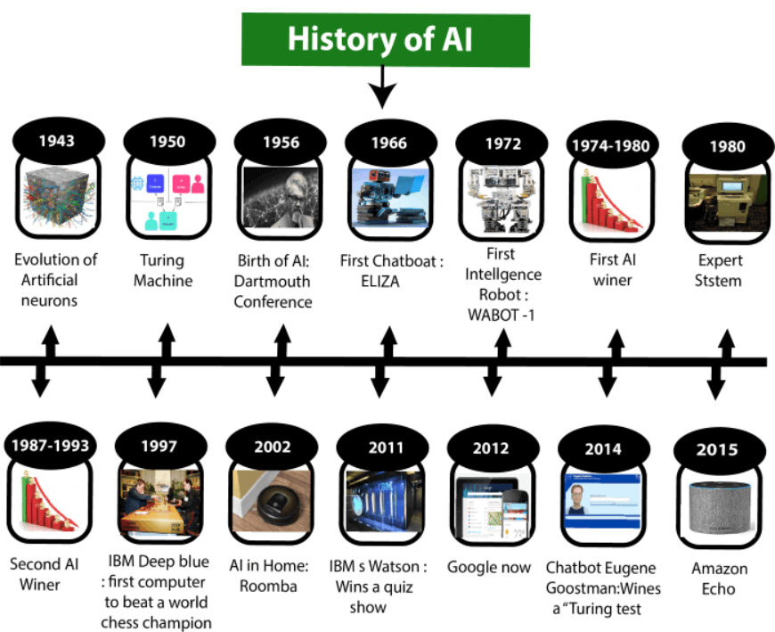
The History of AI

Slide 45
Reference
Chapter 1: Introduction , Pages 1-29
“Artificial Intelligence: A Modern Approach,” by Stuart J. Russell and Peter Norvig,

Slide 46
Books
“Artificial Intelligence: A Modern Approach,” by Stuart J. Russell and Peter Norvig. 4th edition (2021)
"Artificial Intelligence: Structures and Strategies for Complex Problem Solving", by George F. Luger, (2002)
"Artificial Intelligence: Theory and Practice", by Thomas Dean.
"AI: A New Synthesis", by Nils J. Nilsson.
“Programming for machine learning,” by J. Ross Quinlan,
“Neural Computing Theory and Practice,” by Philip D. Wasserman, .
“Neural Network Design,” by Martin T. Hagan, Howard B. Demuth, Mark H. Beale,.
“Practical Genetic Algorithms,” by Randy L. Haupt and Sue Ellen Haupt.
“Genetic Algorithms in Search, optimization and Machine learning,” by David E. Goldberg.
"Computational Intelligence: A Logical Approach", by David Poole, Alan Mackworth, and Randy Goebel.
“Introduction to Turbo Prolog”, by Carl Townsend.

