Slide 1
Course Title: Artificial Intelligence and Expert System
Course Code: CSC4226
Dept. of Computer Science
Faculty of Science and Technology
Lecture No: | Two (2) | Week No: | Two (2) | Semester: | Spring 2023-24
Lecturer: | Prof. Dr. Firoz Ahmed fahmed@aiub.edu

Slide 2
Lecture Outline
Agents and Environments
Good Behavior: The Concept of Rationality
The Nature of Environments
The Structure of Agents

Slide 3
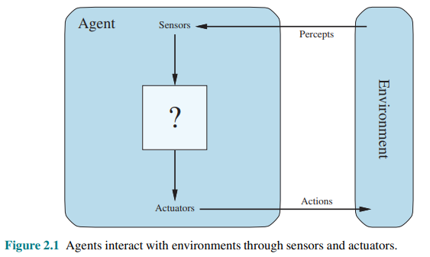
AGENT
An agent is anything that can be viewed as perceiving its environment through sensors and acting upon that environment through actuators.

Slide 4
Agent
In artificial intelligence, an agent is a computer program or system that is designed to perceive its environment, make decisions and take actions to achieve a specific goal or set of goals
The agent operates autonomously, meaning it is not directly controlled by a human operator.
These are the main four rules all AI agents must adhere to:
Rule 1: An AI agent must be able to perceive the environment.
Rule 2: The environmental observations must be used to make decisions.
Rule 3: The decisions should result in action.
Rule 4: The action taken by the AI agent must be a rational. Rational actions are actions that maximize performance and yield the best positive outcome

Slide 5
Agent
An agent can be
Human-Agent
A human agent has eyes, ears, and other organs which work for sensors and hand, legs, vocal tract work for actuators.
Robotic Agent
A robotic agent can have cameras, infrared range finder, NLP for sensors and various motors for actuators.
Software Agent
Software agent can have keystrokes, file contents as sensory input and act on those inputs and display output on the screen.
Hence the world around us is full of agents such as thermostat, cellphone, camera, and even we are also agents.
Before moving forward, we should first know about sensors, effectors, and actuators.

Slide 6
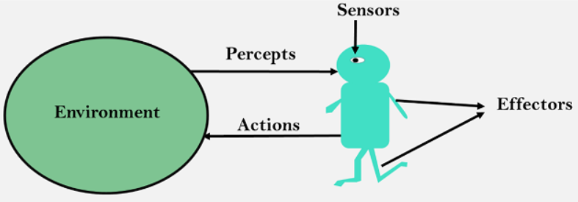

Agent
Sensor
Sensor is a device which detects the change in the environment and sends the information to other electronic devices
An agent observes its environment through sensors.
Actuators
Actuators are the component of machines that converts energy into motion
The actuators are only responsible for moving and controlling a system
An actuator can be an electric motor, gears, rails, etc.
Effectors
Effectors are the devices which affect the environment
Effectors can be legs, wheels, arms, fingers, wings, fins, and display screen.

Slide 7
INTELLIGENT AGENT
Agent: An entity in a program or environment capable of generating action.
An agent uses perception of the environment to make decisions about actions to take.
The perception capability is usually called a sensor.
The actions can depend on the most recent perception or on the entire history (percept sequence).

Slide 8
Agent
An intelligent agent is an autonomous entity which act upon an environment using sensors and actuators for achieving goals
An intelligent agent may learn from the environment to achieve their goals
A thermostat is an example of an intelligent agent.

Slide 9
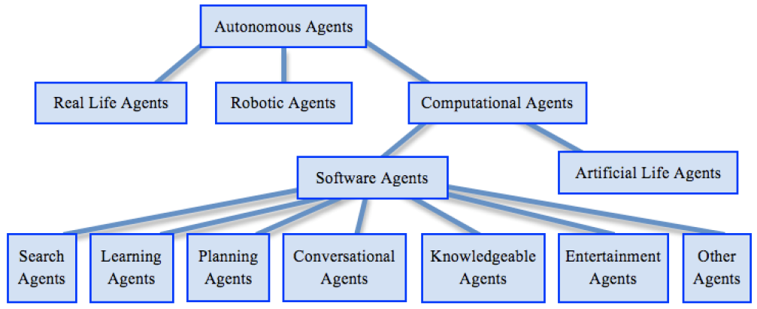
TAXONOMY OF AUTONOMOUS AGENT

Slide 10
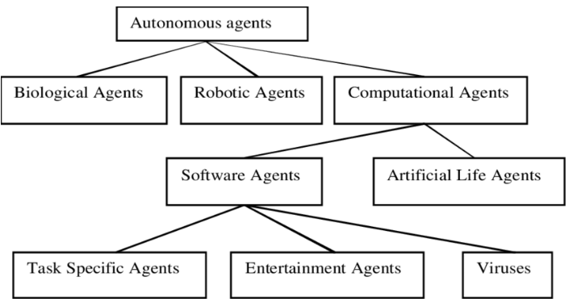
Taxonomy of Autonomous Agent

Slide 11
Agent vs Programs
Size - an agent is usually smaller than a program.
Purpose - an agent has a specific purpose while programs are multi-functional.
Persistence - an agent's life span is not entirely dependent on a user launching and quitting it.
Autonomy - an agent doesn't need the user's input to function.

Slide 12
DIFFERENT AGENTS
A human agent has eyes, ears, and other organs for sensors and hands, legs, vocal tract, and so on for actuators.
A robotic agent might have cameras and infrared range finders for sensors and various motors for actuators.
A software agent receives keystrokes, file contents, and network packets as sensory inputs and acts on the environment by displaying on the screen, writing files, and sending network packets.

Slide 13
AGENTS
The term percept refers to the agent’s perceptual inputs at any given instant.
An agent’s percept sequence is the complete history of everything the agent has ever perceived.
In general, an agent’s choice of action at any given instant can depend on the entire percept sequence observed to date, but not on anything it hasn’t perceived.

Slide 14
AGENT FUNCTION
The agent’s choice of action for every possible percept sequence can be defined.
An agent’s behavior is described by the agent function that maps any given percept sequence to an action.
We can imagine tabulating the agent function that describes any given agent; for most agents, this would be a very large table—infinite, in fact, unless we place a bound on the length of percept sequences we want to consider.

Slide 15
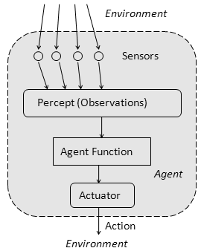
Agent Function
The agent function is a mathematical function that maps a sequence of perceptions into action.
The function is implemented as the agent program.
The part of the agent taking an action is called an actuator.
environment -> sensors -> agent function -> actuators -> environment

Slide 16
AGENT PROGRAM
The table can be constructed by trying out all possible percept sequences and recording which actions the agent does in response. Thus, the table is, of course, an external characterization of the agent. Internally, the agent function for an artificial agent will be implemented by an agent program.
It is important to keep these two ideas distinct. The agent function is an abstract mathematical description; the agent program is a concrete implementation, running within some physical system.

Slide 17

Agent Program
An agent program is an implementation of an agent function
An agent function is a map from the percept sequence(history of all that an agent has perceived to date) to an action.
Agent = Architecture + Agent Program

Slide 18
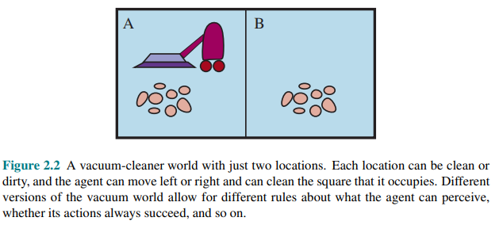
VACUUM CLEANING AGENT

Slide 19
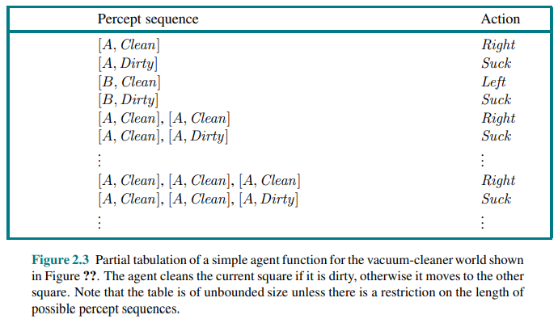
VACUUM CLEANING AGENT

Slide 20
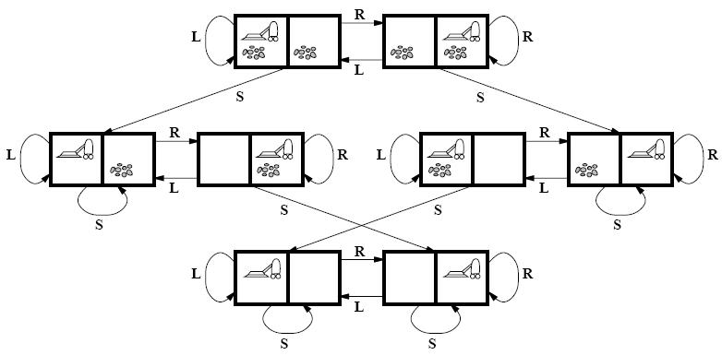
VACUUM CLEANING AGENT

Slide 21
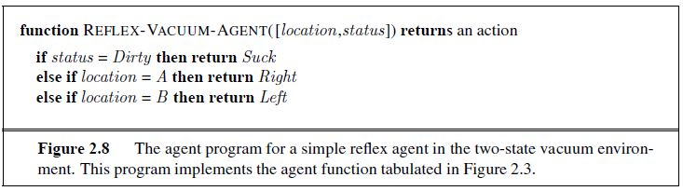
VACUUM CLEANING AGENT
Agent Program

Slide 22
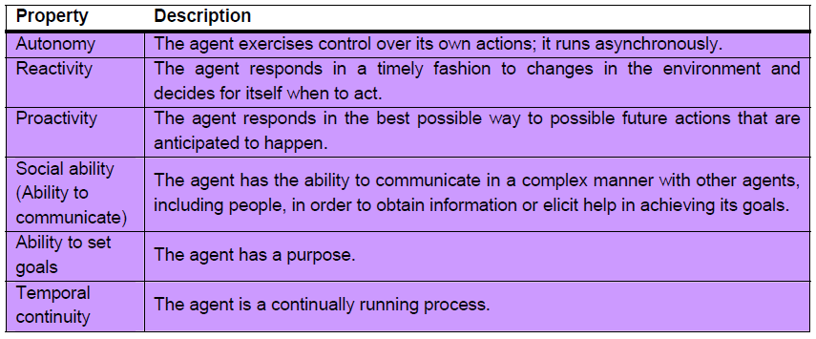
DESIRABLE PROPERTIES OF AGENT

Slide 23
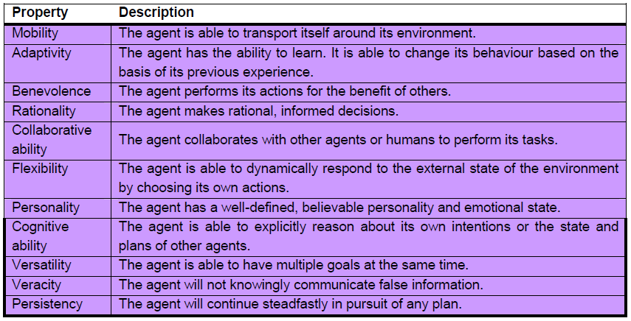
DESIRABLE PROPERTIES OF AGENT

Slide 24
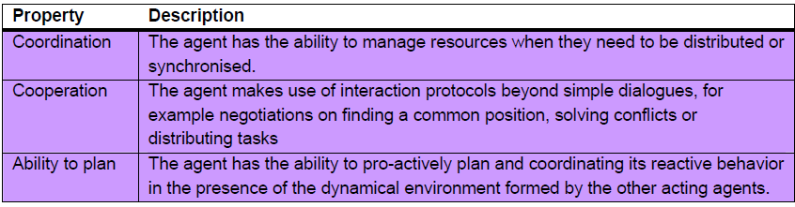
DESIRABLE PROPERTIES OF AGENT

Slide 25
GOOD BEHAVIOR:
THE CONCEPT OF RATIONALITY
Rational Agent: A rational agent is one that does the right thing
What is the right thing?
A sequence of actions causes the environment to go through a sequence of states
If the sequence is desirable, then the agent has performed well
Rationality at any given point depends on four things:
The performance measure that defines the criterion for success.
The agent’s prior knowledge of the environment
The actions that the agent can perform
The agent’s percept sequence till date
Performance measure: a set of criteria/test bed for the success of the agent's behavior.
The performance measures should be based on the desired effect of the agent on the environment.

Slide 26
PEAS
PEAS is a representation system for AI agents which caters to measuring Performance with respect to Environment, Sensors, and actuators
To design an agent, we must know our task environment
PEAS system helps specify the task environment
PEAS is a short form for Performance, Environment, Actuators, and Sensors. Identifying PEAS can help write optimum algorithms for AI

Slide 27

PEAS
Sensors
Sensors help agents perceive their environment by giving them a complete set of Inputs
The action of agents depends on the past history and the current input set
Examples of sensors include cameras, GPS, odometers, various sensing tools, etc.
Actuators
Actuators help agents operate in the environment
Actuators include display boards, object-picking arms, track-changing mechanisms, etc
Actions performed by agents can bring change to the environment as well.
Environment
The surrounding of the agent at a particular instant in which the agent works is called the environment
It can be static or dynamic based on the motion of the agent
A small change in the environment will also change the required sensors and actions of the Agent.
Performance measure
Performance measure is the unit to define the agent’s success or accuracy in achieving its set goals.

Slide 28
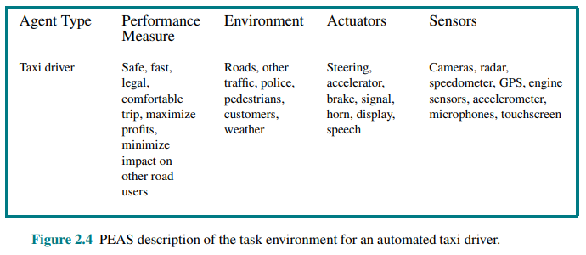
SPECIFYING THE TASK ENVIRONMENT: PEAS DESCRIPTION

Slide 29
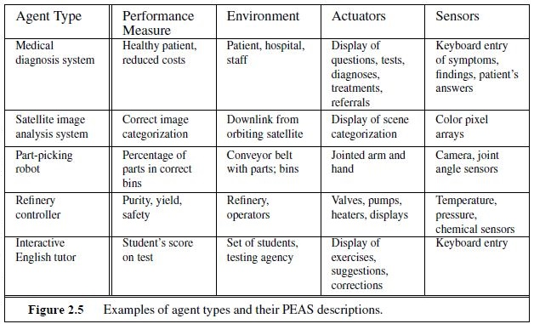
PEAS Example

Slide 30
Properties of Task Environments
Fully Observable vs Partially Observable
When an agent sensor is capable to sense or access the complete state of an agent at each point in time, it is said to be a fully observable environment else it is partially observable.
An environment is called unobservable when the agent has no sensors in all environments.
Examples:
Chess – the board is fully observable, and so are the opponent’s moves.
Driving – the environment is partially observable because what’s around the corner is not known

Slide 31
Properties of Task Environments
Deterministic vs Stochastic
When a uniqueness in the agent’s current state completely determines the next state of the agent, the environment is said to be deterministic.
The stochastic environment is random in nature which is not unique and cannot be completely determined by the agent.
Examples
Chess – there would be only a few possible moves for a coin at the current state and these moves can be determined.
Self-Driving Cars- the actions of a self-driving car are not unique, it varies time to time.

Slide 32
Properties of Task Environments
Competitive vs Collaborative
An agent is said to be in a competitive environment when it competes against another agent to optimize the output.
The game of chess is competitive as the agents compete with each other to win the game which is the output.
An agent is said to be in a collaborative environment when multiple agents cooperate to produce the desired output.
When multiple self-driving cars are found on the roads, they cooperate with each other to avoid collisions and reach their destination which is the output desired.

Slide 33
Properties of Task Environments
Single-agent vs Multi-agent
An environment consisting of only one agent is said to be a single-agent environment.
A person left alone in a maze is an example of the single-agent system.
An environment involving more than one agent is a multi-agent environment.
The game of football is multi-agent as it involves 11 players in each team.

Slide 34
Properties of Task Environments
Dynamic vs Static
An environment that keeps constantly changing itself when the agent is up with some action is said to be dynamic.
A roller coaster ride is dynamic as it is set in motion and the environment keeps changing every instant.
An idle environment with no change in its state is called a static environment.
An empty house is static as there’s no change in the surroundings when an agent enters

Slide 35
Properties of Task Environments
Episodic vs Sequential:
In an episodic environment, there is a series of one-shot actions, and only the current percept is required for the action.
However, in Sequential environment, an agent requires memory of past actions to determine the next best actions.

Slide 36
Properties of Task Environments
Discrete vs Continuous
If an environment consists of a finite number of actions that can be deliberated in the environment to obtain the output, it is said to be a discrete environment.
The game of chess is discrete as it has only a finite number of moves. The number of moves might vary with every game, but still, it’s finite.
The environment in which the actions are performed cannot be numbered i.e. is not discrete, is said to be continuous.
Self-driving cars are an example of continuous environments as their actions are driving, parking, etc. which cannot be numbered

Slide 37
Structure of an AI agent
The task of AI is to design an agent program which implements the agent function
The structure of an intelligent agent is a combination of architecture and agent program
It can be viewed as:
Agent = Architecture + Agent program
Obviously, the program we choose has to be one that is appropriate for the architecture
If the program is going to recommend actions like Walk, the architecture had better have legs
The architecture might be just an ordinary PC, or it might be a robotic car with several onboard computers, cameras, and other sensors.

Slide 38
Structure of an AI agent
Following are the main three terms involved in the structure of an AI agent:
Architecture
Architecture is machinery that an AI agent executes on.
Agent Function
Agent function is used to map a percept to an action.
Agent program
Agent program is an implementation of agent function
An agent program executes on the physical architecture to produce function f.

Slide 39
Table Driven Agents: Agent Example
Table-driven agents
It consists in a lookup table of actions to be taken for every possible state of the environment.
If the environment has n variables, each with t possible states, then the table size is t^{n}.
Only works for a small number of possible states for the environment.

Slide 40
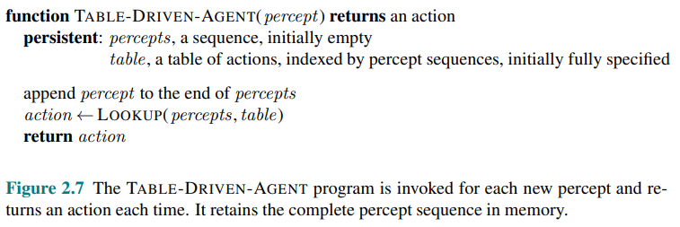
Table Driven Agents

Slide 41
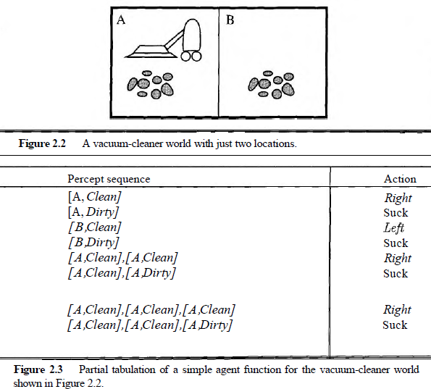
Vacuum Cleaning Agents: Table Driven

Slide 42
Limitation of Table Driven Agent
No physical agent in this universe will have the space to store the table,
No agent could ever learn all the right table entries from its experience, and
Even if the environment is simple enough to yield a feasible table size, the designer still has no guidance about how to fill in the table entries

Slide 43

Types of AI Agents
Simple reflex agents
Model-based reflex agents
Goal-based agents
Utility-based agents
Learning Agents

Slide 44
Simple Reflex Agent
The simple reflex agents are the simplest agents
These agents take decisions on the basis of the current percepts and ignore the rest of the percept history.
These agents only succeed in the fully observable environment.
It does not consider any part of percepts history during their decision and action process.
It works on Condition-action rule, which means it maps the current state to action
Such as a room cleaner agent, it works only if there is dirt in the room.

Slide 45
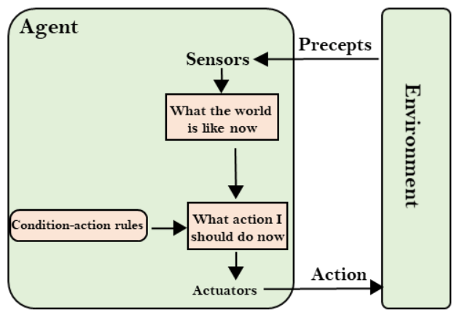
Simple Reflex Agent
A simple reflex agent comprises the following parts:
Agent: The agent is the one who performs actions on the environment.
Sensors: Sensors are the things that sense the environment. They are devices that measure physical property.
Actuators: Actuators are devices that convert energy into motion.
Environment: The environment includes the surroundings of the agent.

Slide 46
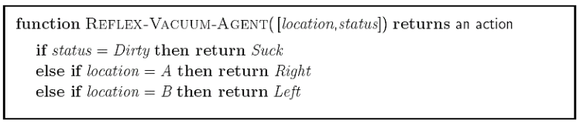
Simple Reflex Agent
Explanation
The actions are taken depending upon the condition
If the condition is true, the relevant action is taken
If it is false, the other action is taken.
The agent takes input from the environment through sensors, and delivers the output to the environment through actuators.

Slide 47
Model Based Agent
The Model-based agent can work in a partially observable environment, and track the situation.
A model-based agent has two important factors:
Model: It is knowledge about "how things happen in the world," so it is called a Model-based agent.
Internal State: It is a representation of the current state based on percept history.
These agents have the model, "which is knowledge of the world" and based on the model they perform actions.
Updating the agent state requires information about:
How the world evolves
How the agent's action affects the world.

Slide 48
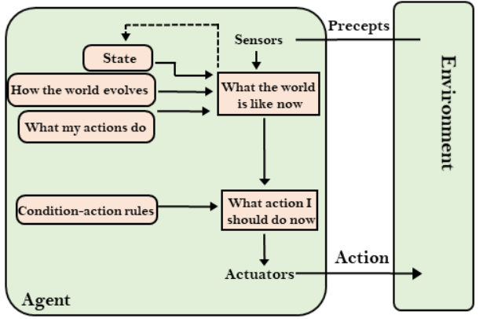
Model Based Agent

Slide 49
Model Based Agent
The model-based reflex agent operates in four stages:
Sense: It perceives the current state of the world with its sensors.
Model: It constructs an internal model of the world from what it sees.
Reason: It uses its model of the world to decide how to act based on a set of predefined rules or heuristics.
Act: The agent carries out the action that it has chosen.
Example: A vacuum cleaner that uses sensors to detect dirt and obstacles and moves and cleans based on a model.

Slide 50
Goal Based Agent
Goal-based agents expand the capabilities of the model-based agent by having the "goal" information.
Goal-based agents are AI agents that use information from their environment to achieve specific goals
They employ search algorithms to find the most efficient path towards their objectives within a given environment.
These agents are also known as rule-based agents, as they follow predefined rules to accomplish their goals and take specific actions based on certain conditions.

Slide 51
Goal Based Agent
Goal-based agents are easy to design and can handle complex tasks
They can be used in various applications like robotics, computer vision, and natural language processing
Unlike basic models, a goal-based agent can determine the optimal course of decision-making and action-taking processes depending on its desired outcome or goal

Slide 52
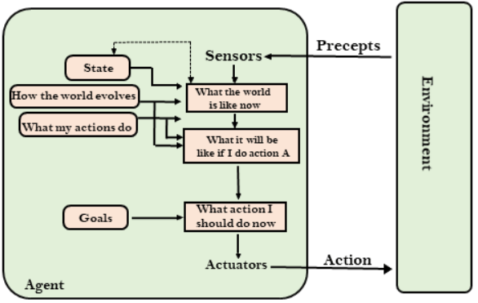
Goal Based Agent

Slide 53
Goal Based Agent
How does it work?
Given a plan, a goal-based agent attempts to choose the best strategy to achieve the goals, It then uses search algorithms and heuristics to find the efficient path to the goal.
The working pattern of the goal-based agent can be divided into five steps:
Perception: The agent perceives its environment using sensors or other input devices to collect information about its surroundings.
Reasoning: The agent analyzes the information collected and decides on the best course of action to achieve its goal.
Action: The agent takes actions to achieve its goal, such as moving or manipulating objects in the environment.
Evaluation: After taking action, the agent evaluates its progress towards the goal and adjusts its actions, if necessary.
Goal Completion: Once the agent has achieved its goal, it either stops working or begins working on a new goal.
Example: A chess-playing AI whose goal is winning the game.

Slide 54
Utility Based Agent
Utility agent have their end uses as their building blocks and is used when best action and decision needs to be taken from multiple alternatives.
It is an improvement over goal based agent
As it not only involves the goal but also the way the goal can be achieved such that the goal can be achieved in a quicker, safer, cheaper way
The extra component of utility or method to achieve a goal provides a measure of success at a particular state that makes the utility agent different.

Slide 55
Utility Based Agent
It takes the agent happiness into account and gives an idea of how happy the agent is because of the utility and hence, the action with maximum utility is considered
This associated degree of happiness can be calculated by mapping a state onto a real number.
Mapping of a state onto a real number with the help of utility function gives the efficiency of an action to achieve the goal.
Example:
A delivery drone that delivers packages to customers efficiently while optimizing factors like delivery time, energy consumption, and customer satisfaction.

Slide 56
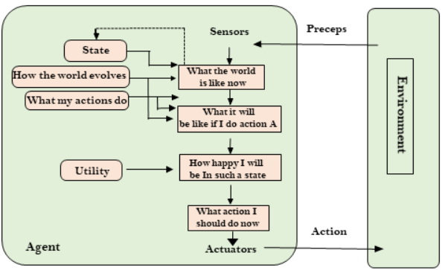
Utility Based Agent

Slide 57
Learning Based Agent
An AI learning agent is a software agent that can learn from past experiences and improve its performance
It initially acts with basic knowledge and adapts automatically through machine learning
The learning agent comprises four main components:
Learning Element: It is responsible for learning and making improvements based on the experiences it gains from its environment.
Citric: It provides feedback to the learning element by the agent’s performance for a predefined standard.
Performance Element: It selects and executes external actions based on the information from the learning element and the critic.
Problem Generator: It suggests actions to create new and informative experiences for the learning element to improve its performance.

Slide 58
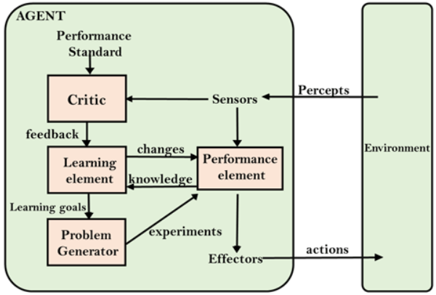

Learning Based Agent

Slide 59
Learning Based Agent
Here’s how the cycle works
Observation: The learning agent observes its environment through sensors or other inputs.
Learning: The agent analyzes data using algorithms and statistical models, learning from feedback on its actions and performance.
Action: Based on what it has learned, the agent acts in its environment to decide how to behave.
Feedback: The agent receives feedback about their actions and performance through rewards, penalties, or environmental cues.
Adaptation: Using feedback, the agent changes its behavior and decision-making processes, updating its knowledge and adapting to its environment

Slide 60
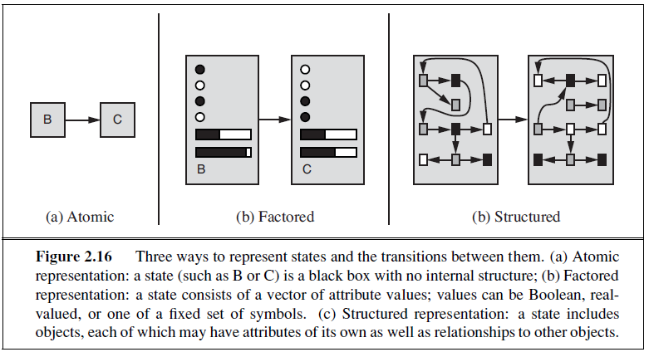
How Component of Agent program Works

Slide 61
References
Chapter 2: Intelligent Agents , Pages 34-58
“Artificial Intelligence: A Modern Approach,” by Stuart J. Russell and Peter Norvig,

Slide 62
Books
“Artificial Intelligence: A Modern Approach,” by Stuart J. Russell and Peter Norvig.
"Artificial Intelligence: Structures and Strategies for Complex Problem Solving", by George F. Luger, (2002)
"Artificial Intelligence: Theory and Practice", by Thomas Dean.
"AI: A New Synthesis", by Nils J. Nilsson.
“Programming for machine learning,” by J. Ross Quinlan,
“Neural Computing Theory and Practice,” by Philip D. Wasserman, .
“Neural Network Design,” by Martin T. Hagan, Howard B. Demuth, Mark H. Beale, .
“Practical Genetic Algorithms,” by Randy L. Haupt and Sue Ellen Haupt.
“Genetic Algorithms in Search, optimization and Machine learning,” by David E. Goldberg.
"Computational Intelligence: A Logical Approach", by David Poole, Alan Mackworth, and Randy Goebel.
“Introduction to Turbo Prolog”, by Carl Townsend.

