Slide 1
Bangabondhu: A visionary statement 7th MARCH SPPECH.

Slide 2
The Beginning of the End
On March the 7th, 1971 Bangabandhu Sheikh Mujibur Rahman delivered an epoch-making speech on the Racecourse Field of Ramana, Dhaka to a gathering of over two million people that shaped the birth of a nation called Bangladesh – our motherland. Bangabandhu spoke for about 18 minutes, but the speech moved the countrymen to snatch their long-desired independence. A speech that can move 75 million people towards a 9 months bloodshed struggle for freedom from the usurping the then West Pakistan can surely be named as a historical speech of all-time. The speech is not only significant for its appeal towards the war of independence of Bangladesh, but also for the everlasting interest for mankind, peacemaking, absolute democracy and strong diplomatic structure. When we talk about this speech, we must not forget the incidents and legitimate reasons behind such a historical event.

Slide 3
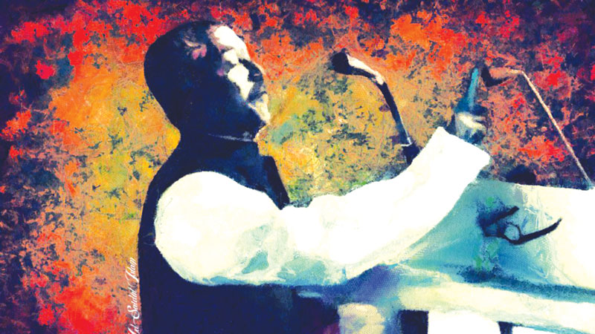
Father of the nation bangabandhu sheikh mujibur rahman

Slide 4
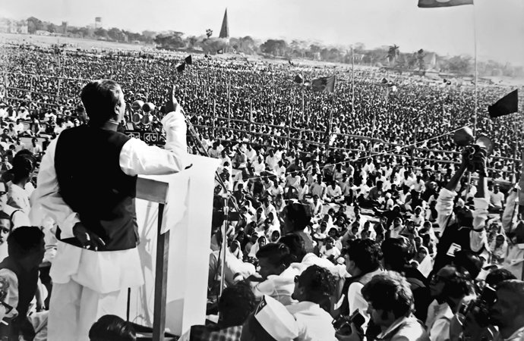
The Speech
Bangabandhu gave everyone a patient hearing but said very little. He knew exactly what his options were and their possible outcomes. By midday, the vast Ramna Racecourse was teeming with millions to hear from the 'Poet of Politics,' a title given to him earlier by Newsweek.

Slide 5
Syed Shahid Husain writes: “I had noted in my diary that Sheikh Mujib was likely to declare independence on March 7. As a matter of fact, I had heard this on the BBC. On March 7, Mujib addressed a vast really but did not declare independence. Yahya must have been disappointed as he had probably hoped that Mujib would proclaim independence and thus provide him the justification to arrest the East Pakistan leader.”
Bangabandhu arrived at the venue at 2.45 in the afternoon and spoke for only 19 minutes. It was electrifying 19 minutes. Not only the people of entire Pakistan and East Bengal were glued to their radios, but the world was holding its breath. However, on orders from the central government, both the radio and the TV had to abstain from broadcasting the historic speech. In protest, the staff of the radio and TV walked out of their broadcasting stations. The speech was extempore and became one of the memorable speeches ever given by a politician.

Slide 6
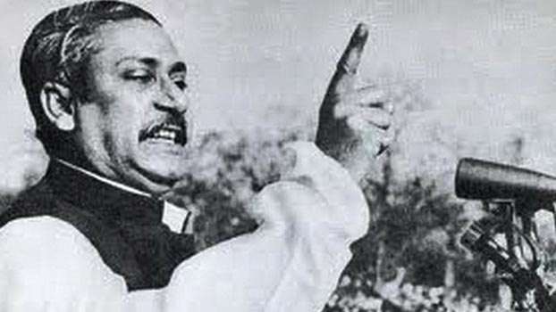
Bangabandhu started with the lines, "Today, I appeared before you with a heavy heart. You know everything and understand as well. We tried with our lives, but the painful matter is that today, in Dhaka, Chittagong, Khulna, Rajshahi and Rangpur, the streets are dyed red with the blood of our brother. Today the people of Bengal want freedom, the people of Bengal want to survive, the people of Bengal want to have their rights. What wrong did we do?"

Slide 7
He mentioned four conditions for joining the National Assembly on 25 March:
1. The immediate lifting of martial law.
2. The immediate withdrawal of all military personnel to their barracks.
3. A proper inquiry into the loss of life during the conflict.
4. The immediate transfer of power to elected representatives of the people;.

Slide 8
He also gave several directives for a civil disobedience movement, instructing that:
People should not pay taxes.
Government servants should take orders only from him.
The secretariat, government and semi-government offices, and courts in East Pakistan should observe strikes, with necessary exemptions announced from time to time.
Only local and inter-district telephone lines should function.
Railways and ports could continue to function, but their workers should not cooperate if they were used to repress the people of East Pakistan.

Slide 9
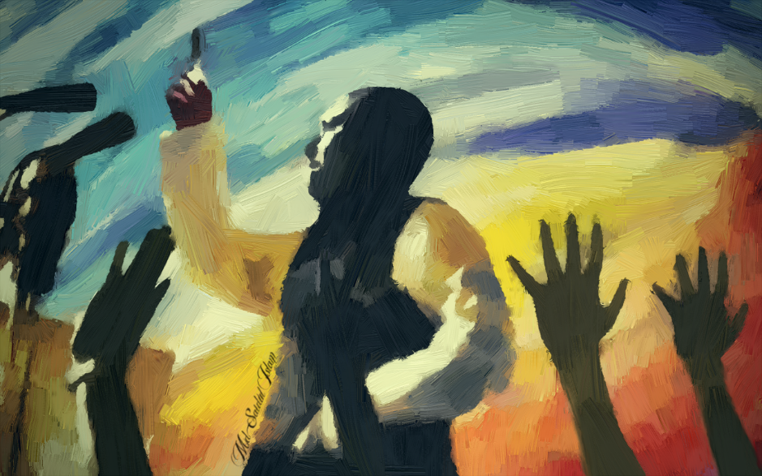
While Bangabandhu was speaking the Dhaka
Garrison was preparing for an assault on the
unarmed civilians in case there was a declaration
of independence. Bangabandhu did not disappoint
the waiting millions, but said what he had to in an
intelligent and statesman-like way. He ended his
speech saying:
“The struggle this time is for emancipation,
the struggle this time is for independence.”
A straight declaration would have branded him a
secessionist and he would have lost world sympathy.

Slide 10
Analysis
The speech continued for about 19 minutes, or 18 minutes and 59 seconds. During this 19 minute the population of 75 million people was looking upon the father of the nation for hope of directions. Sheikh Mujibur Rahman, before to giving that speech had talked to various ambassadors in Dhaka and knew if he declared immediate independence some of those countries which befriends Pakistan will not support the newly formed Bangladesh, this included The United States of America too. On the other hand, on 7th March of 1971, the two million people were being guarded by of a force of 10,000 Pakistani army personnel.
Bangabandhu also knew that if anything wrong takes place, the lives of these 2 million will be at stake. Finally, “The struggle this time is the struggle for our emancipation. The struggle this time is the struggle for our independence.” – in a fabricated tone he declared that Bangladesh from onwards whatever happens is considered independent and so he calls upon the countrymen to confront the military junta and bring their rightful country to birth.

Slide 11
Conclusion
The speech of 7th March has inspired the 200,000 people who were present on the Ramana Racecourse and the whole nation to take part in liberation war and free our country from the enemy. The speech of 7th March was an eye-opening declaration for the nation that we should stand together and free our country from West Pakistan. This speech stands as an oratory version of our declaration of independence. It also inspires the world today to seek for every individual’s rights. It is so much moving that only after 18 days of the event when Operation Searchlight began, the people of the country stood against the militia without any fear and without any immediate indications. We must acknowledge the fact that though the declaration of independence came later, but this speech is the one that represented as the declaration for the 75 million people in general. We are proud that Bangladesh’s Father of Nation had driven us with such a speech that we can hold dear to and gather strength defying the barriers of time and space. It is, our Declaration of Independence.

Slide 12
Thank You Everyone

