Slide 1
Network Model Architecture
Lecture 2

Slide 2
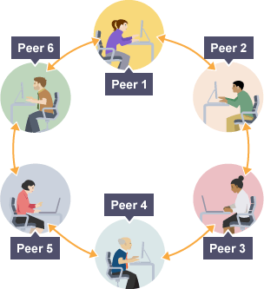
Network Models
A network is a combination of hardware and software that sends data from one location to another. The hardware consists of the physical equipment that carries signals from one point of the network to another. The software consists of instruction sets that make possible the services that we expect from a network.

Slide 3
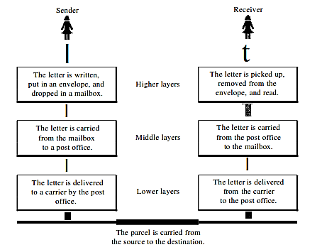
Layered Tasks
We use the concept of layers in our daily life. As an example, let us consider two friends who communicate through postal mail The process of sending a letter to a friend would be complex if there were no services available from the post office.
Fig: Tasks involved in sending a letter

Slide 4


OSI Model
Established in 1947, the International Standards Organization (ISO) is a multinational body dedicated to worldwide agreement on international standards. An ISO standard that covers all aspects of network communications is the Open Systems Interconnection model (OSI) in late 1970s.
The purpose of the OSI model is to show how to facilitate communication between different systems without requiring changes to the logic of the underlying hard­ ware and software. The OSI model is not a protocol; it is a model for understanding and designing a network architecture that is flexible, robust, and interoperable.

Slide 5
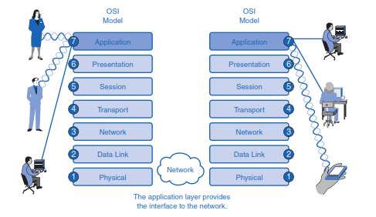
OSI Model cont.

Slide 6
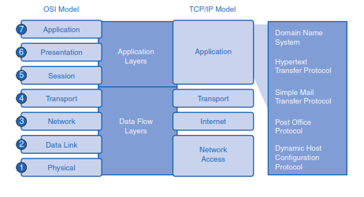
OSI & TCP/IP Model

Slide 7
Application Layer
This section introduces two important concepts:
1. Application layer: The application layer of the OSI model provides the first step of getting data onto the network.
2. Application software: Applications are the software programs used by people to communicate over the network. Examples of application software, including HTTP, FTP, e-mail, and others, are used to explain the differences between these two concepts.

Slide 8
Presentation Layer
The presentation layer has three primary functions:
Coding and conversion of application layer data to ensure that data from the source device can be interpreted by the appropriate application on the destination device
Compression of the data in a manner that can be decompressed by the destination device
Encryption of the data for transmission and decryption of data upon receipt by the destination

Slide 9
Session Layer
Functions at the session layer create and maintain dialogs between source and destination applications. The session layer handles the exchange of information to initiate dialogs and keep them active, and to restart sessions that are disrupted or idle for a long period of time.
This layer support the session by –
Establishing Connections
Maintaining Connections
Synchronizing Connections
Controlling Dialogues
Terminating Connections

Slide 10
Transport Layer
The Transport layer provides for the segmentation of data and the control necessary to reassemble these pieces into the various communication streams. Its primary responsibilities to accomplish this are:
Multiplexing and Demultiplexing
Segmenting data and managing each piece
Reassembling the segments into streams of application data
Identifying the different applications (HTTP 80, FTP 20,21)

Slide 11
Network Layer
The Network layer, or OSI Layer 3, provides services to exchange the individual pieces of data over the network between identified end devices. To accomplish this end-to-end transport, Layer 3 uses following basic processes:
Logical Addressing
Encapsulation
Routing
Decapsulation
Error handling & Diagnostics

Slide 12
Data Link Layer
The data link layer transforms the physical layer, a raw transmission facility, to a reli­able link. It makes the physical layer appear error-free to the upper layer (network layer). Other responsibilities of the data link layer include the following:
Framing: The data link layer divides the stream of bits received from the network layer into manageable data units called frames.
Physical addressing: If frames are to be distributed to different systems on the network, the data link layer adds a header to the frame to define the sender and/or Receiver of the frame. If the frame is intended for a system outside the sender's network, the receiver address is the address of the device that connects the network to the next one.
Flow control: If the rate at which the data are absorbed by the receiver is less than the rate at which data are produced in the sender, the data link layer imposes a Flow control mechanism to avoid overwhelming the receiver.

Slide 13
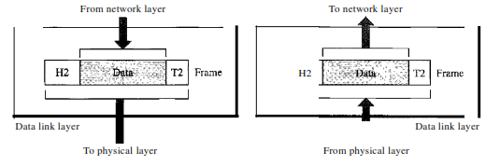
Data Link Layer cont.
4. Error control. The data link layer adds reliability to the physical layer by adding mechanisms to detect and retransmit damaged or lost frames. It also uses a mecha­nism to recognize duplicate frames. Error control is normally achieved through a trailer added to the end of the frame.
5. Access control. When two or more devices are connected to the same link, data link layer protocols are necessary to determine which device has control over the link at any given time.

Slide 14
Physical Layer
The OSI Physical layer provides the means to transport across the network media the bits that make up a Data Link layer frame. This layer accepts a complete frame from the Data Link layer and encodes it as a series of signals that are transmitted onto the local media. The encoded bits that comprise a frame are received by either an end device or an intermediate device.
The delivery of frames across the local media requires the following Physical layer elements:
The physical media and associated connectors
A representation of bits on the media
Encoding of data and control information
Transmitter and receiver circuitry on the network devices

Slide 15
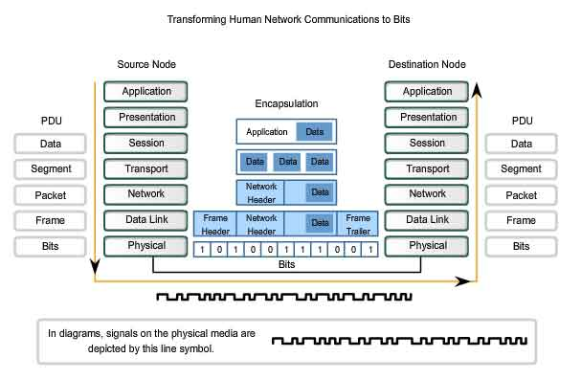
Encapsulation

