Slide 1

Operations Management
William J. Stevenson
8th edition

Slide 2
CHAPTER
3
Forecasting
Operations Management, Eighth Edition, by William J. Stevenson
Copyright © 2005 by The McGraw-Hill Companies, Inc. All rights reserved.
McGraw-Hill/Irwin

Slide 3
FORECAST:
A statement about the future value of a variable of interest such as demand.
Forecasts affect decisions and activities throughout an organization
  Accounting, finance
  Human resources
  Marketing
  MIS
  Operations
  Product / service design

Slide 4
Uses of Forecasts
Accounting | Cost/profit estimates
Finance | Cash flow and funding
Human Resources | Hiring/recruiting/training
Marketing | Pricing, promotion, strategy
MIS | IT/IS systems, services
Operations | Schedules, MRP, workloads
Product/service design | New products and services

Slide 5
Assumes causal system
past ==> future
Forecasts rarely perfect because of randomness
Forecasts more accurate for
groups vs. individuals
Forecast accuracy decreases
as time horizon increases
I see that you will
get an A this semester.

Slide 6
Elements of a Good Forecast
Timely
Reliable
Accurate
Meaningful
Written
Easy to use

Slide 7

Steps in the Forecasting Process
“The forecast”
Step 6 Monitor the forecast
Step 5 Prepare the forecast
Step 4 Gather and analyze data
Step 3 Select a forecasting technique
Step 2 Establish a time horizon
Step 1 Determine purpose of forecast

Slide 8
Types of Forecasts
Judgmental - uses subjective inputs
Time series - uses historical data assuming the future will be like the past
Associative models - uses explanatory variables to predict the future

Slide 9
Judgmental Forecasts
Executive opinions
Sales force opinions
Consumer surveys
Outside opinion
Delphi method
  Opinions of managers and staff
  Achieves a consensus forecast

Slide 10
Time Series Forecasts
Trend - long-term movement in data
Seasonality - short-term regular variations in data
Cycle – wavelike variations of more than one year’s duration
Irregular variations - caused by unusual circumstances
Random variations - caused by chance

Slide 11
Forecast Variations
Figure 3.1
Irregular
variation
Trend
Cycles
90
89
88
Seasonal variations

Slide 12

Naive Forecasts
Uh, give me a minute....
We sold 250 wheels last
week.... Now, next week we should sell....
The forecast for any period equals the previous period’s actual value.

Slide 13
Naïve Forecasts
Simple to use
Virtually no cost
Quick and easy to prepare
Data analysis is nonexistent
Easily understandable
Cannot provide high accuracy
Can be a standard for accuracy

Slide 14
Uses for Naïve Forecasts
Stable time series data
  F(t) = A(t-1)
  Seasonal variations
  F(t) = A(t-n)
Data with trends
  F(t) = A(t-1) + (A(t-1) – A(t-2))

Slide 15
Techniques for Averaging
Moving average/ Simple moving average
Weighted moving average
Exponential smoothing

Slide 16
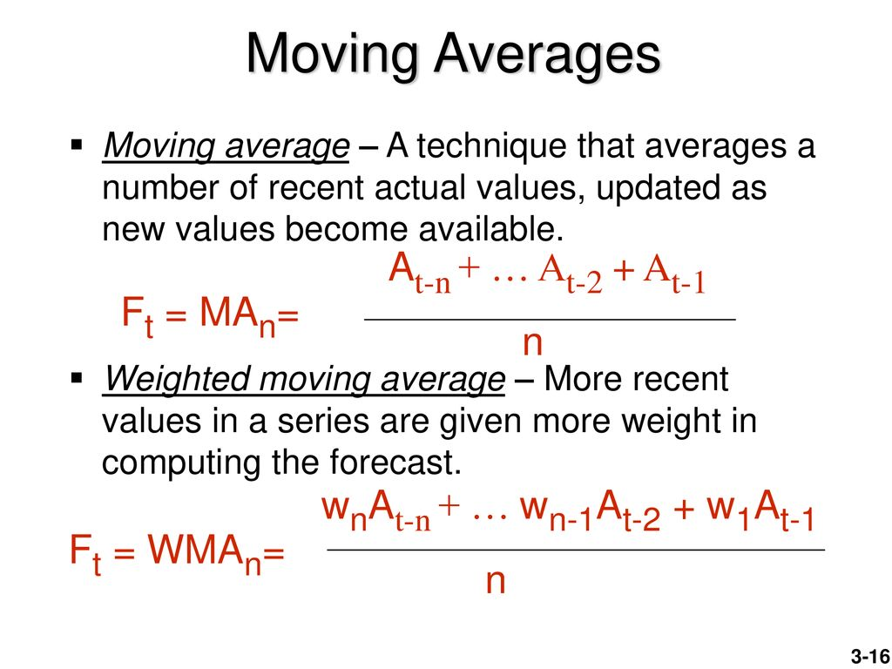


Slide 17
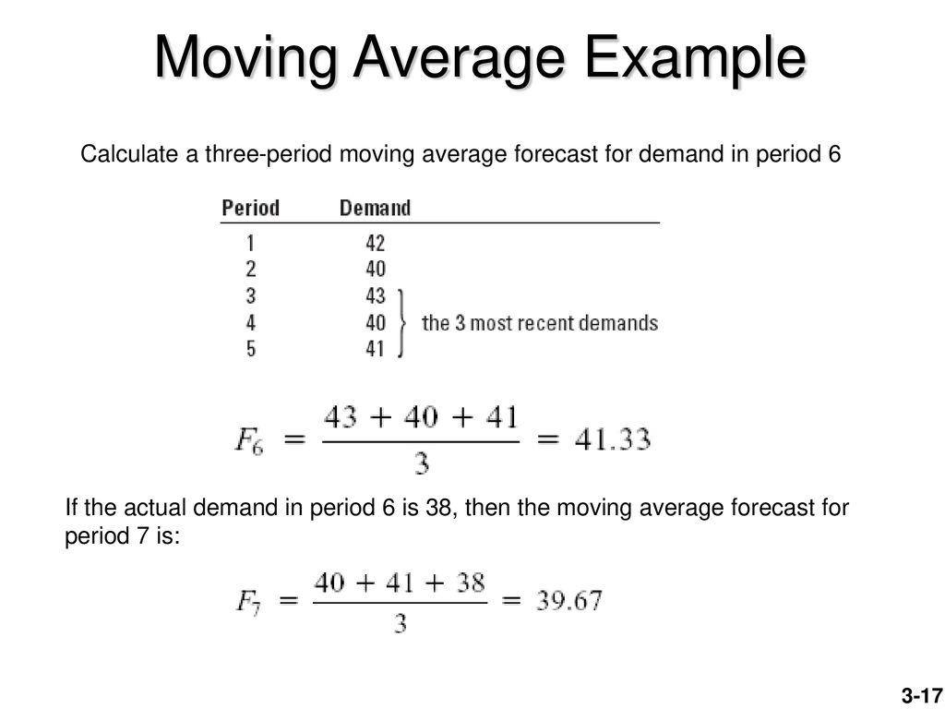
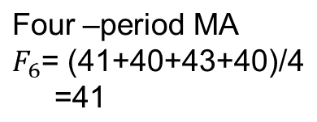
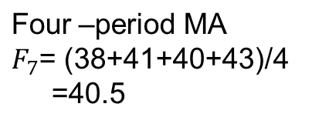
Period 1-6
Forecast
42+40+43/3
40+43+40/3
43+40+41/3
6

Slide 18





given
Forecast Demand
41.67
41
41.33
6
-

Slide 19

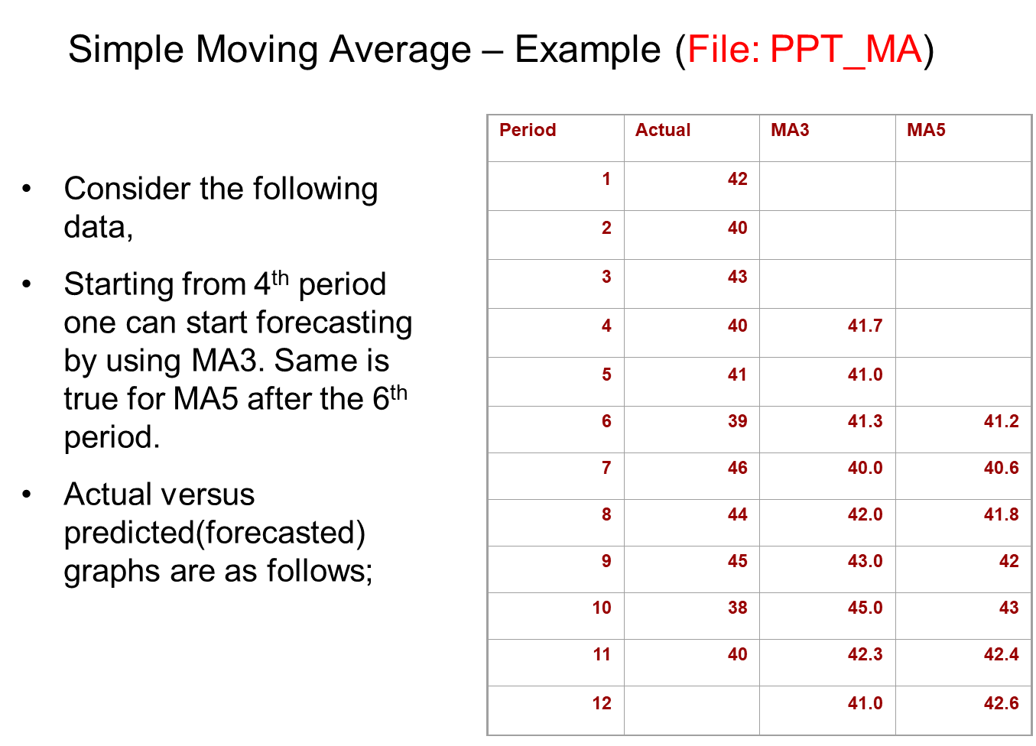
F12=MA3= 45+38+40/3
F₁₂=MA₅=46+44+45+38+40/5
42+40+43/3
42+40+43+40+41/5

Slide 20
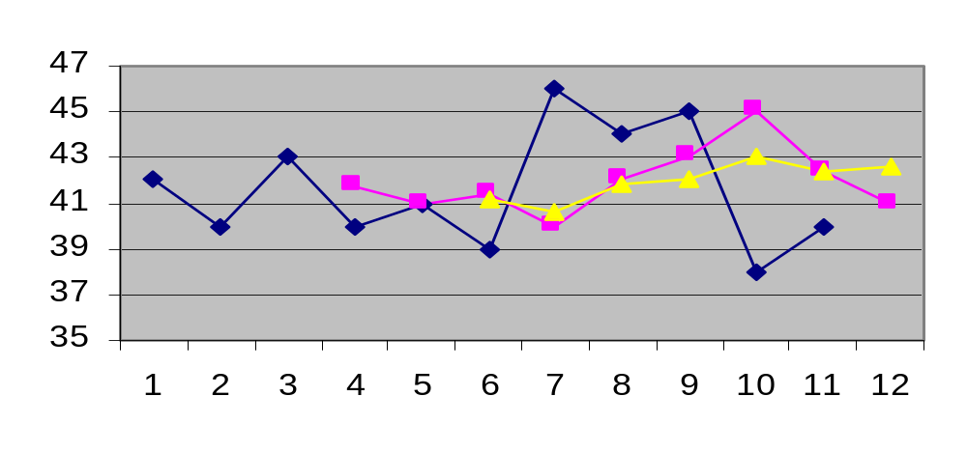
Simple Moving Average
Actual
MA5
MA3
n
∑
A_{i}
MA_{n}
=
i = 1
n

Slide 21
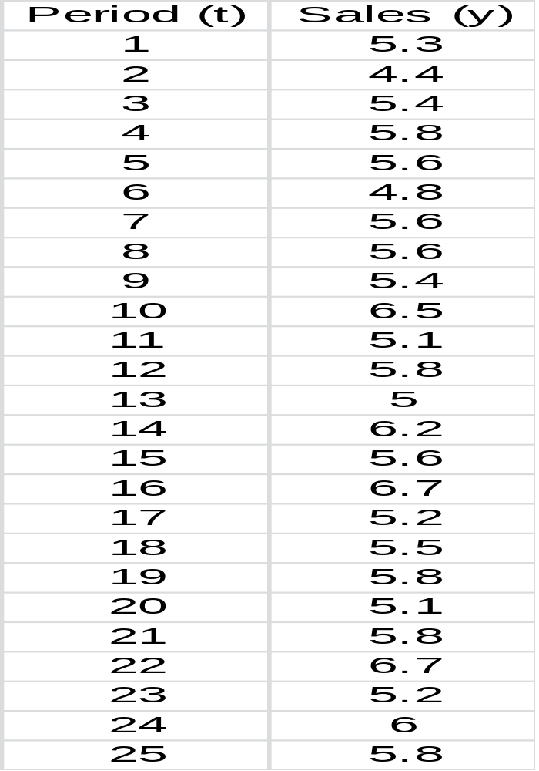
Example: Weekly Department Store Sales
The weekly sales figures (in millions of dollars) presented in the following table are used by a major department store to determine the need for temporary sales personnel.
Assignment 1:
Four –period and Two-period moving average, (Up to period 12)
WMA(4) 0.4, 0.35, 0.15, 0.1
Naïve
Exp Alpha=0.3

Slide 22
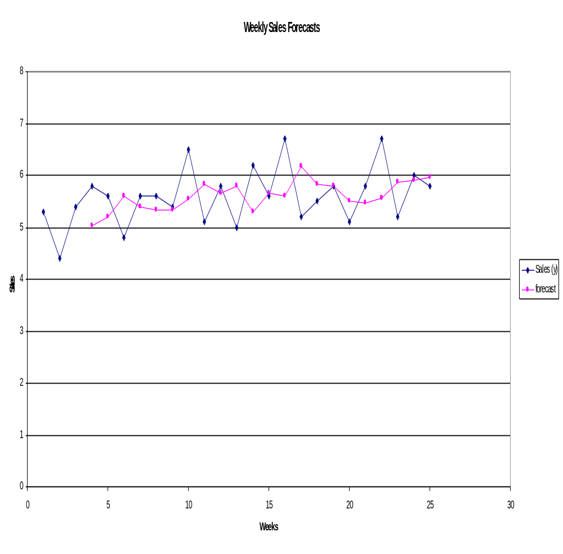
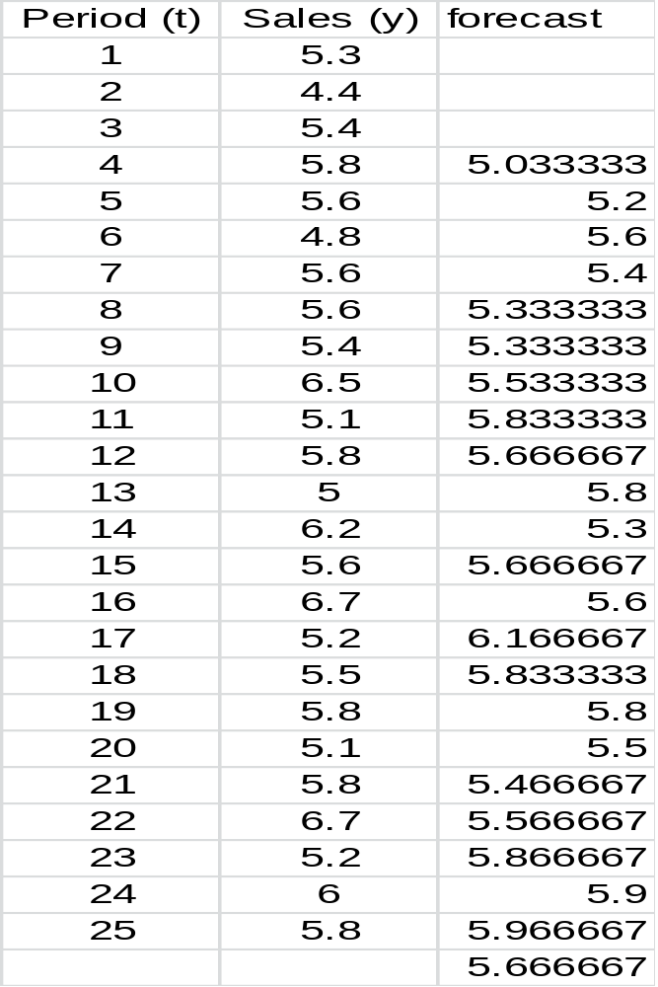
Example: Weekly Department Store Sales

Slide 23
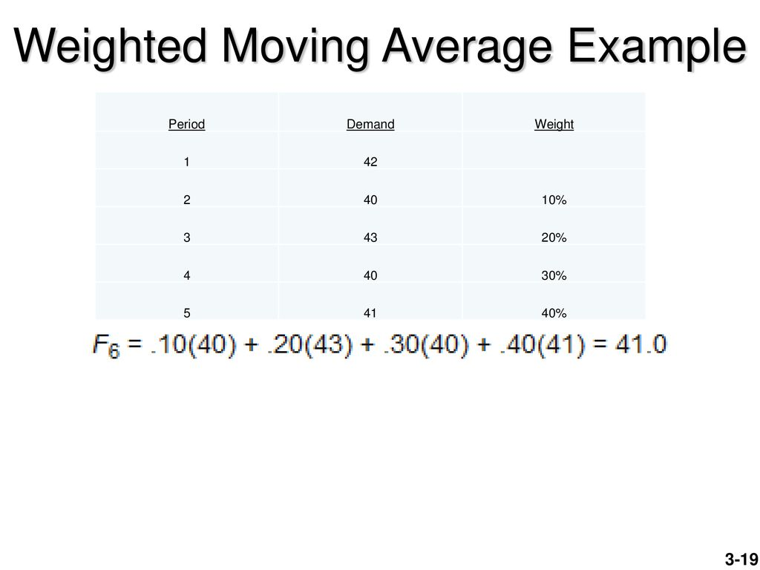
F₅= 0.1*42+0.20*40+0.3*43+0.4*40
0.5, 0.35, 0.15
F₄= 0.15*42+0.35*40+0.5*43=41.8
F₅= 0.15*40+0.35*43+0.5*40=41.05
F₆= 0.15*43+0.35*40+0.5*41=40.95

Slide 24
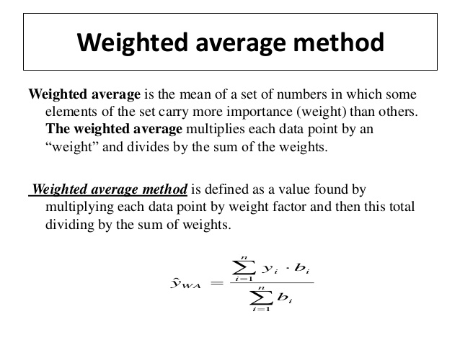

Moving

Slide 25
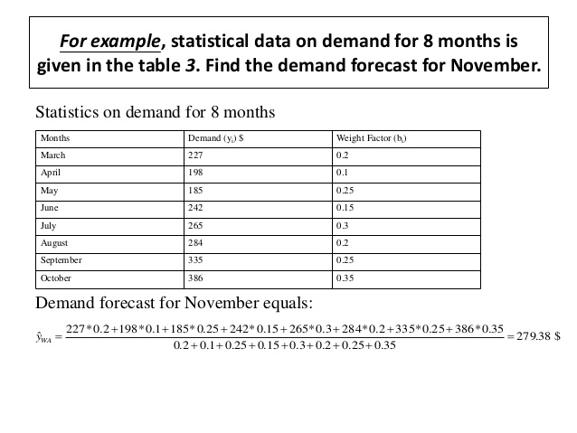

Slide 26
Exponential Smoothing
F_{t} = F_{t-1} + α(A_{t-1} - F_{t-1})
or
F_{t} = αA_{t-1} + (1-α) F_{t-1}
Premise--The most recent observations might have the highest predictive value.
  Therefore, we should give more weight to the more recent time periods when forecasting.

Slide 27
Exponential Smoothing
F_{t} = F_{t-1} + α(A_{t-1} - F_{t-1})
Weighted averaging method based on previous forecast plus a percentage of the forecast error
A-F is the error term, α is the % feedback

Slide 28
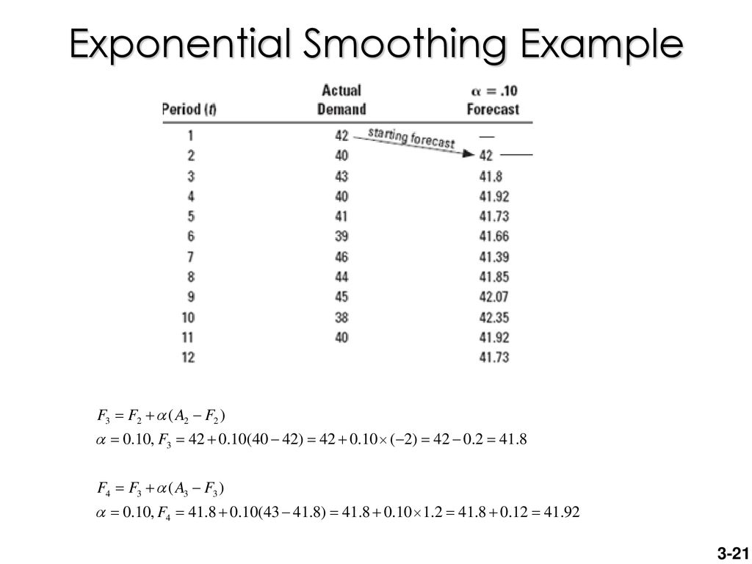

Alpha=0.1
F_{t} = F_{t-1} + α(A_{t-1} - F_{t-1})

Slide 29
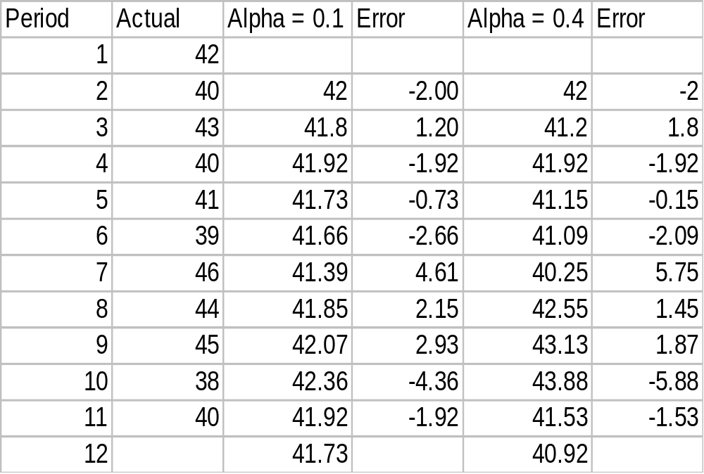
Example 3 - Exponential Smoothing
F_{t} = F_{t-1} + α(A_{t-1} - F_{t-1})
Forecast F_{t}
Forecast F_{t}
Three-period
Naive
MAD₁=24.48/10=2.45
MAD₂=24.44/10=2.44
MAD_{MV}=23.33/8=2.92
MAD_{Naive}=30/10=3
MAD_{exp}=2.44

Slide 30
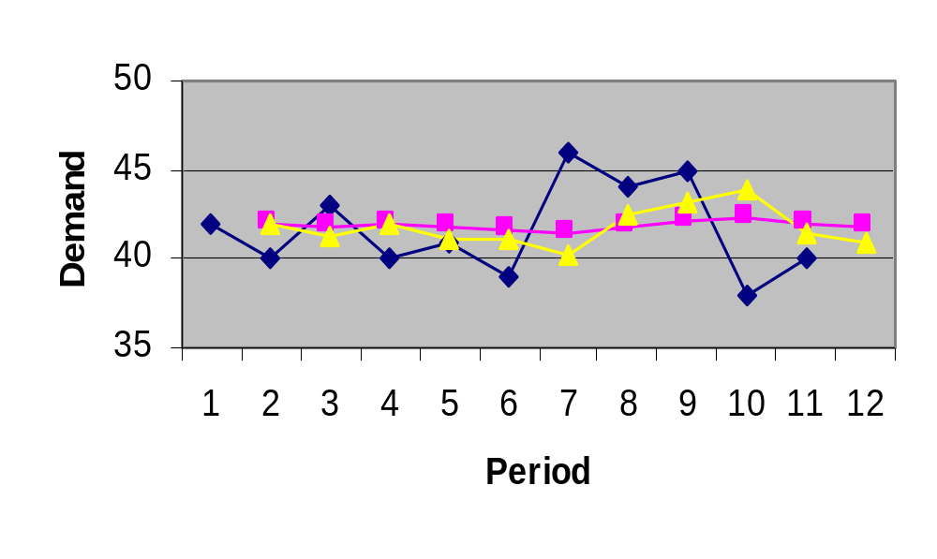
Picking a Smoothing Constant
Actual
α = .4
α = .1

Slide 31
Associative Forecasting
Predictor variables - used to predict values of variable interest
Regression - technique for fitting a line to a set of points
Least squares line - minimizes sum of squared deviations around the line

Slide 32
Forecast Accuracy
Error - difference between actual value and predicted value
Mean Absolute Deviation (MAD)
  Average absolute error
Mean Squared Error (MSE)
  Average of squared error
Mean Absolute Percent Error (MAPE)
  Average absolute percent error

Slide 33
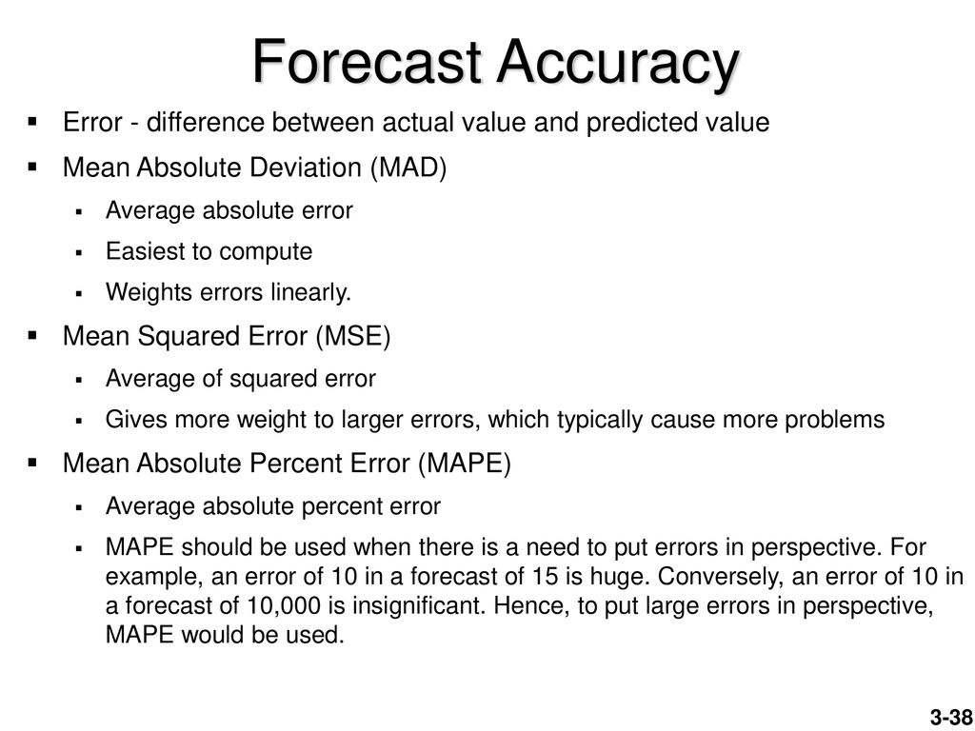

Slide 34
MAD, MSE, and MAPE
∑
Actual
−
forecast
MAD
=
n
(
Actual
−
forecast)
2
∑
MSE
=
n
-
1
∑(
Actual
−
forecas
/ Actual*100)
MAPE
=
n

Slide 36
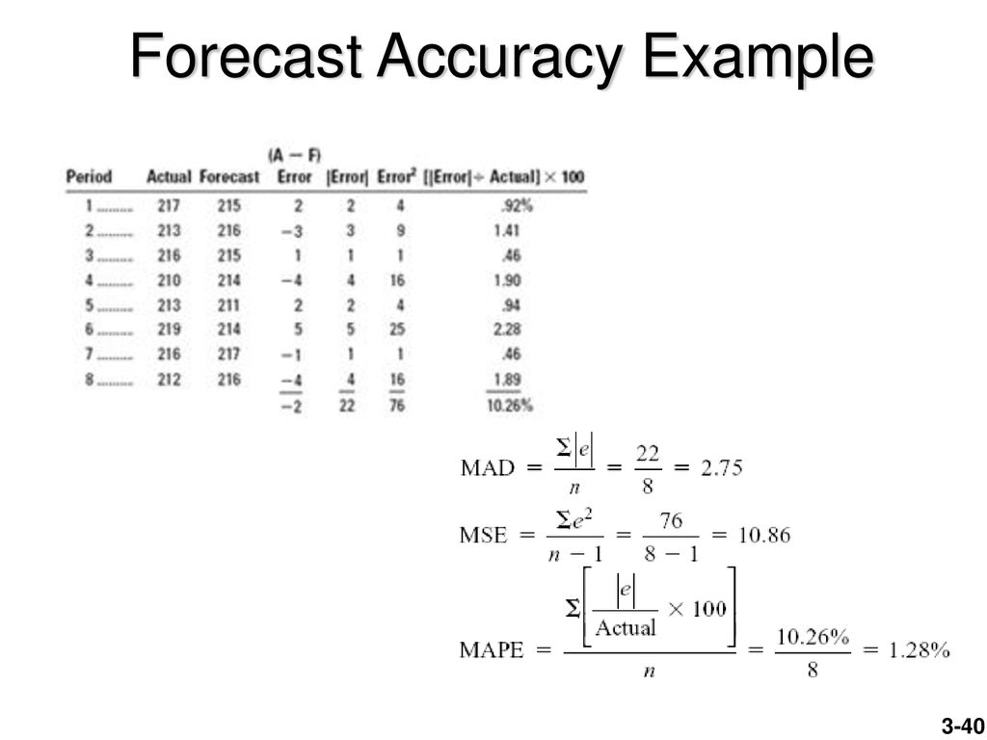
(2/217)*100
(3/213 )* 100
(1/216)* 100
(4/210)* 100
(2/213 )* 100
(5/219 )* 100
(1/216)* 100
(4/212 )* 100

Slide 37
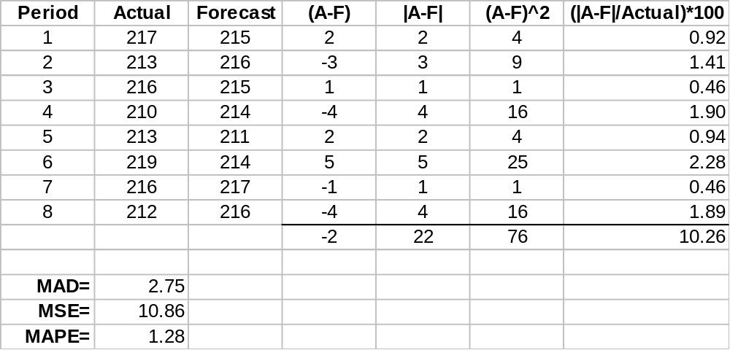
Example 10

Slide 38
Choosing a Forecasting Technique
No single technique works in every situation
Two most important factors
  Cost
  Accuracy
Other factors include the availability of:
  Historical data
  Computers
  Time needed to gather and analyze the data
  Forecast horizon

