Slide 1

Operations Management
William J. Stevenson
8th edition

Slide 2
CHAPTER
3
Forecasting
Operations Management, Eighth Edition, by William J. Stevenson
Copyright © 2005 by The McGraw-Hill Companies, Inc. All rights reserved.
McGraw-Hill/Irwin

Slide 3
FORECAST:
A statement about the future value of a variable of interest such as demand.
Forecasts affect decisions and activities throughout an organization
  Accounting, finance
  Human resources
  Marketing
  MIS
  Operations
  Product / service design

Slide 4
Uses of Forecasts
Accounting | Cost/profit estimates
Finance | Cash flow and funding
Human Resources | Hiring/recruiting/training
Marketing | Pricing, promotion, strategy
MIS | IT/IS systems, services
Operations | Schedules, MRP, workloads
Product/service design | New products and services

Slide 5
Assumes causal system
past ==> future
Forecasts rarely perfect because of randomness
Forecasts more accurate for
groups vs. individuals
Forecast accuracy decreases
as time horizon increases
I see that you will
get an A this semester.

Slide 6
Elements of a Good Forecast
Timely
Reliable
Accurate
Meaningful
Written
Easy to use

Slide 7

Steps in the Forecasting Process
“The forecast”
Step 6 Monitor the forecast
Step 5 Prepare the forecast
Step 4 Gather and analyze data
Step 3 Select a forecasting technique
Step 2 Establish a time horizon
Step 1 Determine purpose of forecast

Slide 8
Types of Forecasts
Judgmental - uses subjective inputs
Time series - uses historical data assuming the future will be like the past
Associative models - uses explanatory variables to predict the future

Slide 9
Judgmental Forecasts
Executive opinions
Sales force opinions
Consumer surveys
Outside opinion
Delphi method
  Opinions of managers and staff
  Achieves a consensus forecast

Slide 10
Time Series Forecasts
Trend - long-term movement in data
Seasonality - short-term regular variations in data
Cycle – wavelike variations of more than one year’s duration
Irregular variations - caused by unusual circumstances
Random variations - caused by chance

Slide 11
Forecast Variations
Figure 3.1
Irregular
variation
Trend
Cycles
90
89
88
Seasonal variations

Slide 12

Naive Forecasts
Uh, give me a minute....
We sold 250 wheels last
week.... Now, next week we should sell....
The forecast for any period equals the previous period’s actual value.

Slide 13
Naïve Forecasts
Simple to use
Virtually no cost
Quick and easy to prepare
Data analysis is nonexistent
Easily understandable
Cannot provide high accuracy
Can be a standard for accuracy

Slide 14
Uses for Naïve Forecasts
Stable time series data
  F(t) = A(t-1)
  Seasonal variations
  F(t) = A(t-n)
Data with trends
  F(t) = A(t-1) + (A(t-1) – A(t-2))

Slide 15
Techniques for Averaging
Moving average/ Simple moving average
Weighted moving average
Exponential smoothing

Slide 16
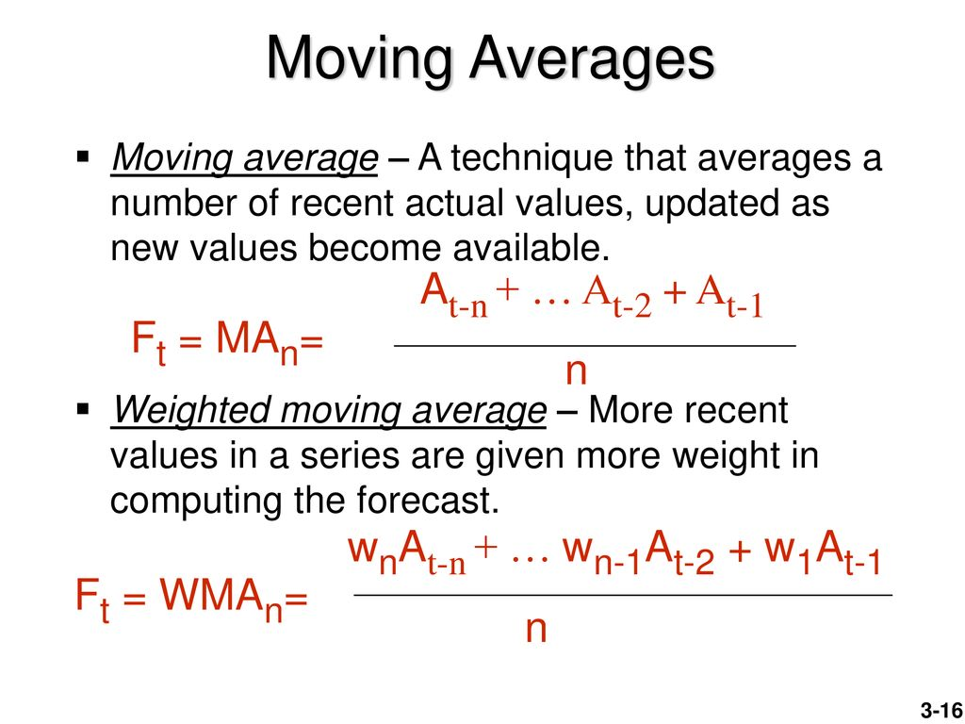



Slide 17
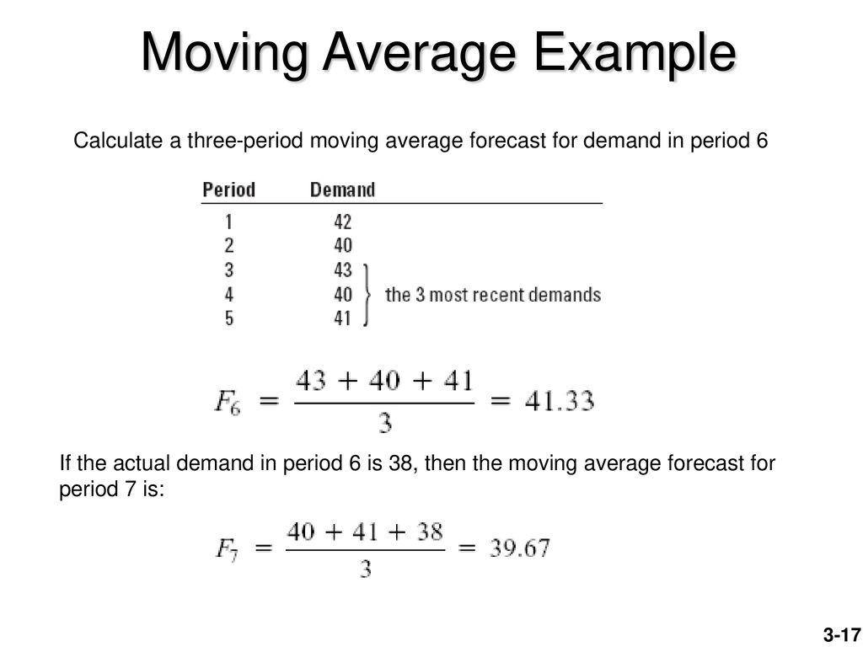
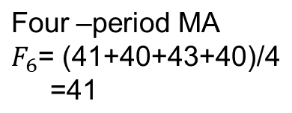
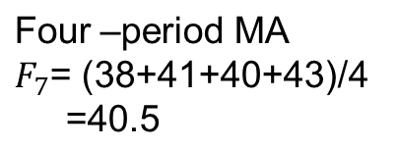
Period 1-6
Forecast
42+40+43/3
40+43+40/3
43+40+41/3
6

Slide 18





given
Forecast Demand
41.67
41
41.33
6
-

Slide 19
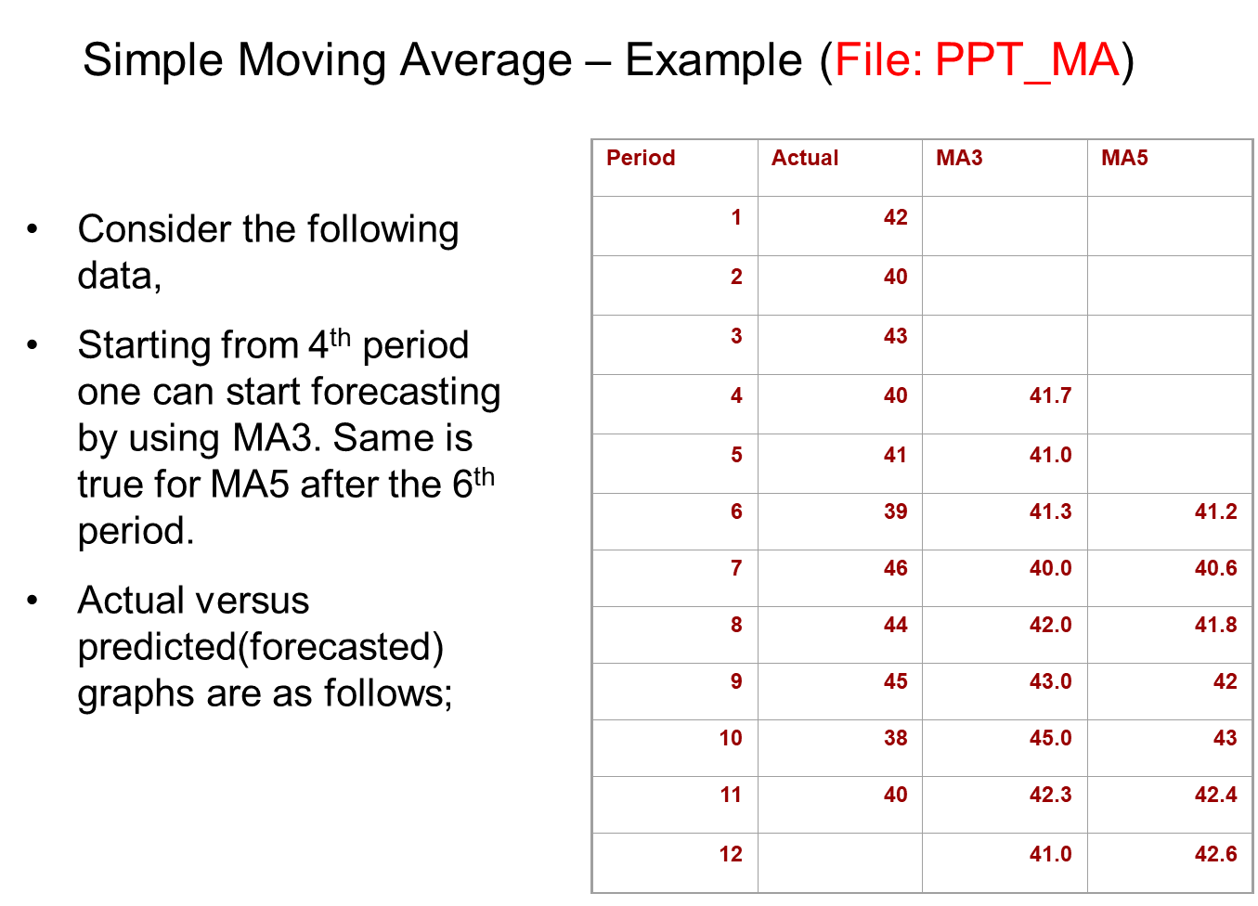

F12=MA3= 45+38+40/3
F₁₂=MA₅=46+44+45+38+40/5
42+40+43/3
42+40+43+40+41/5

Slide 20
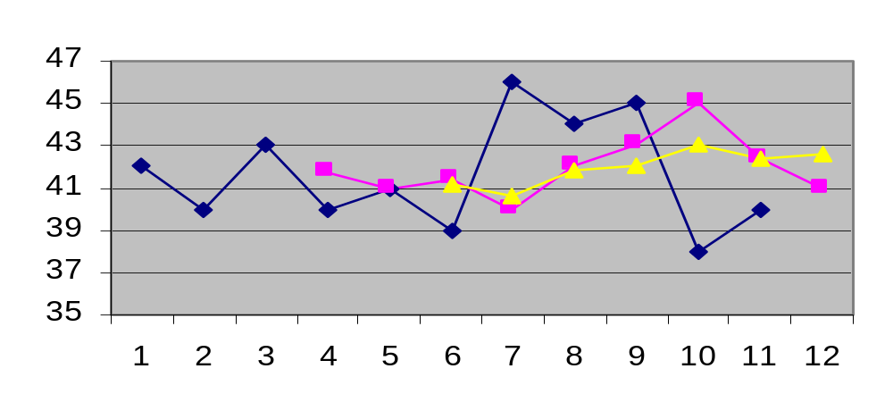
Simple Moving Average
Actual
MA5
MA3
n
∑
A_{i}
MA_{n}
=
i = 1
n

Slide 21
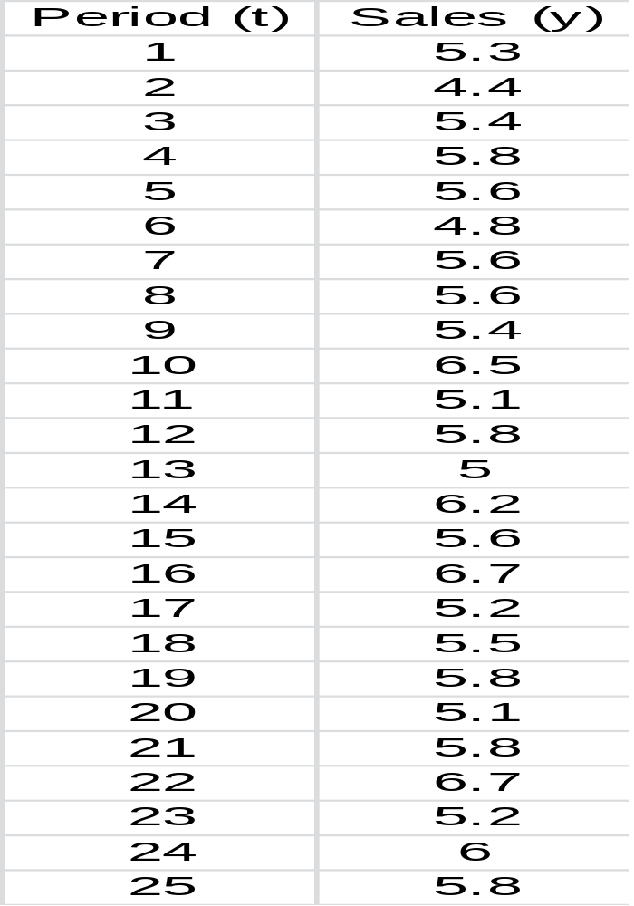
Example: Weekly Department Store Sales
The weekly sales figures (in millions of dollars) presented in the following table are used by a major department store to determine the need for temporary sales personnel.
Assignment 1:
Four –period and Two-period moving average, (Up to period 12)
WMA(4) 0.4, 0.35, 0.15, 0.1
Naïve
Exp Alpha=0.3

Slide 22
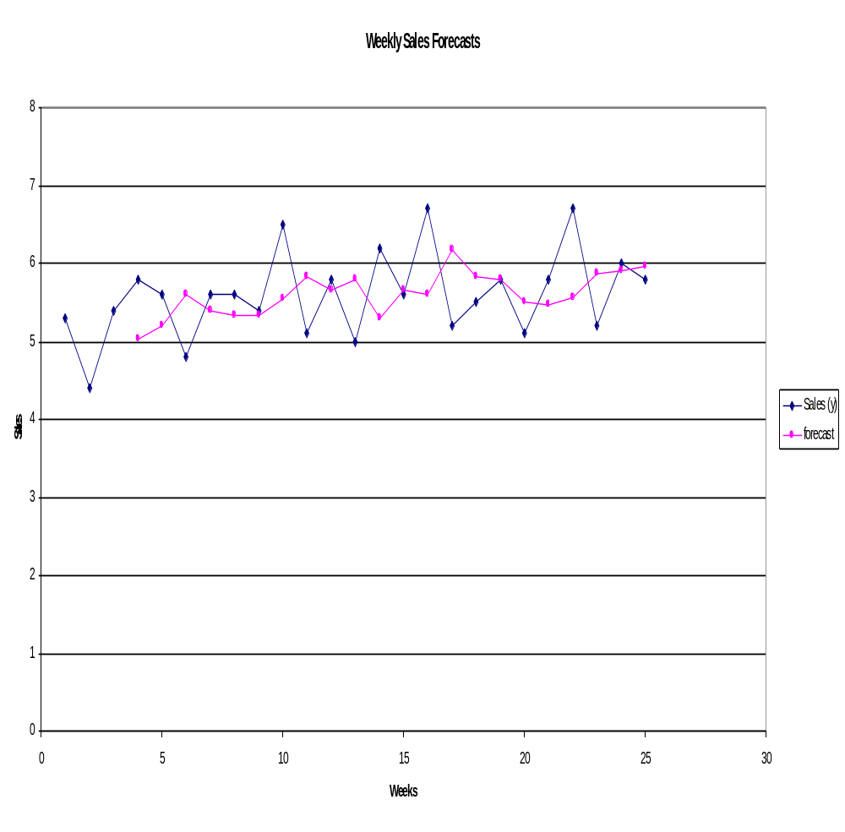
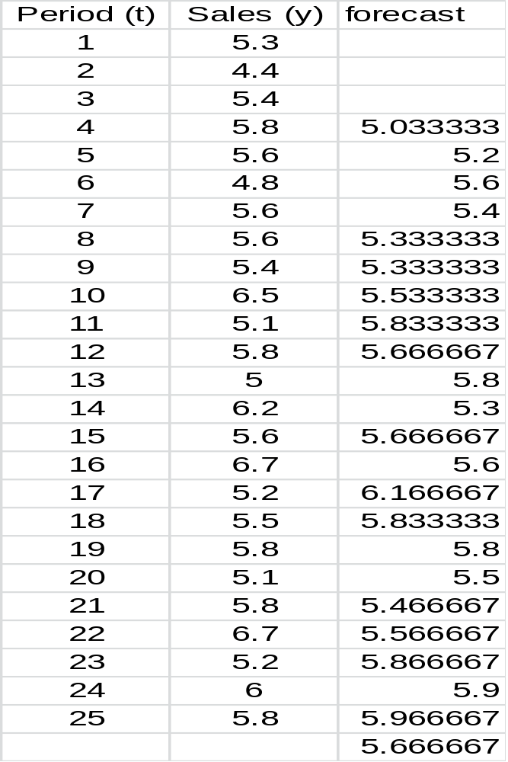
Example: Weekly Department Store Sales

Slide 23
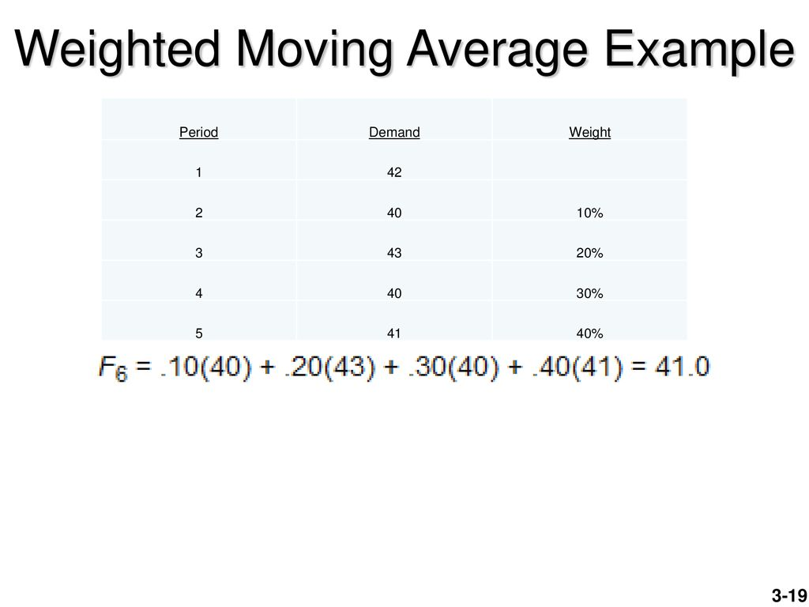
F₅= 0.1*42+0.20*40+0.3*43+0.4*40
0.5, 0.35, 0.15
F₄= 0.15*42+0.35*40+0.5*43=41.8
F₅= 0.15*40+0.35*43+0.5*40=41.05
F₆= 0.15*43+0.35*40+0.5*41=40.95

Slide 24
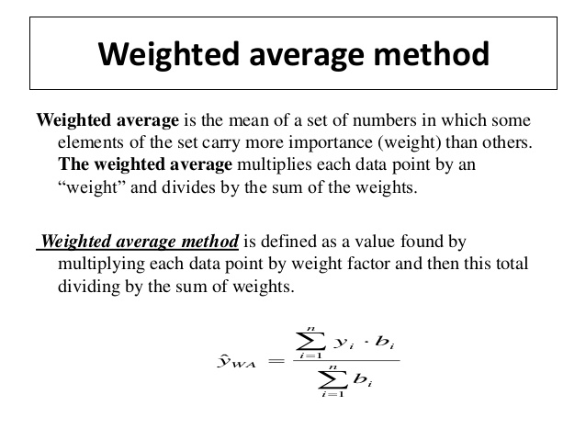

Moving

Slide 25
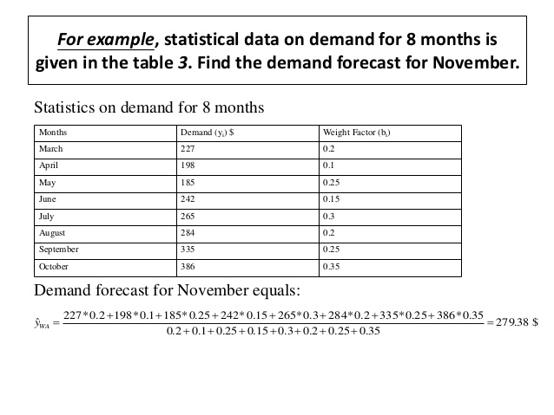

Slide 26
Exponential Smoothing
F_{t} = F_{t-1} + α(A_{t-1} - F_{t-1})
or
F_{t} = αA_{t-1} + (1-α) F_{t-1}
Premise--The most recent observations might have the highest predictive value.
  Therefore, we should give more weight to the more recent time periods when forecasting.

Slide 27
Exponential Smoothing
F_{t} = F_{t-1} + α(A_{t-1} - F_{t-1})
Weighted averaging method based on previous forecast plus a percentage of the forecast error
A-F is the error term, α is the % feedback

Slide 28
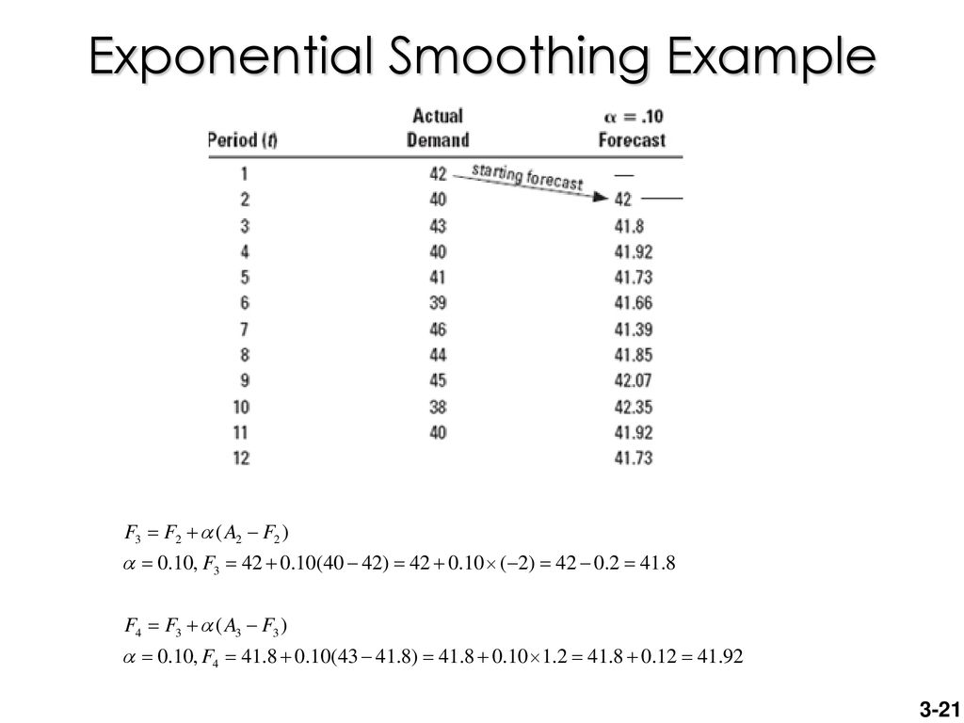

Alpha=0.1
F_{t} = F_{t-1} + α(A_{t-1} - F_{t-1})

Slide 29
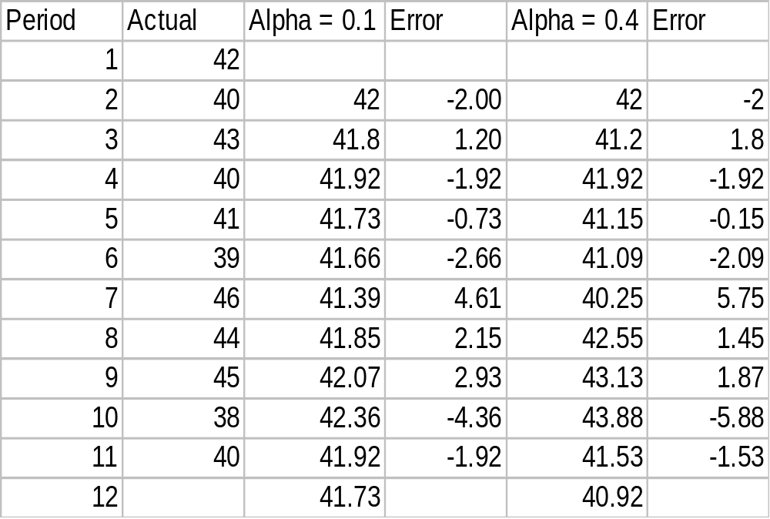
Example 3 - Exponential Smoothing
F_{t} = F_{t-1} + α(A_{t-1} - F_{t-1})
Forecast F_{t}
Forecast F_{t}
Three-period
Naive
MAD₁=24.48/10=2.45
MAD₂=24.44/10=2.44
MAD_{MV}=23.33/8=2.92
MAD_{Naive}=30/10=3
MAD_{exp}=2.44

Slide 30
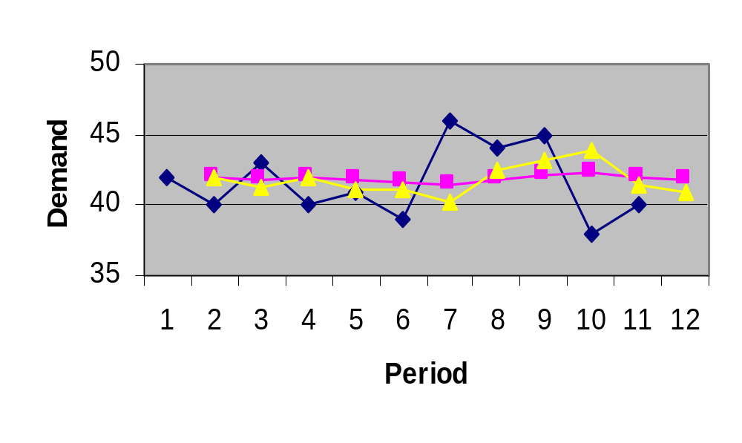
Picking a Smoothing Constant
Actual
α = .4
α = .1

Slide 31
Common Nonlinear Trends
Figure 3.5
Parabolic
Exponential
Growth

Slide 32
Linear Trend Equation
F_{t}
Y= mx + c
F_{t} = a + bt
F_{t} = Forecast for period t
t = Specified number of time periods
a = Value of F_{t} at t = 0, Intercept
b = Slope of the line
0 1 2 3 4 5 t

Slide 33
Simple linear regression
y = a + bx
n
(xy)
∑
-
∑
x
y
∑
b
=
2
∑
y = na + b x
2
∑
n
x
-
(
x)
∑
∑
2
∑
∑
xy =a x+ b x
∑
y
-
b
∑
x
∑
a
=
n

Slide 34
2x+y=6
x−2y=7
4x+2y=12
X-2y=7
or
X=7+2y
Or x=7 + 2 (-8/5)
Or x=7-2* 8/5=3.8
5x=19
Or x=19/5
2x+y=6
Or 2(7+2y) +y =6
Or 14+4y+y =6
Y=-8/5 = -1.6

Slide 35


Linear trend
n
∑
(ty)
-
∑
t
y
∑
b
=
2
∑
y = na + b t
2
∑
n
t
-
(
t)
∑
∑
2
∑
∑
ty =a t+ b t
∑
y
-
b
∑
t
∑
a
=
n

Slide 36
Calculating a and b
n
∑
(ty)
-
∑
t
y
∑
b
=
2
2
n
t
-
(
t)
∑
∑
∑
y
-
b
∑
t
a
=
n

Slide 37
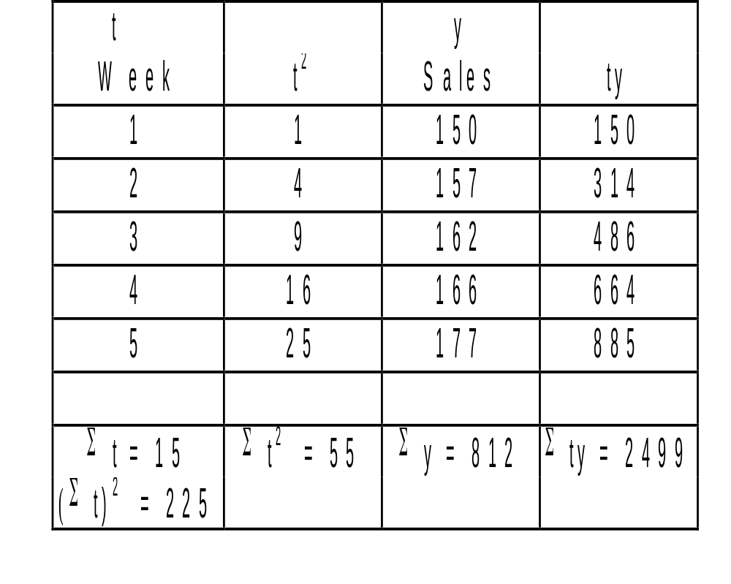


Linear Trend Equation Example
F_{t} = a + bt
Week | units
1 | 149.8
2 | 156.1
3 | 162.4
4 | 168.7
5 | 175
6 | 181.3
n
(ty)
∑
-
t
y
∑
∑
b
=
n
2
2
t
-
∑
(
t)
∑
y
-
∑
b
t
∑
a
=
n
b=6.3
a=143.5
Forecast for period 1-6 using linear trend and show and plot the linear trend equation.

Slide 38
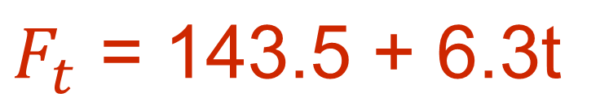
Linear Trend Calculation
5 (2499)
-
15(812)
12495
-
12180
b
=
=
=
6.3
5(55)
-
225
275
-
225
812
-
6.3(15)
a
=
=
143.5
5

Slide 39
185
175
165
155
145
135
Week | Sales Units | units
1 | 150 | 149.8
2 | 157 | 156.1
3 | 162 | 162.4
4 | 166 | 168.7
5 | 177 | 175
6 | - | 181.3
F_{t}
0 1 2 3 4 5 6
Week

Slide 40
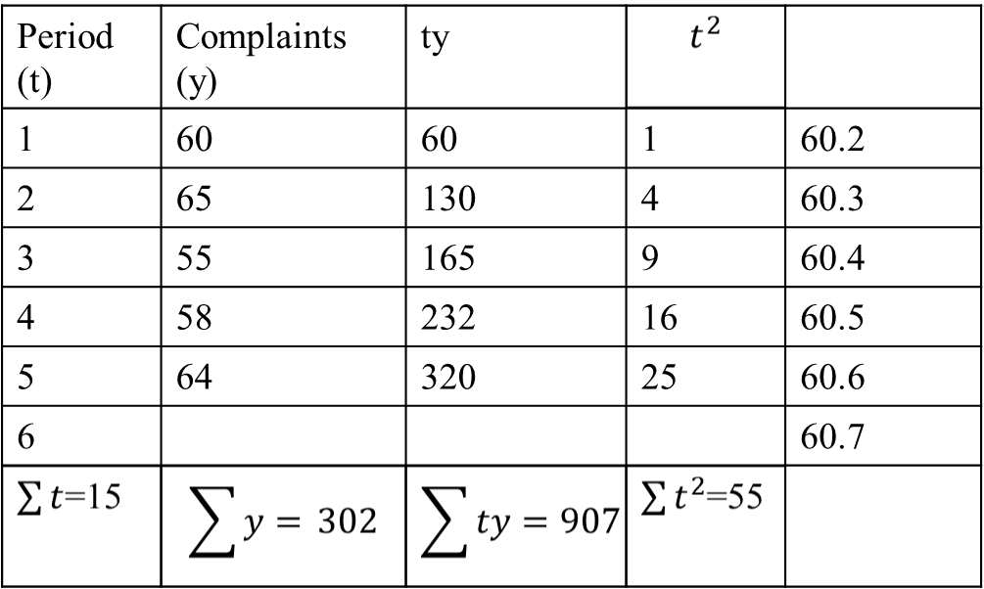
F_{t}=60.1+0.1t
a=60.1
b=0.1

Slide 41
67
64
61
58
55
Period (t) | Complaints (y) | Forecast
1 | 60 | 60.2
2 | 65 | 60.3
3 | 55 | 60.4
4 | 58 | 60.5
5 | 64 | 60.6
6 |  | 60.7
F_{t}
0 1 2 3 4 5 6
Week

Slide 42
Associative Forecasting
Predictor variables - used to predict values of variable interest
Regression - technique for fitting a line to a set of points
Least squares line - minimizes sum of squared deviations around the line

Slide 43
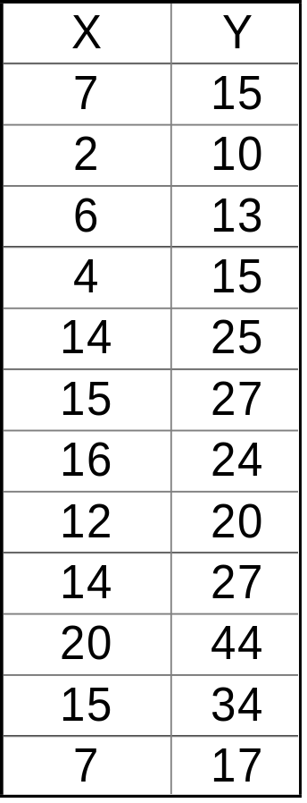
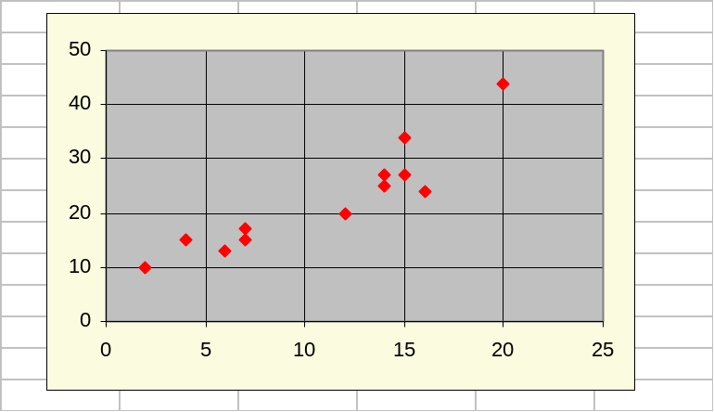
Linear Model Seems Reasonable
Computed
relationship
A straight line is fitted to a set of sample points.

Slide 44
Forecast Accuracy
Error - difference between actual value and predicted value
Mean Absolute Deviation (MAD)
  Average absolute error
Mean Squared Error (MSE)
  Average of squared error
Mean Absolute Percent Error (MAPE)
  Average absolute percent error

Slide 45
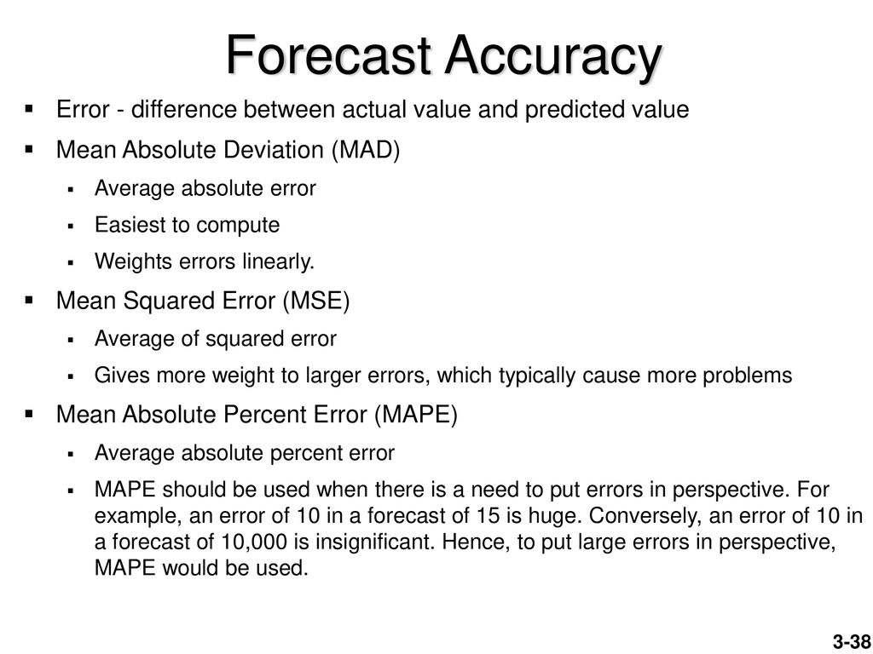

Slide 46
MAD, MSE, and MAPE
∑
Actual
−
forecast
MAD
=
n
(
Actual
−
forecast)
2
∑
MSE
=
n
-
1
∑(
Actual
−
forecas
/ Actual*100)
MAPE
=
n

Slide 48
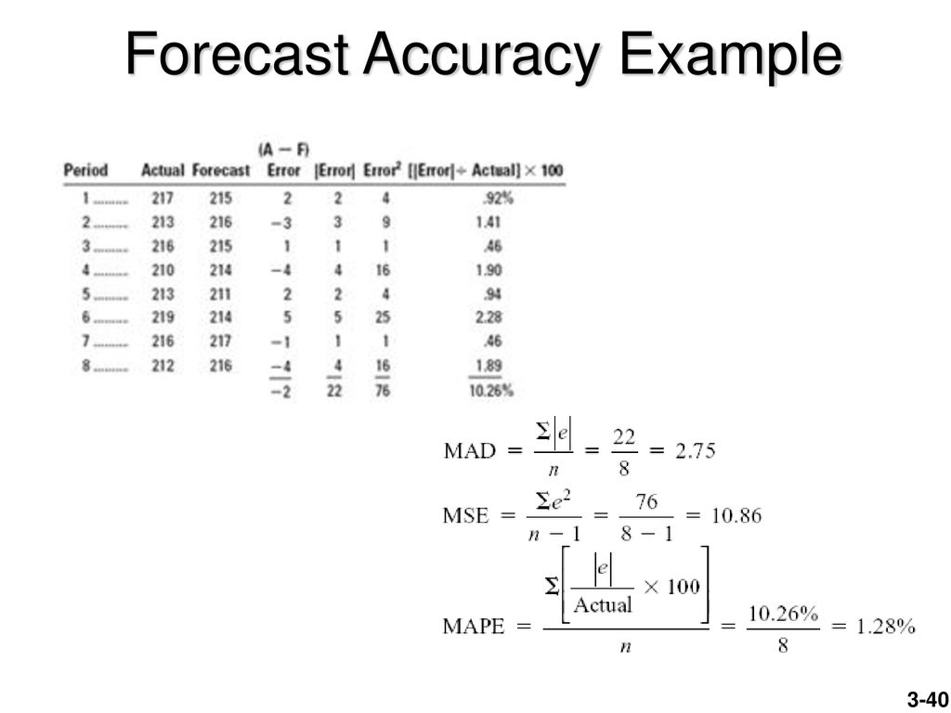
(2/217)*100
(3/213 )* 100
(1/216)* 100
(4/210)* 100
(2/213 )* 100
(5/219 )* 100
(1/216)* 100
(4/212 )* 100

Slide 49
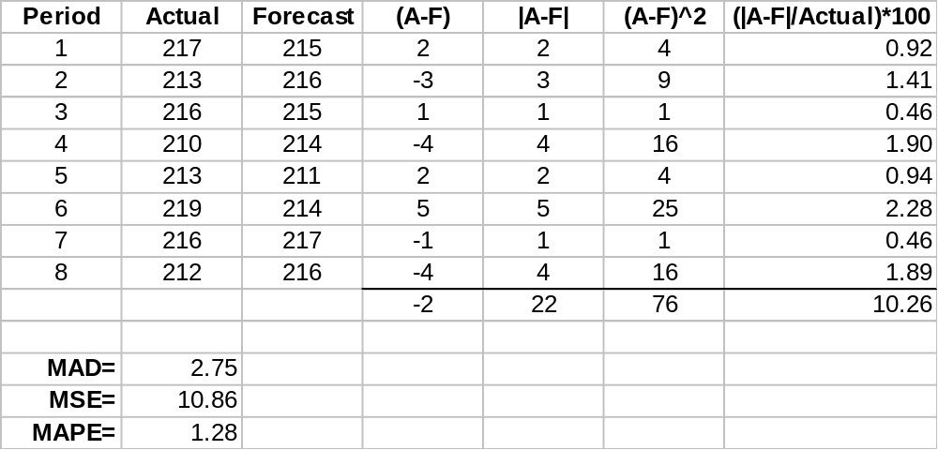
Example 10

Slide 50
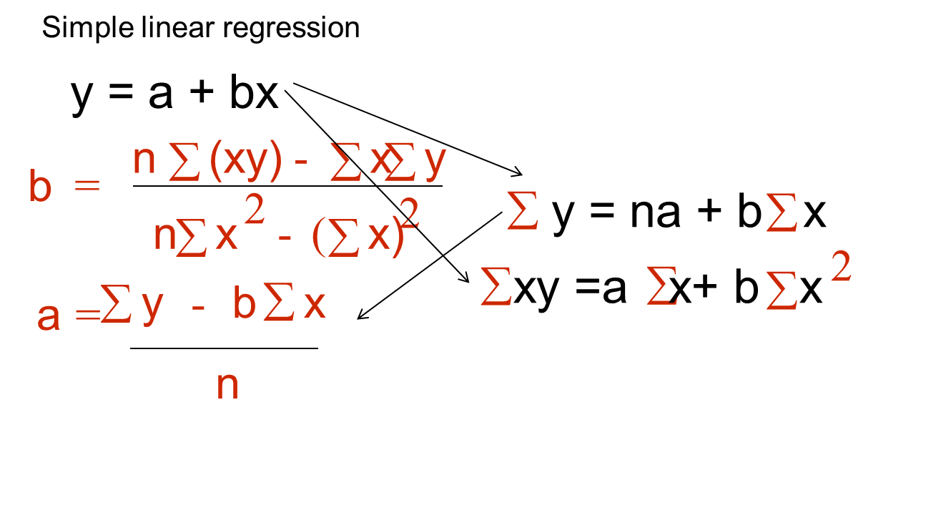
b=(8*2167.70-49*346.7)/(8*311-2401)
=4.06
a=(346.7-4.06*49)/8=18.46
x=independent variable
y= dependent variable

Slide 51
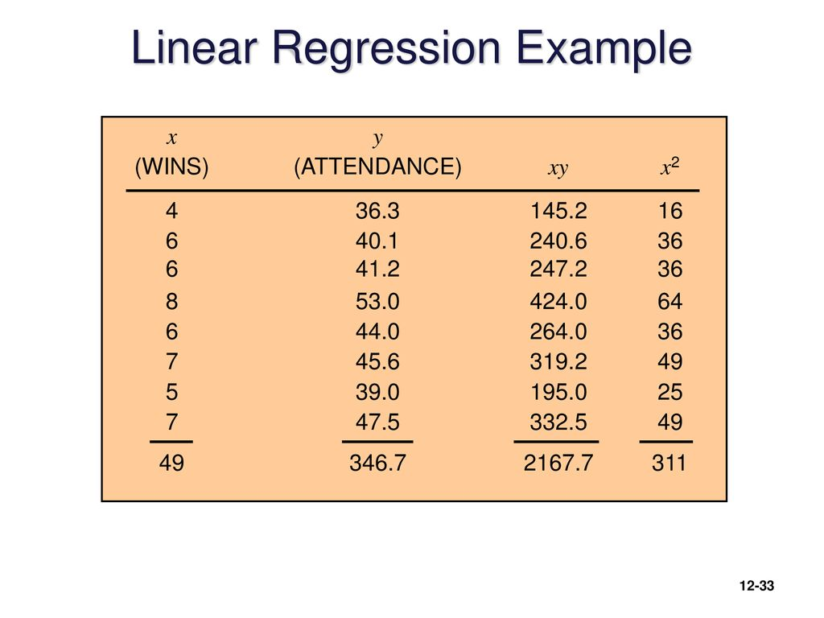
y²
Yc = 18.47 + 4.06x
1317.7
1608.01
1697.44
2809
1936
2079.4
1521
2256.25
15224.75
18.47+4.06*4=34.71
18.47+4.06*6=42.83
42.83
50.95
42.83
46.89
38.77
46.89

Slide 52


Simple linear regression
y = a + bx
n
∑
(xy)
-
∑
x
y
∑
b
=
2
2
n
∑
x
-
(
∑
x)
a
∑
y
-
b
∑
x
=
n
y_{c} = 18.47 + 4.06x

Slide 53
Attendance
55
50
45
40
35
30
25
20
15
0 2 4 6 8
wins

Slide 54
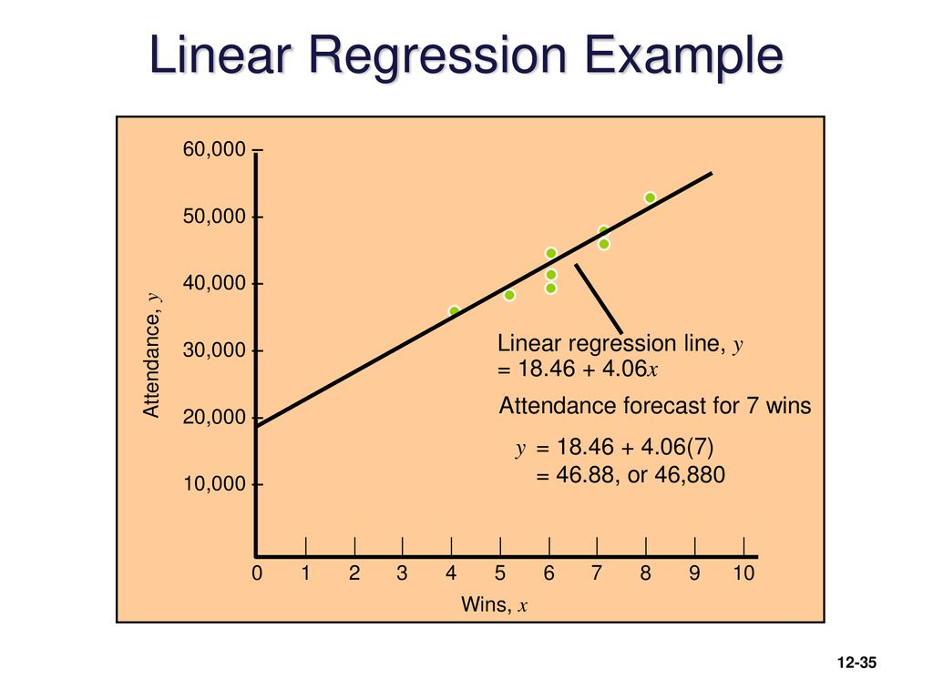

Slide 55
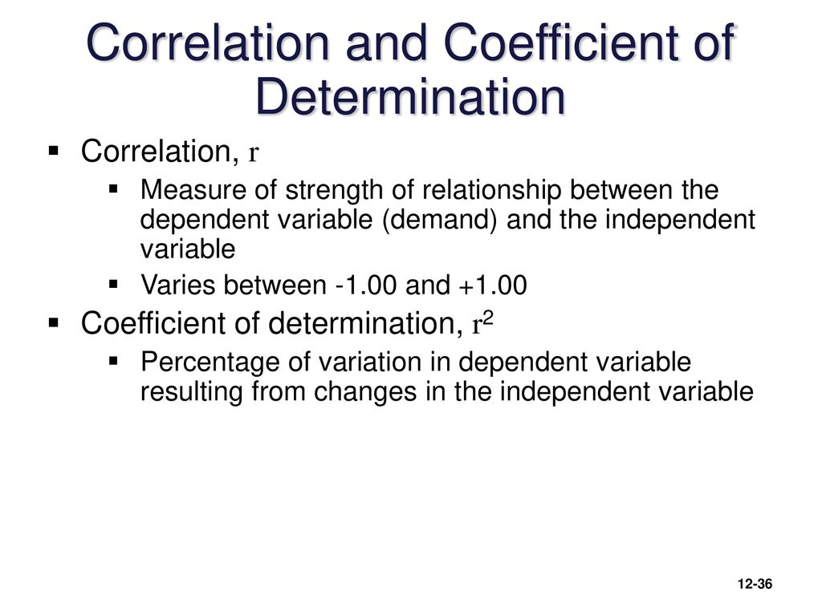

Slide 56
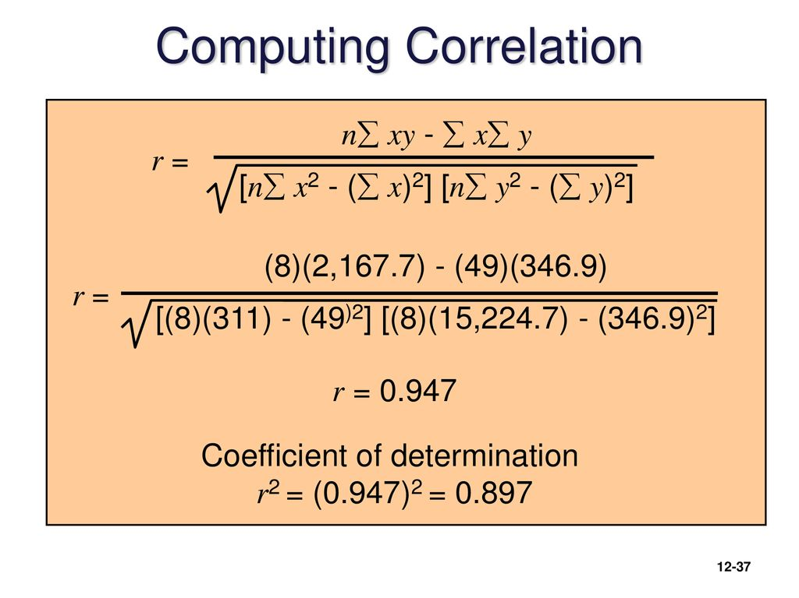

Slide 57
Regression analysis:
2. The owner of a small hardware store has noted a sales pattern for window locks that seems to parallel the number of break-ins reported each week in the newspaper. The data are:
Sales: 46 18 20 22 27 34 14 37 30
Break-ins: 9 3 3 5 4 7 2 6 4
a. Plot the data to determine which type of equation, linear or nonlinear, is appropriate.
b. Obtain a regression equation for the data.
c. Estimate average sales when the number of break-ins is five.
n
∑
(xy)
-
∑
x
y
∑
b
=
= 4.28
2
n
∑
x
-
(
∑
x)
a
∑
y
-
b
∑
x
=
=7.13
n

Slide 58
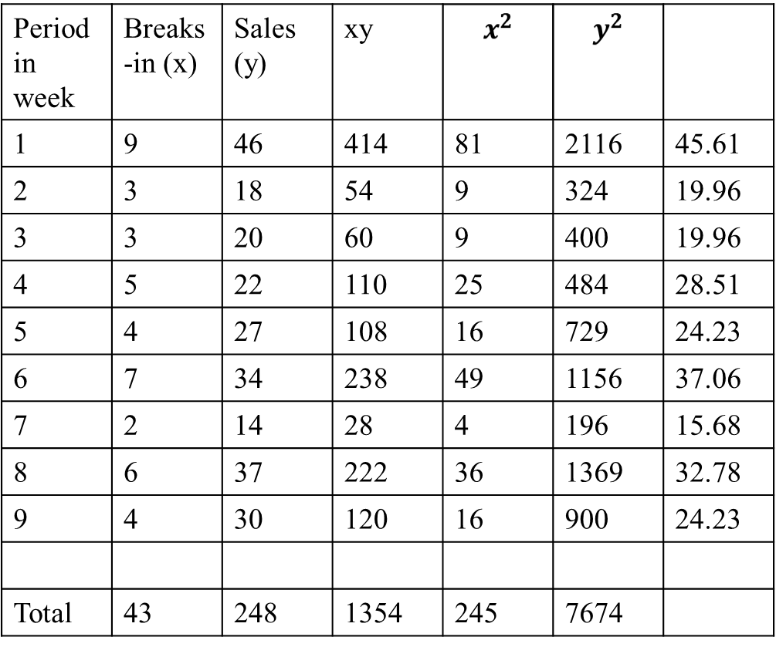
y_{c} = 7.13 + 4.28x

Slide 59
Sales (y)
y_{c} = 7.13 + 4.28x
X=5, = 7.13 +4.28*5=28.53
50
40
30
20
10
0 1 2 3 4 5 6 7 8 9 10
Breaks-in (x)

Slide 60
Controlling the Forecast
Control chart
  A visual tool for monitoring forecast errors
  Used to detect non-randomness in errors
Forecasting errors are in control if
  All errors are within the control limits
  No patterns, such as trends or cycles, are present

Slide 61
Sources of Forecast errors
Model may be inadequate
Irregular variations
Incorrect use of forecasting technique

Slide 62
Tracking Signal
Tracking signal
  Ratio of cumulative error to MAD
∑
(Actual
-
forecast)
Tracking signal
=
MAD
Bias – Persistent tendency for forecasts to be
Greater or less than actual values.

Slide 63
Choosing a Forecasting Technique
No single technique works in every situation
Two most important factors
  Cost
  Accuracy
Other factors include the availability of:
  Historical data
  Computers
  Time needed to gather and analyze the data
  Forecast horizon

Slide 64
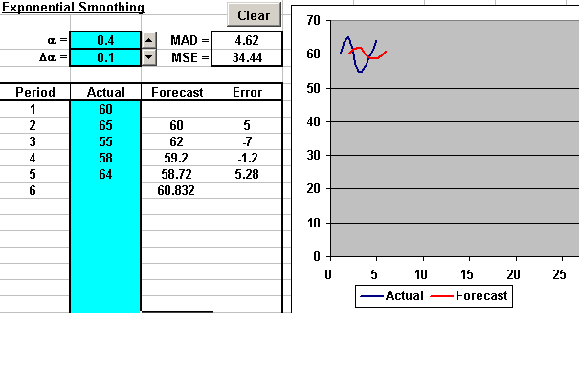
Exponential Smoothing

Slide 65
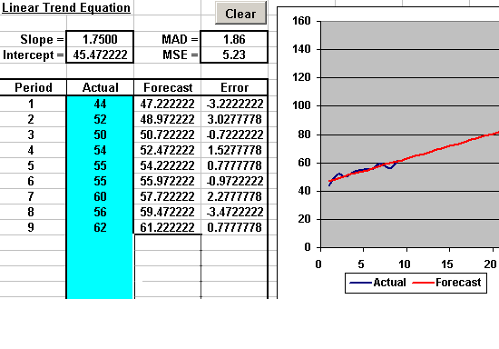
Linear Trend Equation

Slide 66
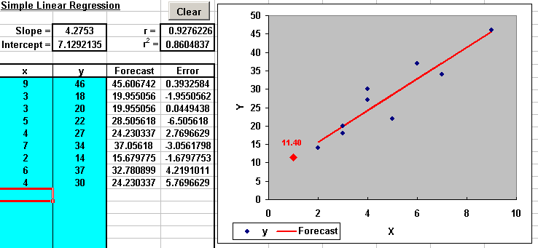
Simple Linear Regression

Slide 67

Workload/Scheduling
SSU9
United Airlines example

