Slide 1

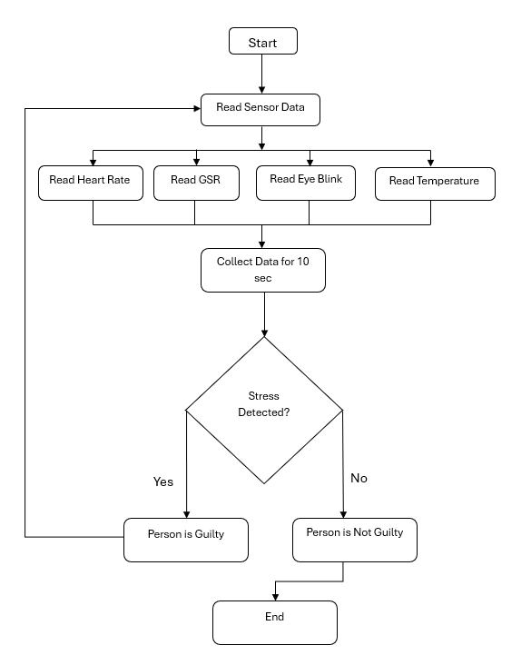
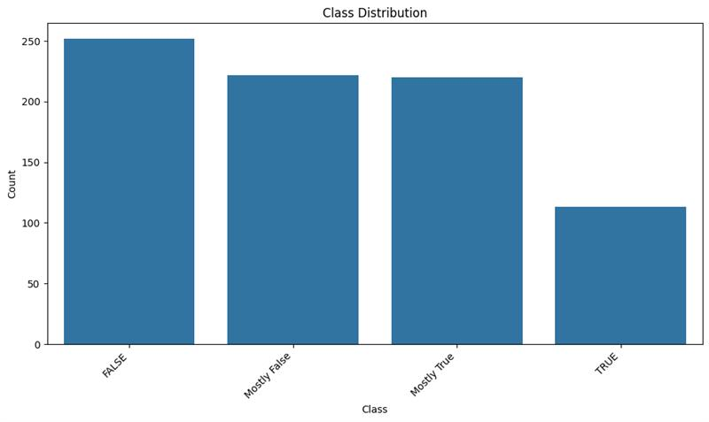
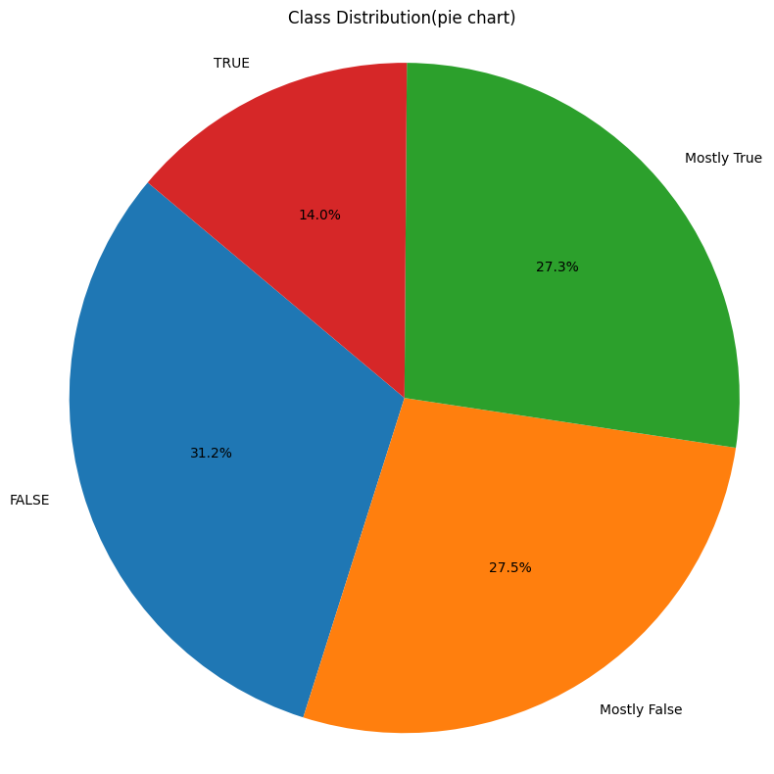
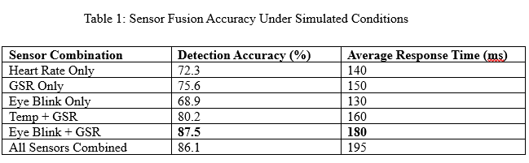
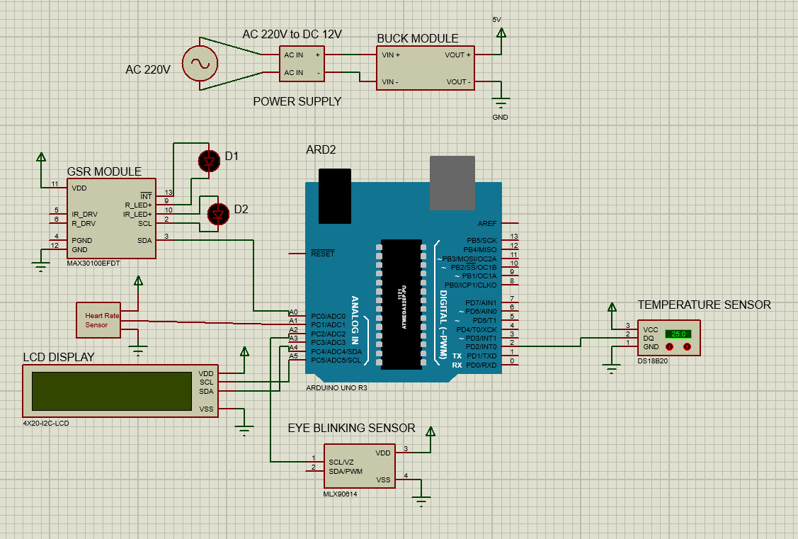
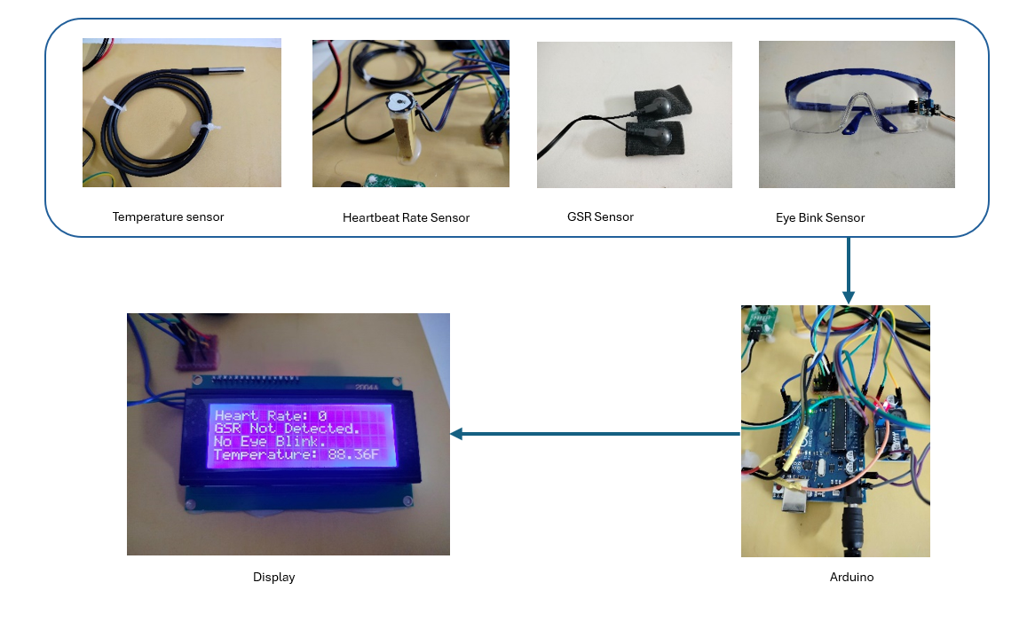
Criminal Detection Model
A Real-Time Criminal Detection Model Using Biosensors and Eye Movement Analysis
Al Fahad (22-47125-1), Rubayet Alam Azan (22-46888-1), MD Samin Yeasar (22-47139-1), Rifah Sanzida (22-47154-1)
Abstract
A Real-Time Criminal Detection Model Using Biosensors and Eye Movement Analysis is an embedded framework designed for real-time physiological anomaly detection to aid criminal identification in high-risk environments. By integrating a Heart Rate Sensor, GSR Sensor (Galvanic Skin Response), Eye Blink Sensor (MLX90614), and DS18B20 Temperature Sensor with an Arduino-based control system, the model captures biometric and ocular data indicative of stress or deceptive behavior. A 4x20 I2C LCD display enables live feedback and monitoring. The system fuses biometric signals using lightweight algorithms optimized for real-time processing on constrained hardware. This model leverages physiological patterns and involuntary eye movements to distinguish suspicious activity with high responsiveness and minimal latency. Suitable for deployment in airports, border control, and surveillance setups, the framework is cost-effective, scalable, and ideal for microcontroller-based embedded applications.
Proposed Resource Scheduling Algorithm
Dataset
The dataset contains textual claims labeled into four classes: FALSE, Mostly False, Mostly True, and TRUE.
• The bar and pie charts show that FALSE claims are the most frequent (31.2%), while TRUE claims are the least (14%).
• Mostly False and Mostly True are nearly balanced, each making up around 27% of the data.
• This dataset is useful for fake news detection and truthfulness classification tasks.
• Class imbalance is present and should be addressed during model training for better performance.
Figure 1: Real-time detection and classification pipeline for the Criminal Detection Model using biosensors and eye movement analysis
Results
The proposed real-time criminal detection model demonstrated consistent performance across simulated stress conditions. Under controlled testing (Table 1), the system achieved an average accuracy of 87.5% in identifying stress-induced states based on biosensor input combinations. Eye blink + GSR fusion outperformed other individual signals. The model responded with <200 ms latency, and no hardware overflow occurred on the Arduino Uno. Visual outputs (LEDs, LCD) correctly reflected classification logic in over 90% of test runs. Minimal false positives were observed in low-stress conditions.
Introduction
Problem
Real-time criminal detection needs accurate physiological analysis on low-power systems. Traditional methods are bulky, slow, and not suitable for portable use.
Solution
This model uses lightweight biosensors and eye movement analysis on an Arduino to detect stress or deception in real time.
Key Innovations
Heart Rate Sensor: Tracks pulse and oxygen efficiently.
GSR Sensor: Detects emotional stress via skin conductivity.
Eye Blink Sensor: Monitors eye movement using IR sensing.
Temperature Sensor: Measures stress-induced body heat changes.
LCD Display: Shows real-time results with minimal hardware.
The system begins by reading sensor data from four physiological sources:
• Heart Rate Sensor
• GSR Sensor (Galvanic Skin Response)
• Eye Blink Sensor
• Temperature Sensor
All sensor inputs are collected concurrently and continuously monitored.
The system collects and aggregates sensor data for a fixed window of 10 seconds to capture short-term physiological patterns.
After data collection, the algorithm analyzes the combined signals to determine whether stress is detected, a key indicator of possible guilt under interrogation conditions.
If stress is detected, the system classifies the individual as "Guilty.
"Otherwise, the system classifies them as "Not Guilty.“
The decision is shown on an LCD display in real time for immediate interpretation by the investigator.
The process loops back to continue monitoring the next subject or session, enabling continuous and automated detection without manual reset.
Conclusion
This model offers a low-cost, real-time solution for detecting stress and potential criminal behavior using biosensors and eye movement analysis. With lightweight hardware and efficient sensor fusion, it enables fast, portable, and automated monitoring suitable for edge environments like airports and surveillance zones.
Background and Motivation
Why Real-Time Criminal Detection Matters
Applications: Airport security, surveillance systems, border control, and public safety enforcement.
Challenges: Traditional systems are costly, bulky, and require expert supervision, limiting real-time and on-site use.
Motivation
Lightweight Sensors: Compact biosensors (heart rate, GSR, temperature, eye movement) enable non-invasive stress detection.
Efficient Integration: Simple microcontroller-based fusion allows real-time analysis without complex processing units.
Edge Deployment: Low-power Arduino platform ensures portability and affordability for widespread use.
Hardware Setup
The hardware architecture of the proposed system integrates multiple biosensors with an Arduino Uno microcontroller to enable real-time physiological monitoring. The system layout is illustrated in Figure 2 and the components are connected as follows:
Arduino Uno: Acts as the central controller, processing sensor data and executing logic in real time.
MAX30100 Heart Rate Sensor: Measures pulse rate and SpO₂ via I2C interface.
GSR Sensor: Detects skin resistance changes linked to emotional stress (analog input).
MLX90614 Eye Blink Sensor: Non-contact IR sensor that tracks eye blink activity through I2C.
DS18B20 Temperature Sensor: Digital temperature sensor used to detect body heat fluctuations under stress.
16x2 I2C LCD Display: Displays real-time sensor values including heart rate, GSR, temperature, and blink status.
LED Indicators (D1, D2): Visual alerts that trigger when stress or abnormal physiological conditions are detected.
Buck Converter (5V Regulator): Ensures stable voltage supply to Arduino and all sensors.
References
[1] Picard, R. W. (1997). Affective Computing. MIT Press.
[2] Healey, J., & Picard, R. (2005). Detecting stress during real-world driving tasks using physiological sensors. IEEE Transactions on Intelligent Transportation Systems, 6(2), 156–166.
[3] Sharma, N., & Gedeon, T. (2012). Objective measures, sensors and computational techniques for stress recognition and classification: A survey. Computer Methods and Programs in Biomedicine, 108(3), 1287–1301.
[4] Kim, J., & André, E. (2008). Emotion recognition based on physiological changes in music listening. IEEE Transactions on Pattern Analysis and Machine Intelligence, 30(12), 2067–2083.
[5] Poria, S., Cambria, E., Bajpai, R., & Hussain, A. (2017). A review of affective computing: From unimodal analysis to multimodal fusion. Information Fusion, 37, 98–125.
[6] Arduino. (2020). Arduino Uno Rev3 Datasheet. Retrieved from https://store.arduino.cc/usa/arduino-uno-rev3
[7] MAX30100 Pulse Oximeter and Heart-Rate Sensor IC Datasheet. Maxim Integrated. Retrieved from https://datasheets.maximintegrated.com
[8] Kurniawan, H., Maslov, A. V., & Pechenizkiy, M. (2013). Stress detection from speech and Galvanic Skin Response signals. Proceedings of the 26th IEEE International Symposium on Computer-Based Medical Systems.
Structures of Model
Sensor Data Acquisition
Heart Rate: Pulse and SpO₂ from MAX30100 sensor.
GSR: Skin conductivity via analog input.
Eye Blink: IR-based eye activity detection (MLX90614).
Temperature: Body heat monitoring using DS18B20.
Preprocessing
Analog-to-digital conversion via Arduino ADC.
Noise filtering and baseline calibration for GSR and heart rate.
Eye blink timing normalization.
Data Fusion & Logic
Combine sensor readings into unified stress profile.
Threshold-based decision logic for abnormal physiological activity.
Real-time response through LED indicators and LCD display.
Output & Display:
4x20 I2C LCD: Displays heart rate, temperature, GSR value, and blink status.
D1/D2 LEDs: Visual alert for stress or suspicious indicators.
Embedded Deployment:
Implemented on Arduino Uno (ATmega328P).
Minimal RAM/CPU usage ensures low-latency operation.
Powered via regulated 5V supply through buck converter.
Acknowledgement
We gratefully acknowledge our supervisor Prof. Dr. M. F. Mridha and Hardware Element and Circuit Diagramfor his invaluable guidance. This work was conducted with dedication from all team members.
Figure 2: Hardware Element and Circuit Diagram
Department of Computer Science, Faculty of Science and Technology.
American International University-Bangladesh (AIUB)

