Slide 1
Regular Expression
CSC3113: Theory of Computation
1
1
Summer 2022-2023
Dr. Afroza Nahar, Associate Professor,
Department of Computer Science, Faculty of Science & Technology.
afroza@aiub.edu room no. DN 0113

Slide 2
Overview
Regular Expressions (RE)
Equivalence of RE and RL

Slide 3
Equivalences so far…
Regular Languages
DFA
Regular Expressions
NFA

Slide 4
Regular Expressions
Regular languages (RL) are often described by means of algebraic expressions called regular expressions (RE).
In arithmetic we use the +, * operations to construct expressions: (2+3)*5
The value of the arithmetic expression is the number 25.
The value of a regular expression is a regular language.

Slide 5
Regular operations
In RE we use regular operations to construct expressions describing regular languages: ( 0 + 1 )* ◦ 0
where :
r + s means r OR s
r* means Kleene star of r
r ◦ s (or rs) means concatenation of r and s

Slide 6
Regular Expressions
Regular languages (RL) are often described by means of algebraic expressions called regular expressions (RE).
We use three operations
union ∪
concatenation
Kleene star (*) [Kleene star]
The value of a regular expression is a regular language.

Slide 7
Union ∪ ( disjunction, OR, |, +)
The union of languages is the usual thing, since languages are sets.
Example: {01,111,10} ∪ {00, 01}
= {01,111,10,00}.
01 happens to be in both sets, so it will be once in the union

Slide 8
Concatenation: represented by juxtaposition (no punctuation) or middle dot ( · )
The concatenation of languages L and M is denoted LM.
It contains every string wx such that w is in L and x is in M.
Example: {01,111,10}{00, 01} = {0100, 0101, 11100, 11101, 1000, 1001}.

Slide 9
Kleene Star: represented by an asterisk aka star (*)
If L is a language, then L*, the Kleene star or just “star,” is the set of strings formed by concatenating zero or more strings from L, in any order.
L* = {ε} ∪ L ∪ LL ∪ LLL ∪ …
Example: {0,10}* = {ε, 0, 10, 00, 010, 100, 1010,…} If you take no strings from L, that would give you the empty string.

Slide 10
Formal definition
A set of regular expressions over an alphabet Σ is defined inductively as follows:
Basis: ε, φ, and σ (for all σ ∈ Σ, ) are regular expressions.
Induction: If r and s are RE then the following expressions are also RE:
(r)
r+s
r◦s
r*

Slide 11
Regular expressions and regular languages
A Regular Expression can be recursively defined as follows −
ε is a Regular Expression indicates the language containing an empty string. (L (ε) = {ε})
φ is a Regular Expression denoting an empty language. (L (φ) = { })
x is a Regular Expression where L = {x}

Slide 12
Regular expressions and regular languages
If X is a Regular Expression denoting the language L(x) and Y is a Regular Expression denoting the language L(Y), then
X + Y is a Regular Expression corresponding to the language L(X) ∪ L(Y), where L(X+Y) = L(X) ∪ L(Y).
X . Y is a Regular Expression corresponding to the language L(X) . L(Y) where L(X.Y) = L(X) . L(Y)
R* is a Regular Expression corresponding to the language L(R*), where L(R*) = (L(R))*
If we apply any of the rules several times from 1 to 5, they are Regular Expressions.

Slide 13
Examples over Σ ={a,b}
ε, a, a+b, b*, (a+b)b, ab*, a*+b*
To avoid using many parentheses, the operations have the following priority hierarchy:
* , highest (do it first)
◦
+ , lowest (do it last)
Example: (b+(a◦(b*)) = b + ab*
(Notations: The symbol ◦ can be dropped. Σ means (σ₁ + σ₂ + σ₃…) , r+ means rr * ).

Slide 14
Regular expressions and regular languages
We associate each regular expression r with a regular language L(r) as follows:
L(φ)= φ,
L(ε)={ε},
L(σ)={σ} for each σ ∈Σ,
L(r+s)=L(r) U L(s),
L(r◦s)=L(r)◦L(s),
L(r*)=(L(r))*.

Slide 15
Converting a regular expression to an NFA
Example 2: Convert the following Regular Expression into equivalent NFA using formal procedure (ab∪ a)*
Example 3: Convert the following Regular Expression into equivalent NFA using formal procedure 0(1 ∪ 01*) ∪ 0*1*

Slide 16
Examples :Describe each language as a regular expression over Σ ={0,1}
0∗10∗
Σ*1Σ* or (0+1)*1(0+1)*
Σ*110Σ*
(Σ Σ)*
1(0+1)*
(0+1)*00
1*(01111*)*
0*(1000)*
1*0 1*01*0⁺
(ΣΣΣ)∗
0*(100*)*
L = { w | w has a single 1}
L = { w | w has at least one 1}
L = { w | w contains the string 110}
L = { w | |w| mod 2 =0}
L = { w | w starts with 1}
L6 = { w | w ends with 00}
L7 = {w | each 0 in w is followed by at least three 1’s}
{w | each 1 in w is followed by exactly three 0’s}
{w | w contains at least three 0’s and ends with 0}
{w|w the length of w is a multiple of 3}
w | w does not contain consecutive 1’s

Slide 17
Examples: over Σ ={x,y}
L = { w | w contains the string xyx or the string yxy }
(x+y)*xyx (x+y)* + (x+y)* yxy (x+y)*
L = { w | w starts and ends with the same letter }:
[ x+xΣ∗x] + [y+yΣ∗y]
L = {w | w contains exactly three y’s and ends with x}
x*yx*yx*yx⁺
over Σ ={0, 1}
L = The set of strings of 0’s and 1’s whose tenth symbol from the right end is 1.
(0 + 1)*1(0 + 1)⁹
L = The set of strings of 0’s and 1’s with at most one pair of consecutive 1’s.
(0 + 10)*(11 + ε)(0 + 10)*

Slide 18
RL to RE
Give a regular expression for the following languages:
Σ = {a,b}: The set of all strings where the second letter from the start and the end is an a.
Answer: (a + b)a(a + b)*a(a + b)
Σ = {a,b}: The set of all strings that have both aa and bb as a substring.
Answer: ((a + b)*aa(a + b)∗bb(a + b)∗) + ((a + b)∗bb(a + b)∗aa(a + b)∗)
Σ = {a,b,c}: The set of all strings, such that between any a and c there's at least one b.
Answer: ((ε + aa∗ + cc∗)b)*(ε + aa∗ + cc∗)

Slide 19
RL to RE
All strings that contain an even number of b’s.
a∗(ba∗ba∗)∗
All strings which do not contain the substring ba.
a∗b∗
The set of all strings where the second letter from L.H.S and the end is an a
(a + b) a (a + b)* a (a + b)
SEC:F

Slide 20
Properties of regular expressions 1
Useful properties of regular expressions:
r+s=s+r
r+ φ = φ +r=r
r+r=r
r φ = φ r= φ
rr * =r+
rε = εr=r

Slide 21
Properties of regular expressions
r(s+t)=rs+rt
r+(s+t)=(r+s)+t
r(st)=(rs)t
r*=(r*)*=r*r*=r*+r
r*+r+=r*

Slide 22
Properties of Regular Expressions
If we let R be any regular expression, we have the following identities. They are good tests of whether you understand the deﬁnition.
R∪∅= R. Adding the empty language to any other language will not change it.
R◦ε = R. Joining the empty string to any string will not change it.

Slide 23
Properties of RE…
Joining the empty string to any string will not change it.
However, exchanging ∅ and ε in the preceding identities may cause the equalities to fail.
R∪ε may not equal R.
For example, if R = 0, then
L(R)={0}but L(R∪ε)={0,ε}.
R◦∅ may not equal R.
For example, if R = 0, then L(R)={0}but L(R◦∅)=∅.

Slide 24
Equivalences so far…
Regular Languages
DFA
Regular Expressions
NFA

Slide 25
Regular Expressions | Regular Set
(0 + 10*) | L = { 0, 1, 10, 100, 1000, 10000, … }
(0*10*) | L = {1, 01, 10, 010, 0010, …}
(0 + ε)(1 + ε) | L = {ε, 0, 1, 01}
(a+b)* | Set of strings of a’s and b’s of any length including the null string. So L = { ε, a, b, aa , ab , bb , ba, aaa…….}
(a+b)*abb | Set of strings of a’s and b’s ending with the string abb. So L = {abb, aabb, babb, aaabb, ababb, …………..}
(11)* | Set consisting of even number of 1’s including empty string, So L= {ε, 11, 1111, 111111, ……….}
(aa)*(bb)*b | Set of strings consisting of even number of a’s followed by odd number of b’s , so L = {b, aab, aabbb, aabbbbb, aaaab, aaaabbb, …………..}
(aa + ab + ba + bb)* | String of a’s and b’s of even length can be obtained by concatenating any combination of the strings aa, ab, ba and bb including null, so L = {aa, ab, ba, bb, aaab, aaba, …………..}

Slide 26
Give English descriptions of the languages of the following regular expressions.
(1 + ε )(00*1)*0*
This is the language of strings with no two consecutive 1’s.
(0*1*)*000(0 + 1)
This is the language of strings with three consecutive 0’s.
(0 + 10)*1*
This is the language of strings in which there are no two consecutive 1’s,

Slide 27
Σ = {0, 1}.
(0U1)*00010(0U1)*
Ans: L={w|w contains the substring 00010}
0*1(0*10* 10*)*
Ans: L={w|w contains the odd no of 1’s}
10*10*(1U0)*
Ans: L={w|w starts with 1 and contains at least two 1’s}

Slide 28
Σ = {0, 1}.
Σ∗0101Σ∗
Ans: L = {w| w contains the substring 0101}
1∗(01 ∗ 01 ∗) ∗ ∪ 0 ∗ 10 ∗ 10 ∗
Ans: L = {w| w contains an even number of 0s, or contains exactly two 1s}
(1Σ) ∗(ε ∪ 1)
Ans: L = {w| every odd position of w is a 1}
0*10*10*10⁺
Ans: L = {w | w contains exactly three 1’s and ends with 0}

Slide 29
Σ = {0, 1}.
01*01*01*
Ans: L = {w| w has exactly three 0’s}
1*(0111⁺)*
Ans: L = {w | each 0 in w is followed at least three 1’s}
(11*0)*1*
Ans: L = {w | w does not contain consecutive 0’s}
0∗(10∗10∗)∗
Ans: L = {w| w contains an even number of 1’s}
0∗1∗
Ans: L = {w| w does not contain the substring 10}

Slide 30
Σ = {a, b}.
(ab + ba)*
ANS:
The set of all strings of a’s and b’s that have as equal amount of a’s and b’s

Slide 31
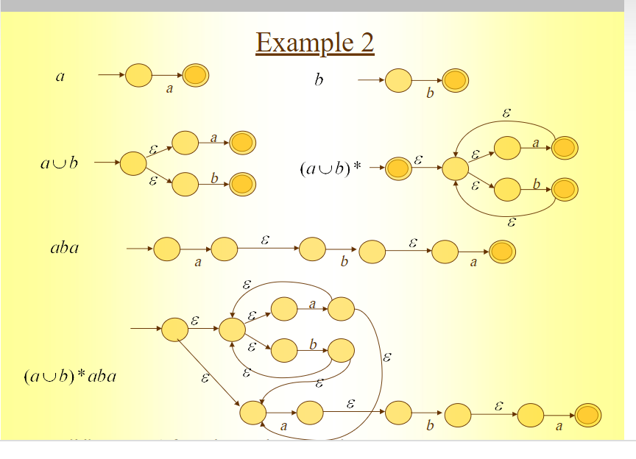
Building NFA from regular expressions

Slide 32
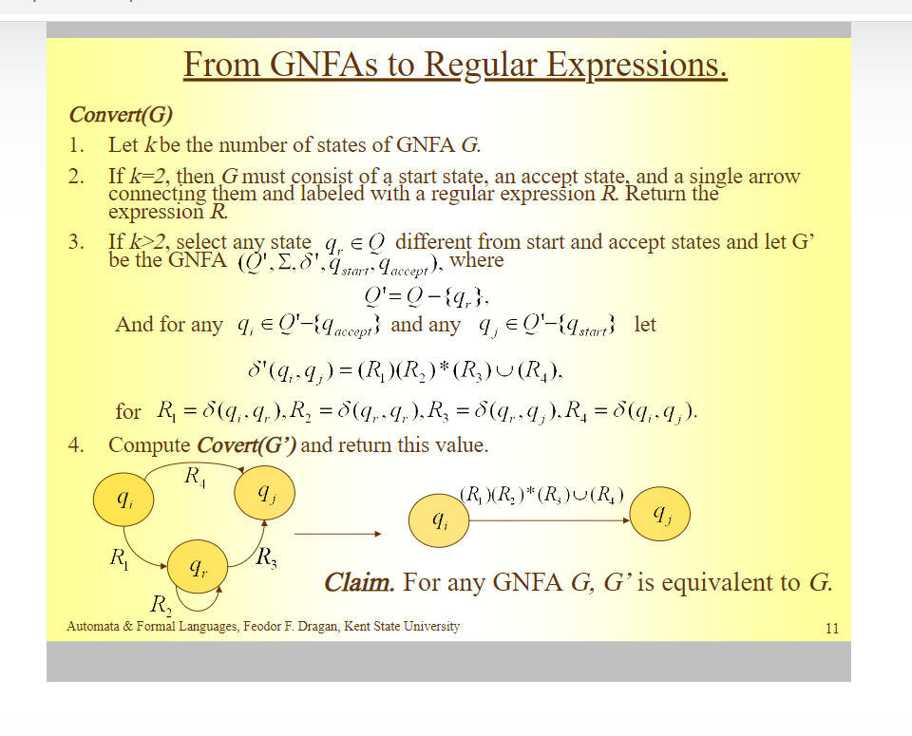
Regular Expression from DFA

Slide 33
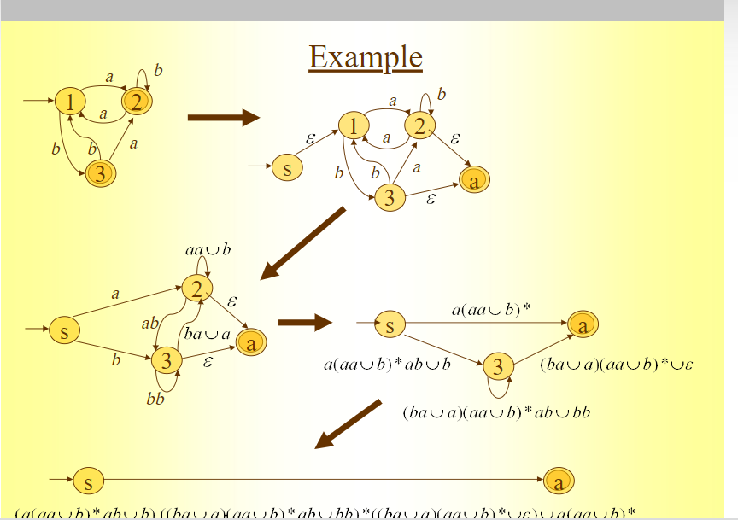
Regular Expression from DFA

Slide 34
DFA → RE: State Elimination method
The initial state of the DFA must not have any incoming edge.
Step-01:
If there exists any incoming edge to the initial state, then create a new initial state having no incoming edge to it.
Step-02:
There must exist only one final state in the DFA.
If there exists multiple final states in the DFA, then convert all the final states into non-final states and create a new single final state.
The final state of the DFA must not have any outgoing edge

Slide 35
DFA → RE: State Elimination method
Step-03:
If there exists any outgoing edge from the final state, then create a new final state having no outgoing edge from it.
Step-04:
Eliminate all the intermediate states one by one.
These states may be eliminated in any order.
In the end
Only an initial state going to the final state will be left.
The cost of this transition is the required regular expression.

Slide 36
Converting a DFA to a regular expression
This can be done in two parts. For this we introduce a new type of finite automata called generalized nondeterministic automaton, GNFA.
First, we will convert a DFA to GNFA, and
then GNFA to regular expression.
GNFA has the following special form –
Transition labels might be in regular expression form.
The start state doesn’t have any incoming arrow from any other state.
There is only one accept state, and it doesn’t have any outgoing arrow to any other state.
Start state is never the same as accept state.
There is only one outgoing arrow to any other state and to itself, except the start and accept states. We will consider φ labeled outgoing arrows, if no transition exists between any two states.
aa
ab*
ab ∪ ba
q_{start}
a*
(aa)*
q_{accept}
∅
b*
b
ab

Slide 37
Converting a DFA to GNFA
Add a new start state with an ε arrow to the old start state.
Add new accept state with ε arrows from the old accept states.
If any arrows have multiple labels, union the previous labels into one label.
Add arrows with φ label between states where there are no arrows. This won’t change the language as φ label arrows can never be used.
Even we might ignore adding such arrows, as these are arrows which can be assumed to be there with no use.
s
ε
1
a
φ
φ
b
φ
φ
a,b
a∪b
f
ε
2
2

Slide 38
Formal Definition of GNFA
A generalized nondeterministic finite automaton is a 5-tuple, (Q, Σ, δ, q_{start}, q_{accept}) where –
Q is the finite set of states,
Σ is the input alphabet,
δ : (Q - {q_{start}}) × (Q - {q_{accept}}) → R is the transition function,
q_{start} is the start state,
q_{accept} is the accept state.
A GNFA accepts a string w in Σ* if w = w₁w₂…w_{k}, where each w_{i} is in Σ* and a sequence of states q₀, q₁, …q_{k} exists such that –
q₀=q_{start} is the start state,
q_{k}=q_{accept} is the accept state, and
For each i, we have w_{i} ∈L(R_{i}), where R_{i} = δ(q_{i-1}, q_{i});
i.e., R_{i} is the expression on the arrow from q_{i-1} to q_{i}.

Slide 39
Converting a GNFA to a regular expression
Let consider the GNFA to be with k states.
We will continuously remove one state from the GNFA until k = 2. These last two states are actually the start and the accept states.
We do so by selecting a state, ripping it out of the machine, and repairing the remainder so that the same language is still recognized.
Any state will do, provided that the state is not the start or the accept states.

Slide 40
Repairing after removing a state
Let us call the removed state q_{rmv}.
Repair the machine by altering the regular expressions that label each of the remaining arrows. This change is done for each arrow going from any state q_{s} to q_{d}, including the case where q_{s} = q_{d}.
The new labels compensate for the absence of q_{rmv} by adding back the lost computations. i.e., The new label going from a state q_{s} to state q_{d} is a regular expression that describes all strings that would take the machine from q_{s} to q_{d} either directly or via q_{rmv}.
(R₁)
•(R₂)*
•(R₃)
∪
(R₄)
q_{s}
q_{d}
R₄
R₁
q_{rmv}
R₃
R₂

Slide 41
Repairing after removing a state
Let us call the removed state q_{rmv}.
Repair the machine by altering the regular expressions that label each of the remaining arrows. This change is done for each arrow going from any state q_{s} to q_{d}, including the case where q_{s} = q_{d}.
The new labels compensate for the absence of q_{rmv} by adding back the lost computations. i.e., The new label going from a state q_{s} to state q_{d} is a regular expression that describes all strings that would take the machine from q_{s} to q_{d} either directly or via q_{rmv}.
(R₁)
•(R₂)*
•(R₃)
∪
(R₄)
q_{s}
q_{d}
R₄
R₁
q_{rmv}
R₃
R₂

Slide 42
Example:
Converting a two state DFA to an equivalent regular expression
s
ε
1
a
a*
b
a*b(a∪b)*
b
b(a∪b)*
a,b
a∪b
f
ε
2
2

Slide 43
Example:
Converting a two state DFA to an equivalent regular expression
a
a
b
aa∪b
1
2
2
ε
ε
a
ab
s
a
b
ba∪a
f
b
b
ε
a(aa∪b)*ab∪b
3
(ba ∪a)(aa ∪b)* ∪ε
3
bb
(ba∪a)(aa ∪b)*ab ∪bb
a(aa∪b)*
(a(aa∪b)*ab∪b)((ba∪a)(aa ∪b)*ab ∪bb)*((ba ∪a)(aa ∪b)* ∪ε) ∪(a(aa∪b)*)

Slide 44
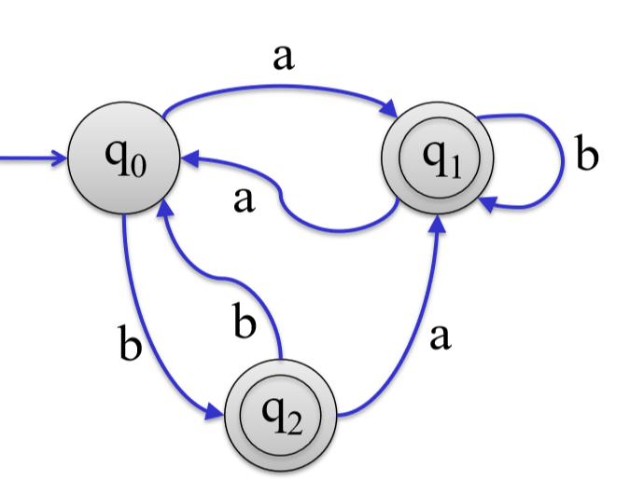
a
b
1
2
2
a
b
a
b
3
3

Slide 45
Regular Expression: Part-1
Introduction to Theory of Computation, Sipser, (3rd ed), Regular Expression.

Slide 46
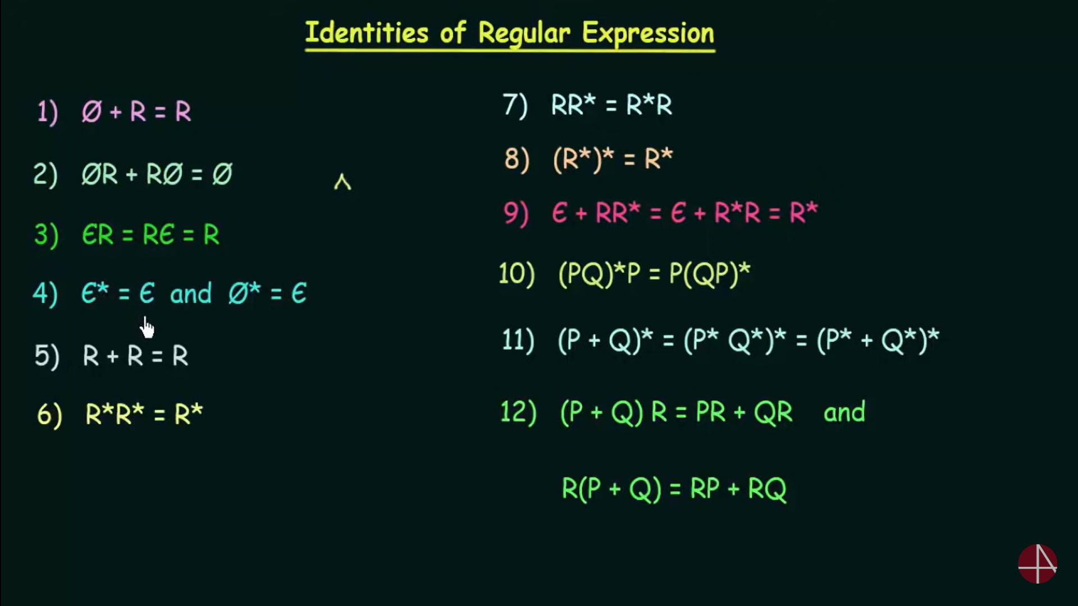
Identities of Regular Expression

