Slide 1
Regular Expressions (RE)
CSC3113: Theory of Computation
7
4
Summer 2022-2023
Dr. Afroza Nahar, Associate Professor,
Department of Computer Science, Faculty of Science & Technology.
afroza@aiub.edu

Slide 2
Formal Definition of Regular Expression (RE)
Equivalence with Finite Automaton
Conversion from NFA to RE
Conversion from DFA to RE.
Closure under regular operations.

Slide 3
Mathematical model of Regular Expression (RE)
Understand the uniformity of RE and FA.
Conversion Techniques from NFA to RE.
The strength of RE.
Techniques to convert DFA to RE
Closure under different regular operations.

Slide 4
All outcome are represented with examples
Understand the mathematical interpretation of Regular Expression (RE)
Learn the rules for equivalence of RE with Finite Automaton
Apply the conversion rules from RE to NFA
Apply the techniques to convert DFA to RE
Identify the closure under different regular operations.

Slide 5
Regular Expression
Regular expression is used to describe languages.
Regular expression is specific, standard textual syntax (combined with alphabets and regular operators) for representing patterns for matching strings.
Regular expression can be built up using regular operations.
Precedence order: * • ∪
Example:
(0∪1)0* = ({0}∪{1})•{0}* = {0,1}•{0}* A = {w | string w starts with a 0 or a 1 followed by zero or more 0’s}
(0∪1)* = ({0}∪{1})* = {0,1}* A = {all possible string with 0s and/or 1s}.

Slide 6
Formal Definition of Regular Expression
R is a regular expression if R is –
a for some a ∈ Σ, represents the language {a}.
ε, represents the language {ε} containing a single string, namely, the empty string.
φ, represents the empty language that doesn’t contain any string. L(φ*) = {ε}.
(R₁∪R₂), where R₁ and R₂ are regular expressions,
R ∪ φ = R, but R ∪ ε may not be equal to R.
(R₁•R₂), where R₁ and R₂ are regular expressions,
R • ε = R, but R • φ may not be equal to R.
(R₁*), where R₁ is a regular expressions,

Slide 7
Equivalence with finite automata
Let convert regular language R into an NFA considering the six cases in the formal definition of regular language.
R = a, a∈Σ. Then L(R)={a}, and the NFA that recognizes L(R) is –
R = ε. Then L(R)={ε}, and the NFA that recognizes L(R) is –
R = φ. Then L(R)= φ, and the NFA that recognizes L(R) is –
a

Slide 8
Equivalence with finite automata
R = R₁∪R₂. Then L(R)={R₁,R₂}, and the NFA that recognizes L(R) is –
R = R₁•R₂. Then L(R)={R₁R₂}, and the NFA that recognizes L(R) is –
R = R₁*. Then L(R)={R₁}*, and the NFA that recognizes L(R) is –
ε
R₂
ε
R₁
R₁
R₂
ε
ε
ε
ε
R₁
ε

Slide 9
Converting a regular expression to an NFA
ε
a
a
ε
ε
(a∪b)*
(a∪b)*aba
a∪b
ε
ε
b
b
ε
ε
ε
aba
a
ε
b
ε
a
Building an NFA from regular expression: (a∪b)*aba

Slide 10
DFA → RE: State Elimination method
The initial state of the DFA must not have any incoming edge.
Step-01:
If there exists any incoming edge to the initial state, then create a new initial state having no incoming edge to it.
Step-02:
There must exist only one final state in the DFA.
If there exists multiple final states in the DFA, then convert all the final states into non-final states and create a new single final state.
The final state of the DFA must not have any outgoing edge

Slide 11
DFA → RE: State Elimination method
Step-03:
If there exists any outgoing edge from the final state, then create a new final state having no outgoing edge from it.
Step-04:
Eliminate all the intermediate states one by one.
These states may be eliminated in any order.
In the end
Only an initial state going to the final state will be left.
The cost of this transition is the required regular expression.

Slide 12
Converting a DFA to a regular expression
This can be done in two parts. For this we introduce a new type of finite automata called generalized nondeterministic automaton, GNFA.
First, we will convert a DFA to GNFA, and
then GNFA to regular expression.
GNFA has the following special form –
Transition labels might be in regular expression form.
The start state doesn’t have any incoming arrow from any other state.
There is only one accept state, and it doesn’t have any outgoing arrow to any other state.
Start state is never the same as accept state.
There is only one outgoing arrow to any other state and to itself, except the start and accept states. We will consider φ labeled outgoing arrows, if no transition exists between any two states.
aa
ab*
ab ∪ ba
q_{start}
a*
(aa)*
q_{accept}
∅
b*
b
ab

Slide 13
Converting a DFA to GNFA
Add a new start state with an ε arrow to the old start state.
Add new accept state with ε arrows from the old accept states.
If any arrows have multiple labels, union the previous labels into one label.
Add arrows with φ label between states where there are no arrows. This won’t change the language as φ label arrows can never be used.
Even we might ignore adding such arrows, as these are arrows which can be assumed to be there with no use.
s
ε
1
a
φ
φ
b
φ
φ
a,b
a∪b
f
ε
2
2

Slide 14
Formal Definition of GNFA
A generalized nondeterministic finite automaton is a 5-tuple, (Q, Σ, δ, q_{start}, q_{accept}) where –
Q is the finite set of states,
Σ is the input alphabet,
δ : (Q - {q_{start}}) × (Q - {q_{accept}}) → R is the transition function,
q_{start} is the start state,
q_{accept} is the accept state.
A GNFA accepts a string w in Σ* if w = w₁w₂…w_{k}, where each w_{i} is in Σ* and a sequence of states q₀, q₁, …q_{k} exists such that –
q₀=q_{start} is the start state,
q_{k}=q_{accept} is the accept state, and
For each i, we have w_{i} ∈L(R_{i}), where R_{i} = δ(q_{i-1}, q_{i});
i.e., R_{i} is the expression on the arrow from q_{i-1} to q_{i}.

Slide 15
Converting a GNFA to a regular expression
Let consider the GNFA to be with k states.
We will continuously remove one state from the GNFA until k = 2. These last two states are actually the start and the accept states.
We do so by selecting a state, ripping it out of the machine, and repairing the remainder so that the same language is still recognized.
Any state will do, provided that the state is not the start or the accept states.

Slide 16
Repairing after removing a state
Let us call the removed state q_{rmv}.
Repair the machine by altering the regular expressions that label each of the remaining arrows. This change is done for each arrow going from any state q_{s} to q_{d}, including the case where q_{s} = q_{d}.
The new labels compensate for the absence of q_{rmv} by adding back the lost computations. i.e., The new label going from a state q_{s} to state q_{d} is a regular expression that describes all strings that would take the machine from q_{s} to q_{d} either directly or via q_{rmv}.
(R₁)
•(R₂)*
•(R₃)
∪
(R₄)
q_{s}
q_{d}
R₄
R₁
q_{rmv}
R₃
R₂

Slide 17
Repairing after removing a state
Let us call the removed state q_{rmv}.
Repair the machine by altering the regular expressions that label each of the remaining arrows. This change is done for each arrow going from any state q_{s} to q_{d}, including the case where q_{s} = q_{d}.
The new labels compensate for the absence of q_{rmv} by adding back the lost computations. i.e., The new label going from a state q_{s} to state q_{d} is a regular expression that describes all strings that would take the machine from q_{s} to q_{d} either directly or via q_{rmv}.
(R₁)
•(R₂)*
•(R₃)
∪
(R₄)
q_{s}
q_{d}
R₄
R₁
q_{rmv}
R₃
R₂

Slide 18
Example:
Converting a two state DFA to an equivalent regular expression
s
ε
1
a
a*
b
a*b(a∪b)*
b
b(a∪b)*
a,b
a∪b
f
ε
2
2

Slide 19
Example:
Converting a three state DFA to an equivalent regular expression
a
a
b
aa∪b
1
2
2
ε
ε
a
ab
s
a
b
ba∪a
f
b
b
ε
a(aa∪b)*ab∪b
3
(ba ∪a)(aa ∪b)* ∪ε
3
bb
(ba∪a)(aa ∪b)*ab ∪bb
a(aa∪b)*
(a(aa∪b)*ab∪b)((ba∪a)(aa ∪b)*ab ∪bb)*((ba ∪a)(aa ∪b)* ∪ε) ∪(a(aa∪b)*)

Slide 20
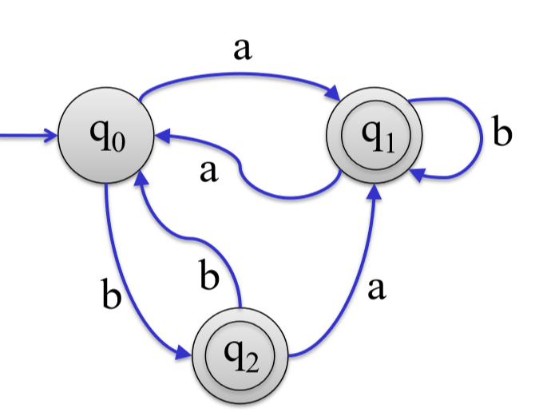
a
b
1
2
2
a
b
a
b
3
3

Slide 21
Closure
Regular Languages are Closed Under Regular Operations:
Union: A ∪ B = { w | w ∈ A or w ∈ B }
Intersection: A ∩ B = { w | w∈A and w∈B }
Reverse: A^{R} = { w₁ …w_{k} | w_{k} …w₁ ∈ A }
Negation: ¬A = { w | w ∉ A }
Concatenation: A⋅B = { vw | v∈A and w∈B }
Star: A* = { w₁…w_{k} | k≥0 and each w_{i}∈A }

Slide 22
Regular Expression: Part-1
Introduction to Theory of Computation, Sipser, (3rd ed), Regular Expression.

