Slide 1

AMERICAN INTERNATIONAL UNIVERSITY- BANGLADESH
DEPARTMENT OF COMPUTER SCIENCE
FALL 2022-23
PROJECT TOPIC: VEHICLE CONTROL AND MANAGEMENT SYSTEM
PRESENTED BY: RIFAH SANZIDA, MD SAMIN YEASAR & TAHMIDA ALAMGIR
COURSE NAME: INTRODUCTION TO DATABASE
SECTION: C
GROUP NO: 06
COURSE FACULTY: MST. TASNIM PARVEEN

Slide 2
Agenda
INTRODUCTION
SCENARIO DESCRIPTION
ER DIAGRAM
NORMALIZATION
TABLE CREATION
DATA INSERTION
QUERY DESIGN
CONCLUSION AND FUTURE PLAN

Slide 3
Introduction
IN BANGLADESH, WE CANNOT EASILY VERIFY A VEHICLE OR A DRIVER DUE TO SHORTEST OF RESOURCES. LAW ENFORCEMENT UNITS CANNOT PUNISH ANY VEHICLE JUST BY SEEING THE NUMBER OF THE VEHICLE. IN THIS PROJECT WE TRY TO MANAGE THIS SITUATION. WE TRY OUR BEST TO MAKE A GOOD MANAGEMENT BY WHICH LAW ENFORCEMENT UNITS CAN EASILY VERIFY A VEHICLE. THEY CAN EASILY FIND OUT ALL THE DETAILS ABOUT THAT VEHICLE, AND IF THERE ARE ANY OTHER CASES AGAINST THAT VEHICLE BY USING OUR MANAGEMENT SYSTEM.

Slide 4
SCENARIO DESCRIPTION

Slide 5
A VEHICLE CONTROL AND INFORMATION MANAGEMENT SYSTEM IS BASICALLY CONTROLLING THE VEHICLES IN A SYSTEMATIC WAY.VEHICLE IS UNIQUELY IDENTIFIED BY VEHICLE_ NUMBER. OTHER ATTRIBUTES OF A VEHICLE ARE VEHICLE_TYPE, VEHICLE_MODEL, VEHICLE_REG_DATE. A DRIVER DRIVES A VEHICLE. DRIVER IS ALSO IDENTIFIED BY DRIVER_LICENSE_NUMBER.DRIVER HAS DRIVER_NAME, DRIVER_PHONE_NO, AND DRIVER_HOME_DIST. AN OWNER OWNS MANY VEHICLES. AN OWNER IS IDENTIFIED BY OWNER_NID. AN OWNER ALSO HAS OWNER_NAME, OWNER_PHONE_NO, OWNER_ADDRESS, AND OWNER_EMAIL. MANY POLICE OBSERVES MANY VEHICLES. POLICE HAS UNIQUE POLICE_ID. POLICE ALSO HAS POLICE_NAME, POLICE_PHONE_NO, POLICE_WORKING_CITY, AND POLICE_WORKING_ZONE. POLICE GIVES MANY CASES.POLICE CAN PUNISH DRIVERS BY ASSIGNING CASES AGAINST VEHICLES CASE HAS UNIQUE CASE_NO AS PRIMARY KEY. CASE ALSO HAS CASE_DATE, CASE_INFO, AND CASE_FINE.

Slide 6
ER DIAGRAM

Slide 7
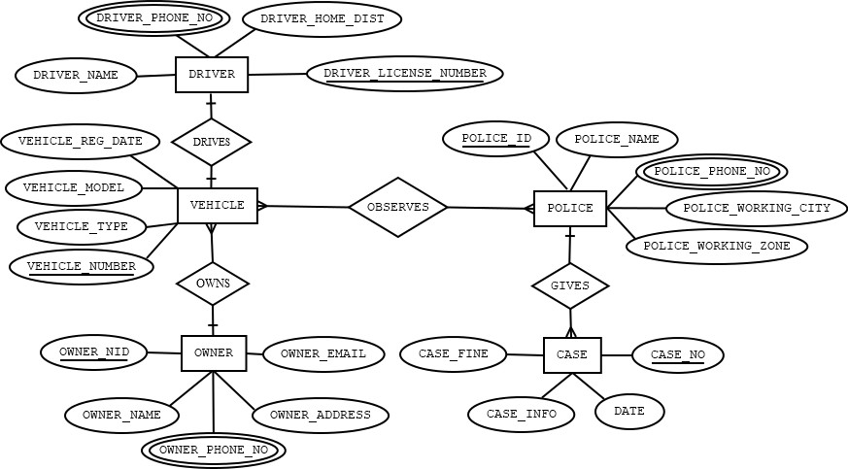
BEFORE NORMALIZATION:

Slide 8
NORMALIZATION

Slide 9
DRIVER DRIVES VEHICLE
UNF:
DRIVES(VEHICLE_REG_DATE,VEHICLE_MODEL,VEHICLE_TYPE, VEHICLE_NUMBER,DRIVER_NAME,DRIVER_PHONE_NO, DRIVER_HOME_DIST,DRIVER_LICENSE_NUMBER)
1NF:
DRIVER_PHONE_NO IS MULTIVALUED ATTRIBUTE.
2NF:
1.VEHICLE_NUMBER,VEHICLE_MODEL,VEHICLE_REG_DATE,VEHICLE_TYPE,
2. DRIVER_LICENSE_NUMBER,DRIVER_NAME,DRIVER_PHONE_NO, DRIVER_HOME_DIST,
3NF:
THERE IS NO TRANSITIVE DEPENDENCY.
1.VEHICLE_NUMBER,VEHICLE_MODEL,VEHICLE_REG_DATE, VEHICLE_TYPE, DRIVER_LICENSE_NUMBER
2. DRIVER_LICENSE_NUMBER,DRIVER_NAME, DRIVER_PHONE_NO, DRIVER_HOME_DIST

Slide 10
OWNER OWNS VEHICLE
UNF:
OWNS(VEHICLE_REG_DATE,VEHICLE_MODEL,VEHICLE_TYPE, VEHICLE_TYPE,DRIVER_LICENSE_NUMBER,OWNER_NID, OWNER_NAME,OWNER_PHONE_NO,OWNER_ADDRESS, OWNER_EMAIL)
1NF:
OWNER_PHONE_NO IS MULTIVALUED ATTRIBUTE.
2NF:
1.VEHICLE_NUMBER,VEHICLE_MODEL,VEHICLE_REG_DATE, VEHICLE_TYPE 2.OWNER_NID,OWNER_NAME,OWNER_PHONE_NO,OWNER_ADDRESS, OWNER_EMAIL, VEHICLE_NUMBER
3NF:
THERE IS NO TRANSITIVE DEPENDENCY.
1.VEHICLE_NUMBER,VEHICLE_MODEL,VEHICLE_REG_DATE, VEHICLE_TYPE
2.OWNER_NID,OWNER_NAME,OWNER_PHONE_NO,OWNER_ADDRESS, OWNER_EMAIL, VEHICLE_NUMBER

Slide 11
POLICE GIVES CASE
UNF:
GIVE(POLICE_ID,POLICE_NAME,POLICE_PHONE_NO, POLICE_WORKING_CITY,POLICE_WORKING_ZONE,CASE_NO,DATE, CASE_INFO, CASE_FINE)
1NF:
POLICE_PHONE_NO IS MULTIVALUED ATTRIBUTE.
2NF:
1.POLICE_ID,POLICE_NAME,POLICE_PHONE_NO, POLICE_WORKING_CITY,POLICE_WORKING_ZONE
2. CASE_NO, DATE, CASE_INFO, CASE_FINE, POLICE_ID
3NF:
THERE IS NO TRANSITIVE DEPENDENCY.
1.POLICE_ID,POLICE_NAME,POLICE_PHONE_NO, POLICE_WORKING_CITY,POLICE_WORKING_ZONE
2. CASE_NO, DATE, CASE_INFO, CASE_FINE, POLICE_ID

Slide 12
POLICE OBSERVES VEHICLE
UNF:
OBSERVES(VEHICLE_MODEL,VEHICLE_REG_DATE,VEHICLE_TYPE, VEHICLE_TYPE,POLICE_ID,POLICE_NAME,POLICE_PHONE_NO, POLICE_WORKING_CITY,POLICE_WORKING_ZONE)
1NF:
POLICE_PHONE_NO IS MULTIVALUED ATTRIBUTE
2NF:
1.VEHICLE_NUMBER,VEHICLE_MODEL,VEHICLE_REG_DATE, VEHICLE_TYPE
2.POLICE_ID,POLICE_NAME,POLICE_PHONE_NO, POLICE_WORKING_CITY,POLICE_WORKING_ZONE
3.VP_ID, VEHICLE_MODEL,POLICE_ID
3NF:
THERE IS NO TRANSITIVE DEPENDENCY.
1.VEHICLE_MODEL,VEHICLE_REG_DATE,VEHICLE_TYPE,
2.POLICE_ID,POLICE_NAME,POLICE_PHONE_NO, POLICE_WORKING_CITY,POLICE_WORKING_ZONE
3.VP_ID, VEHICLE_MODEL, POLICE_ID

Slide 13
TOTAL TABLE:
1. VEHICLE_NUMBER,VEHICLE_MODEL,VEHICLE_REG_DATE, VEHICLE_TYPE, DRIVER_LICENSE_NUMBER
2. DRIVER_LICENSE_NUMBER,DRIVER_NAME, DRIVER_PHONE_NO, DRIVER_HOME_DIST
3. VEHICLE_NUMBER,VEHICLE_MODEL,VEHICLE_REG_DATE, VEHICLE_TYPE
4. OWNER_NID,OWNER_NAME,OWNER_PHONE_NO,OWNER_ADDRESS, OWNER_EMAIL,
VEHICLE_NUMBER
5. POLICE_ID,POLICE_NAME,POLICE_PHONE_NO,POLICE_WORKING_CITY,
POLICE_WORKING_ZONE
6. CASE_N0, DATE, CASE_INFO, CASE_FINE, POLICE_ID
7. VEHICLE_NUMBER,VEHICLE_MODEL,VEHICLE_REG_DATE, VEHICLE_TYPE
8. POLICE_ID,POLICE_NAME,POLICE_PHONE_NO, POLICE_WORKING_CITY, POLICE_WORKING_ZONE
9. VP_ID, VEHICLE_NUMBER, POLICE_ID

Slide 14
FINAL TABLE:
1.VEHICLE_NUMBER,VEHICLE_MODEL,VEHICLE_REG_DATE,
VEHICLE_TYPE, DRIVER_LICENSE_NUMBER
2. DRIVER_LICENSE_NUMBER,DRIVER_NAME, DRIVER_PHONE_NO, DRIVER_HOME_DIST
3. OWNER_NID,OWNER_NAME,OWNER_PHONE_NO,OWNER_ADDRESS, OWNER_EMAIL, VEHICLE_NUMBER
4.POLICE_ID,POLICE_NAME,POLICE_PHONE_NO,POLICE_WORKING_CITY,POLICE_WORKING_ZONE
5. CASE_N0, DATE, CASE_INFO, CASE_FINE, POLICE_ID
6.VP_ID, VEHICLE_NUMBER, POLICE_ID

Slide 15
TABLE CREATION

Slide 16
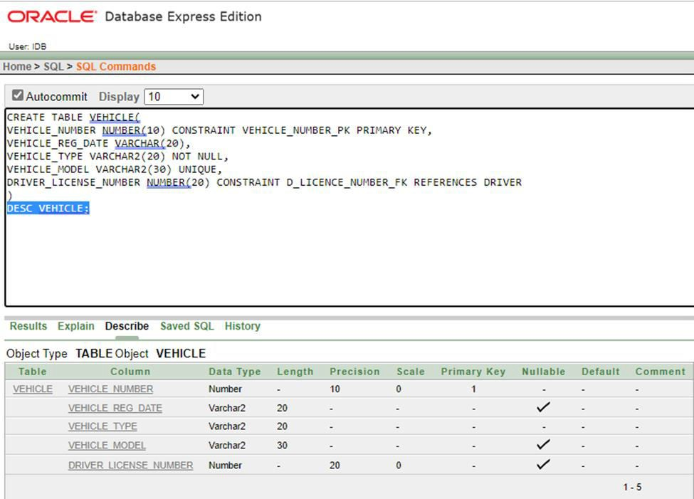
VEHICLE TABLE
CREATE TABLE VEHICLE(
VEHICLE_NUMBER NUMBER(10) CONSTRAINT VEHICLE_NUMBER_PK PRIMARY KEY,
VEHICLE_REG_DATE VARCHAR(20), VEHICLE_TYPE VARCHAR2(20) NOT NULL, VEHICLE_MODEL VARCHAR2(30) UNIQUE,
DRIVER_LICENSE_NUMBER NUMBER(20) CONSTRAINT D_LICENCE_NUMBER_FK REFERENCES DRIVER
);
DESC DRIVER;

Slide 17
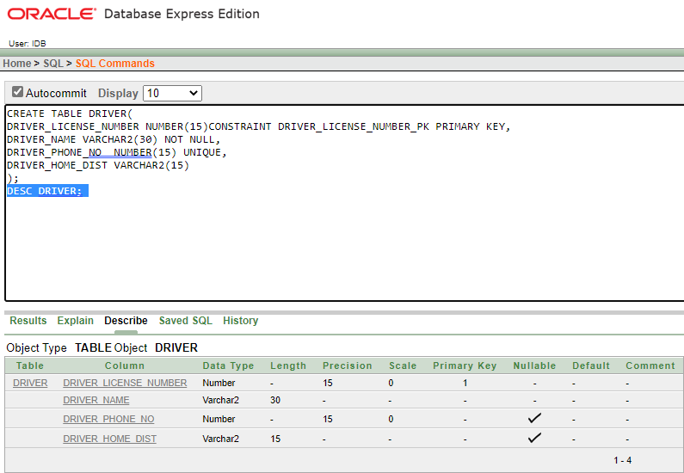
DRIVER TABLE
CREATE TABLE DRIVER(
DRIVER_LICENSE_NUMBER NUMBER(15)CONSTRAINT DRIVER_LICENSE_NUMBER_PK PRIMARY KEY,
DRIVER_NAME VARCHAR2(30) NOT NULL,
DRIVER_PHONE_NO NUMBER(15) UNIQUE, DRIVER_HOME_DIST VARCHAR2(15)
);
DESC DRIVER;

Slide 18
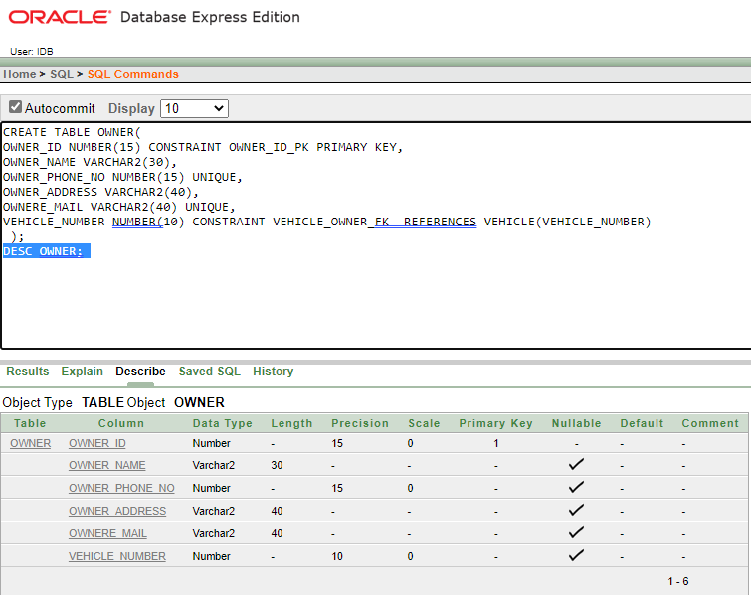
OWNER TABLE
CREATE TABLE OWNER(
OWNER_ID NUMBER(15) CONSTRAINT OWNER_ID_PK PRIMARY KEY, OWNER_NAME VARCHAR2(30),
OWNER_PHONE_NO NUMBER(15) UNIQUE, OWNER_ADDRESS VARCHAR2(40), OWNERE_MAIL VARCHAR2(40) UNIQUE,
VEHICLE_NUMBER NUMBER(10) CONSTRAINT VEHICLE_OWNER_FK REFERENCES VEHICLE(VEHICLE_NUMBER)
);
DESC OWNER;

Slide 19
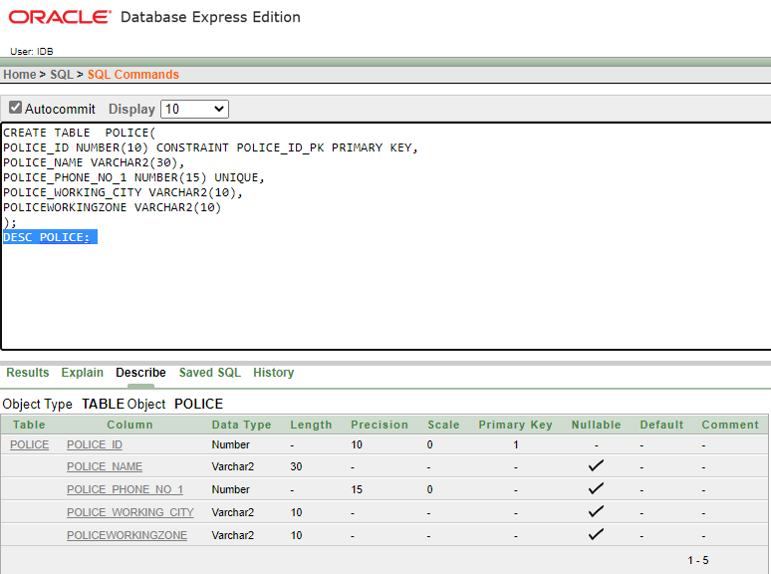
POLICE TABLE
CREATE TABLE POLICE(
POLICE_ID NUMBER(10) CONSTRAINT POLICE_ID_PK PRIMARY KEY, POLICE_NAME VARCHAR2(30),
POLICE_PHONE_NO_1 NUMBER(15) UNIQUE, POLICE_WORKING_CITY VARCHAR2(10), POLICEWORKINGZONE VARCHAR2(10)
);
DESC POLICE;

Slide 20
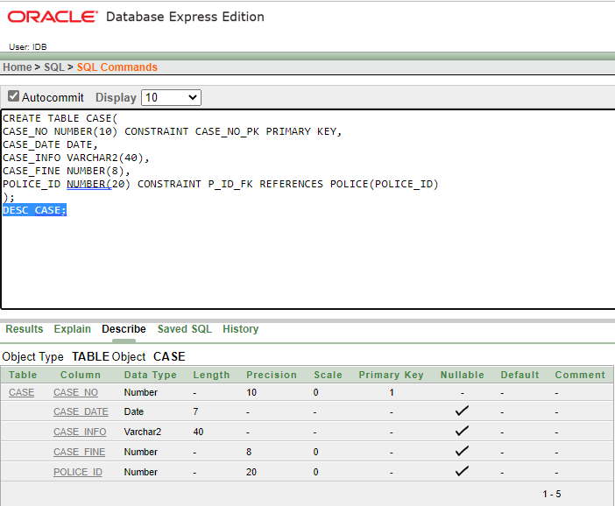
CASE TABLE
CREATE TABLE CASE(
CASE_NO NUMBER(10) CONSTRAINT CASE_NO_PK PRIMARY KEY, CASE_DATE DATE,
CASE_INFO VARCHAR2(40),
CASE_FINE NUMBER(8),
POLICE_ID NUMBER(20) CONSTRAINT P_ID_FK REFERENCES POLICE(POLICE_ID)
);
DESC CASE;

Slide 21
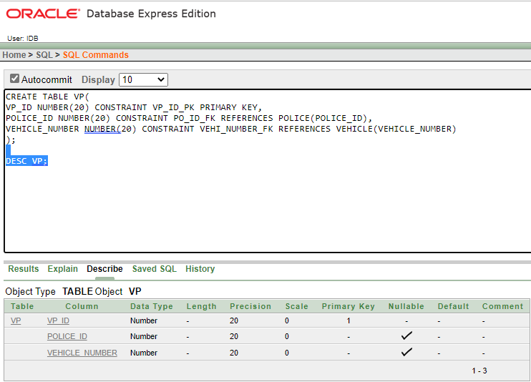
VP TABLE
CREATE TABLE VP(
VP_ID NUMBER(20) CONSTRAINT VP_ID_PK PRIMARY KEY, POLICE_ID NUMBER(20) CONSTRAINT PO_ID_FK REFERENCES POLICE(POLICE_ID),
VEHICLE_NUMBER NUMBER(20) CONSTRAINT VEHI_NUMBER_FK
REFERENCES VEHICLE(VEHICLE_NUMBER)
);
DESC VP;

Slide 22
DATA INSERTION

Slide 23
VEHICLE TABLE
INSERT INTO VEHICLE VALUES (132868,TO_DATE('12-APR-2016','DD-MM-YYYY'),'CAR','COROLLA',1285518);
INSERT INTO VEHICLE VALUES (142569,TO_DATE('17-OCT-2012','DD-MM-YYYY'),'BIKE','APACE',1286619);
INSERT INTO VEHICLE VALUES (256563,TO_DATE('14-JUN-2018','DD-MM-YYYY'),'BUS','HYUNDAI',1284420);
INSERT INTO VEHICLE VALUES (177045,TO_DATE('02-FEB-2014','DD-MM-YYYY'),'TRUCK','TATA'1185621);
INSERT INTO VEHICLE VALUES (166559,TO_DATE('03-MAR-2013','DD-MM-YYYY'),'CAR','ALLION',1185519);
INSERT INTO VEHICLE VALUES (154587,TO_DATE('24-OCT-2015','DD-MM-YYYY'),'CAR','PREMIO',1188692);
INSERT INTO VEHICLE VALUES (125253,TO_DATE('11-NOV-2011','DD-MM-YYYY'),'BUS','SCANIA',1356695);
INSERT INTO VEHICLE VALUES (278565,TO_DATE('12-SEP-2020','DD-MM-YYYY'),'CAR','BMW',1458558);
INSERT INTO VEHICLE VALUES (254548,TO_DATE('10-JUL-2019','DD-MM-YYYY'),'BIKE','GIXER',1178899);
INSERT INTO VEHICLE VALUES (241963,TO_DATE('22-AUG-2017','DD-MM-YYYY'),'TRUCK','EICHER',1150258);
SELECT * FROM VEHICLE;

Slide 24
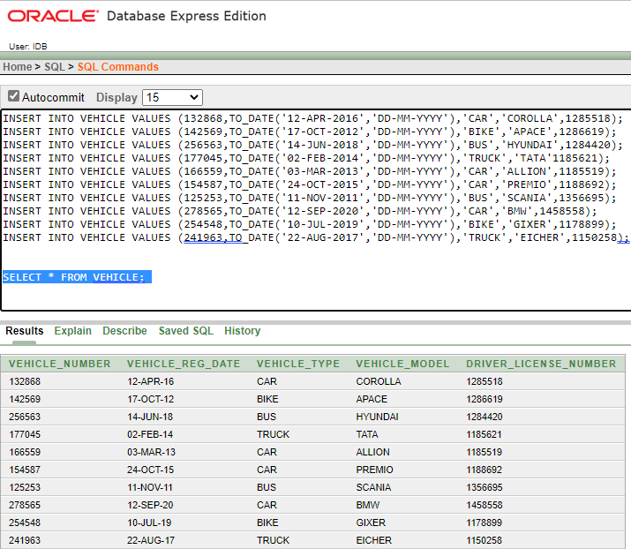

Slide 25
DRIVER TABLE
INSERT INTO DRIVER VALUES (1285518,'HASAN ALI',01317810827,'DHAKA');
INSERT INTO DRIVER VALUES (1286619,'RAFI AHMED',01715040513,'RAJSHAHI’);
INSERT INTO DRIVER VALUES (1284420,'RUBEL HASAN',01767808817,'CUMILLA’);
INSERT INTO DRIVER VALUES (1185621,'AHNAF SAYEM',01993927063,'BARISAL’);
INSERT INTO DRIVER VALUES (1185519,'NAYEEM AHMED',01456985258,'NATORE');
INSERT INTO DRIVER VALUES (1188692,'AMINUL ISLAM',01955696969,'THAKURGAO');
INSERT INTO DRIVER VALUES (1356695,'SHAFWAN AHMED',01836965858,'DHAKA’);
INSERT INTO DRIVER VALUES (1458558,'SABIT HASAN',01535131063,'DHAKA’);
INSERT INTO DRIVER VALUES (1178899,'PANTHO AHMED',01818971458,'GAZIPUR’);
INSERT INTO DRIVER VALUES (1150258,'DIPTO HASAN',01456244569,'JOYPURHAT');
SELECT * FROM DRIVER;

Slide 26
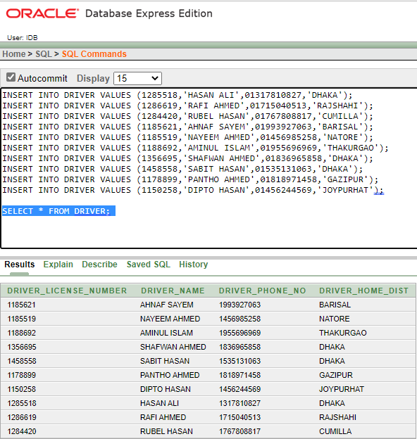

Slide 27
OWNER TABLE
INSERT INTO OWNER VALUES (1212585,'SHATABDI SARKER',01928381122,'DOCTORPARA,FENI', 'SHATABDI22@GMAIL.COM',154587);
INSERT INTO OWNER VALUES (9999869,'UMAIYA TAHIYAT BUSHRA',01928388895,'DOCTORPARA,FENI', 'TAHIYAT11@GMAIL.COM',125253);
INSERT INTO OWNER VALUES (7788585,'MD. ABDUR ROUF',01928381478,'KHILGAON,DHAKA', 'ABDUR78@GMAIL.COM',278565);
INSERT INTO OWNER VALUES (6653585,'ZAFIR KEN ZAMAN',01928384633,'UTTORA,DHAKA', 'ZAFIR11@GMAIL.COM',254548);
INSERT INTO OWNER VALUES (1266558,'DIPTO ROY',01928385565,'MALIBAGH,DHAKA', 'DIPTO99@GMAIL.COM',241963);
SELECT * FROM OWNER;

Slide 28
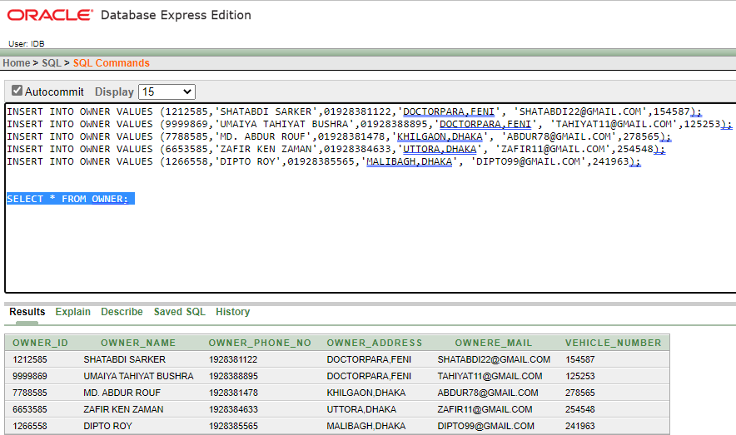

Slide 29
POLICE TABLE
INSERT INTO POLICE VALUES (20235,'KIBRIA HOSSAIN',01928382457,'DHAKA','UTTORA’);
INSERT INTO POLICE VALUES (20236,'RUBEL ALI',01928385898,'DHAKA','MOGHBAZAR’);
INSERT INTO POLICE VALUES (20252,'GOLAM AHMED',01928380295,'SYHLET','AIRPORT’);
INSERT INTO POLICE VALUES (21285,'RAKIB HOSSAIN',01928345496,'RAJSHAHI','STATION’);
INSERT INTO POLICE VALUES (45852,'RAJIB KHAN',01928303490,'BARISAL','ILISHMOR’);
INSERT INTO POLICE VALUES (25692,'REDWAN AHMED',01928092587,'KHULNA','KHULNA’);
INSERT INTO POLICE VALUES (48528,'RAJI KHAN',01928782257,'GAZIPUR','CHONDRA’);
INSERT INTO POLICE VALUES (58282,'ZERIN AHMED',01928522997,'SAVAR','NOBINOGOR’);
INSERT INTO POLICE VALUES (45823,'NAYEEMKHAN',01928389905,'CHANDPUR','MOTLOB');
INSERT INTO POLICE VALUES (45825,'RAFSANCHOWDHURY’, 01928345404,'CHITTAGONG’,
‘PORTAREA’);
SELECT *FROM POLICE;

Slide 30
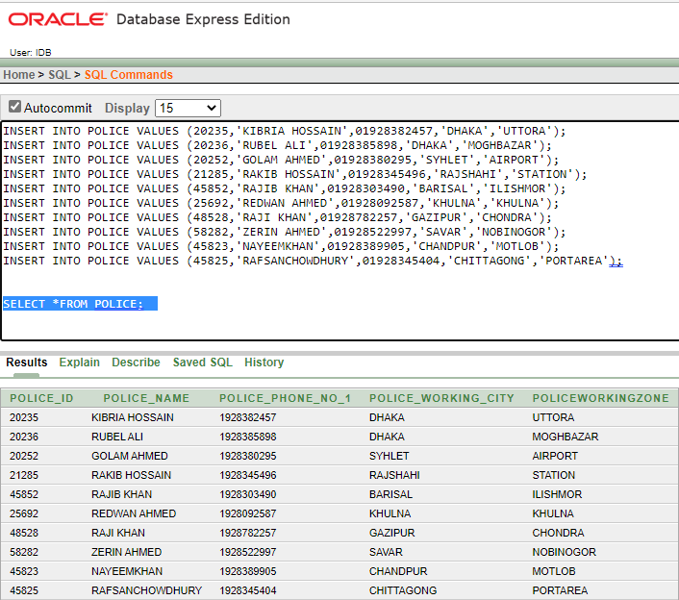

Slide 31
CASE TABLE
CREATE SEQUENCE CASE_CASENO INCREMENT BY 1 START WITH 101 MAXVALUE 20000 NOCACHE
NOCYCLE;
INSERT INTO CASE VALUES (CASE_CASENO.NEXTVAL,TO_DATE('12-MAY-2018','DD-MM- YYYY'),'HIGHSPEED',5000,20235);
INSERT INTO CASE VALUES (CASE_CASENO.NEXTVAL,TO_DATE('17-OCT-2016','DD-MM- YYYY'),'BREAK SIGNAL',6500,20236);
INSERT INTO CASE VALUES (CASE_CASENO.NEXTVAL,TO_DATE('20-JUN-2021','DD-MM- YYYY'),'HIGHSPEED',8000,20252);
INSERT INTO CASE VALUES (CASE_CASENO.NEXTVAL,TO_DATE('02-FEB-2022','DD-MM- YYYY'),'MODIFIED CAR',3000,21285);
INSERT INTO CASE VALUES (CASE_CASENO.NEXTVAL,TO_DATE('03-MAR-2019','DD-MM- YYYY'),'HIGHSPEED',8000,45852);
INSERT INTO CASE VALUES (CASE_CASENO.NEXTVAL,TO_DATE('20-NOV-2020','DD-MM- YYYY'),'HEADLIGHT MISSING',1500,25692);
INSERT INTO CASE VALUES (CASE_CASENO.NEXTVAL,TO_DATE('16-OCT-2022','DD-MM- YYYY'),'BREAK SIGNAL',10000,48528);
INSERT INTO CASE VALUES (CASE_CASENO.NEXTVAL,TO_DATE('13-DEC-2022','DD-MM- YYYY'),'ACCIDENT',15000,58282);
INSERT INTO CASE VALUES (CASE_CASENO.NEXTVAL,TO_DATE('15-JUL-2021','DD-MM- YYYY'),'BREAKLIGHT MISSING',2000,45823);
INSERT INTO CASE VALUES (CASE_CASENO.NEXTVAL,TO_DATE('22-AUG-2017','DD-MM- YYYY'),'WRONG WAY USE',20000,45825);
SELECT * FROM CASE;

Slide 32
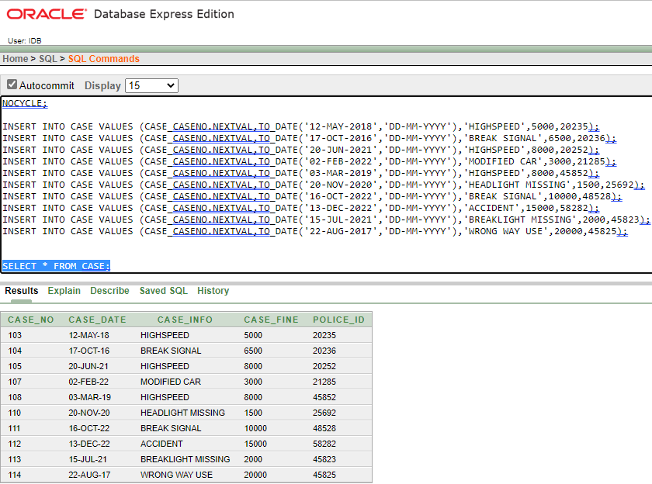

Slide 33
VP TABLE
INSERT INTO VP VALUES (123,20235,132868);
INSERT INTO VP VALUES (234,20236,142569);
INSERT INTO VP VALUES (345,20252,256563);
INSERT INTO VP VALUES (456,21285,177045);
INSERT INTO VP VALUES (567,45852,166559);
INSERT INTO VP VALUES (678,25692,154587);
INSERT INTO VP VALUES (789,48528,125253);
INSERT INTO VP VALUES (890,58282,278565);
INSERT INTO VP VALUES (901,45823,254548);
INSERT INTO VP VALUES (912,45825,241963);
SELECT * FROM VP;

Slide 34
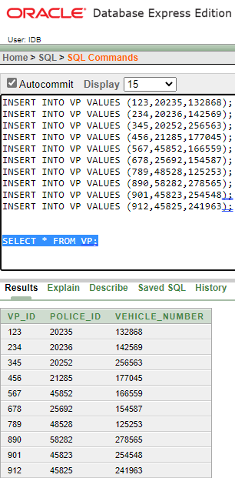

Slide 35
QUERY DESIGN

Slide 36
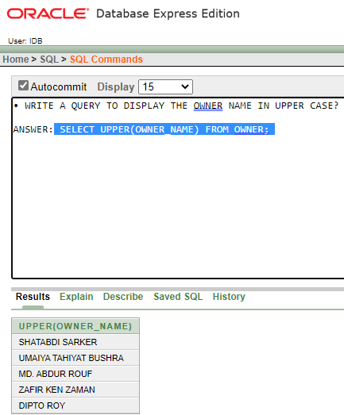
FUNCTION
1.SINGLE ROW:
• WRITE A QUERY TO DISPLAY THE OWNER NAME IN UPPER
CASE?
ANSWER: SELECT UPPER(OWNER_NAME) FROM OWNER;

Slide 37
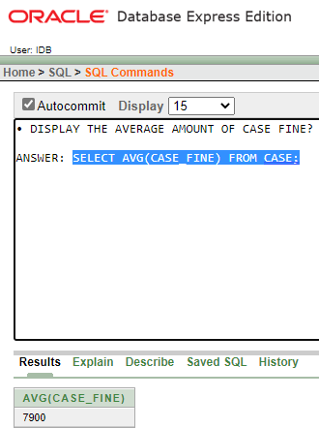
2.AGGREGATE:
• DISPLAY THE AVERAGE AMOUNT OF CASE FINE?
ANSWER: SELECT AVG(CASE_FINE) FROM CASE;

Slide 38
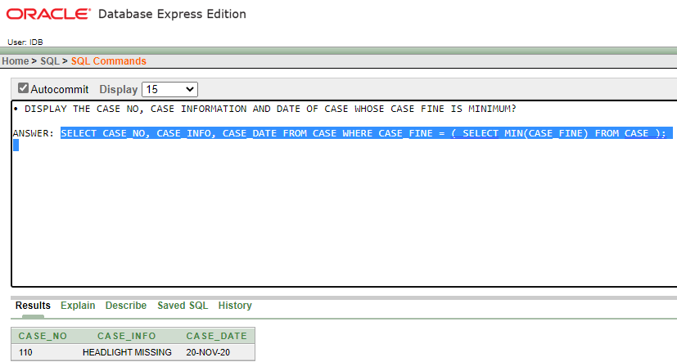
SUBQUERY
1.SINGLE ROW :
• DISPLAY THE CASE NO, CASE INFORMATION AND DATE OF CASE
WHOSE CASE FINE IS MINIMUM?
ANSWER: SELECT CASE_NO, CASE_INFO, CASE_DATE FROM CASE WHERE CASE_FINE = ( SELECT MIN(CASE_FINE) FROM CASE );

Slide 39
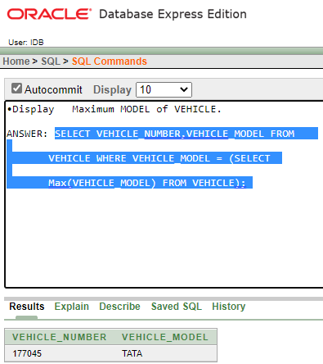
Display Maximum MODEL of VEHICLE.
ANSWER: SELECT VEHICLE_NUMBER,VEHICLE_MODEL FROM
VEHICLE WHERE VEHICLE_MODEL = (SELECT
Max(VEHICLE_MODEL) FROM VEHICLE);

Slide 40
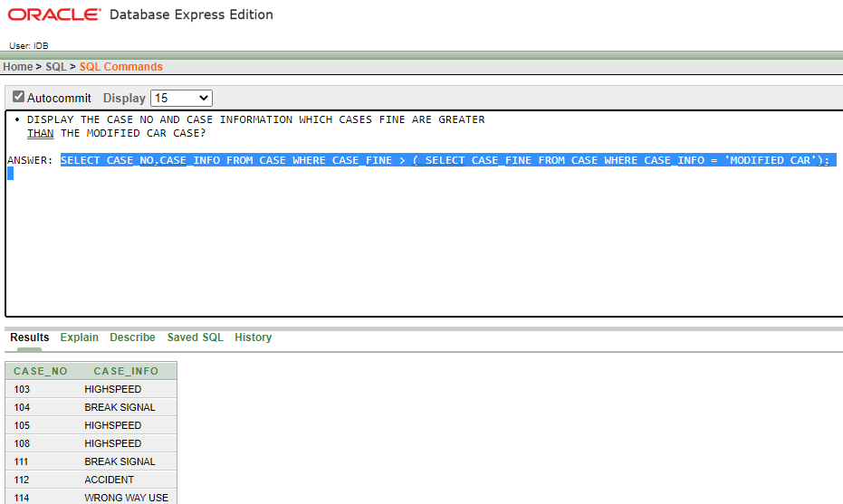
2.MULTIPLE ROW:
•DISPLAY THE CASE NO AND CASE INFORMATION WHICH CASES
FINE ARE GREATER THAN THE MODIFIED CAR CASE?
ANSWER: SELECT CASE_NO,CASE_INFO FROM CASE WHERE
CASE_FINE > ( SELECT CASE_FINE FROM CASE WHERE CASE_INFO
= 'MODIFIED CAR');

Slide 41
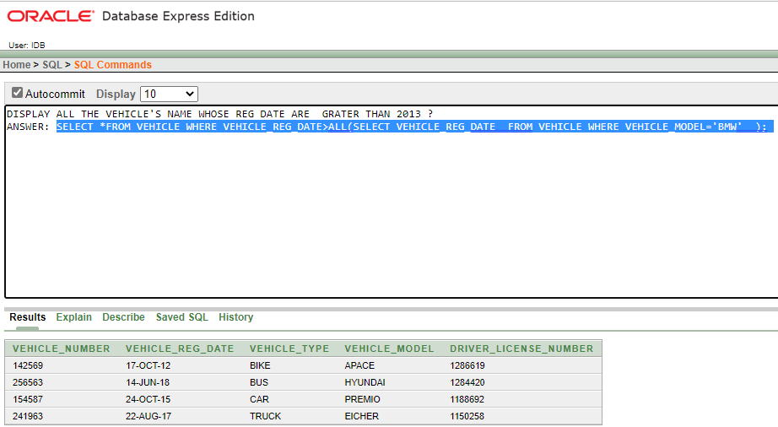
DISPLAY ALL THE VEHICLE'S NAME WHOSE REG DATE ARE GRATER THAN 2013 ?
ANSWER: SELECT *FROM VEHICLE WHERE VEHICLE_REG_DATE>ALL(SELECT VEHICLE_REG_DATE FROM VEHICLE WHERE VEHICLE_MODEL='BMW' );

Slide 42
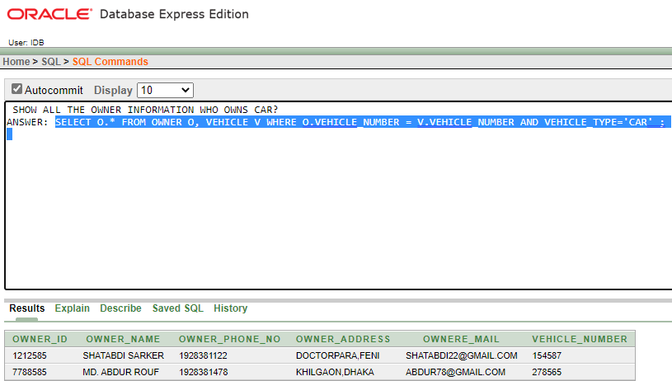
JOINING
1. EQUI JOINING:
SHOW ALL THE OWNER INFORMATION WHO OWNS CAR?
ANSWER: SELECT O.* FROM OWNER O, VEHICLE V WHERE
O.VEHICLE_NUMBER = V.VEHICLE_NUMBER AND
VEHICLE_TYPE='CAR';

Slide 43
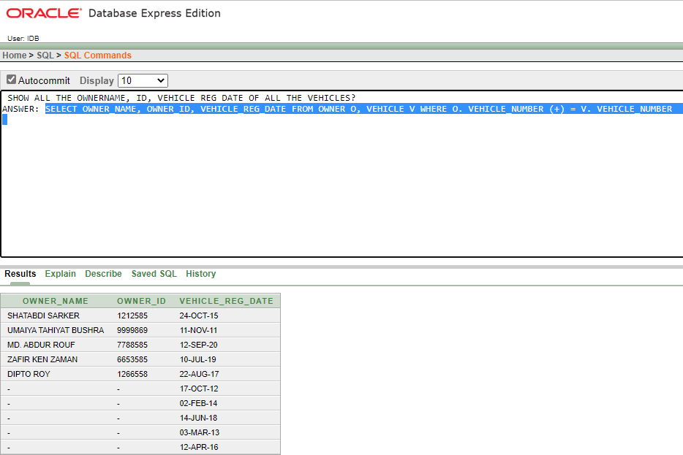
2.OUTER JOINING:
SHOW ALL THE OWNERNAME, ID, VEHICLE REG DATE OF ALL THE VEHICLES?
ANSWER: SELECT OWNER_NAME, OWNER_ID, VEHICLE_REG_DATE
FROM OWNER O, VEHICLE V WHERE O. VEHICLE_NUMBER (+) = V.
VEHICLE_NUMBER

Slide 44
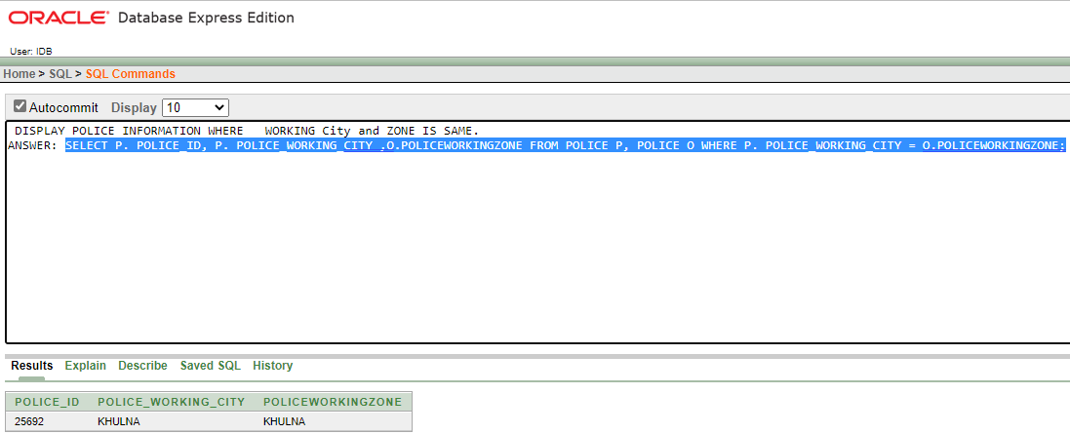
3.SELF JOINING:
DISPLAY POLICE INFORMATION WHERE WORKING City and ZONE IS SAME.
ANSWER: SELECT P. POLICE_ID, P. POLICE_WORKING_CITY ,O.POLICEWORKINGZONE FROM POLICE P, POLICE O WHERE P. POLICE_WORKING_CITY = O.POLICEWORKINGZONE;

Slide 45
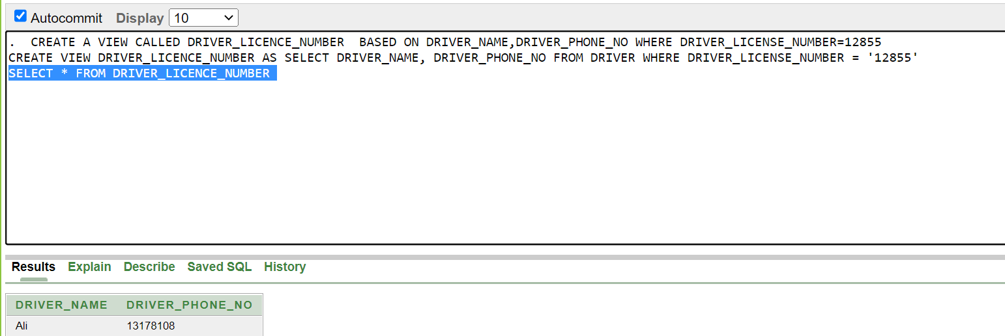
VIEW
SIMPLE VIEW:
CREATE A VIEW CALLED DRIVER_LICENCE_NUMBER BASED
ON DRIVER_NAME,DRIVER_PHONE_NO WHERE
DRIVER_LICENSE_NUMBER=12855.
ANSWER: CREATE VIEW DRIVER_LICENCE_NUMBER AS SELECT DRIVER_NAME, DRIVER_PHONE_NO FROM DRIVER WHERE DRIVER_LICENSE_NUMBER = '12855'
SELECT * FROM DRIVER_LICENCE_NUMBER

Slide 46
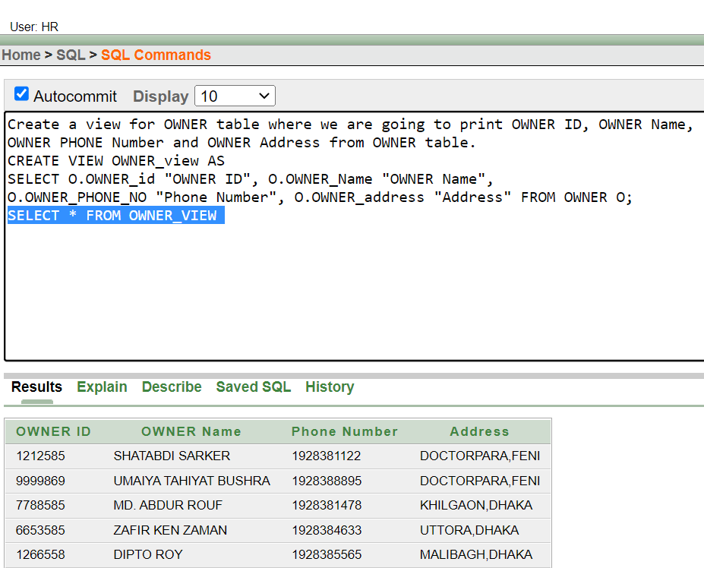
2.COMPLEX VIEW:
CREATE A VIEW FOR OWNER TABLE WHERE WE ARE GOING TO PRINT OWNER ID,OWNER NAME,OWNER PHONE NUMBER AND OWNER ADDRESS FROM OWNER TABLE.
ANSWER: CREATE VIEW OWNER_VIEW AS SELECT O.OWNER_ID "OWNER ID", O.OWNER_NAME "OWNER NAME",O.OWNER_PHONE_NO "PHONE NUMBER", O.OWNER_ADDRESS "ADDRESS" FROM OWNER O;
SELECT * FROM OWNER_VIEW;

Slide 47
CONCLUSION & FUTURE WORK

Slide 48
THIS IS A VERY SMALL SCENARIO OF A VEHICLE CONTROL AND INFORMATION MANAGEMENT SYSTEM. THE MAIN LACKING THIS APPLICATION IS ITS FEW FEATURES. IN REALITY THIS MANAGEMENT SYSTEM IS VERY BIG AND ITS STORED HUGE AMOUNT OF DATA. BUT IT MIGHT BE HELPFUL FOR THEM WHO WANTS TO BUILD THIS TYPE OF MANAGEMENT SYSTEM. THEY CAN TAKE THE IDEA FROM THIS MANAGEMENT SYSTEM.

Slide 49

Thank you

